Slide 1
Parker Lee
Fighting for your budget
Using visual strategy to prove unseen value.
InnoLead Webcast · June 4, 2026
Notes:
Welcome, everyone. If you’re here, you probably have one of the hardest jobs - to build the future, but you’re forced to budget it using today’s standards and metrics.
So, we aren't going to talk about ideation or running better hackathons. We are going to talk about survival and how to defend your budget, prove the value of your work, before a product even launches, and make the invisible work of innovation impossible for leadership to ignore.

Slide 2


THE PROBLEM
The innovation black hole
The kickoff
The messy middle
The launch
Excitement & funding
Where budgets go to die
Results expected
Notes:
Here is the trap most innovation teams fall into. We get budget for a project, we go dark for six months to build it, and then we come back for the big 'Ta-Da!' reveal.
But what happens in the middle? To the CFO, or the skeptical GM, that middle period looks like a black hole. They don't see the pivots, the validated learnings, or the avoided risks.
And in today's economy, if leadership can't see what you're doing, they assume you aren't doing anything of value. That's when budgets get slashed.

Slide 3

THE GAP
The translation problem
INNOVATION SPEAKS
LEADERSHIP SPEAKS
Disruption
Agility
Future state
Risk
Profitability
This quarter
You need a translation layer.
Notes:
On top of the visibility problem, we have a translation problem. Innovation leaders speak the language of the future. But the 'corporate antibodies,' finance, legal, core business operators speak the language of the present.
If you try to pitch a visionary concept without translating it into their language, their immune response will kill the project. What you need is a translation layer.

Slide 4

THE WEAPON
Visual strategy
Visual strategy isn’t about making things pretty. It’s about making things clear.
Notes:
This is where Visual Strategy comes in. At Territory, we often say that visual strategy isn't about making things pretty; it’s about making things clear. When you map a strategy visually, you force alignment, translate work into business outcomes, and create visual proof of work and value.
You can’t hide behind corporate jargon in a drawing.
We’ll look at three specific ways to use visual strategy and storytelling to defend your turf and keep your programs funded.

Slide 5
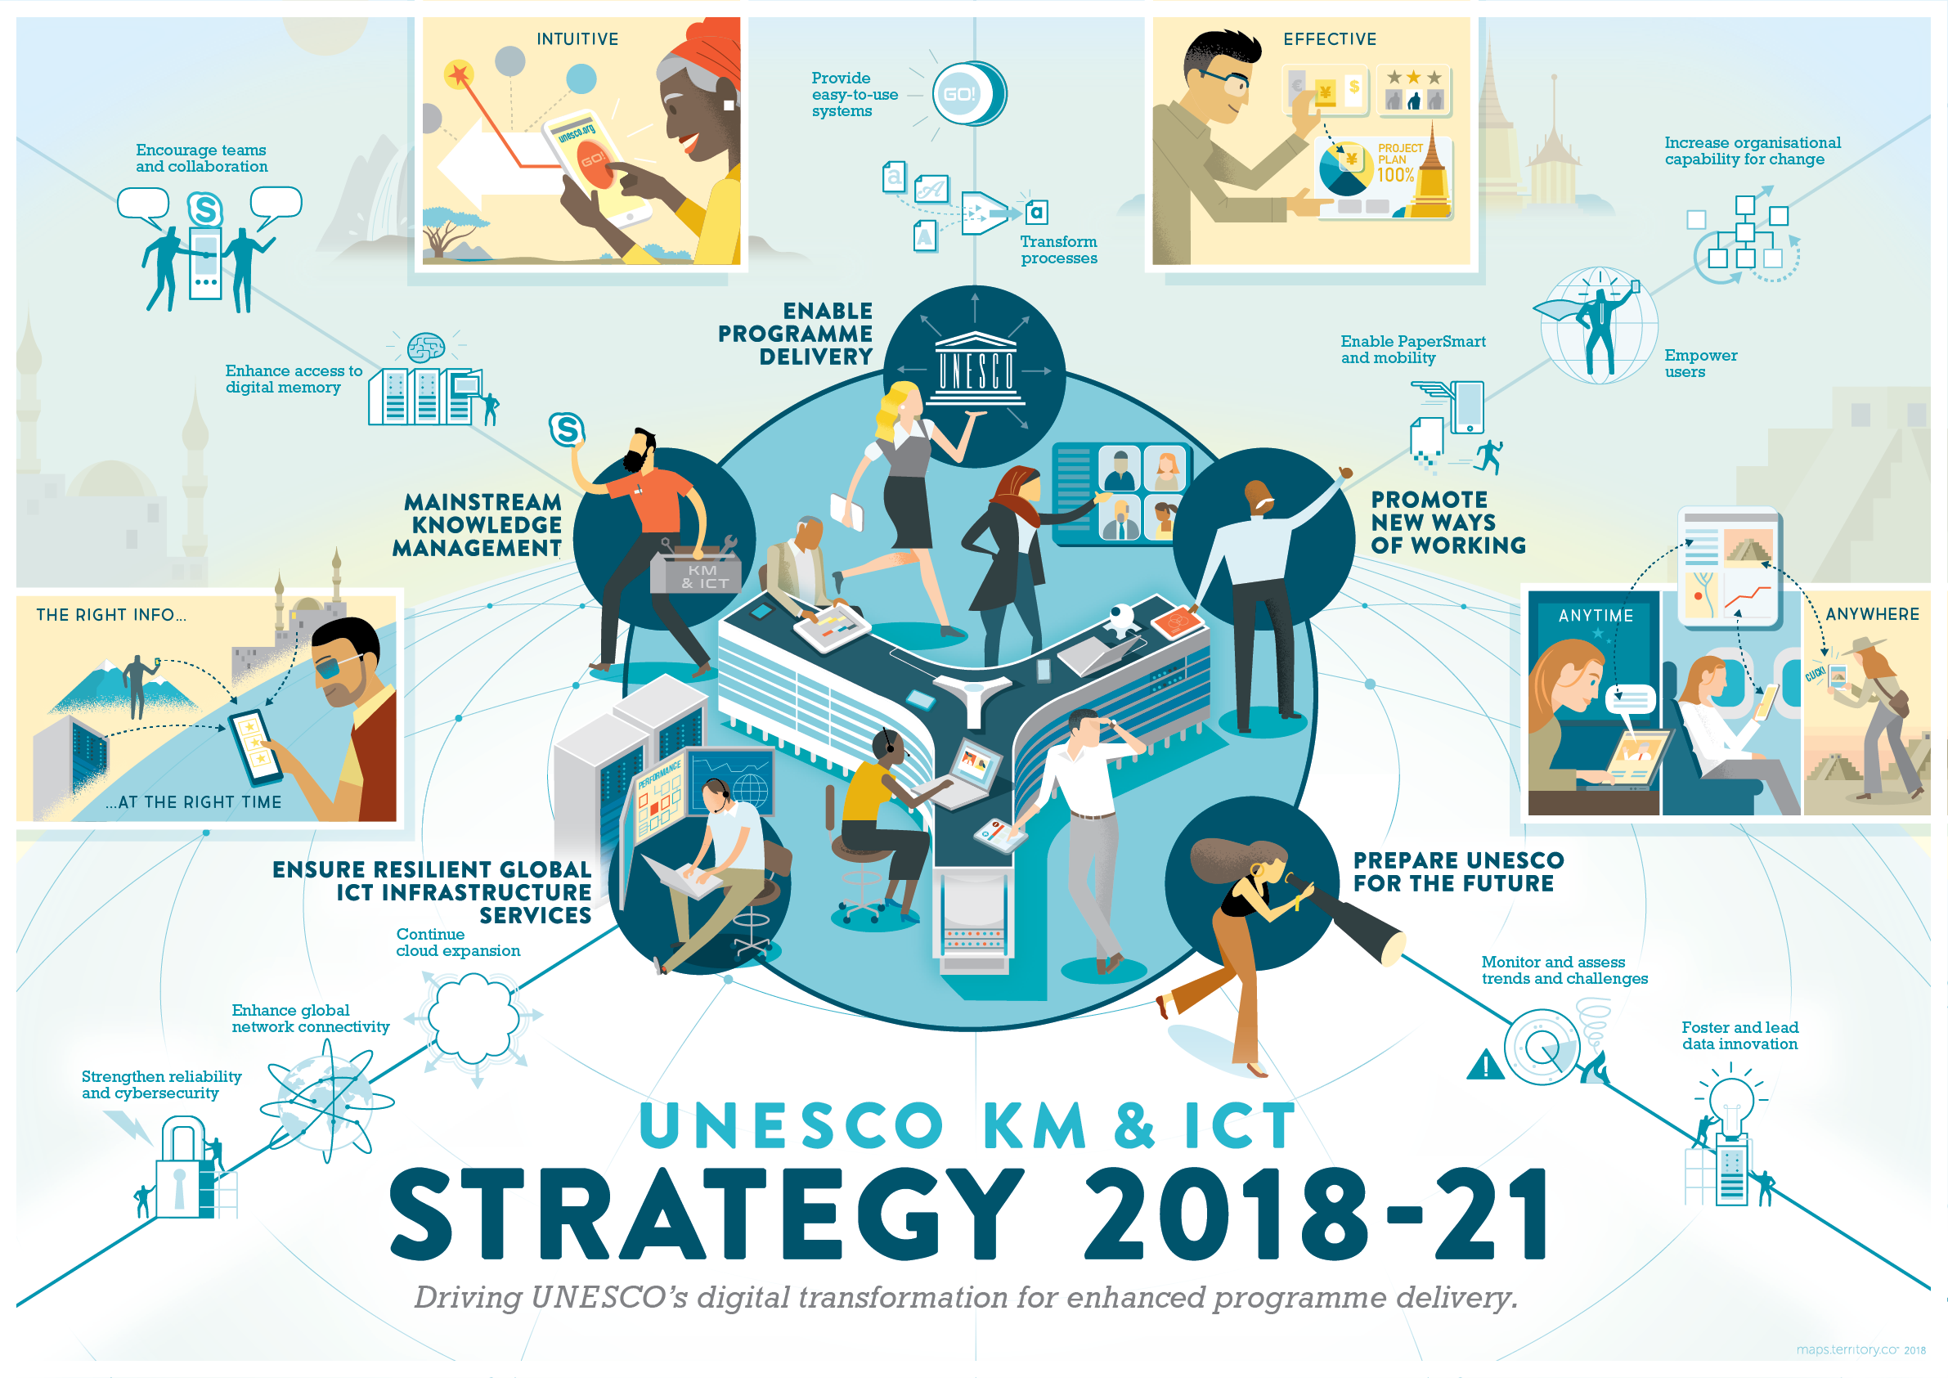
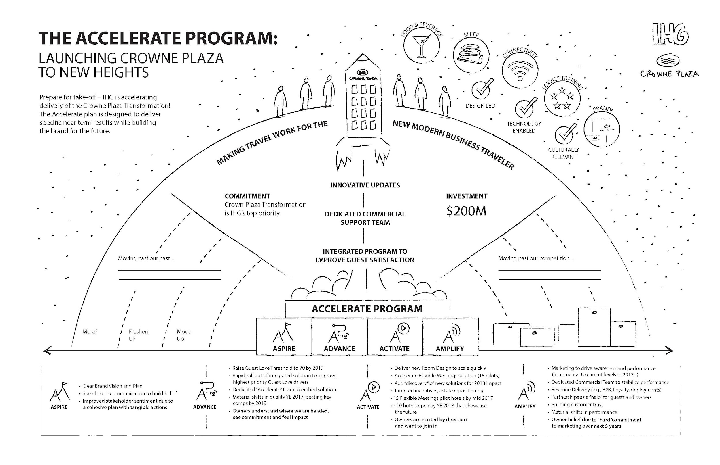
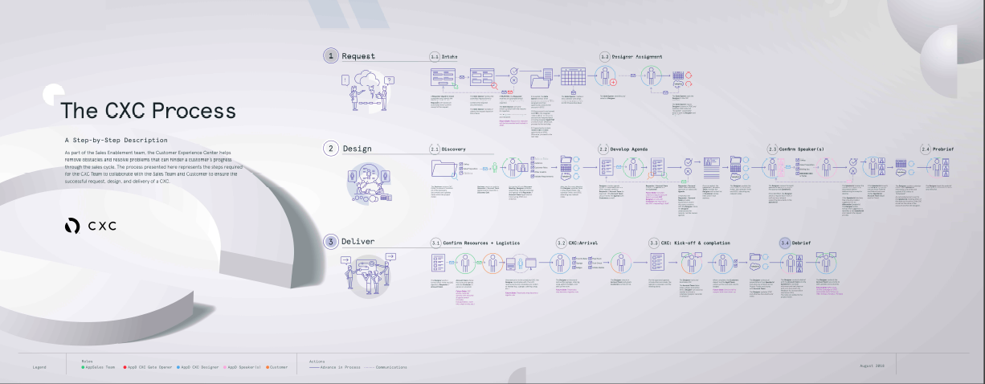

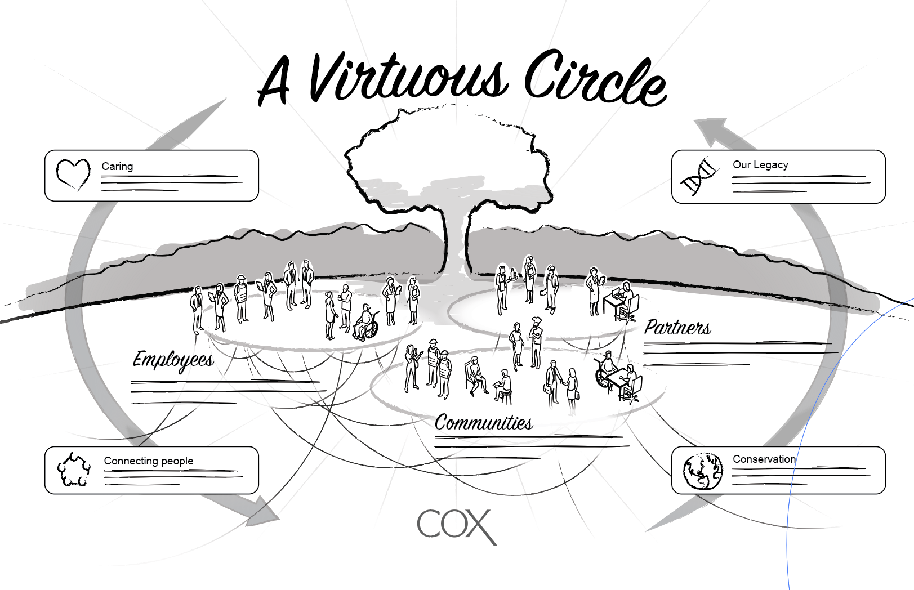

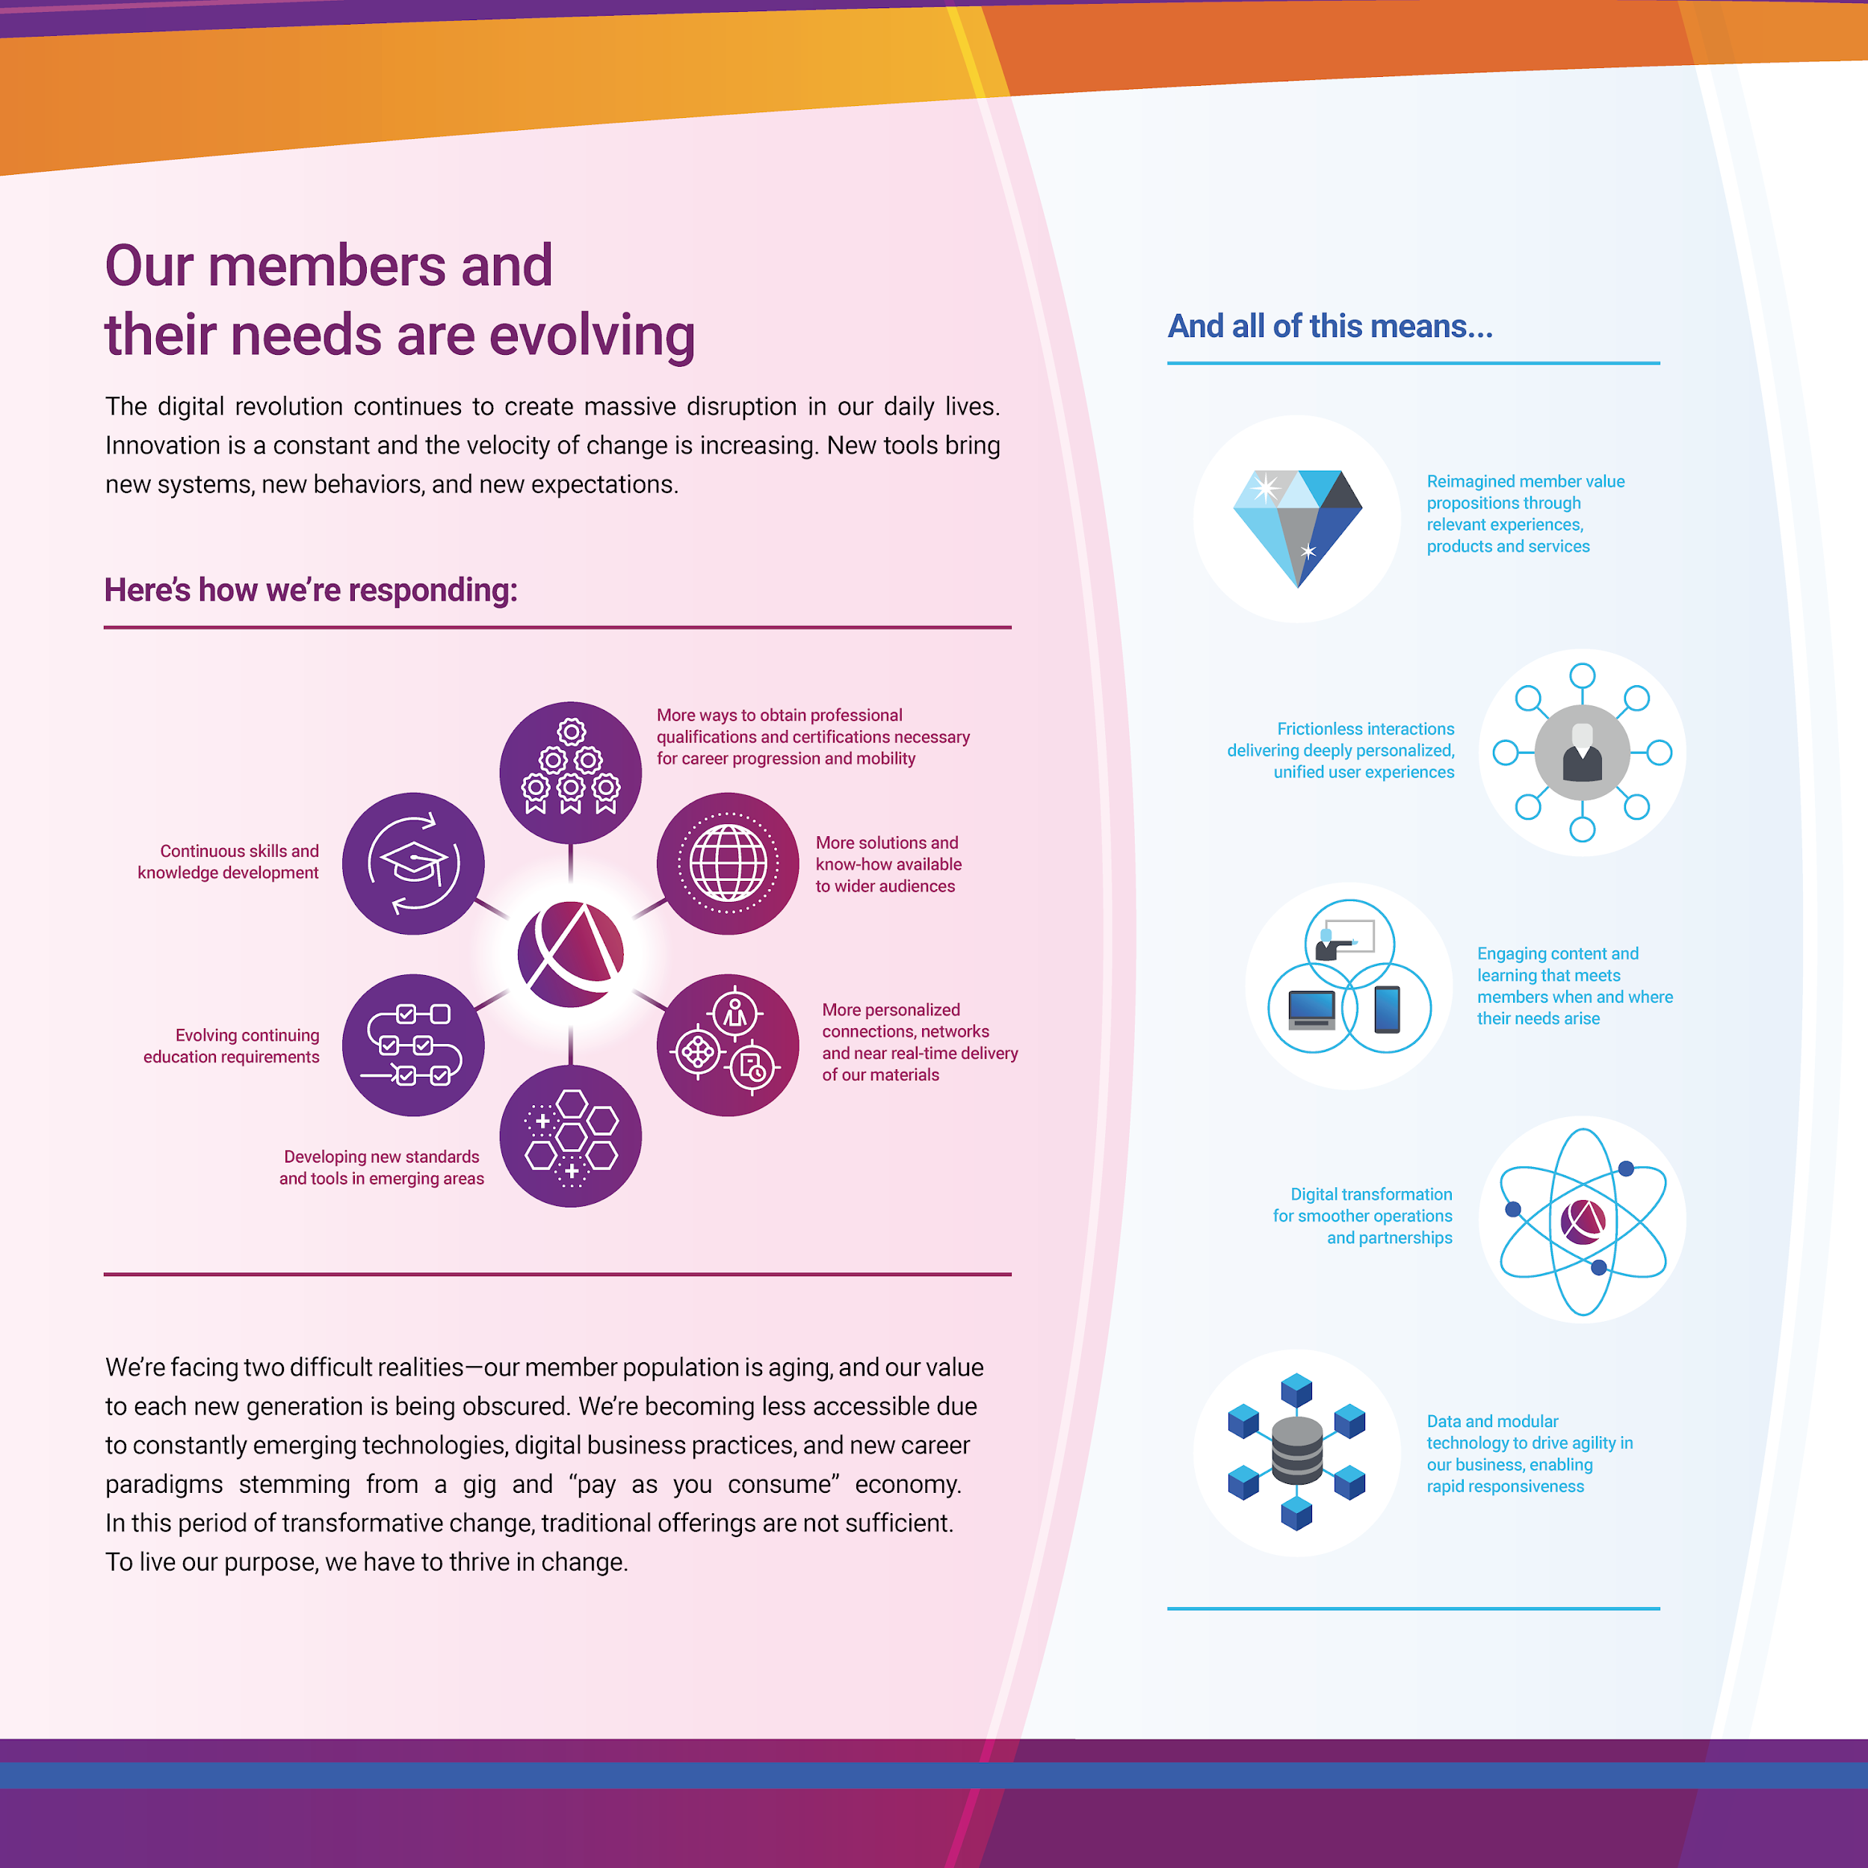

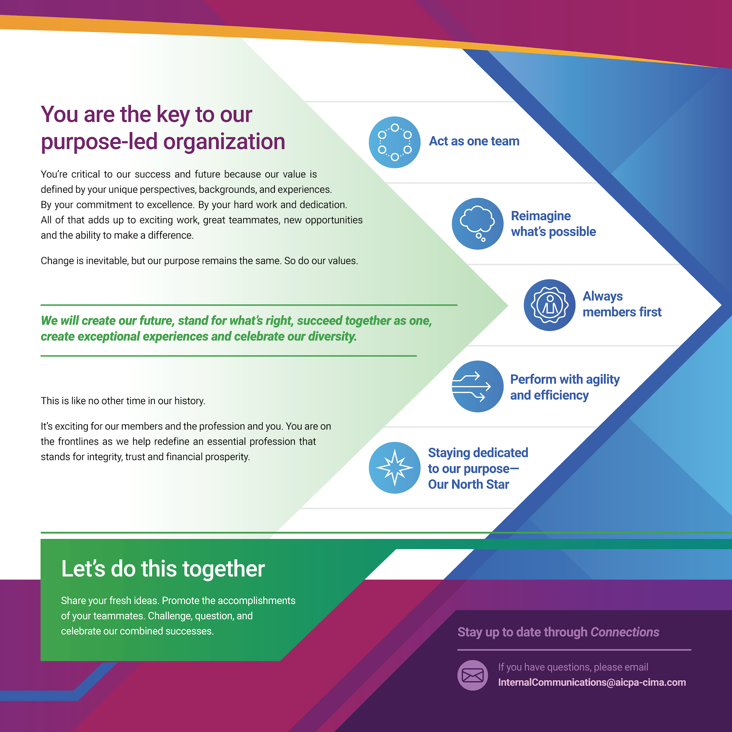
TACTIC 1
Produce artifacts of progress
Show them the map, not a summary.
Notes:
Tactic number one: You must produce Artifacts of Progress. Stop sending text-heavy update emails that no one reads. Instead, turn your ongoing research and 'messy middle' work into tangible, visual assets.
If you did user interviews, don't just send a summary, create a highly visual Customer Journey Map. If you are mapping out a new market, build an Ecosystem Map.
These artifacts become physical proof of your team's value. They show leadership: even though the product isn't launched yet, learning and assets are being actively generated as intellectual property and a deep understanding.

Slide 6

TACTIC 2
Pitch options, not projects
OLD WAY
NEW WAY
The single-project bet
The decision-tree option
— Win or lose
— Pivot, scale, or kill
— High exec anxiety
— Lower exec anxiety
— Binary outcome
— Milestone-gated learning
Notes:
Tactic two changes how you ask for money. When you pitch a single Project, you are asking leadership to make a binary bet: Win or Lose. That's high risk. Instead, use visual storytelling to pitch Options. Show them a visual roadmap where an initial investment buys the option to pivot, scale, or kill an idea based on specific milestones.
You aren't asking them to fund a $2 million unknown; you are asking them for $200k to buy the data required to make a smart decision. Visualizing this decision-tree instantly lowers executive anxiety.

Slide 7
TACTIC 3
The 3-slide upward narrative
01
02
03
The threat
The future state
The ask
Why change?
What’s the vision?
What do we need today?
Visual proof of the threat or opportunity. No jargon.
A narrative future. Show what it looks like if you win.
Immediate & Specific.
One clear call to action.
Notes:
Tactic three is about upward communication. You have 5 minutes in a steering committee meeting. Do not bring a 40-page deck. Bring three highly visual slides:
Slide 1: The visual proof of the threat or opportunity.
Slide 2: A Narrative Future. Design a visual story of what the company looks like if we get this right.
Slide 3: The precise, immediate ask. By keeping it visual and narrative-driven, you stop the executives from wordsmithing your bullet points and force them to engage with the actual strategy.

Slide 8
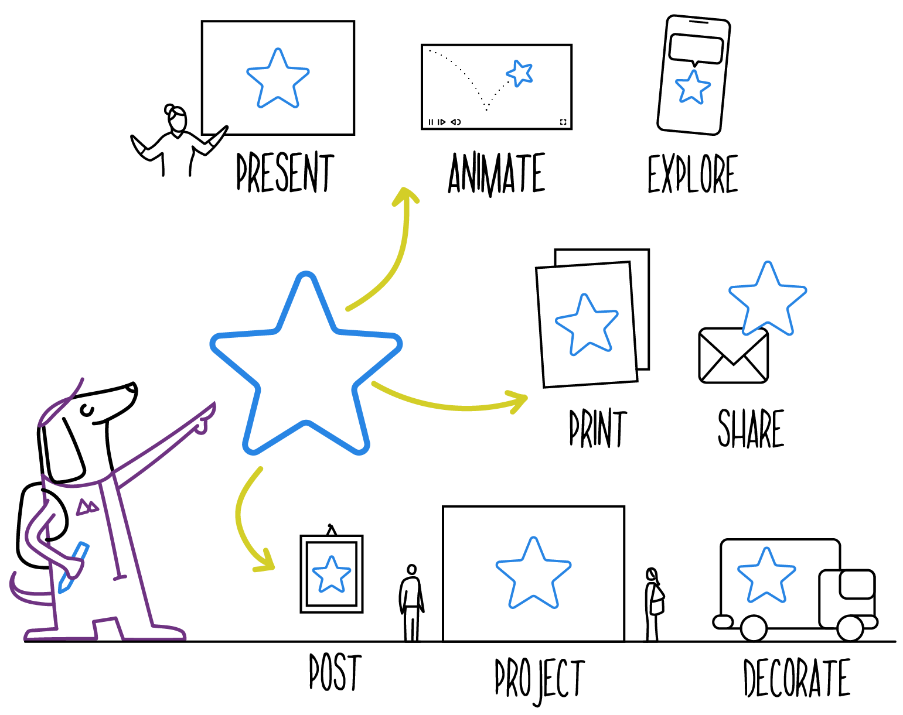
DON’T FORGET YOUR TEAM
The visual north star
Innovation teams suffer from massive burnout. Projects get killed, priorities shift. You can use visual storytelling downward, too.
By creating a visual 'North Star,' a physical or digital poster that illustrates the ultimate vision, you give your team an anchor.
Notes:
We talk a lot about convincing leadership, but what about your teams? Innovation teams suffer from massive burnout. Projects get killed, priorities shift.
You can use visual storytelling downward, too. By creating a visual North Star, a physical or digital poster that illustrates the ultimate vision. You give your team an anchor; create their “flag.”
When a specific project gets killed by leadership, you can point to the North Star map and show how you are just taking a different route to the same destination. It protects their psychological safety.

Slide 9
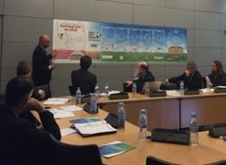
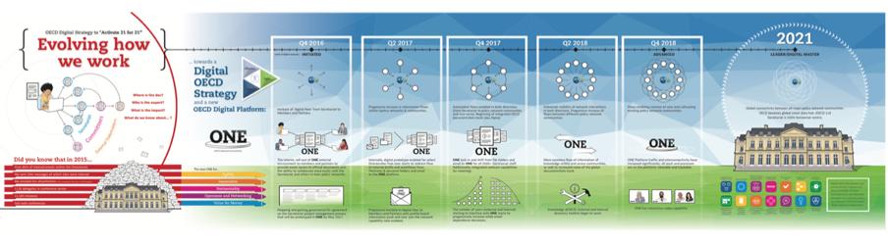
CASE STUDY
A tale of two pitches
When the tech was right, but the story was wrong.
Notes:
I want to share a quick story. We worked with the OECD, an international, intergovernmental organization of 38 member countries, headquartered in Paris, France. OECD’s CTO sought to get budget for a needed digital transformation. He pitched it to the leadership team highlighting the incredible tech stack and the disruption it would cause. ​ OECD’s leadership heard “expensive and risky,” and killed the idea. ​
Then a new CTO came in and reached out to us. He decided he needed a new story to gain endorsement from member country stakeholders and key internal and external teams.​ We worked with them to re-package the pitch. ​​
Our plan was to create a clear and compelling visual tool that tells the story of why the digital transformation is needed, the results it will deliver, and a roadmap to achieve it. ​
We built 12 foot wall map, a visual story showing the pain points for the organization on the left, the roadmap of how the plan could be achieved in the center, culminating in the vision and outcomes on the right side.

Slide 10
THE LESSON
Storytelling matters.
Same idea. Different story. One funded, one didn’t.
Notes:
Same tech idea. Different Story.
The new CTO got the funding the next week, based on the new story pitch.

Slide 11

HOW TO MAKE AN IMPACT
Your New Title: The Bridge.
Connecting strategy, story, and execution.
YOU
PRESENT REALITY
VISIONARY FUTURE
The bridge
Visual strategy and storytelling
Notes:
InnoLead recently published data showing that the most valuable skill right now is “Bridging.”
IMO. that is your actual job. You are not just the idea generator; you are the bridge between the visionary future and the operational present.
Visual strategy and storytelling are the materials you use to build that bridge. It’s how you walk a skeptical CFO over the chasm of the unknown.

Slide 12
SOME EXAMPLES

Slide 13


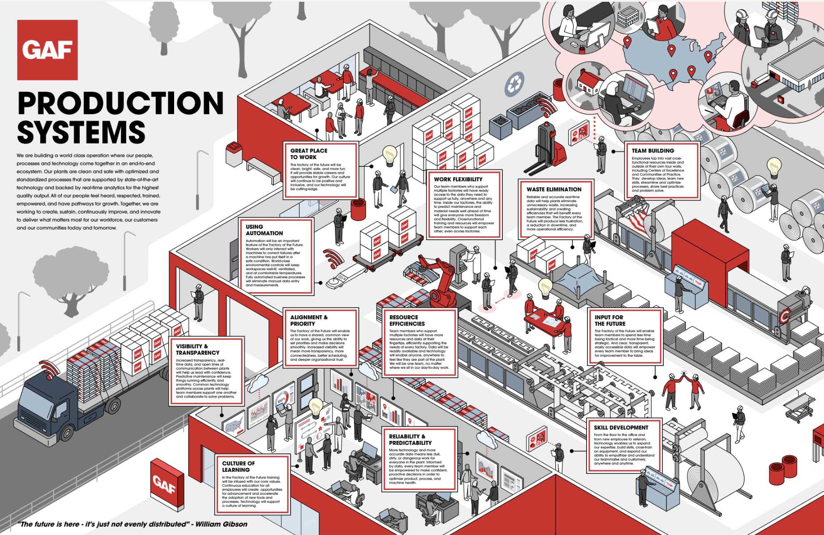

VISION MAP
Conveying the story
to drive a vision of the future
GAF developed the Factory of the Future (FoF) mainly to impact customers positively and enable inspired change. However, the company needed to communicate this vision to stakeholders to create understanding and boost buy-in.
Territory worked alongside GAF’s leadership, engineering, and manufacturing teams in a series of collaborative workshops. The group collectively strategized and co-created visualizations creatively portraying a Factory of the Future narrative to prepare for becoming future-ready.
CONFIDENTIAL MATERIALS © TERRITORY, INC.
‹#›

Slide 14


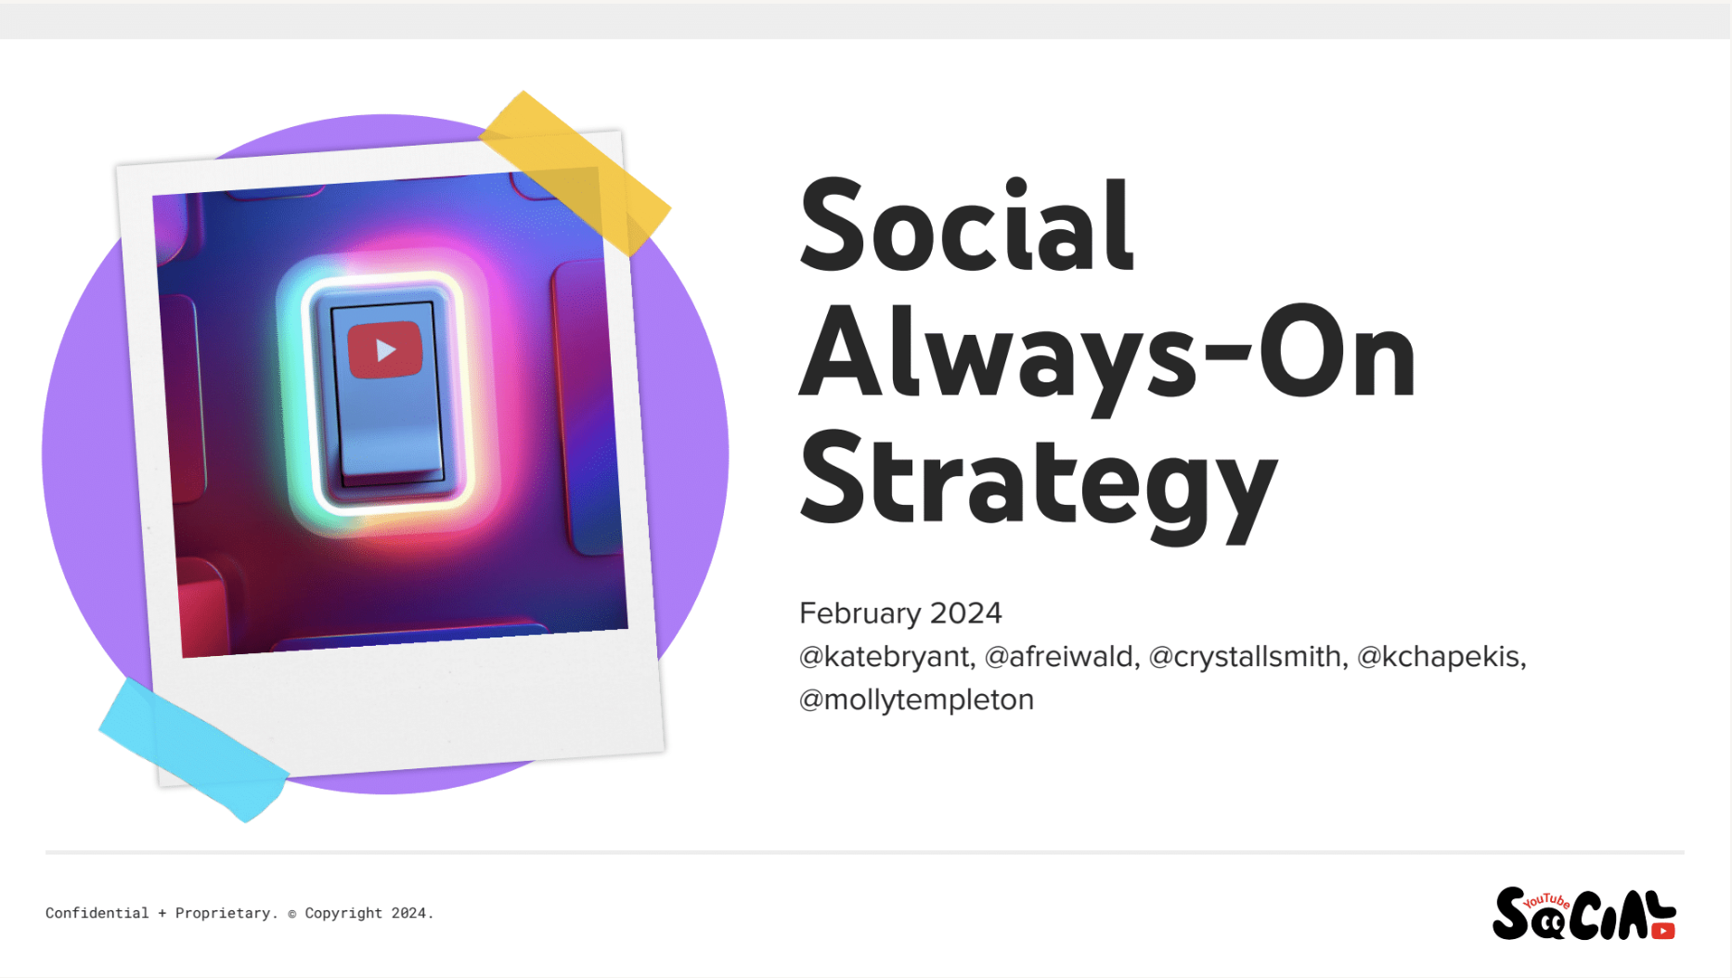
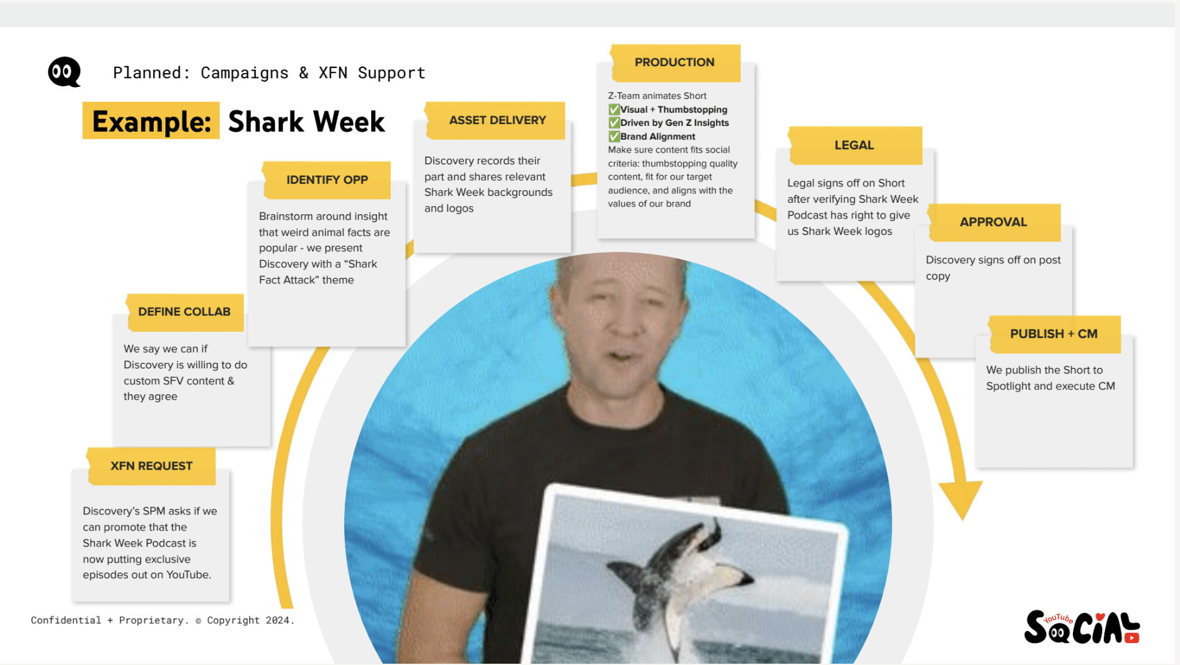
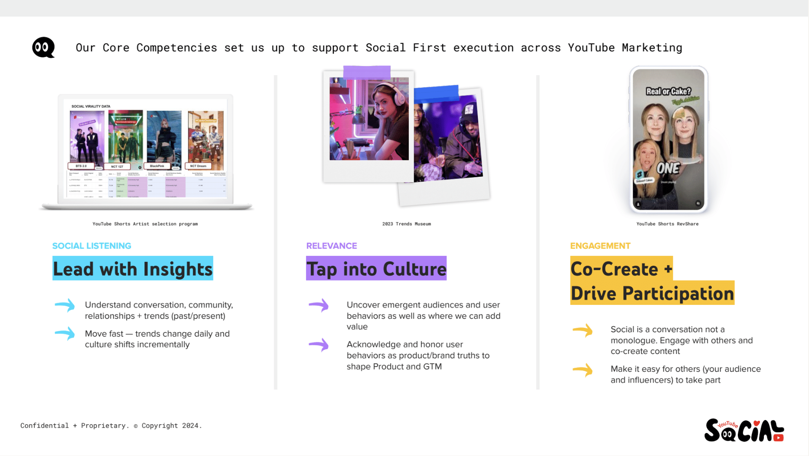
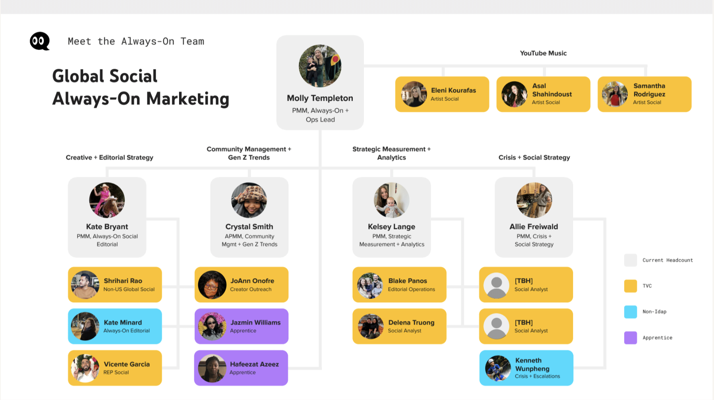
COMMUNICATIONS DECK
Proving the value
of a social media strategy
The Youtube Social team came to Territory
with a request—to help them create a series of engaging presentations that would describe the value of their team to new management.
To accomplish this request, Territory created
a comprehensive communications ecosystem that answered key questions, describing both
the social teams’ structure and overall strategy.
Our approach led to a source of truth
for the social team that gave them the
alignment and confidence to push forward.
CONFIDENTIAL MATERIALS © TERRITORY, INC.
‹#›

Slide 15


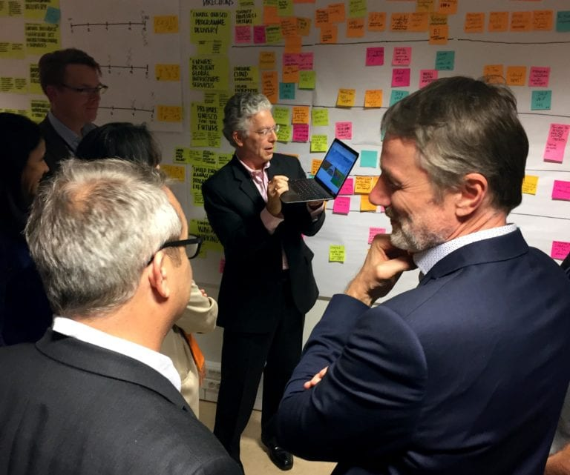
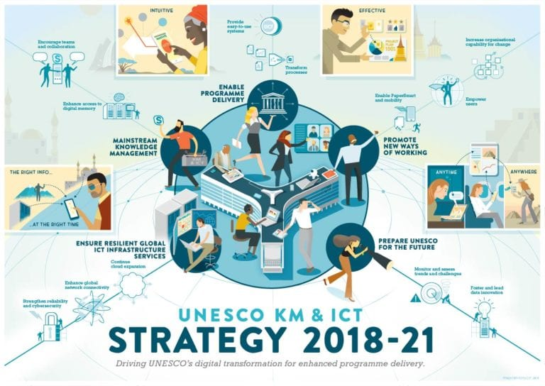
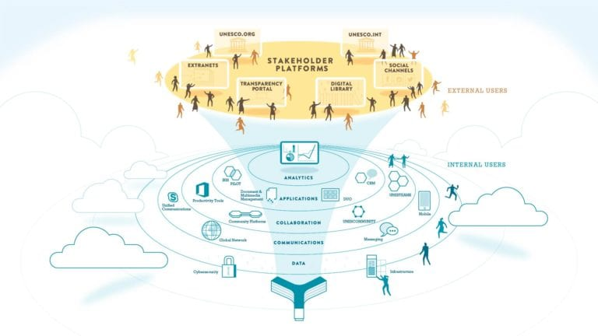
STRATEGIC PLAN
Creating a global strategy for UNESCO’s technology future
UNESCO’s Knowledge Management & Information and Communication Technology
(KM & ICT) strategy needed renewal. The former strategy had a strong focus on improving efficiencies and basic infrastructure. However,
the new strategy needed to focus on Digital Transformation to enable optimal use
of KM & ICT technological developments.
The results of Territory’s efforts at UNESCO
was establishing a clear and easily understood strategy that the KM & ICT group could use in
the future, and that would be widely shared among stakeholders.
CONFIDENTIAL MATERIALS © TERRITORY, INC.
‹#›

Slide 16
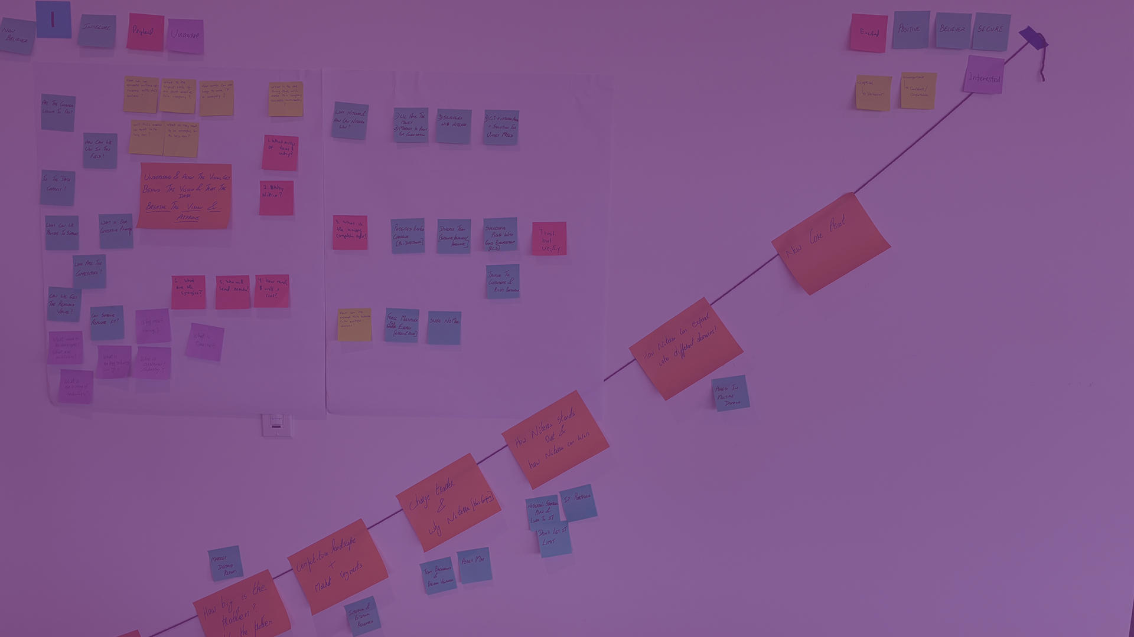

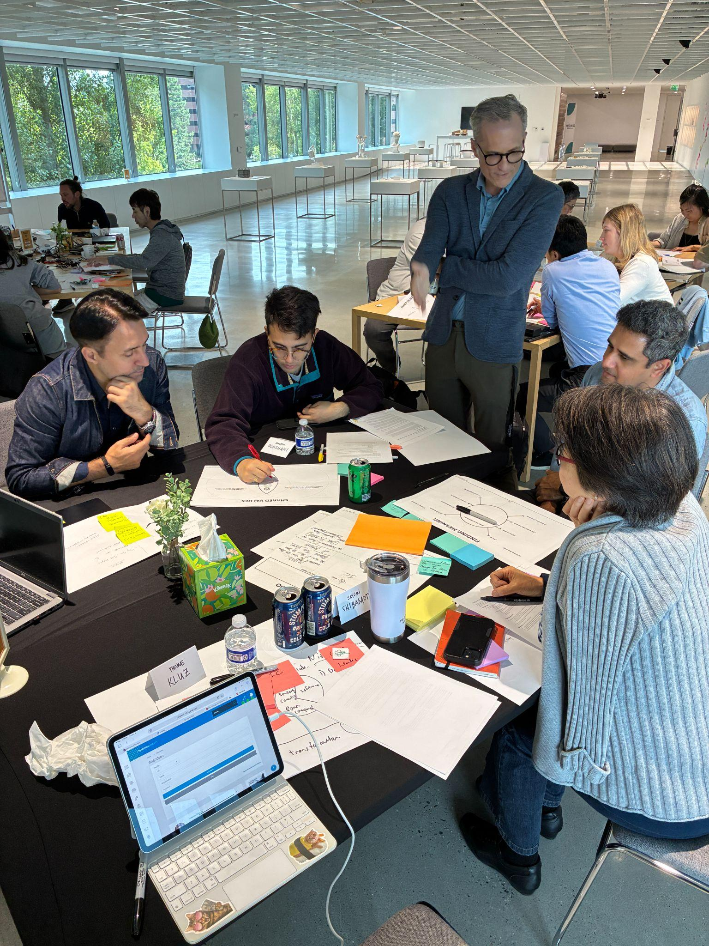
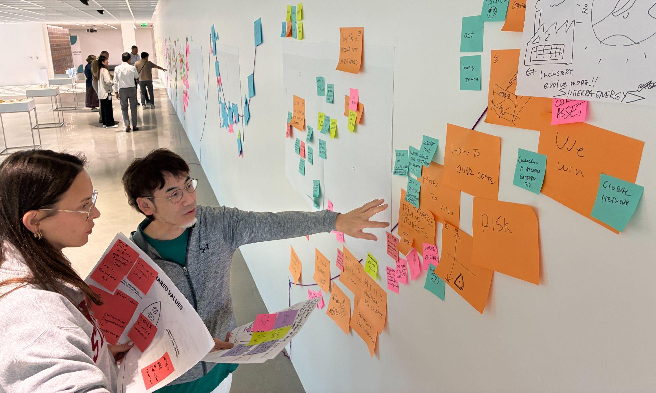
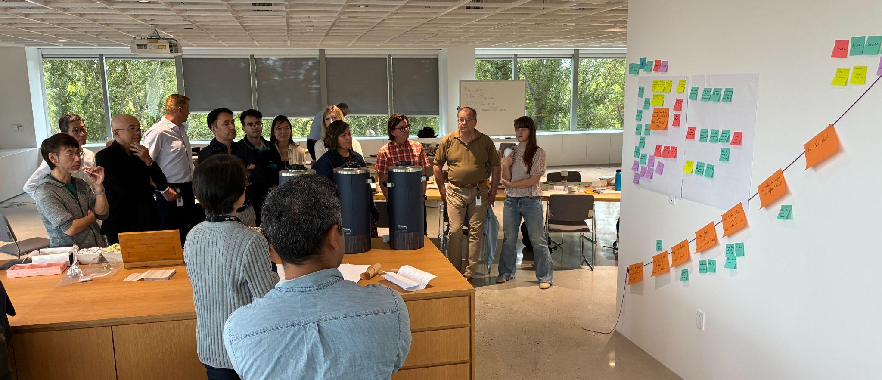
STORYTELLING WORKSHOP
Training executives to create compelling presentations
Storytelling is hard enough on its own, let alone incorporating North American, European and Asian cultures. The global innovation investment team of a leading vehicle ignition and sensor manufacturer brought this challenge to Territory to help them connect more effectively with key audiences across cultures.
To address their needs, Territory delivered a hands-on learning experience that took participants through storytelling fundamentals—from understanding audience needs and goals, to identifying and developing content to refining ways to present and genuinely connect. Along the way, the team identified challenges and techniques that contributed to a shared (and more streamlined) approach to consistently engaging with their key audiences.
CONFIDENTIAL MATERIALS © TERRITORY, INC.
‹#›

Slide 17


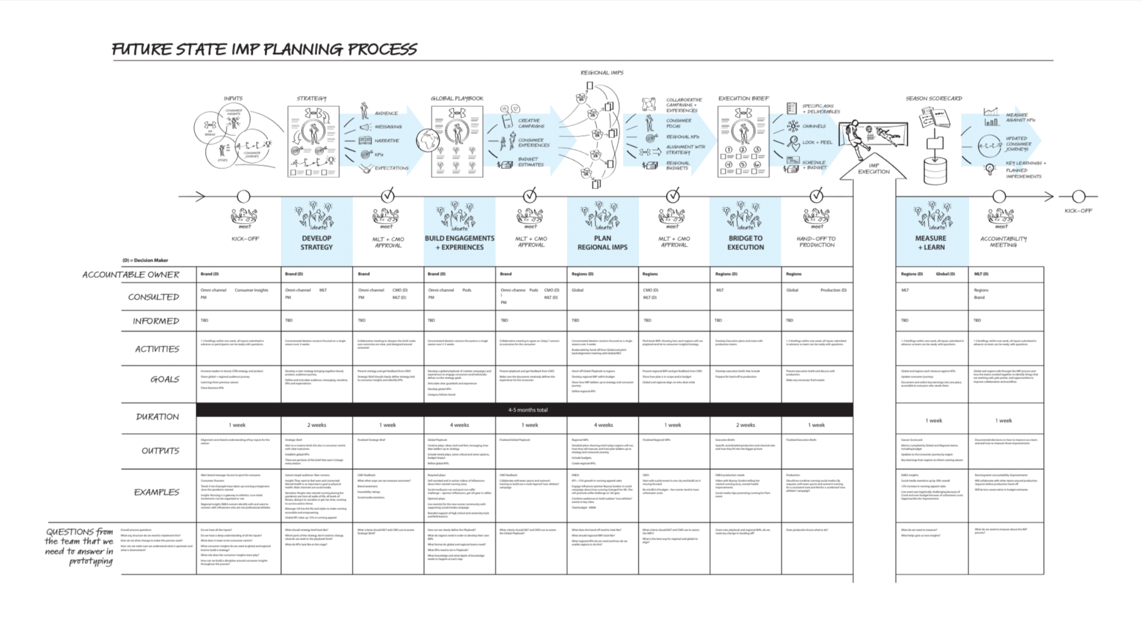

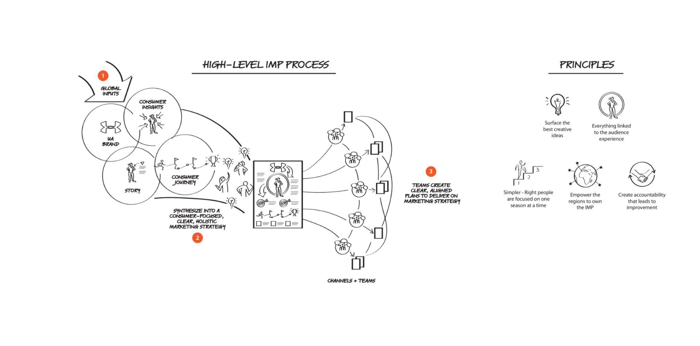
PROCESS MAP
Strategy in the midst
of transformation
Under Armour found itself in the middle of a perfect storm. In addition to challenges created by the pandemic, critical leadership roles had turned over and the entire company was adopting a new, customer-led approach. Territory was brought in to help the team navigate this shifting, uncertain environment and arrive at a cohesive five-year strategy.
Working in bite-sized, remote workshops, the team started with the vision—clarifying and defining it. Next, each function needed to see how their work impacted the work of the other functions. Once this was understood, the team was able to focus on aligning and coordinating their efforts toward the larger goals.
CONFIDENTIAL MATERIALS © TERRITORY, INC.
‹#›

Slide 18
THE ASK
Three things to do tomorrow
1
Audit your updates
Stop sending paragraphs. Start designing artifacts. Are you sharing visual proof of progress?
2
Reframe your ask
Look at your next budget request. Reframe it from a single project to a set of options.
3
Draw the map
Next time leadership is misaligned, stop talking. Go to a whiteboard and draw the map.
Notes:
To wrap up, before we move to Q&A, here is what you can do tomorrow morning.
First, audit how you report upward. Stop sending paragraphs; start designing artifacts.
Second, look at your next budget request. Reframe it from a project to a set of options.
And third, the next time your leadership team is misaligned, stop talking.
Go to a whiteboard and draw the map (or hire a team like Territory to help you). Force your leadership team to point at where they disagree.

Slide 19
Q&A

