Slide 1

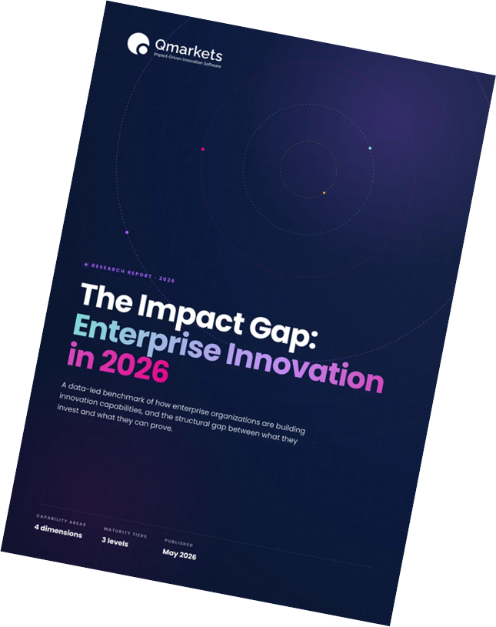
RESEARCH WEBINAR
The Impact Gap:
Enterprise Innovation in 2026
A data-led look at the structural distance between what enterprises invest in innovation — and what they can prove.
CAPABILITY AREAS
MSTURITY TIERS
PUBLISHED
4 dimensions
3 levels
May 2026

Slide 2
Driving Innovation Results at Scale
For nearly 20 years, we’ve been helping enterprises turn innovation into measurable impact - from launching new products and revenue streams to accelerating tech adoption, boosting customer experience, advancing sustainability, streamlining operations, building organizational resilience, and more…
10M+
100,000+
500+
End Users
Innovations Implemented
$1B+
Enterprise Clients
Total Customer ROI
Copyright 2025 Qmarkets. All rights reserved

Slide 3



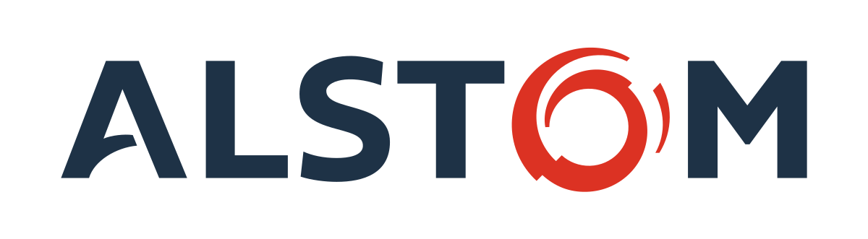
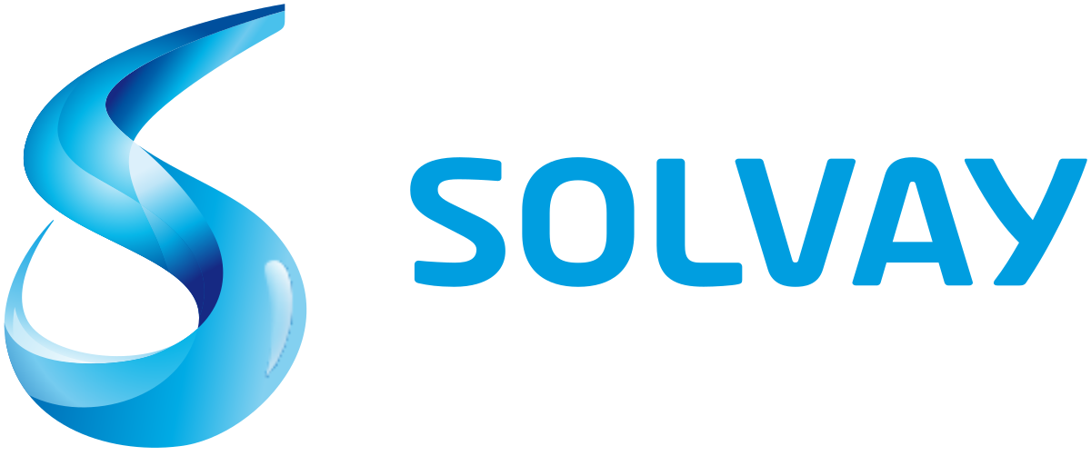






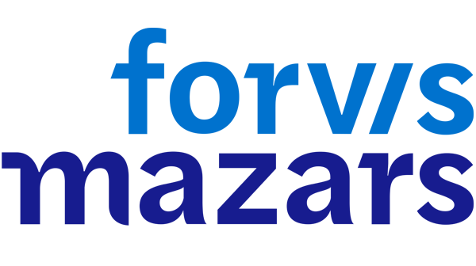



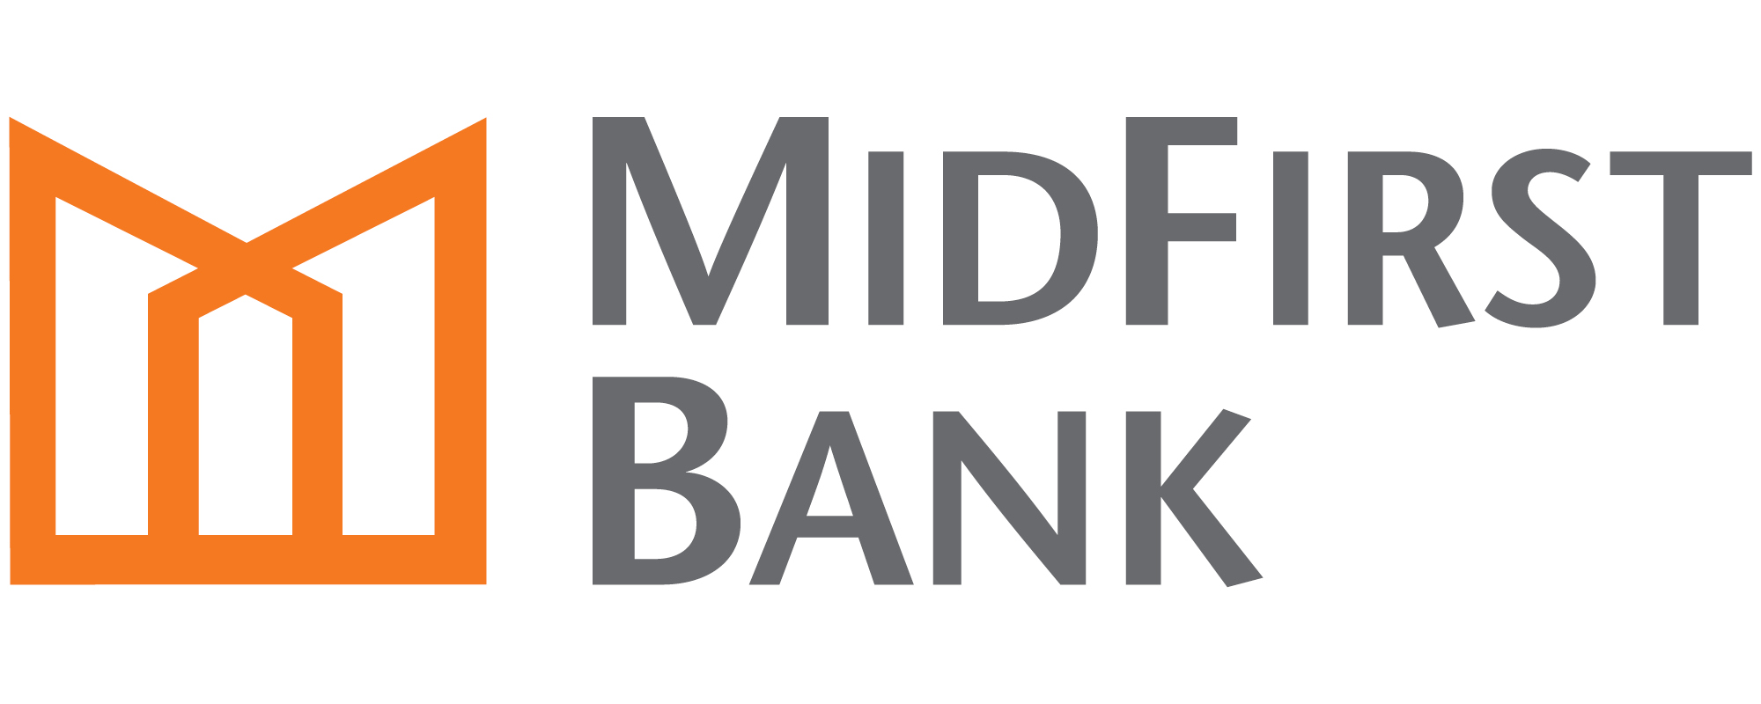
Our World Class Clients

Slide 4
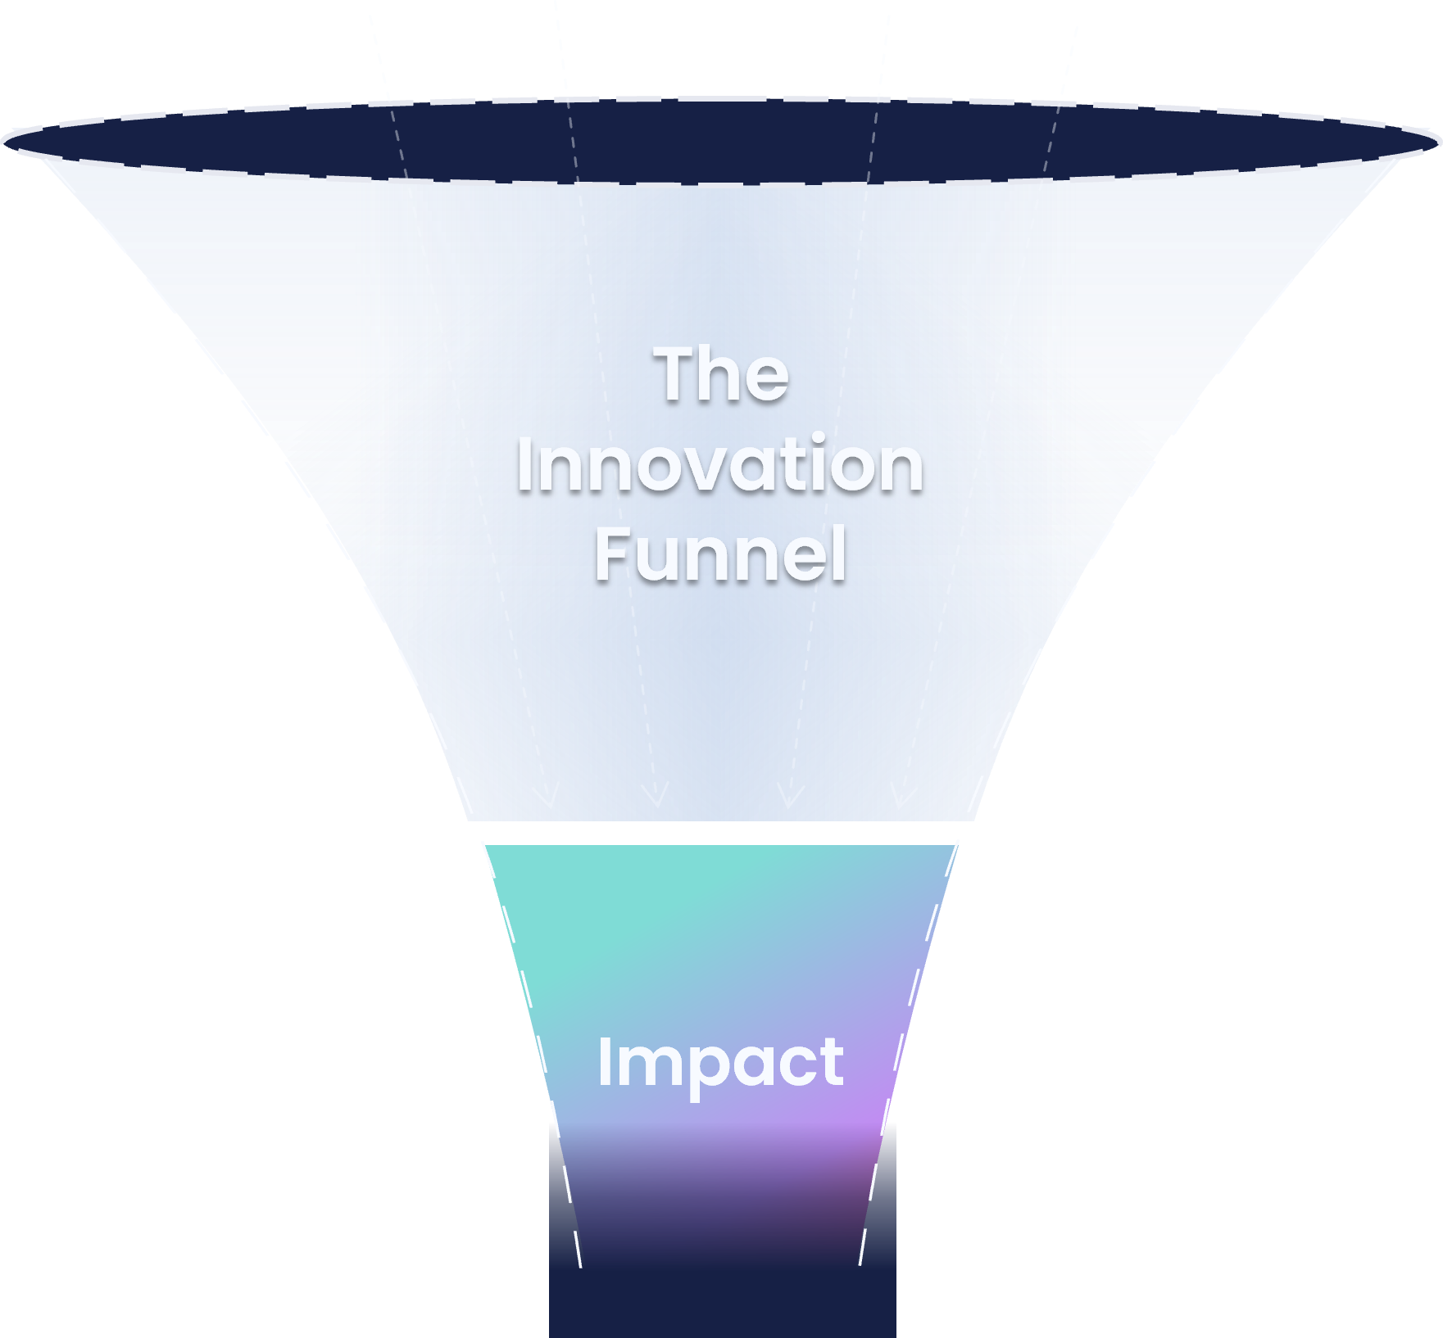
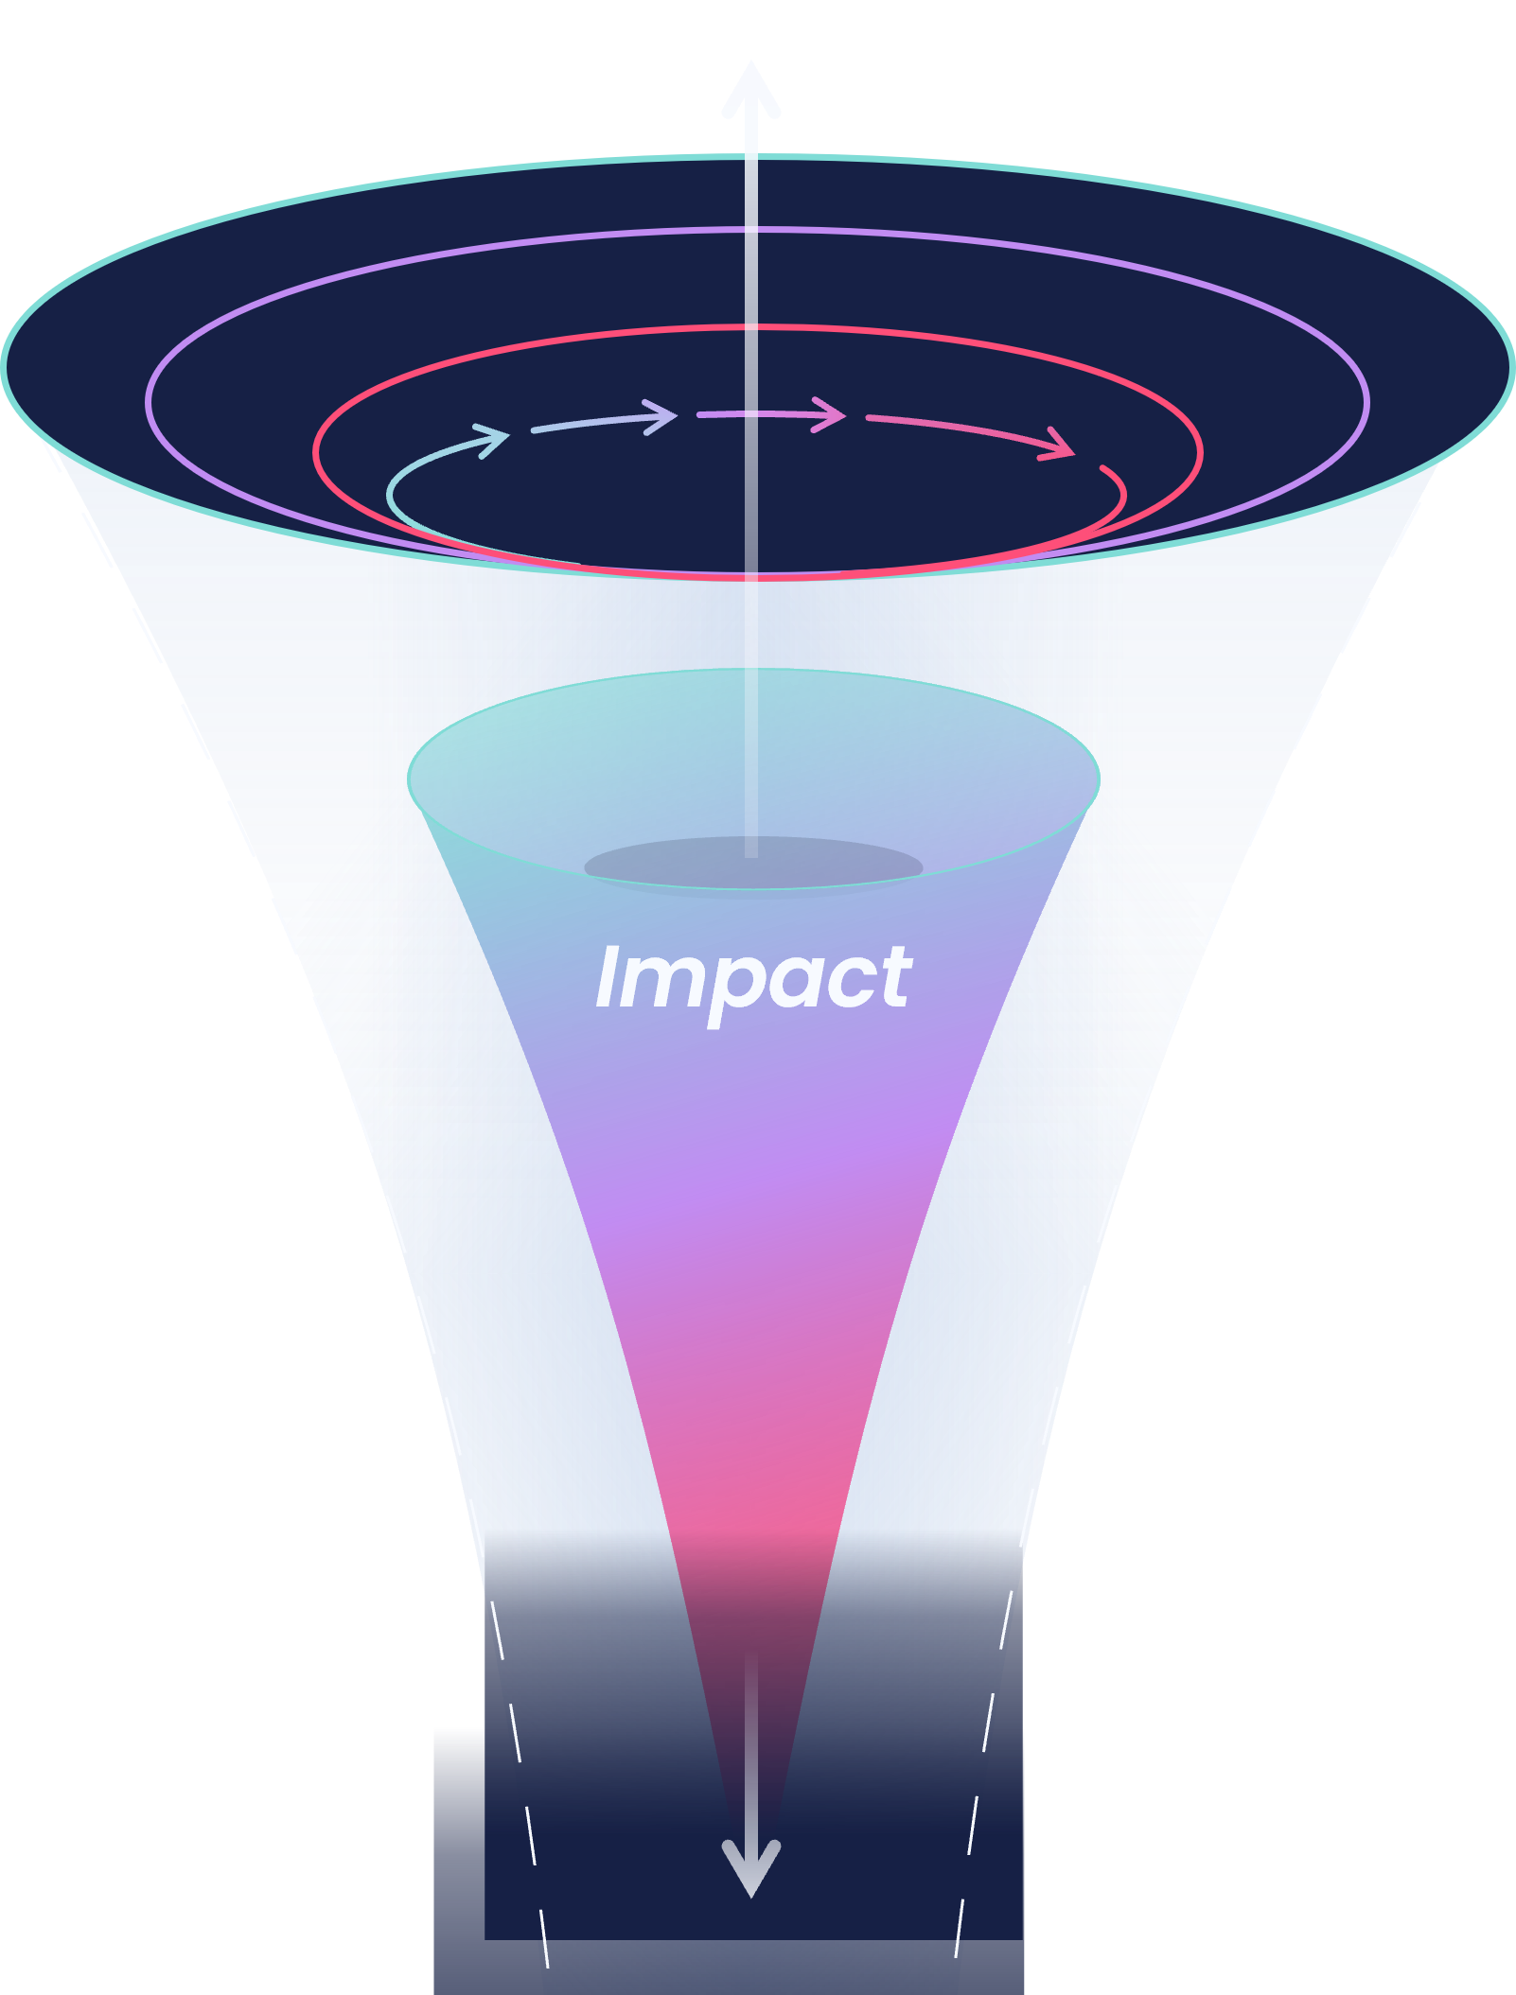
From the Old Innovation Funnel to the New
Impact measured at the end
Impact embedded throughout
Most programs filter ideas through a long process, hoping for value at the end. Without impact as a compass, they underdeliver.
Sustainable ROI requires impact embedded across the entire process — not just measured at the end. We call this Impact-Driven Innovation.

Slide 5




The 4 Pillars of Impact-Driven Innovation
Align Your Impact with Objectives
You need to prioritize the outcomes that reflect your strategic goals, and then align your whole innovation funnel around those.
1
Engage Your Innovation Alliance
There are many stakeholders both inside and outside your organization, and you need to involve the right people at the right time.
2
3
Harness Your Innovation Assets
You need to effectively gather and manage all relevant assets through a unified process to maximize your potential impact.
4
Configure Your Innovation Process
Finally, you need to connect everything together with a process that is tailored to engage your allies, manage your assets, and deliver impact.

Slide 6
THE PROBLEM
Why do innovation programs feel
so busy yet struggle to produce compounding impact?
Boards expect innovation. Strategy decks demand it. Employee surveys confirm the appetite is real. And yet, the output rarely matches the input. We ran a diagnostic across enterprise innovation programmes to find out why.
QMARKETS · THE IMPACT GAP · 2026

Slide 7
THE FRAMING
The will to innovate has outpaced the way.
THE INTENT
THE EXECUTION
Cultural and strategic readiness.
The operational layer that turns intent into proof.
The conditions for innovation are mostly in place. Strategic intent, cultural ambition, executive sponsorship — the upstream layer scores consistently well in the data.
The infrastructure, integration, and measurement systems that convert activity into demonstrable outcomes. This is where the gap consistently shows up in the data.
Strategy alignment
Executive sponsorship
Customer focus
Cross-functional engagement
Connected platforms
Portfolio-level visibility
Data and integrations
Scalable governance
QMARKETS · THE IMPACT GAP · 2026

Slide 8
THE METHODOLOGY
A structured diagnostic across four capability areas of enterprise innovation.
DIAGNOSTIC QUESTIONS
CAPABILITY AREAS
MATURITY TIERS
25
4
3
Structured diagnostic questions spanning the full innovation operating model, aggregated into a composite maturity score.
Strategy, Program, Infrastructure, Foundations — each scored 0–100% on the diagnostic.
Composite scores map to Emerging Innovator, Innovation Explorer, or Innovation Trendsetter.
01
02
03
Emerging Innovator
Innovation Explorer
Innovation Trendsetter
Foundational gaps in process, tooling, or governance limit scalable impact.
Real momentum, but uneven. Strong on strategy and culture, weaker on infrastructure.
Strong, well-aligned capabilities — yet most still have at least one capability in the developing band.
THE IMPACT GAP · 2026

Slide 9
THE LANDSCAPE
Most organisations sit in the middle: competent but not cohesive.
Distribution across the three maturity tiers reveals a market clustered around the middle, with a thinly populated frontier.
15% OF ORGANISATIONS
69% OF ORGANISATIONS
16% OF ORGANISATIONS
15%
69%
16%
Emerging Innovator
Innovation Explorer
Innovation Trendsetter
Foundational gaps in process, tooling, or governance limit scalable impact.
Real momentum has been built. Strong on strategy and culture, weaker on the operational layer that proves it.
Strong, well-aligned capabilities — yet most still have at least one area in the developing band.
THE IMPACT GAP · 2026

Slide 10
WHAT THIS MEANS
The dominant story isn't failure. It's incompleteness.
Most organizations have started building. Few have finished. The opportunity to differentiate isn't to do innovation — it's to scale it operationally.
The Diagnosis
The Opportunity
Strong intent,
weak infrastructure.
The benchmark to beat is lower than you think.
→
The cultural foundation is there. Leadership backing, methodology, engaged workforce — these are built or being built across most enterprise programs.
Even the leaders haven't fully closed the gap. Most Innovation Trendsetters still show at least one capability in the developing band.
THE IMPACT GAP · 2026
Notes:
And here’s what it all means. The dominant story in enterprise innovation isn’t failure. It’s incompleteness.
Almost everyone has started building. Very few have finished. The intent is there — the leadership backing, the methodology, the engaged people. What’s missing is the operational layer that turns ambition into compounding output: connected systems, portfolio visibility, intelligence that scales beyond the heroics of one small team.
That operational layer has a name. It's a platform — a real one. Strong enough to run ideation, initiative delivery, portfolio governance, foresight and continuous improvement side by side, with the data flowing between them. When that spine is in place, every initiative compounds on the last one instead of starting from zero. That's what finishing actually looks like.
And this is exactly where the AI story comes full circle. AI is a perfect example of an incomplete capability. Powerful, eager, full of potential — and useless, even dangerous, until you wrap it in human judgment, real context, and proper guidance. On its own it gave us a headdress for the Choctaw Nation. Guided properly, it becomes one of the most valuable tools you’ll ever put in your innovation stack.
Incompleteness, though, is genuinely good news. Because the benchmark to beat is lower than you think. Even the leaders — the Innovation Trendsetters — still have at least one capability sitting in the developing band. Nobody has finished. Which means the organisations that close the operational gap first won’t just catch up. They’ll compound an advantage over the next two to three years that the rest of the market will struggle to touch.

Slide 11
FINDING 01 · THE STRATEGY-EXECUTION SPLIT
Strategy and culture are running ahead of execution.
On average, organisations score highest on Strategy — vision, sponsorship, alignment. And lowest on Infrastructure — the operational layer that turns ambition into measurable output.
AVERAGE MATURITY SCORE, BY CAPABILITY AREA % of full diagnostic score per area
Strategy
62 %
Foundations
60 %
Program
55 %
Infrastructure
43 %
THE PATTERN
5 of 5 lowest-scoring questions in the diagnostic are about infrastructure. The cultural-operational gap is structural.
THE IMPACT GAP · 2026

Slide 12
FINDING 01 · THE STRATEGY-EXECUTION SPLIT
Align Innovation Outcomes With Your Strategic Goals
Processes & Capabilities
Customer Experience
Innovation outcomes fall into four main categories, and each of these can be delivered across three distinct levels.
Products & Services
Business Models & Markets
Improve
You need to prioritize the outcomes that reflect your strategic goals, and then align your whole innovation program to fit.
Invent
Transform
THE IMPACT GAP · 2026

Slide 13
FINDING 02 · THE BROKEN IMPACT CHAIN
Three in four programmes leak value between intent and outcome.
Innovation needs five linked stages to deliver impact end-to-end. Each stage scores reasonably on its own. Almost none score well across all five.
% OF ORGANISATIONS STRONG ON EACH FUNNEL STAGE
STRATEGY
IDEATION
IMPLEMENTATION
MEASUREMENT
SCALING
52%
55%
48%
45%
52%
76 %
24 %
45 %
have a broken impact chain — leaking value at one or more stages between strategic intent and proven outcome.
are strong on all five stages — the cohort that compounds activity into demonstrable impact.
of executive-sponsored programmes cannot measure their own impact in real time.
THE IMPACT GAP · 2026

Slide 14
Configure Your Innovation Process
FINDING 02 · THE BROKEN IMPACT CHAIN
Finally, you need to connect everything together with a process that is tailored to engage your allies, manage your assets, and deliver your chosen outcomes.
Discovery
Evaluation
Implementation
THE IMPACT GAP · 2026

Slide 15
Configure Your Innovation Process
FINDING 02 · THE BROKEN IMPACT CHAIN
Finally, you need to connect everything together with a process that is tailored to engage your allies, manage your assets, and deliver your chosen outcomes.
Ideate
Collect
Develop
Review
Compliance
Collaborate
Validate
Evaluate
Prioritize
Track
Business Case
Pilot
THE IMPACT GAP · 2026

Slide 16
FINDING 03 · THE INFRASTRUCTURE DEFICIT
Running today's strategy on yesterday's tooling.
Programmes have evolved. The systems they run on, in most cases, haven't. Across the diagnostic's infrastructure capabilities, the deficit is consistent.
% OF ORGANISATIONS LACKING EACH INFRASTRUCTURE CAPABILITY
Integrations
76 %
Open Innovation Hub
72 %
Ideation Platform
72 %
Reporting & Analytics
69 %
Projects & Portfolio
69 %
WHAT THIS MEANS
52% of organisations lack all four core infrastructure capabilities at once. The deficit isn't a tweak problem — it's a build problem.
THE IMPACT GAP · 2026

Slide 17
Engage Your Innovation Alliance
FINDING 03 · THE INFRASTRUCTURE DEFICIT
Supply Chain
There are many stakeholders both inside and outside your organization who can contribute across your innovation funnel.
Startups
Leadership
Business Units
Academia
R&D
Innovation Team
CVC
Your
Strategy
Office Employees
Team Leaders
You need to engage the right people at the right time across your entire process.
Innovation Catalysts
Innovation Scouts
Innovation Communities
Experts
Y
m
o
a
u
r
e
T
Front-line Employees
Subject-Matter Experts
Customers
Business Partners
y
Y
n
o
a
u
p
r
m
o
C
Y
m
o
e
u
t
r
s
y
E
s
c
o
THE IMPACT GAP · 2026

Slide 18
Harness Your Innovation Assets
FINDING 03 · THE INFRASTRUCTURE DEFICIT
Ideas
Challenges
Needs
At the top of your funnel there are different kinds of data and input that can bring value to your innovation program.
Startups
Trends
Projects
You need to effectively gather and manage all relevant assets with distinct but connected processes to maximize the potential impact.
THE IMPACT GAP · 2026

Slide 19
Impact-Driven Innovation Management
s
y
t
s
e
o
m
c
E
r
u
p
m
a
o
n
Y
o
y
r
C
u
o
Y
a
e
m
T
Needs
r
u
o
Y
Challenges
Trends
Impact
Startups
Ideas
Projects
Your Innovation Assets
Your Innovation Alliance
Your Innovation Process

Slide 20
THREE CAPABILITY PROFILES
Most programs fall into one of three patterns.
PROFILE 01
~15% OF ORGS
PROFILE 02
~20% OF ORGS
PROFILE 03
~20% OF ORGS
Strong platform, weak process.
Engaged workforce, unstable program
Methodical but narrow.
Invested in tooling but lack the structured methodology and organisational alignment to drive consistent results.
Enthusiastic culture but lack the structured programme, resources, and stability to turn engagement into sustained results.
Strong internal alignment and methodology, but apply innovation narrowly — usually a single use-case run well.
DEFINING SHAPE
DEFINING SHAPE
DEFINING SHAPE
Low Process maturity
High Platform maturity
Mid People maturity
High People maturity
Low Programme maturity
Low–mid Planning maturity
High Process maturity
Low Programme maturity
Mid Platform & People
THE IMPACT GAP · 2026
Notes:
When we looked at the patterns, most programs fall into one of three shapes — and I’d gently invite you to find yourself in here.
Profile one: strong platform, weak process. Great tools, no methodology to drive them. About 15%.
Profile two: engaged workforce, unstable program. Brilliant energy, no structure to hold it. Around 20%.
Profile three: methodical but narrow. Disciplined and aligned — but applied to a single use case run well, instead of scaled across the enterprise. Another 20%.
Different shapes. Same underlying story. And the same answer underneath all three: a platform strong enough to carry the whole portfolio. Not a campaign tool. Not an ideation box. A system that runs ideas, initiatives, portfolios, foresight and trend-scouting in one place — so the methodology has somewhere to live, the workforce has somewhere to plug in, and the disciplined team can finally scale beyond their one use case.

Slide 21
WHAT WORKS · FROM RESEARCH TO PRACTICE
Best practices for closing the gap.
Three priorities the research points to, in the order they need to be tackled.
THREE KEY TAKEAWAYS
01
02
03
Build the operational layer first.
Treat measurement as architecture, not reporting.
Use AI to scale, not to substitute.
Activity without infrastructure fragments instead of compounding.
Recommendation: Pause new programs until the foundation can carry them.
Measurement bolted on after launch loses the data path.
Recommendation: Define impact metrics before launch, not after.
AI compounds whatever's underneath.
Recommendation: Sequence integrations and measurement first, intelligence on top.
THE IMPACT GAP · 2026

Slide 22
Rapid Growth
Prove value early, deliver quick wins, and scale your ecosystem with tools built for enterprise growth.
Your Innovation Impact Superpowers
Super Agility
Anticipate change and reconfigure your innovation process in real time with a flexible, modular platform.
Unlimited Insights
Make tough decisions with confidence using data-driven analytics and reporting to cut through the noise.
Rooted in our core company values, our impact-driven approach equips you with five superpowers designed to maximize your innovation results:
High-Tech Utility Belt
Best-in-class tools that evolve alongside your challenges — including AI, smart automations, integrations, and more.
Elite Alliance
Leverage the expertise, frameworks, and best practices of our innovation experts and customer community.
Copyright 2025 Qmarkets. All rights reserved

Slide 23
Product Features
Dedicated
Impact Support
Full-Funnel ROI & Impact Tracking
Gather weighted ROI estimates
both during idea evaluation and after implementation to get a clear picture of forecasted value vs actual impact
Best Practice Scaling
Engage employees and teams to adopt your selected solutions and track the companywide impact
At Qmarkets we know how important it is to deliver, track, and multiply your bottom-line innovation impact. That’s why we offer all clients a combination of customer success services and product features that focus on continuously boosting the ROI of your program.
Innovation Catalyst Toolkit
Get support, resources, guidance, and smart features to help you scale up the impact of your program.
Expert Guidance
Your dedicated CSM can provide ongoing consultation, training, and roadmap sessions focused on ROI.
Client Community
Our peer-to-peer innovation community is packed with proven insights and best practices.
Customer Success
THE IMPACT GAP · 2026

Slide 24

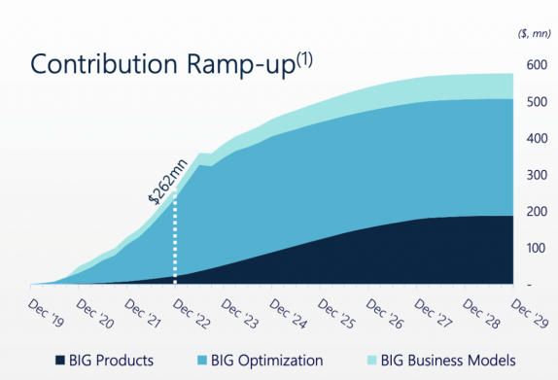
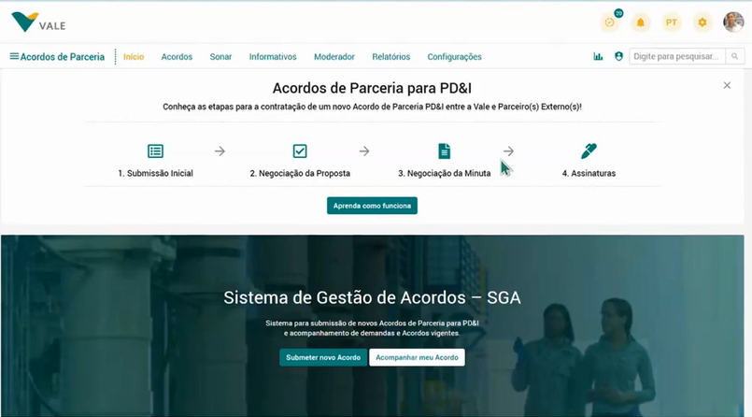

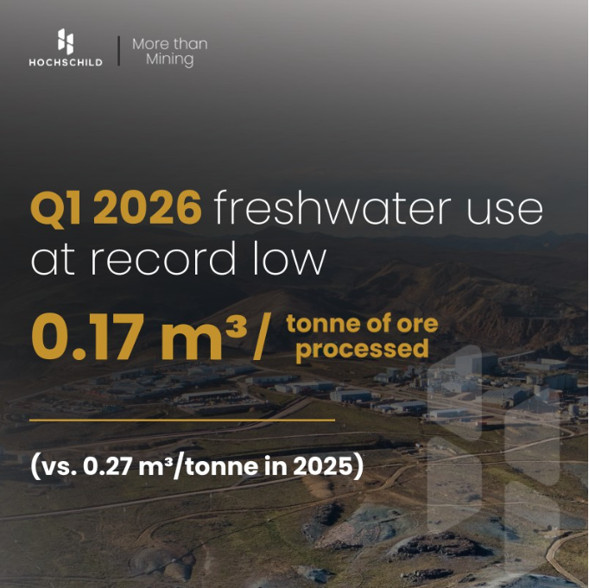

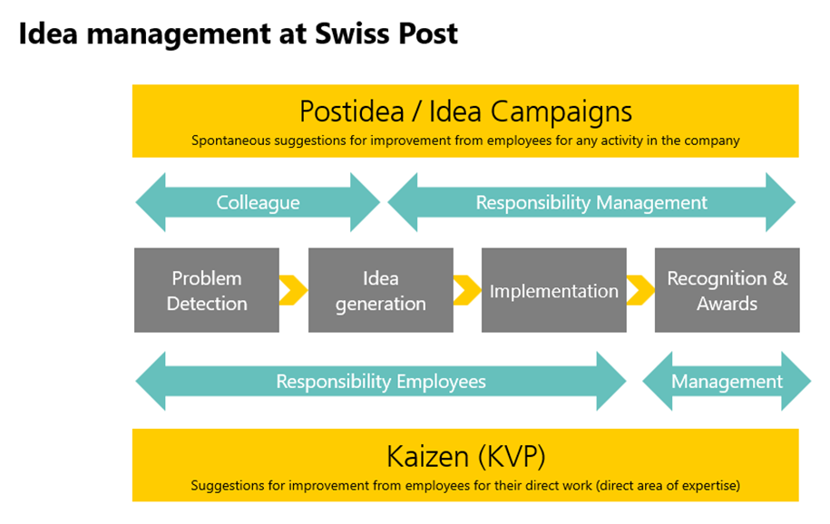

Cross-Industry Success Stories
“$1BN Innovation Portfolio”
“$400M RD&I Portfolio Management”
Shift from innovation “momentum” to measurable delivery velocity
“$40M+ ROI from a single improve-ment”
“$2.4m Saved By Fast-Track Kaizen”
“1000+ employees coached in 12 months”

Slide 25
TAKE THE NEXT STEP
Where does your programme stand?
THE 2026 INNOVATION MATURITY ASSESSMENT
A diagnostic built to find your gap.
The assessment uses the same diagnostic as this research. You'll get a personalised maturity score across all four capability areas — plus tailored recommendations for closing the specific gap in your programme.
Average time to complete the full diagnostic across all capability areas.
Capability dimensions measured, Strategy, Foundations, Program, Infrastructure.
Tailored recommendations delivered with every report, calibrated to your specific profile.
15 min
4
3
Qmarkets.net/maturity-assessment
THE IMPACT GAP · 2026

Slide 26
THE Q&A
Your questions.
We'll batch and answer for the next 5–10 minutes. Thanks for joining — and for helping us pressure-test this research.
★ YOUR ONE NEXT STEP
Take the 2026 Maturity Assessment
qmarkets.net/maturity-assessment
THE IMPACT GAP · 2026

