Slide 1


ENVISION - BUILD - VALIDATE
Safir
Jamal
Head of Strategy & Operations

Slide 2
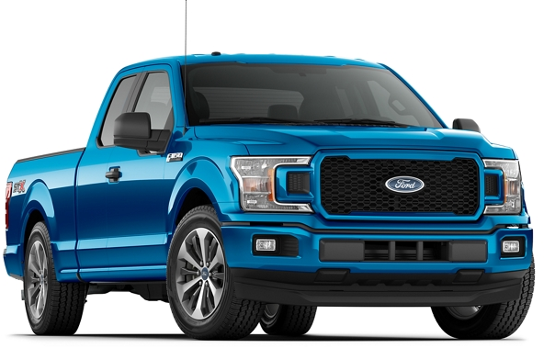

How COVID Forced Us to Create
3 New Revenue Streams in 30 Days

Slide 3
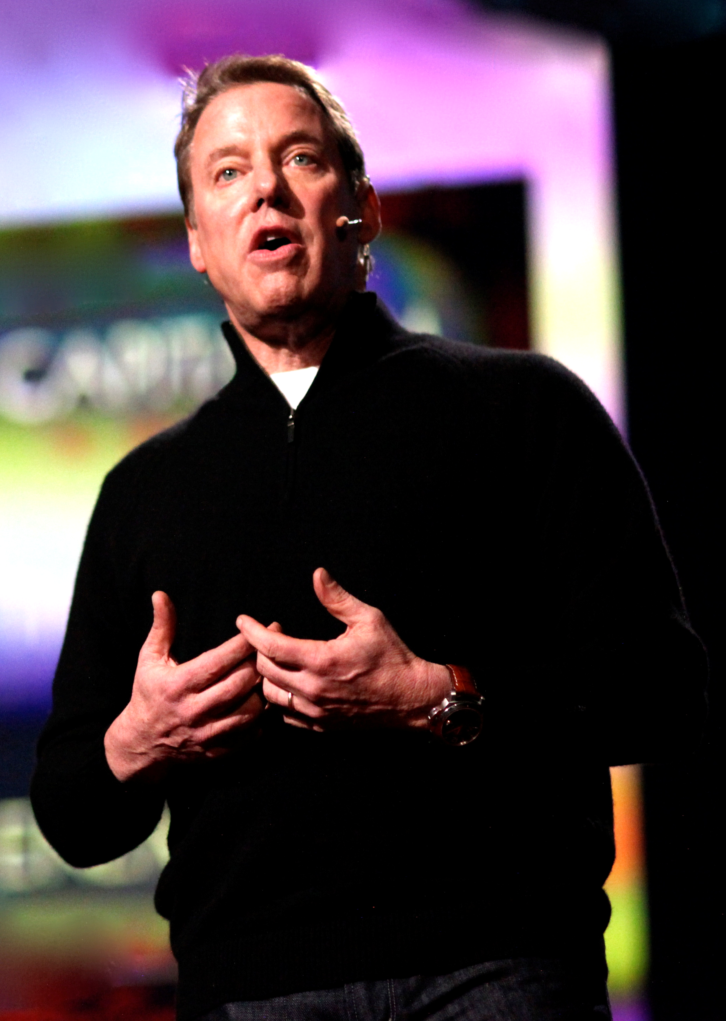


I worried about “how am I going to sell more cars and trucks?”. But today, I worry about “what if all we do is sell more cars and trucks?”
Bill Ford, Chairman of the Ford Motor Company;
2011 TED Talk
https://www.ted.com/talks/bill_ford_a_future_beyond_traffic_gridlock?language=en#t-19476

Slide 4
Bridging the Gap Toward a New Organization
New Talent
New Metrics
New Processes
New Capabilities
New Clockspeed

Slide 5
Understanding
What?
Ford’s venture incubator
Why?
To envision, build, and validate new business opportunities for Ford
How?
Launching in-market ventures
Who?
Entrepreneurs, designers, and engineers
Where?
Palo Alto, Detroit, and London
ENVISION - BUILD - VALIDATE

Slide 6



Ford X’s 3 Founding Principles
3 full-time dedicated employees
(a mix of internal Ford transfers &
external hires)
$400K USD per venture team to cover all expenses until transactional validation, including team salaries
Aspire to launch an in-market pilot and validate the venture with paying customers within
90 days

Slide 7

Successful Ventures Must Pass Through 3 Gates
(1) CONSUMER
DESIRABILITY
Is this the right solution?
Does the solution solve the consumer’s pain point?
(2) ECONOMIC VIABILITY
Should we do this?
Does this solution have paying customers?
How profitable is it?
(3) OPERATIONAL FEASIBILITY
Can we do this?
Can we make
this solution an
ongoing reality?

Slide 8
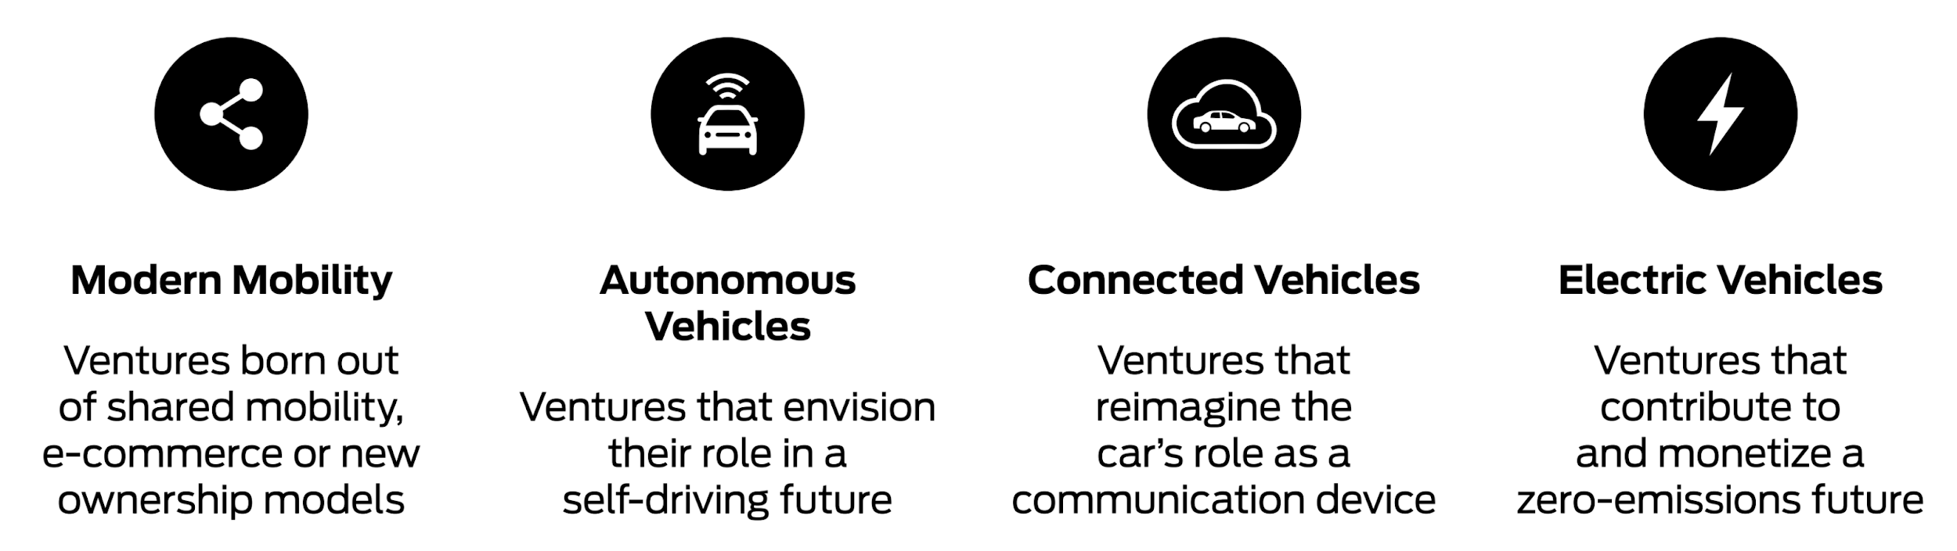
We Build Ventures Across 4 Spaces

Slide 9


Slide 10
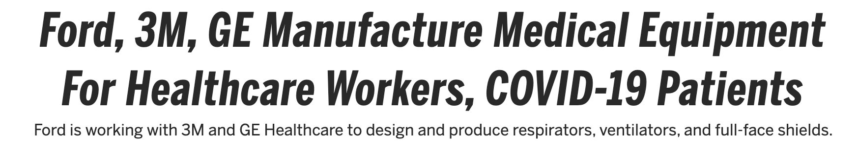


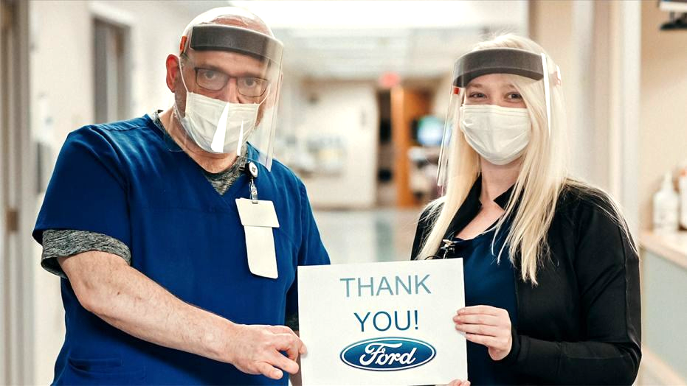
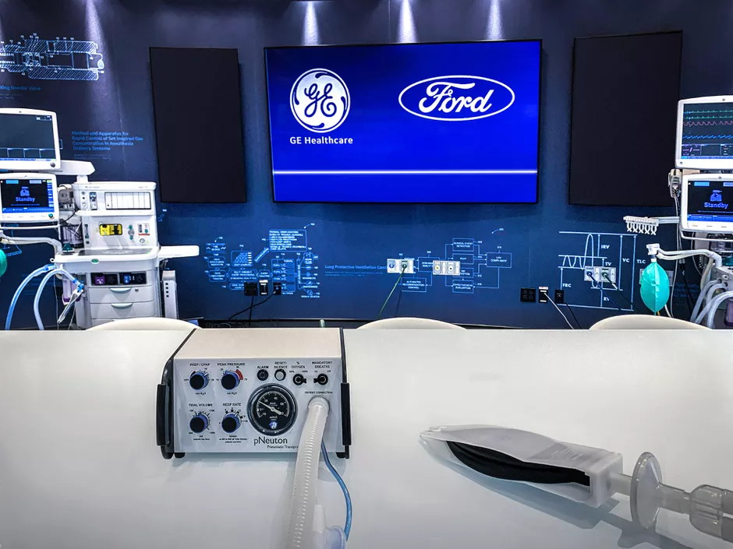
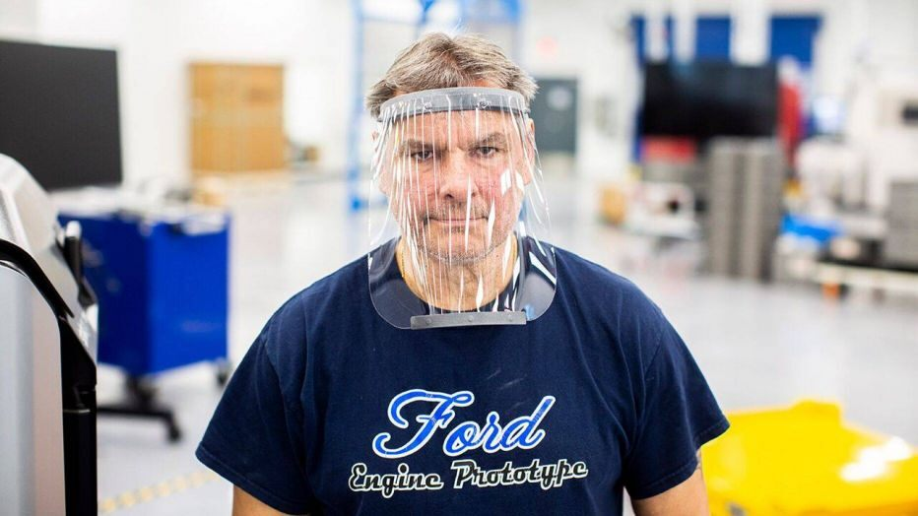

Slide 11
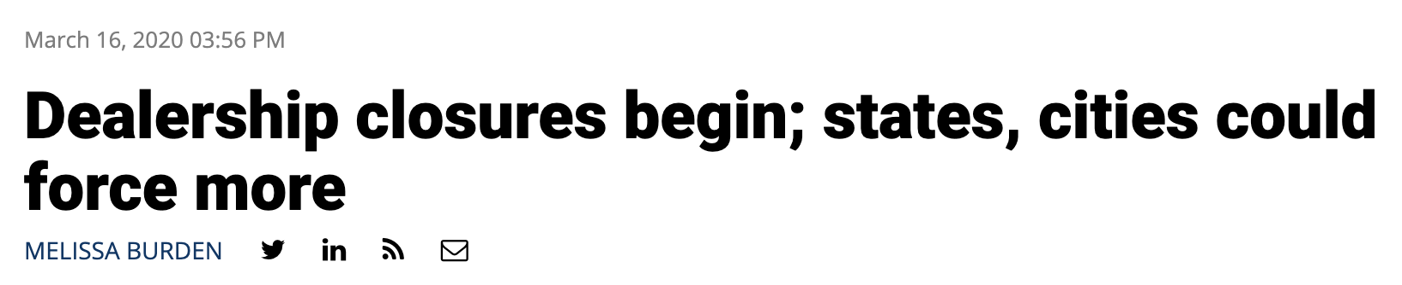
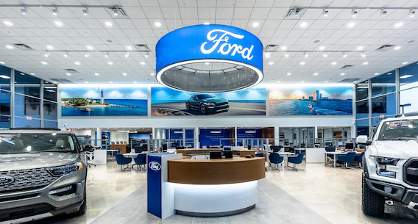
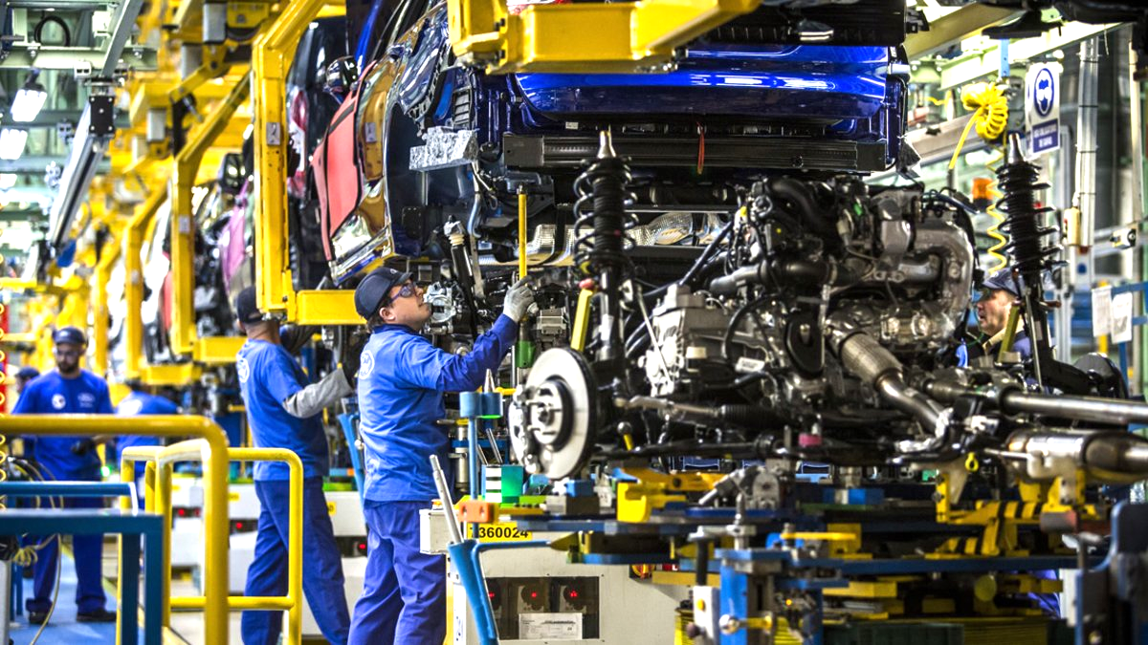
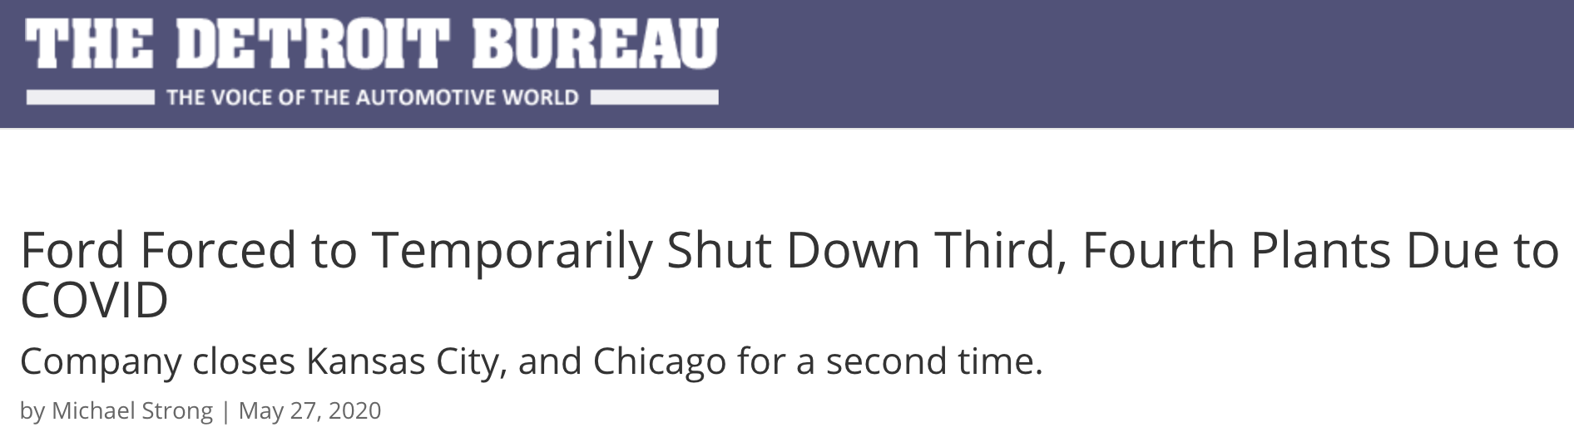

Slide 12

Ford X’s Innovation Lens
Help the Company
&
Help Society

Slide 13
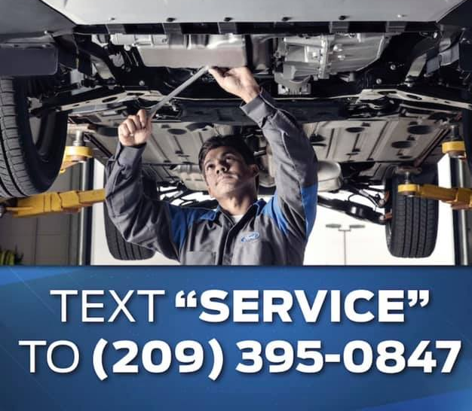
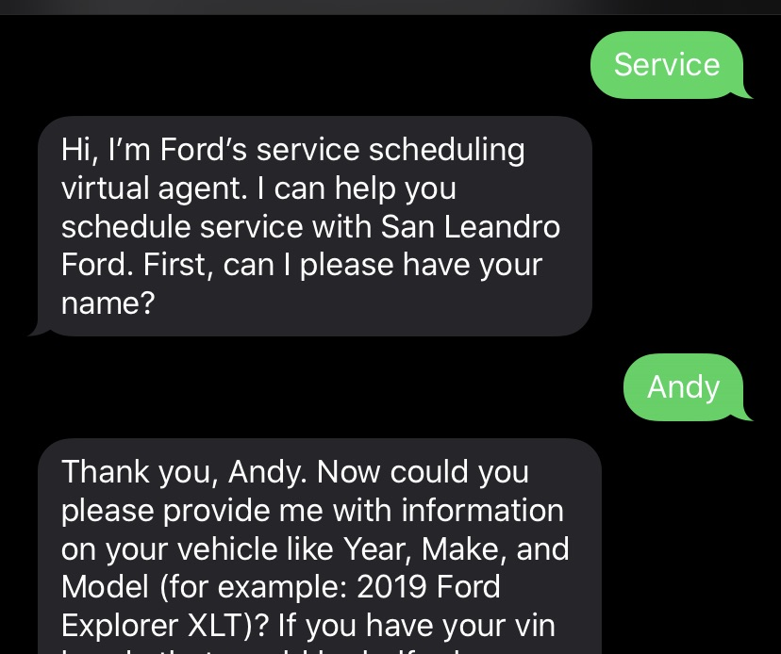
Venture #1: Text-for-Service
Problem
Service walk-in traffic down 60%
Essential workers don’t know whether service & maintenance are available
Appointments can only be scheduled by phone (but the line is always busy)
Solution
SMS appointment scheduler
Increases service traffic (and revenue)
Provides peace of mind and a more convenient booking method
Looking Ahead
National expansion
Customer experience win

Slide 14

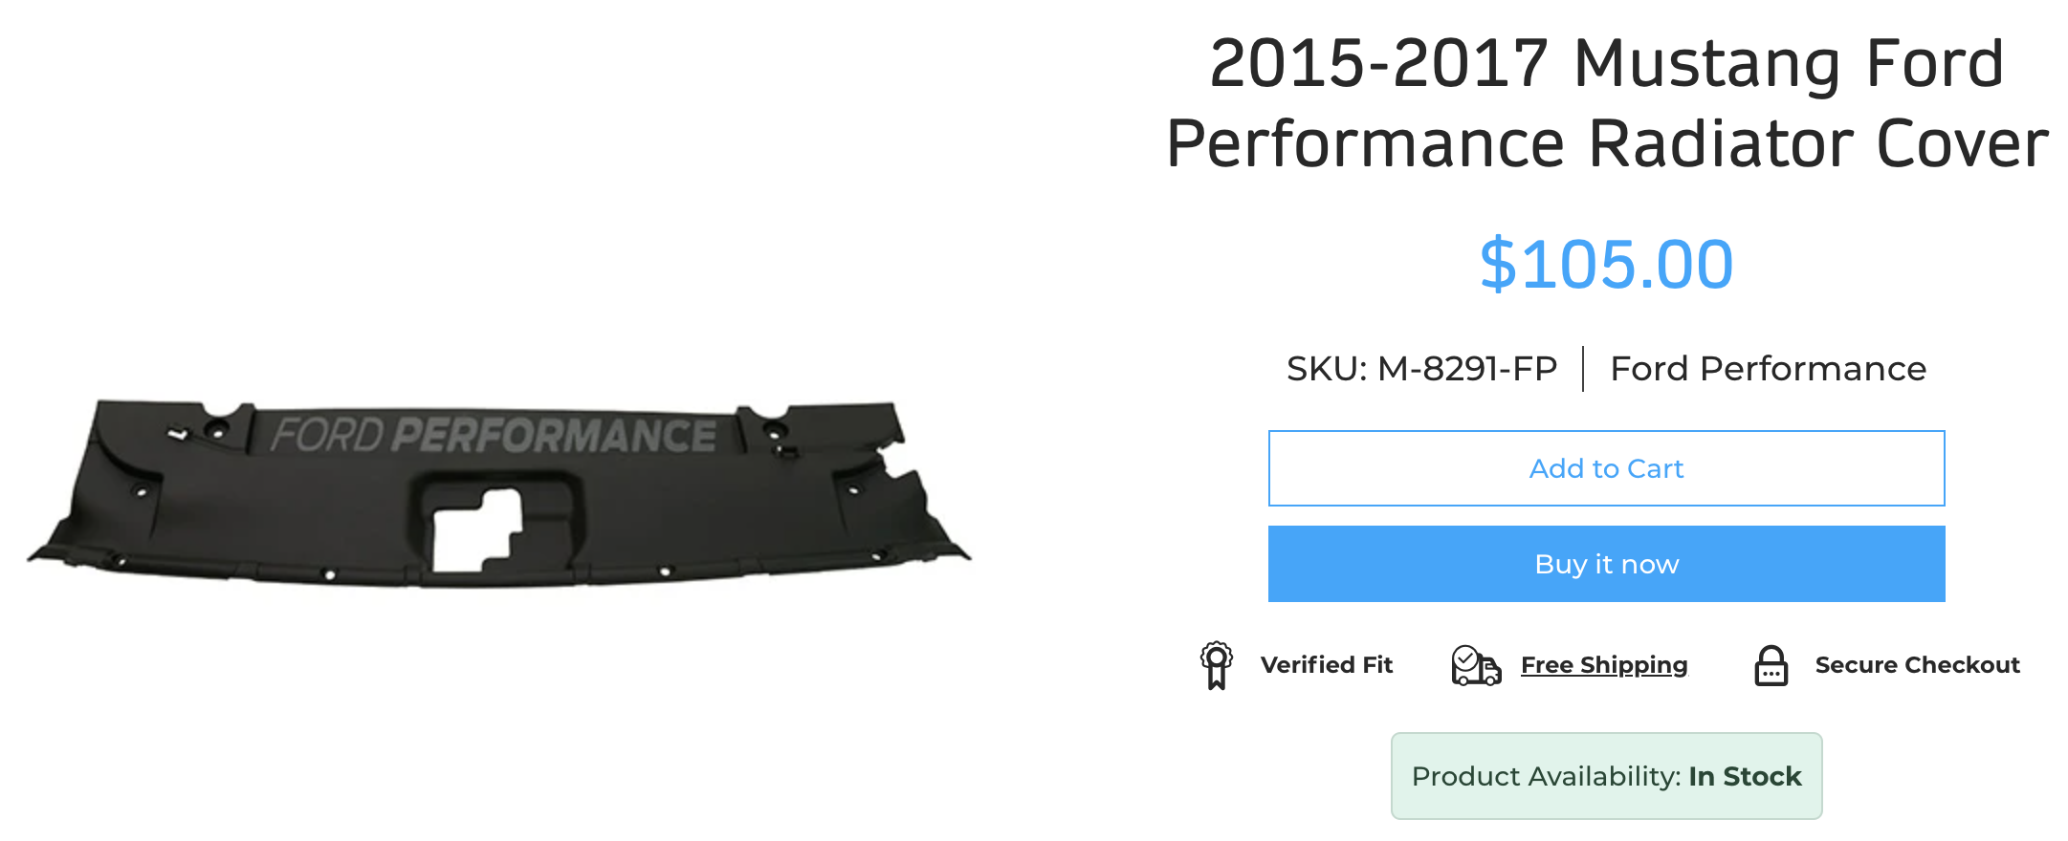
Venture #2: E-Commerce Parts Store
Problem
Most Ford parts are only sold at the dealership - and no one wants to go in
Consumers are turning to non-Ford options because they’re sold online
Solution
An e-commerce store for Ford parts and accessories
Curbside pick-up or home delivery
Looking Ahead
Robust plans to grow e-commerce for parts & accessories

Slide 15
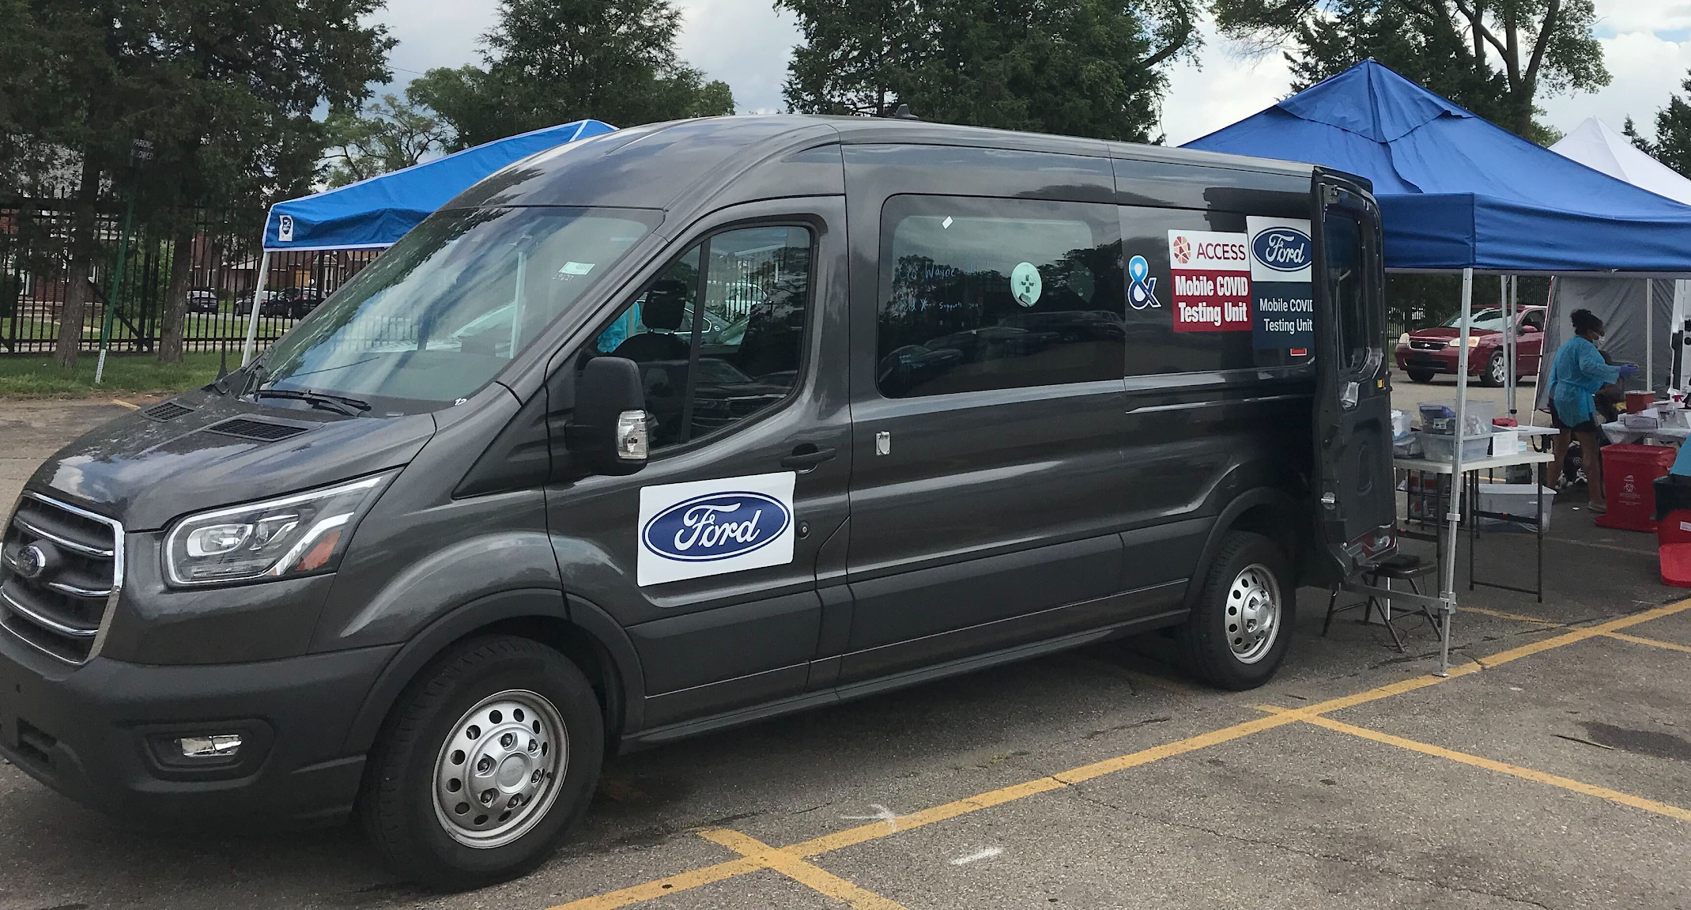
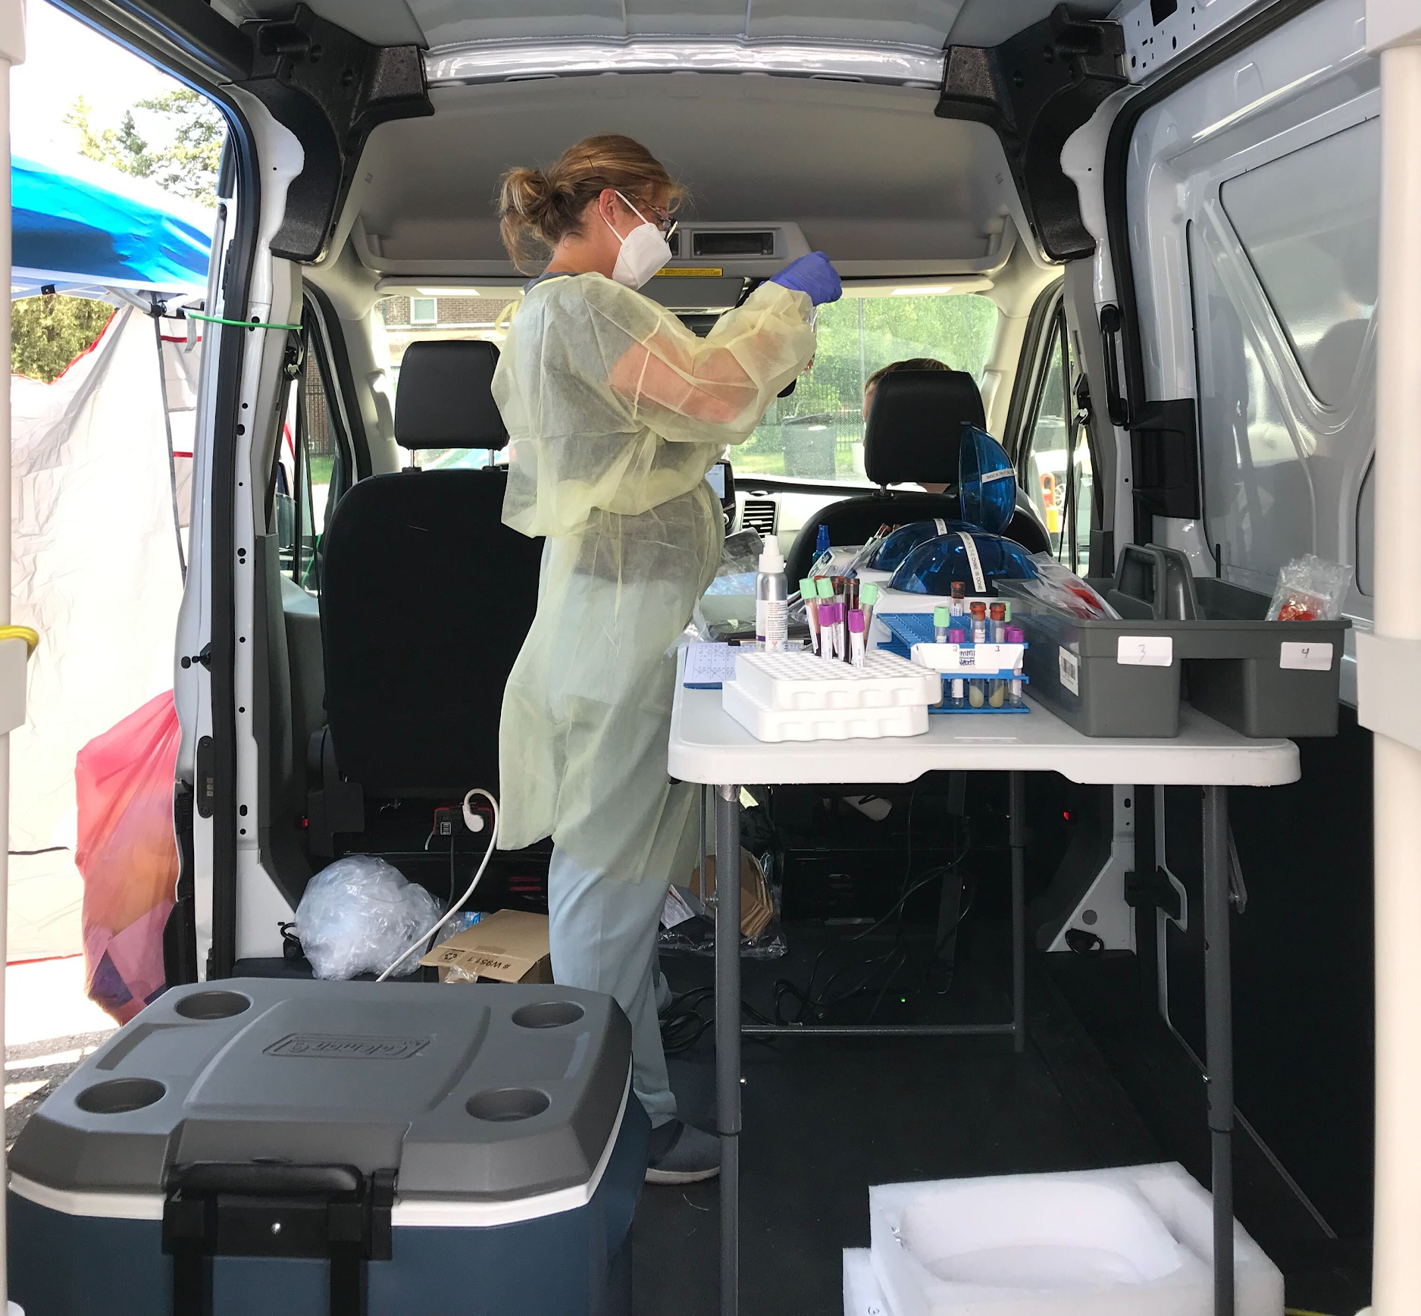
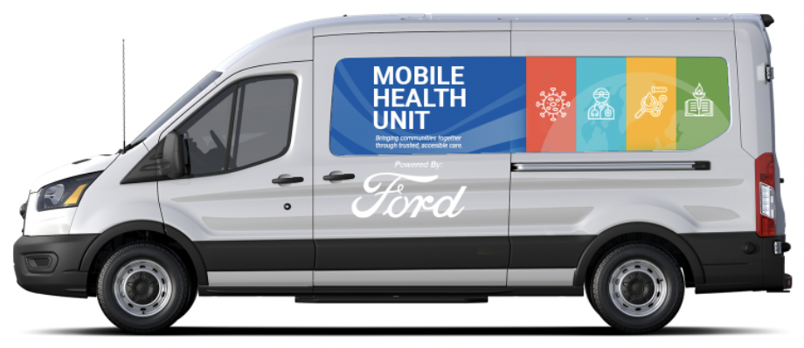
Venture #3: Mobile Health Unit
Problem
Urgent need for COVID-testing
Hospital-based testing is capacity-constrained and not accessible to everyone
Solution
Medical partnership on mobile health
Ford Transit van, outfitted for COVID and antibody testing (tested 15K+ ppl)
“The testing van comes to you”
Looking Ahead
Selling pre-outfitted mobile health vans to governments, nonprofits, and other healthcare providers

