Slide 1




5 WAYS TO PROVE THE ROI OF CORPORATE INNOVATION
(and Secure Leadership Buy-In)
Caitlin Lawrence, Innovation Manager
Jennifer Dunn, Global Head of Consulting

Slide 2
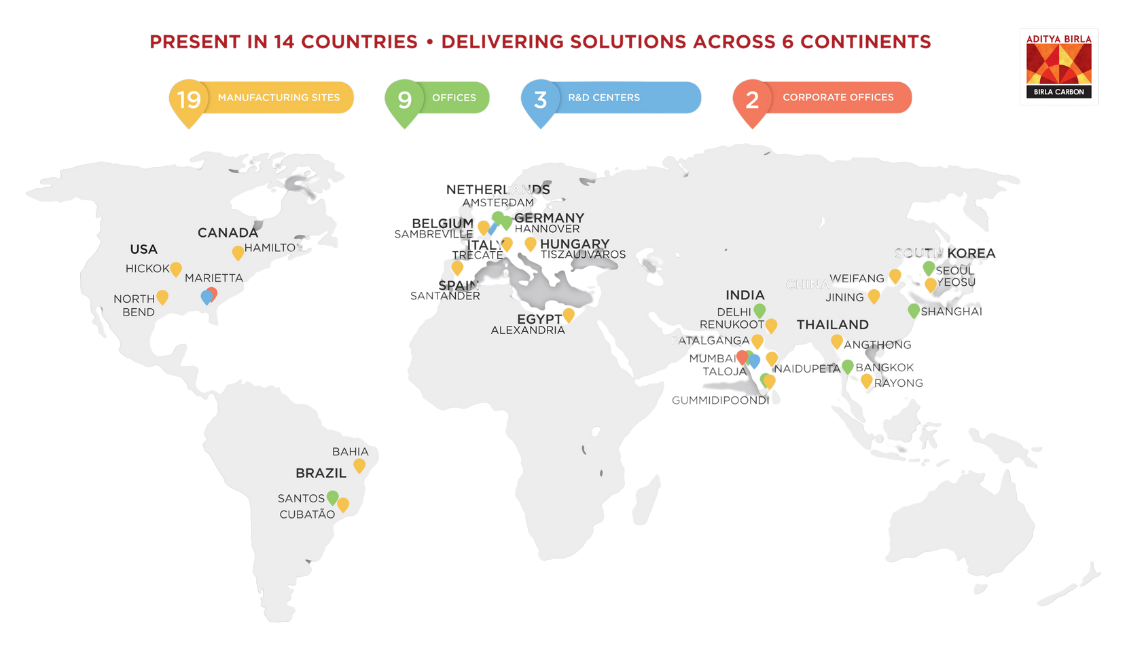
ABOUT BIRLA CARBON
Our Values
NET-ZERO BY 2050
In 2021, the organization pledged to be net-zero carbon emissions by 2050; a first for the carbon black industry.
Innovation & Sustainability
SHARE THE FUTURE
Our commitment to innovation is primed to accelerate and help our customers, and industry, achieve the levels of sustainable growth demanded by the environment, economy, and society.
Our Application
CARBON BLACK
  Tires
  Specialty Blacks
  Mechanical Rubber Goods

Slide 3










Our Commitment Reflected in Our Achievements
MANCHESTER
HELSINKI
BONN
FRANKFURT
MONTREAL
100%
OKLAHOMA
BOSTON
Focus on Innovation Management
BANGALORE
600+
Enterprise Customers
28M €
200
Revenue 2024
Employees
6M €
8
2001
EBITDA 2024
Offices Worlwide
Founded & Constantly Growing

Slide 4


WHAT DO YOU SEE AS THE BIGGEST BARRIER TO MEASURING INNOVATION WITHIN YOUR ORGANIZATION?
Notes:
Answer Choices:
Lack of clear metrics benchmarks
Difficult to quantify intangible outcomes
Diversity of project portfolio
Long time-frame for innovation efforts to return results
Difficulty in demonstrating the impact of innovation activities
Resistance to change and risk aversion
Lack of leadership support and resource allocation
Other (specify)

Slide 5


ALIGN STRATEGIC PRIORITIES
Notes:
Audience Question:
What are the strategic innovation areas your organization is prioritizing for growth?

Slide 6



ALIGN STRATEGIC PRIORITIES
SET CLEAR KPIs
Notes:
Audience Question:
What is your biggest challenge when selecting KPIs to measure innovation performance?
Aligning KPIs with strategic business priorities
Difficulty in measuring qualitative data
Communicating value to stakeholders
Keeping the list of KPIs manageable and focused

Slide 7


ALIGN STRATEGIC PRIORITIES
SET CLEAR KPIs
COMMUNICATE WITH CREDIBILITY
Notes:
Audience Question:
How are you communicating your innovation efforts across the organization?

Slide 8


ALIGN STRATEGIC PRIORITIES
SET CLEAR KPIs
COMMUNICATE WITH CREDIBILITY
CREATE A COMMON LANGUAGE

Slide 9


ALIGN STRATEGIC PRIORITIES
SET CLEAR KPIs
COMMUNICATE WITH CREDIBILITY
CREATE A COMMON LANGUAGE
ENGAGE EXECUTIVES EFFECTIVELY
Notes:
Audience Question:
What is the biggest barrier you have experienced when trying to get leadership buy-in?
Lack of clear communication
Resistance to change
Conflicting priorities
Insufficient resources (time, budget, personnel, etc.)
Lack of clear ROI
Other (Specify)

Slide 10

KEY TAKEAWAYS
Quantify Innovation
Metrics that Resonate
Credibility
Alignment
Visibility
Quantifying innovation impact goes beyond KPIs. Adopting a holistic approach that focuses on both quantitative metrics and qualitative measures, like culture change, can give you a greater insights into innovation performance.
Breaking down results into short-term gains that fit into the long-term organizational objectives enables you to contextualize innovation outcomes.
Transparency in reporting helps to build trust and credibility in the organization’s innovation journey and enables you to drive continued engagement.
A key component of ensuring value creation for an organization is selecting the right topics and projects to pursue; ensuring that ideation campaigns align with strategic business objectives.
Effective communication ensures that employees understand the organization’s innovation goals and can actively work to achieve them.

Slide 11
THANK YOU
Contact Information
Caitlin Lawrence
Jennifer Dunn
Caitlin.Lawrence@adityabirla.com
https://www.linkedin.com/in/caitlinolawrence/
Jennifer.Dunn@hypeinnovation.com
https://www.linkedin.com/in/jennifer-dunn-23a4926b/

