Slide 1
Corporate Innovation: 14 Essential Concepts

Slide 2
Introduction
Innovation is the lifeblood of any organization aiming to build (or maintain) its competitive advantage — and attract the best talent.
This deck, assembled by InnoLead, highlights the 14 most essential concepts in corporate innovation to help organizations foster creativity, agility, and leadership.
We define each concept; recommend additional reading; and provide a visual model or framework for each.
* We incorporated input from generative AI in this project to help make each concept succinct.

Slide 3
1. The Innovator's Dilemma
Core Idea: Established companies often fail to innovate because they focus on sustaining innovations (serving existing customers) rather than disruptive innovations that create new markets.
Takeaway: Prioritize long-term disruptive technologies/opportunities even when they challenge your existing business.
Additional Reading:
Book: The Innovator’s Dilemma: When New Technologies Cause Great Firms to Fail by Clayton M. Christensen
Article: “What is Disruptive Innovation?” by Clayton M. Christensen, Michael E. Raynor, and Rory McDonald (Harvard Business Review)

Slide 4
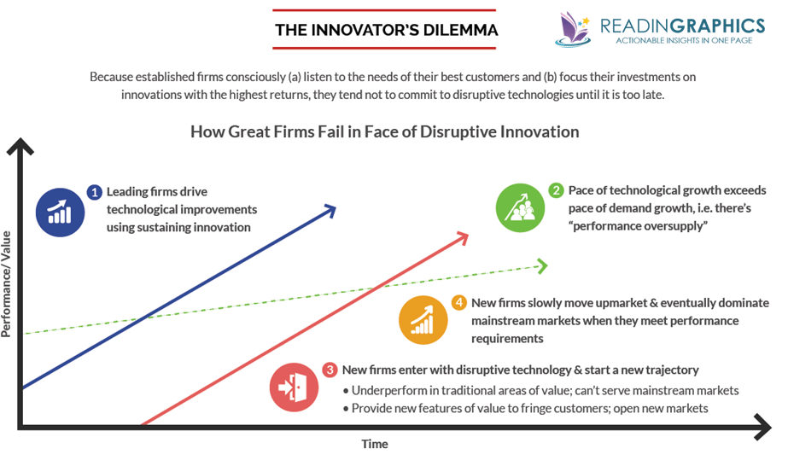
1. The Innovator's Dilemma

Slide 5
2. The Three Horizons of Growth
Core Idea: Organizations should manage innovation across three horizons: sustaining the core business (H1), scaling emerging opportunities (H2), and creating transformational innovations (H3).
Takeaway: Allocate resources across all three horizons for sustained growth.
Book: The Alchemy of Growth: Practical Insights for Building the Enduring Enterprise by Mehrdad Baghai, Stephen Coley, and David White
Article: “Enduring Ideas: The Three Horizons of Growth” by McKinsey & Company

Slide 6
2. The Three Horizons of Growth

Slide 7
2. The Three Horizons of Growth

Slide 8
3. Open Innovation
Core Idea: Companies should leverage both internal and external ideas and paths to market, moving beyond closed, internal R&D models.
Takeaway: Collaborate with startups, universities, and external stakeholders to accelerate innovation.
Book: Open Innovation: The New Imperative for Creating and Profiting from Technology by Henry Chesbrough
Article: “Open Innovation: Definitions, Benefits, and Examples,” InnovatingSociety.com

Slide 9
3. Open Innovation
Source: Lead-Innovation.com

Slide 10
4. Lead User Theory
Core Idea: Innovation can be driven by engaging with lead users who experience needs earlier than the general market.
Takeaway: Involve lead users in co-creating solutions that address emerging market demands.
Book: Democratizing Innovation by Eric von Hippel
Article: “Lead Users: A Source of Novel Product Concepts” by Eric von Hippel (Management Science)

Slide 11
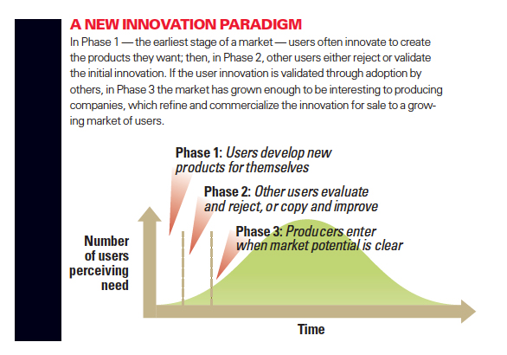
4. Lead User Theory
Source: MIT Sloan Management Review

Slide 12
5. Ambidexterity
Core Idea: Organizations must simultaneously exploit current strengths and explore new opportunities.
Takeaway: Develop structures and cultures that allow both efficiency and innovation to thrive.
Book: The End of Competitive Advantage: How to Keep Your Strategy Moving as Fast as Your Business by Rita McGrath
Article: “Organizational Ambidexterity: Balancing Exploitation and Exploration for Sustained Performance” by Michael L. Tushman, Sebastian Raisch, Julian Birkinshaw, and Gilbert Probst (Organization Science)

Slide 13
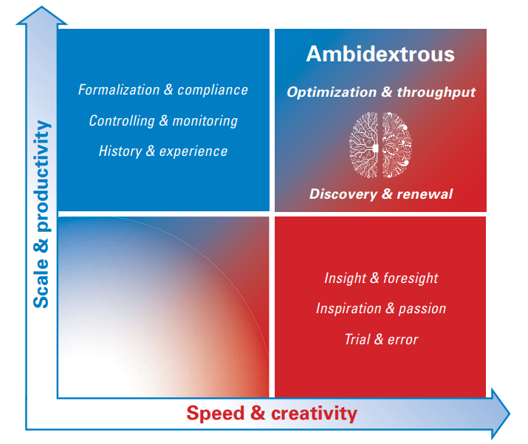
5. Ambidexterity
Source: Arthur D. Little

Slide 14
6. Design Thinking
Core Idea: A human-centered approach to innovation that involves empathizing with users, defining problems, ideating, prototyping, and testing solutions.
Takeaway: Foster creativity and user-centric problem-solving in teams.
Book: Change by Design: How Design Thinking Transforms Organizations and Inspires innovation by Tim Brown
Article: “Design Thinking Comes of Age” by Jon Kolko (Harvard Business Review)

Slide 15
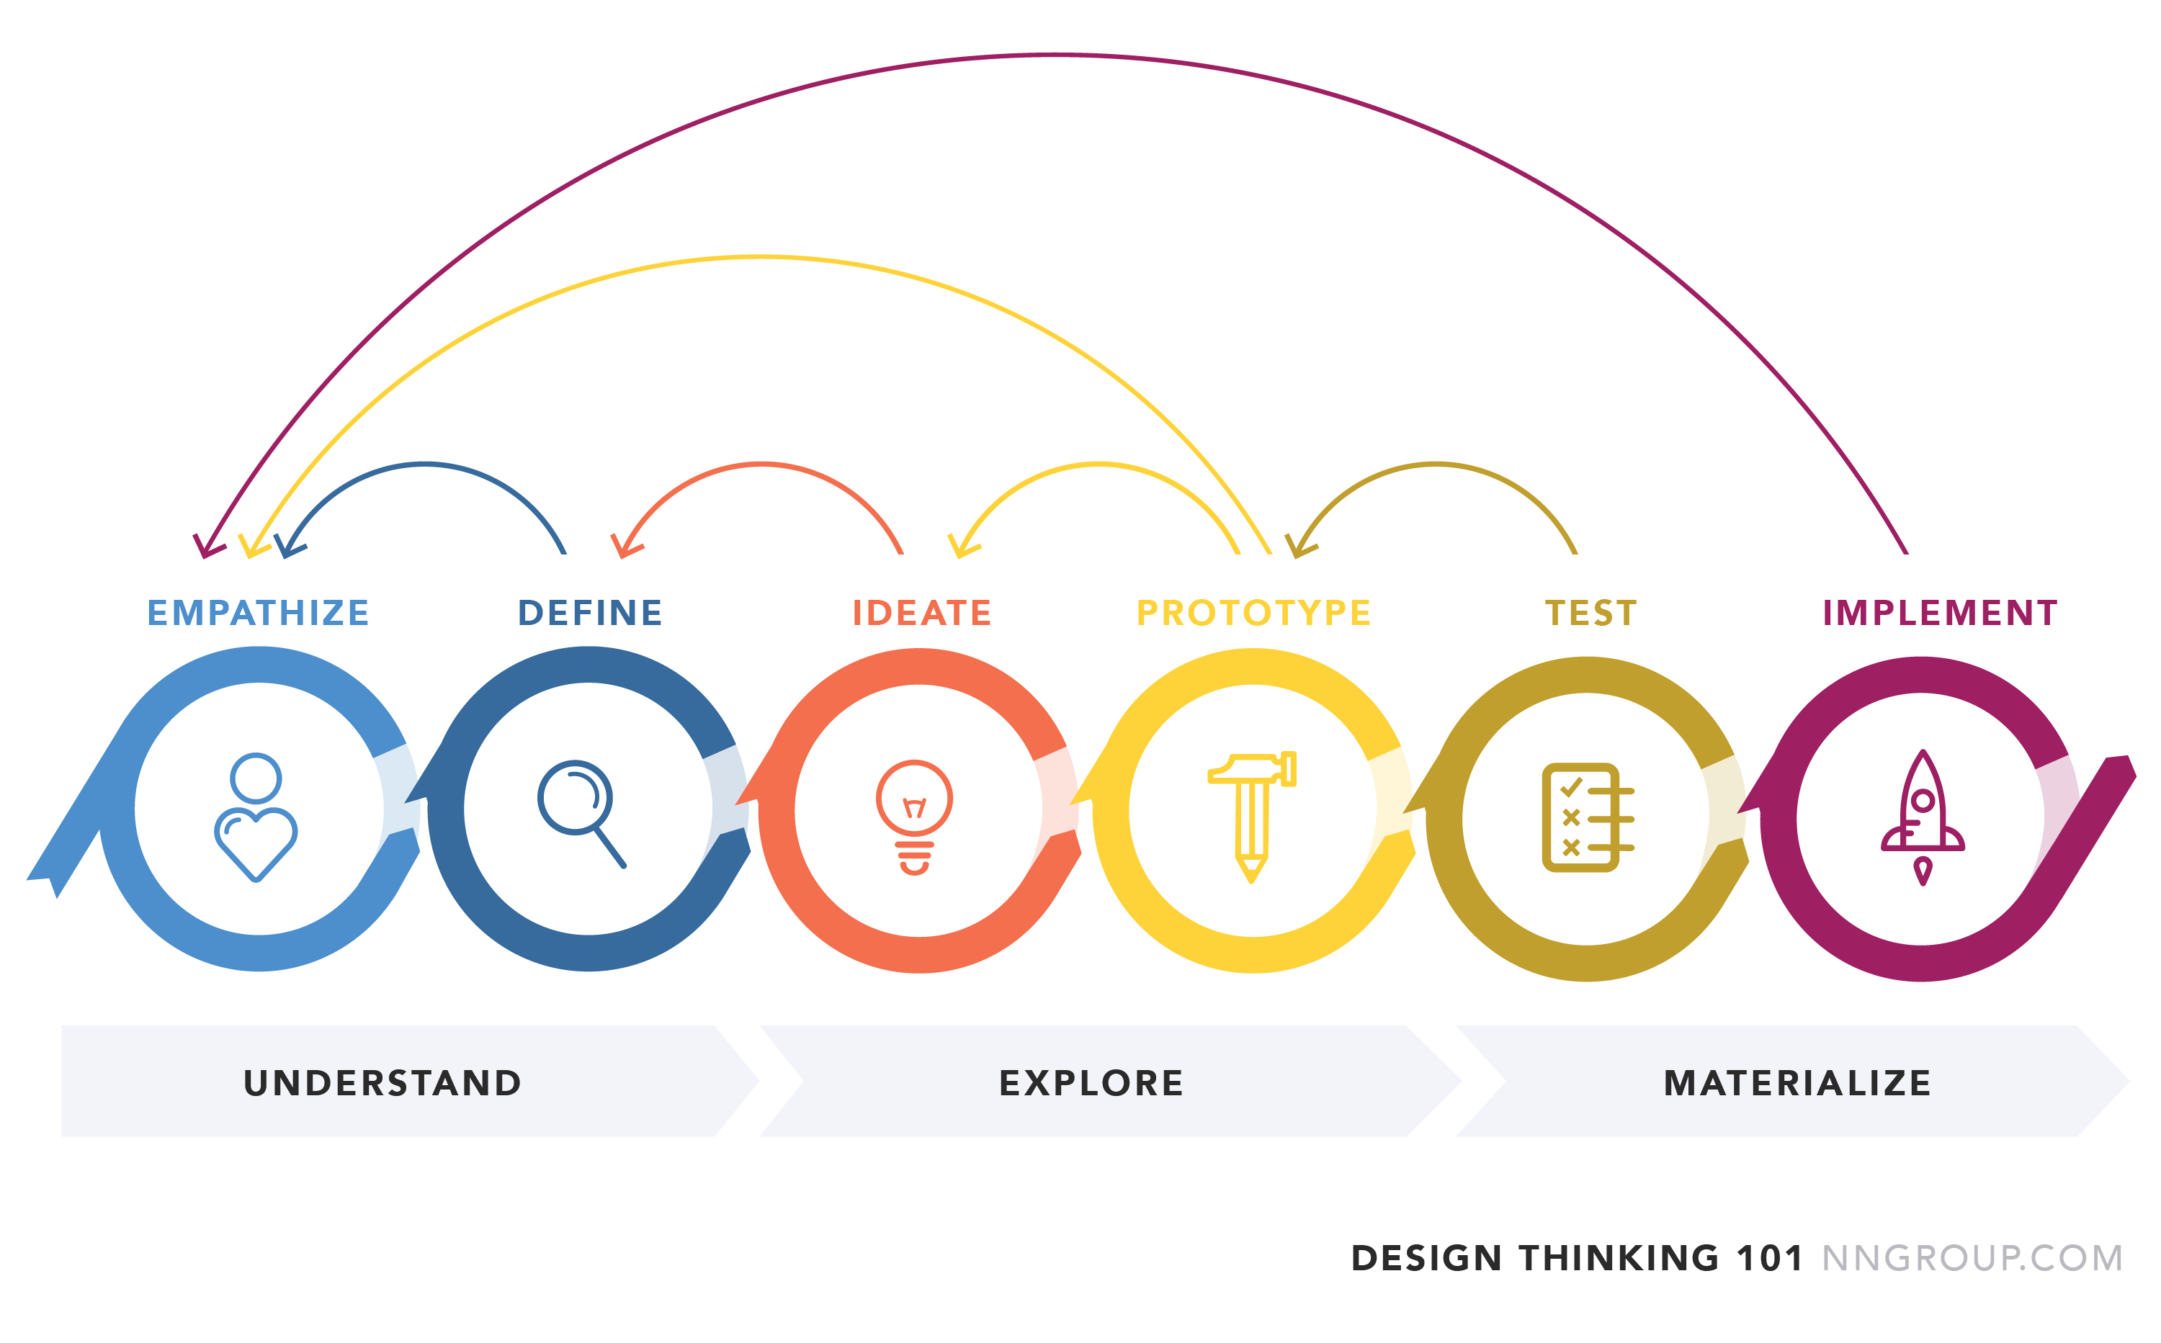
6. Design Thinking

Slide 16
7. The Jobs-to-Be-Done Framework
Core Idea: Customers “hire” products or services to get a job done.
Takeaway: Understand the jobs customers want to accomplish to develop relevant innovations.
Book: Competing Against Luck: The Story of Innovation and Customer Choice by Clayton M. Christensen, Taddy Hall, Karen Dillon, and David S. Duncan
Article: “Know Your Customers’ ‘Jobs to Be Done’” by Clayton M. Christensen, Taddy Hall, Karen Dillon, and David S. Duncan (Harvard Business Review)

Slide 17
7. The Jobs-to-Be-Done Framework
Source: Productboard

Slide 18
8. Agile Innovation
Core Idea: Apply agile principles (like iterative development, cross-functional teams, and adaptive planning) to the innovation process.
Takeaway: Make innovation faster, more flexible, and better aligned with customer needs.
Book: Agile Innovation: The Revolutionary Approach to Accelerate Success, Inspire Engagement, and Ignite Creativity by Langdon Morris, Moses Ma, and Po Chi Wu
Article: “Agile Innovation” by Bain & Company

Slide 19
8. Agile Innovation

Slide 20
9. Innovation Ecosystems
Core Idea: Build interconnected networks of partners, suppliers, and customers that co-create value and innovation.
Takeaway: Emphasize collaboration and resource-sharing across the ecosystem.
Book: Innovation Ecosystems: Increasing Competitiveness by Martin Fransman
Article: “How to Create an Innovation Ecosystem” by Art Markman (Harvard Business Review)

Slide 21
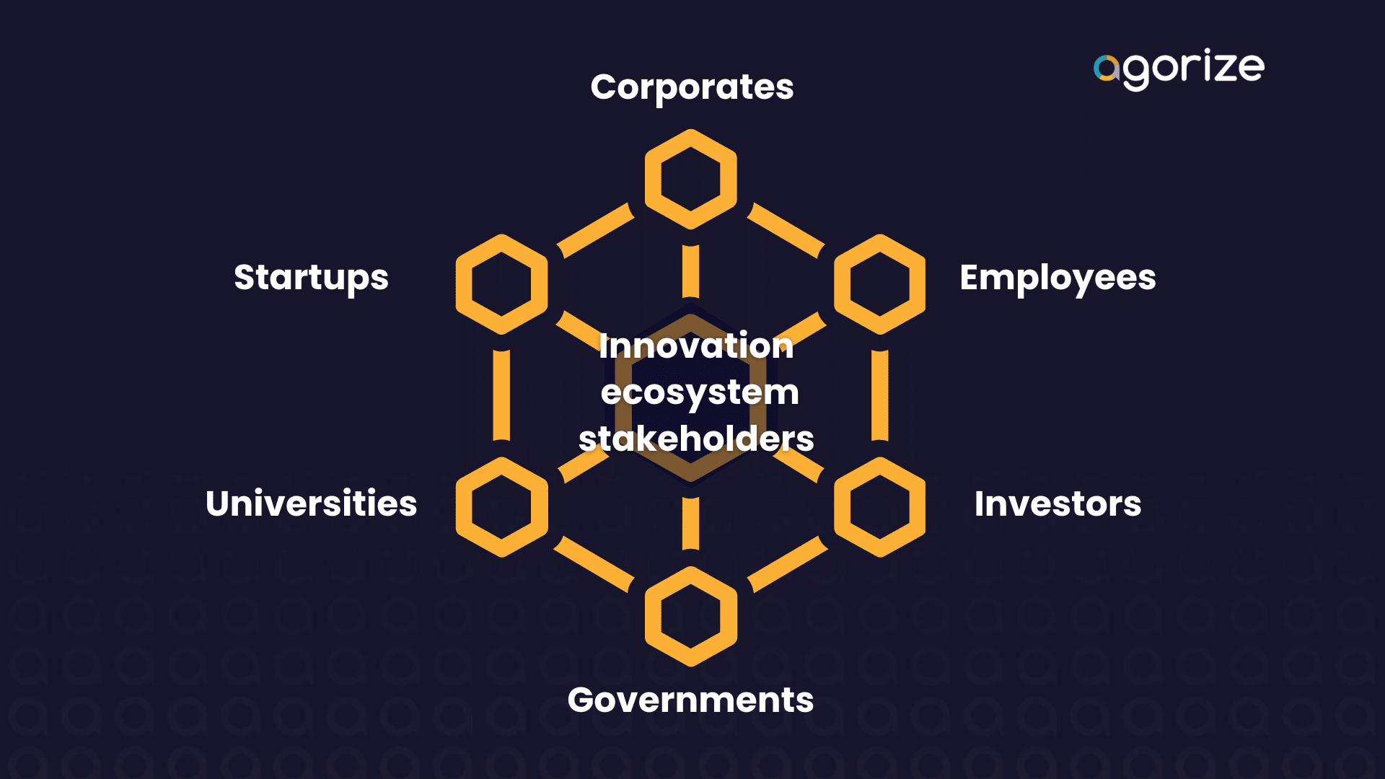
9. Innovation Ecosystems

Slide 22
10. Diffusion of Innovations Theory
Core Idea: Innovations spread through specific adopter categories (innovators, early adopters, early majority, late majority, laggards).
Takeaway: Tailor your innovation strategy to target each group effectively.
Book: Diffusion of Innovations by Everett M. Rogers
Article: “The Diffusion of Innovation,” by Lt. Daniel W. Berger (CHIPS)

Slide 23
10. Diffusion of Innovations Theory
Source: Smart Insights

Slide 24
11. Lean Startup
Core Idea: A methodology for building businesses and products that focuses on creating a minimum viable product (MVP), testing hypotheses, and iterating quickly based on feedback.
Takeaway: Embrace a build-measure-learn cycle to reduce risk and ensure innovations meet real customer needs.
Book: The Lean Startup: How Today's Entrepreneurs Use Continuous Innovation to Create Radically Successful Businesses by Eric Ries
Article: “Why the Lean Start-Up Changes Everything” by Steve Blank (Harvard Business Review)

Slide 25
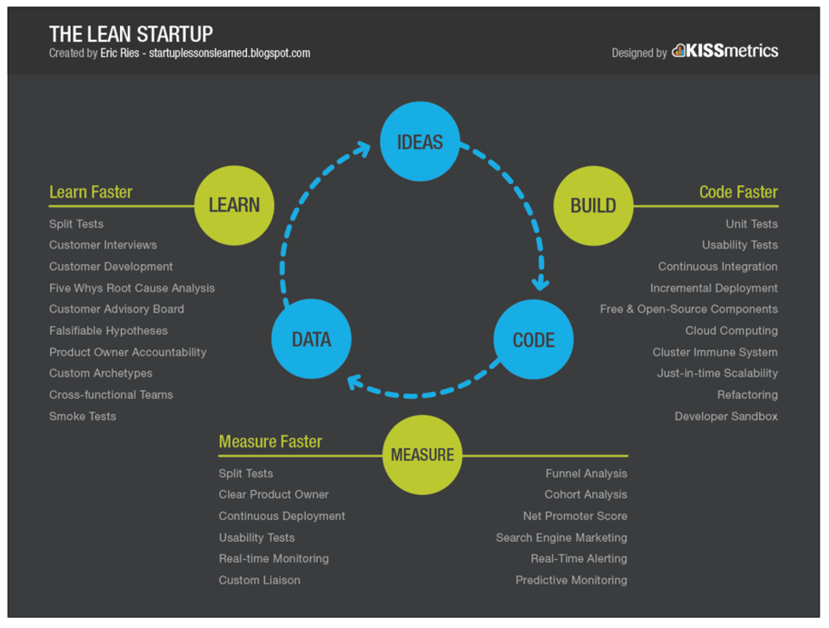
11. Lean Startup

Slide 26
12. Blue Ocean Strategy
Core Idea: Focus on creating new market spaces (blue oceans) where competition is irrelevant rather than competing in existing markets (red oceans).
Takeaway: Innovate by creating unique value propositions that address untapped customer needs.
Book: Blue Ocean Strategy: How to Create Uncontested Market Space and Make the Competition Irrelevant by W. Chan Kim and Renée Mauborgne
Article: “Blue Ocean Leadership” by W. Chan Kim and Renée Mauborgne (Harvard Business Review)

Slide 27
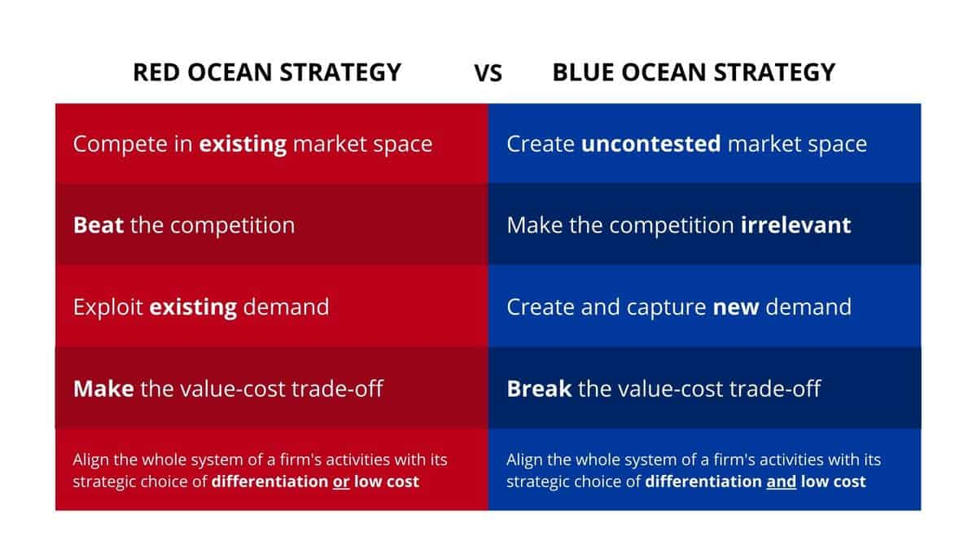
12. Blue Ocean Strategy
Source: Blue Ocean Strategy

Slide 28
13. Frugal Innovation
Core Idea: Innovate by designing simple, effective, and affordable solutions, particularly for resource-constrained environments.
Takeaway: Focus on efficiency and accessibility to open up new market opportunities.
Book: Frugal Innovation: How to Do More with Less by Navi Radjou and Jaideep Prabhu
Article: “The Rising Frugal Economy” by Navi Radjou (MIT Sloan Management Review)

Slide 29
13. Frugal Innovation
Source: Navi Radjou

Slide 30
14. Business Model Innovation
Core Idea: Rethinking how a company delivers value, not just the products and services it offers. One frequently-used tool is the Business Model Canvas.
Takeaway: Regularly challenge and reimagine your business model to adapt to market changes.
Book: Business Model Generation: A Handbook for Visionaries, Game Changers, and Challengers by Alexander Osterwalder and Yves Pigneur
Article: “Reinventing Your Business Model” by Mark W. Johnson, Clayton M. Christensen, and Henning Kagermann (Harvard Business Review)

Slide 31
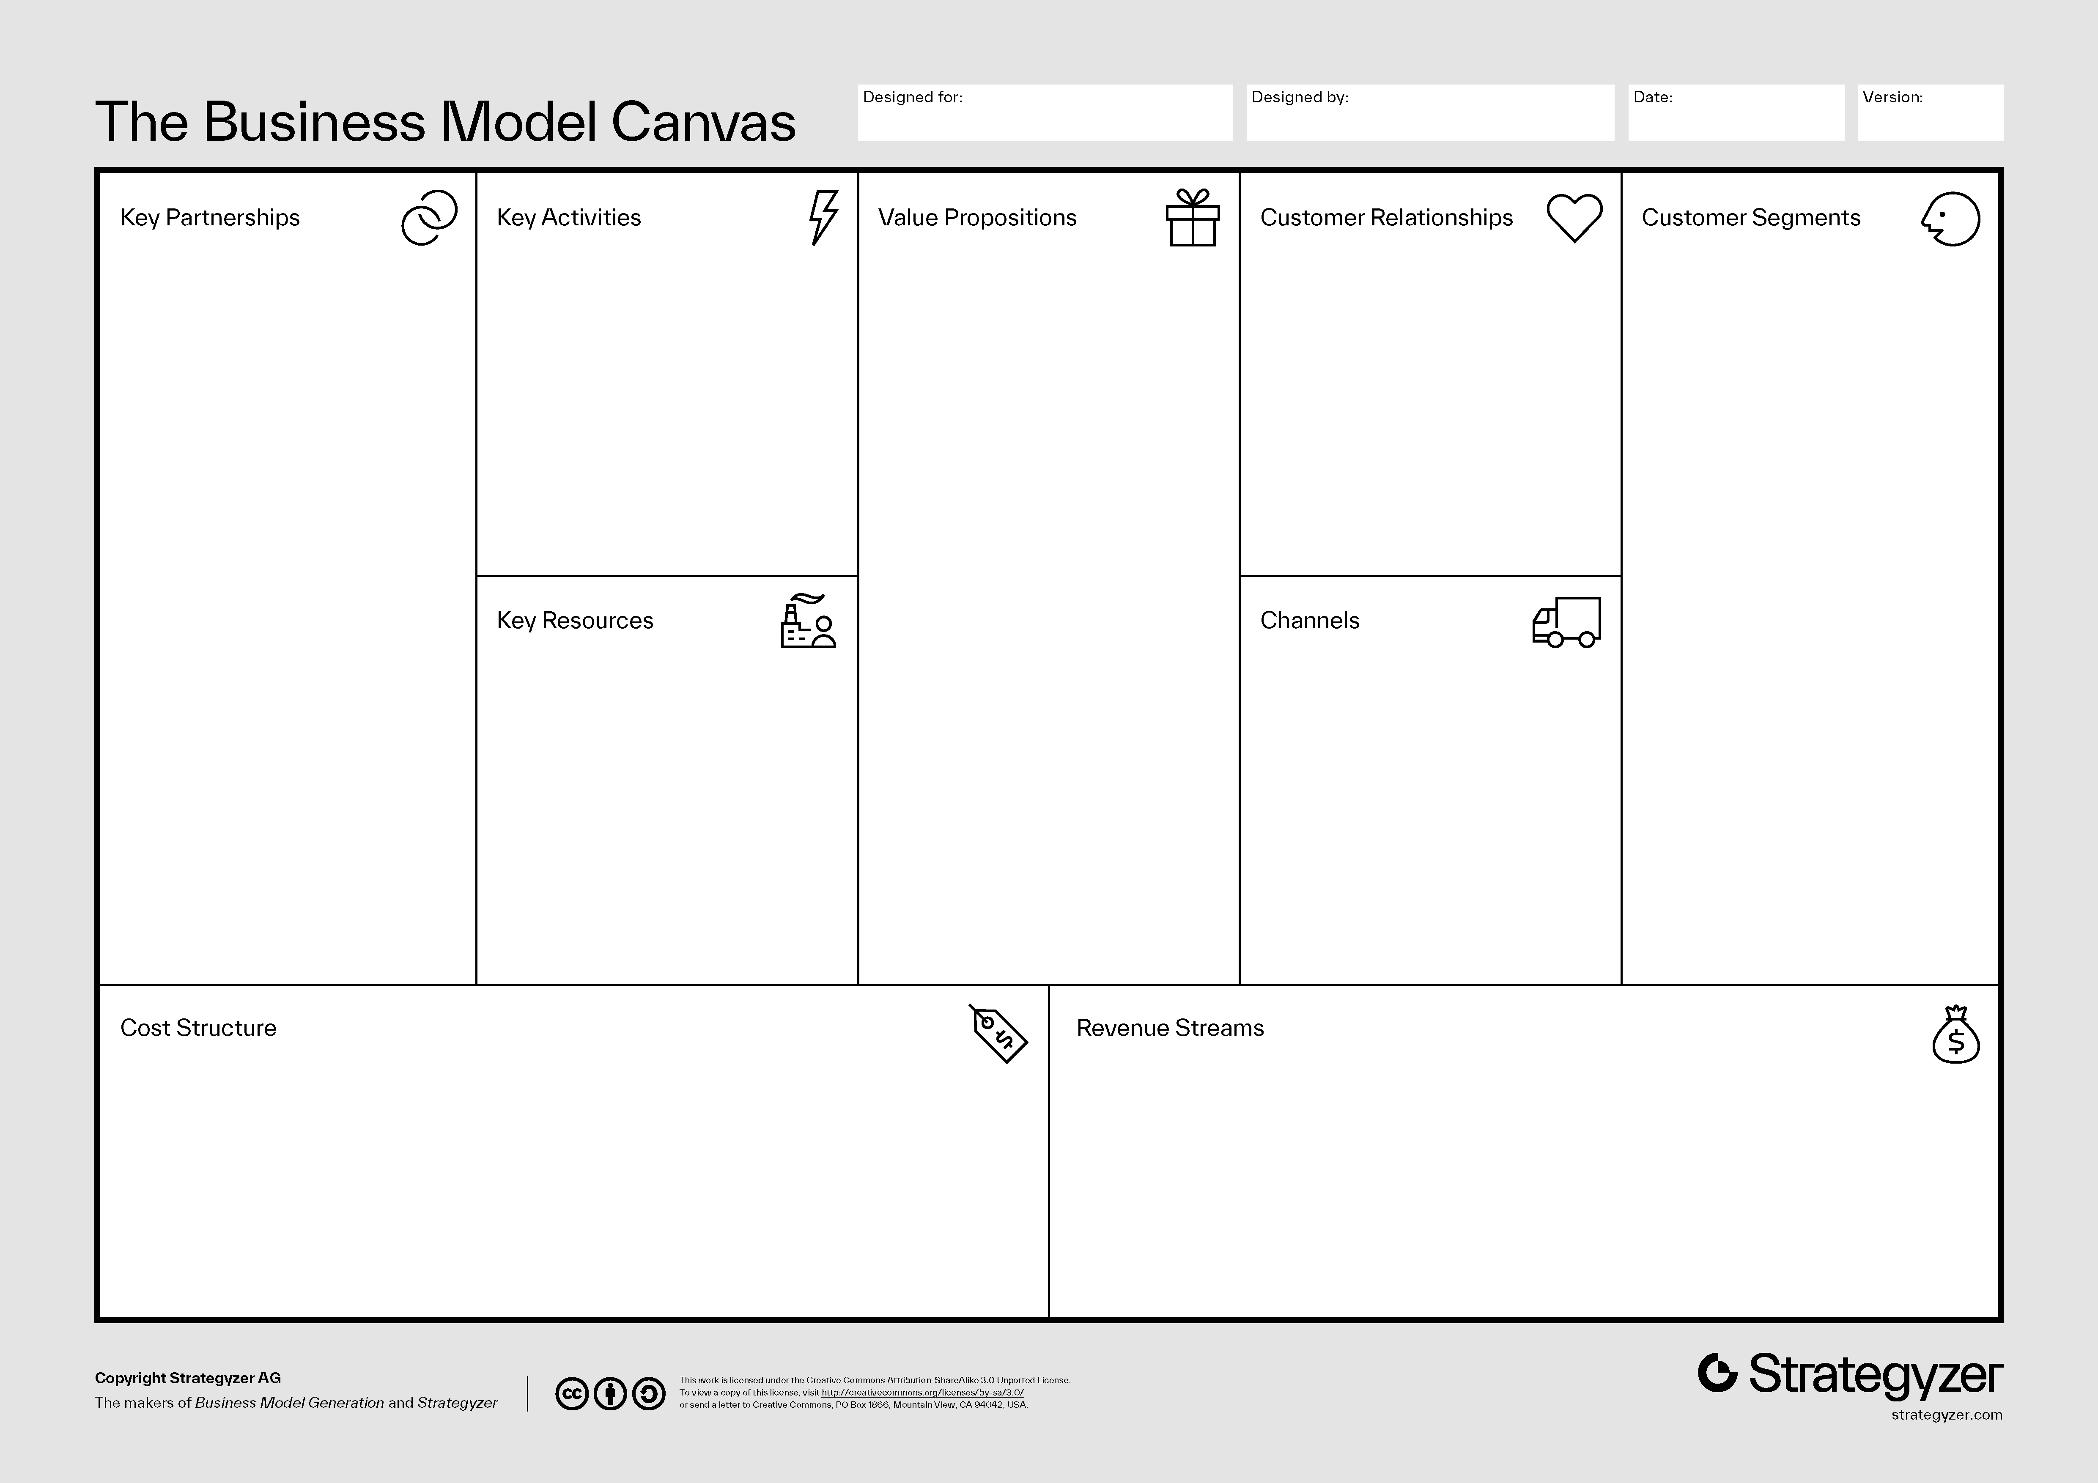
14. Business Model Innovation

Slide 32
For more…
InnoLead is the world’s most trusted resource on leadership, change, and innovation.
For more resources like this one, visit InnoLead: innolead.com/data-and-templates

