Slide 1
AI in the Enterprise: 30 Useful Charts
Compiled January 2025

Slide 2
About This Deck
The InnoLead team compiled this deck as a resource for professionals helping to shape AI strategy and deployments. All the data was published in 2024. Please note that some data refers to AI broadly, and some data to generative AI specifically.
If you cite data from this report or incorporate these charts in your own presentations, kindly reference the original source.
We’ve divided this deck into six sections:
1. Spending, Strategy & Drivers
2. Use Cases and Value
3. People, Training & Upskilling
4. Leader Perspectives
5. Risk Mitigation & Metrics
6. Root Causes of Failure, Data Capabilities & More

Slide 3
1. Spending, Strategy & Drivers

Slide 4
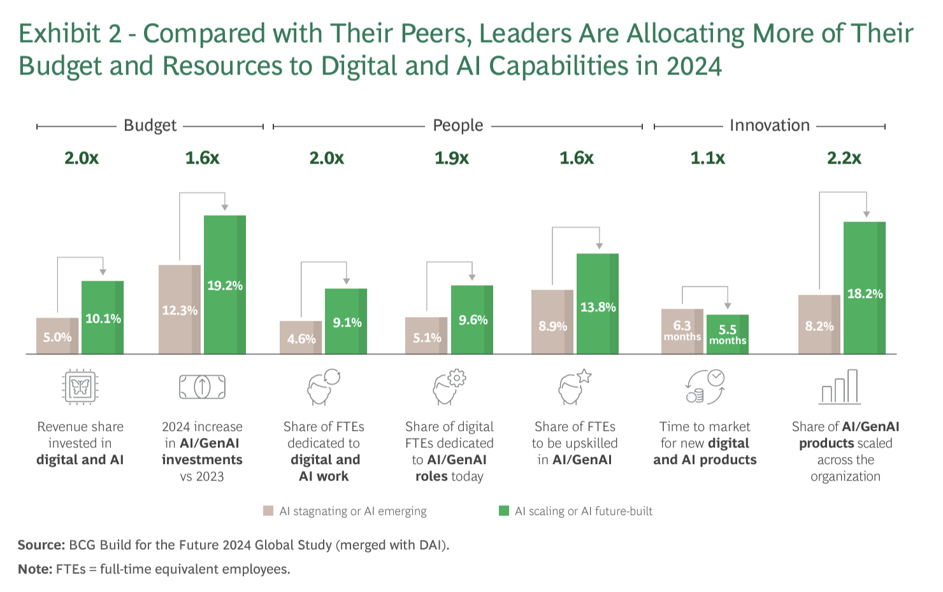
From Where’s the Value in AI?, published October 2024 by BCG.
AI IN THE ENTERPRISE. A SPECIAL DATA DECK FROM INNOLEAD. INNOLEAD.COM / INFO@INNOLEAD.COM

Slide 5
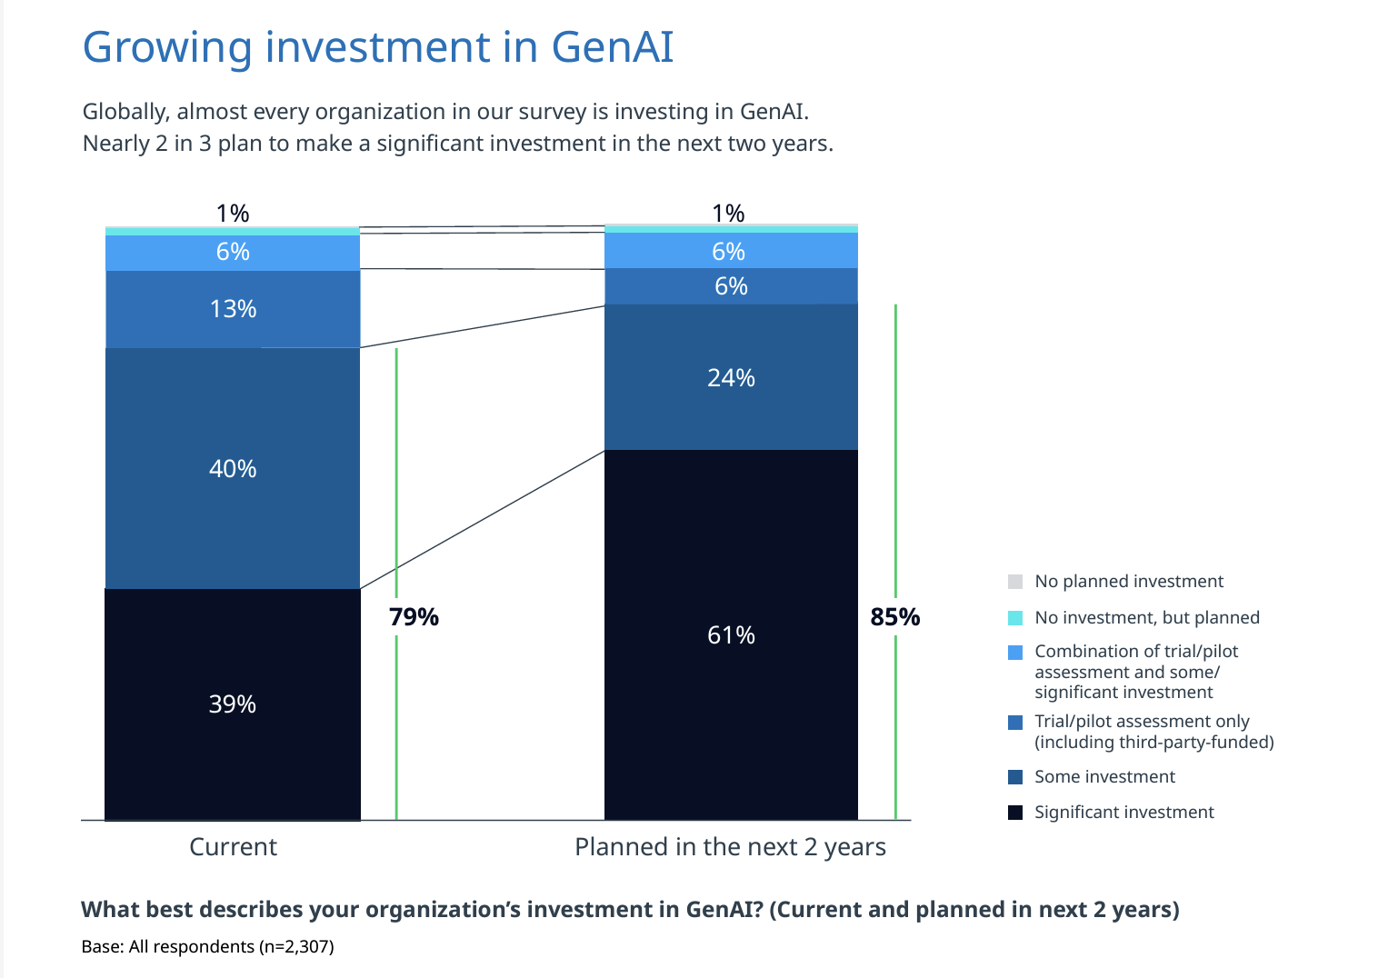
From The Global Gen AI Report, published November 2024 by NTT DATA.
AI IN THE ENTERPRISE. A SPECIAL DATA DECK FROM INNOLEAD. INNOLEAD.COM / INFO@INNOLEAD.COM

Slide 6
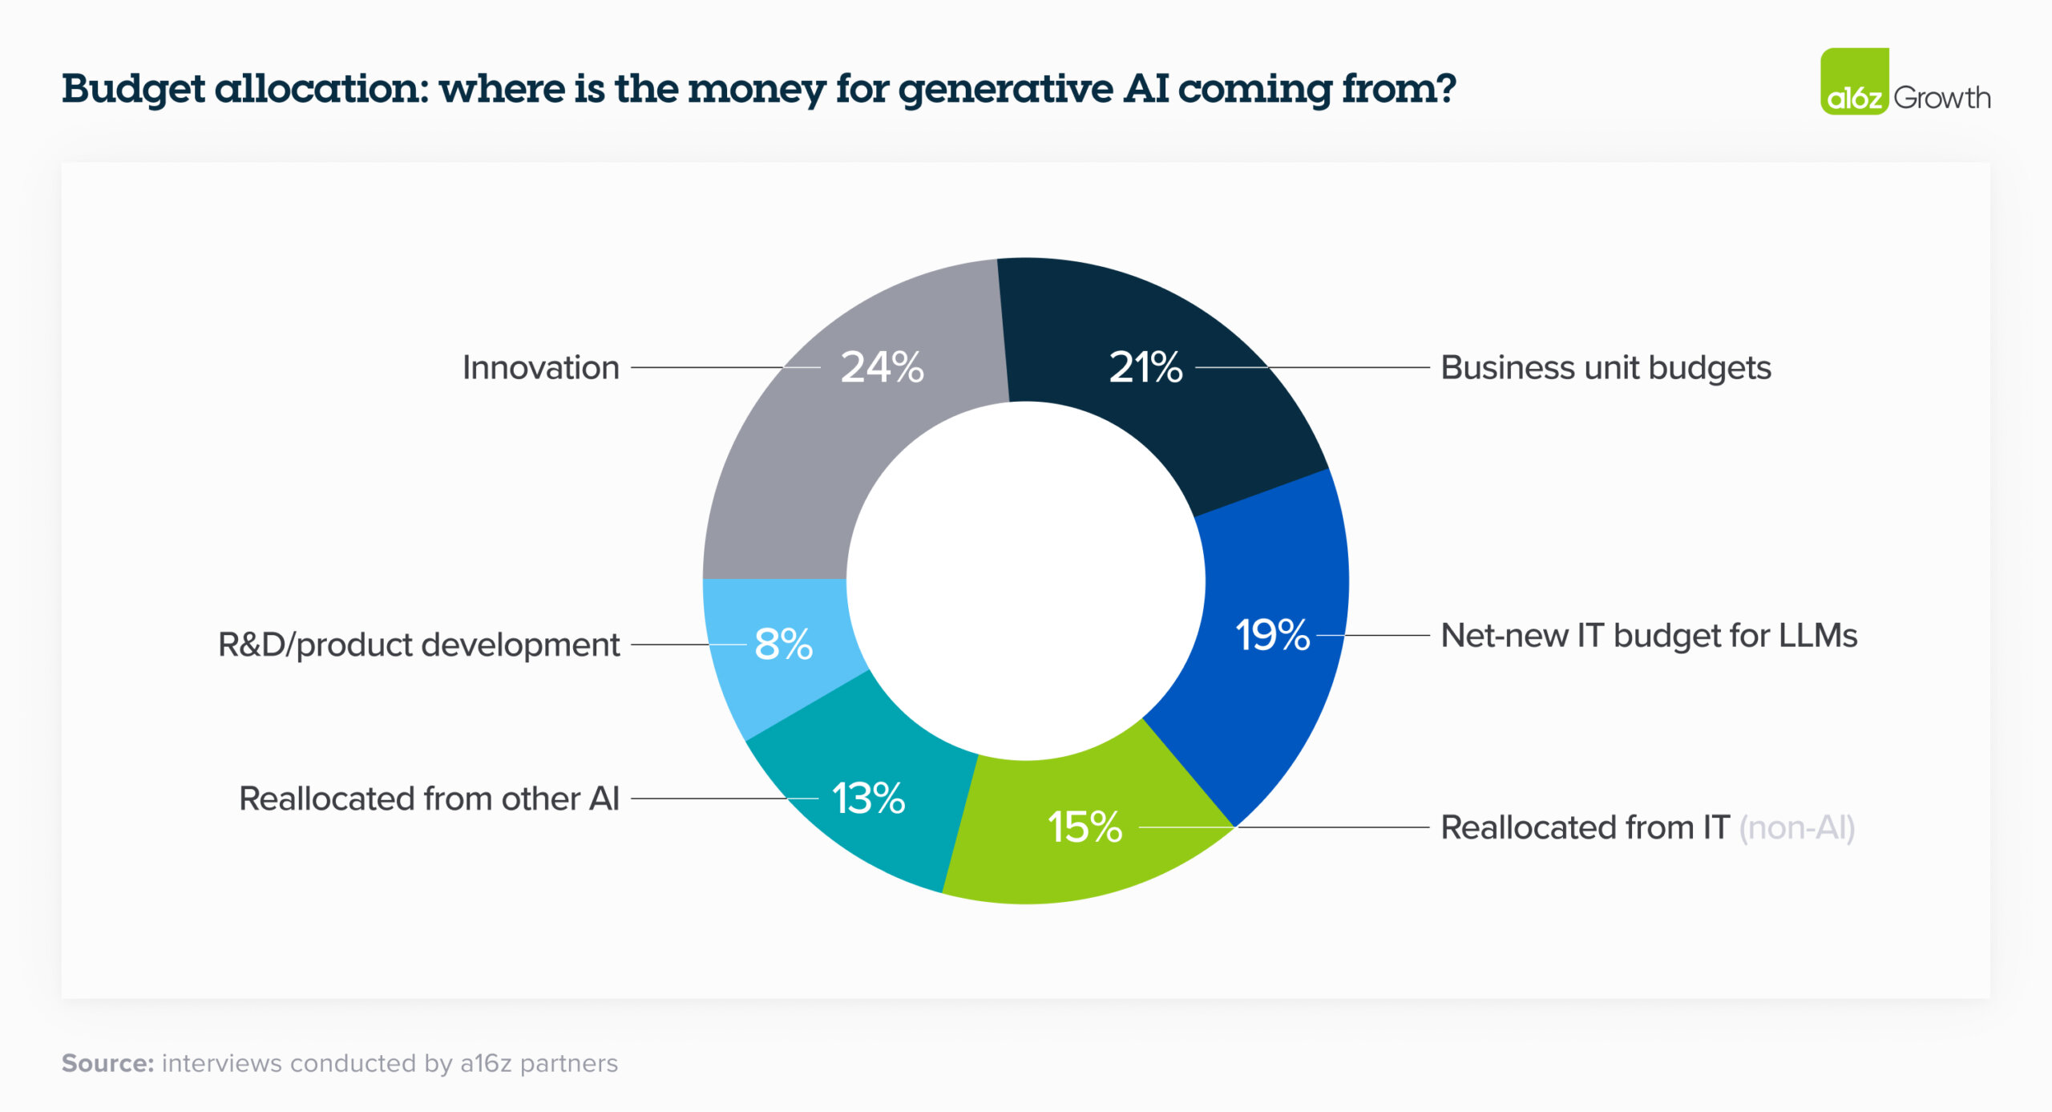
From 16 Changes to the Way Enterprises are Building and Buying Generative AI, published March 2024 by a16z.
AI IN THE ENTERPRISE. A SPECIAL DATA DECK FROM INNOLEAD. INNOLEAD.COM / INFO@INNOLEAD.COM

Slide 7
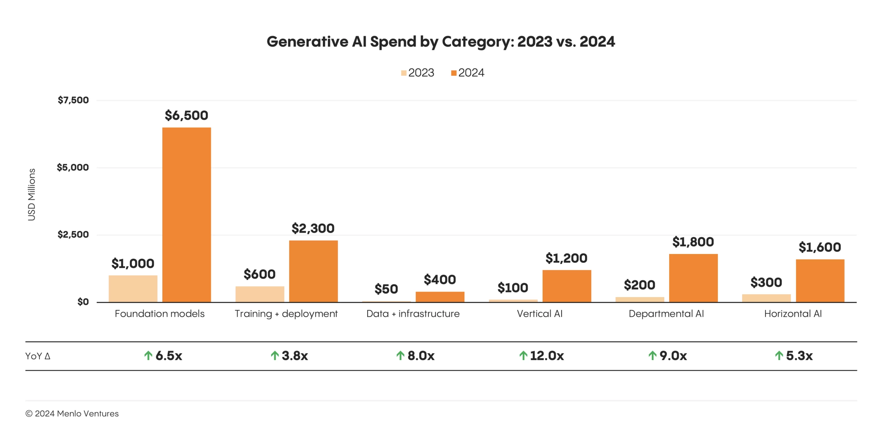
From The State of Generative AI in the Enterprise, published November 2024 by Menlo Ventures. “Today, 60% of enterprise generative AI investments come from innovation budgets, reflecting the early stages of generative AI adoption. However, with 40% of generative AI spending sourced from more permanent budgets—58% of which is redirected from existing allocations—businesses are demonstrating a growing commitment to AI transformation.”
AI IN THE ENTERPRISE. A SPECIAL DATA DECK FROM INNOLEAD. INNOLEAD.COM / INFO@INNOLEAD.COM

Slide 8
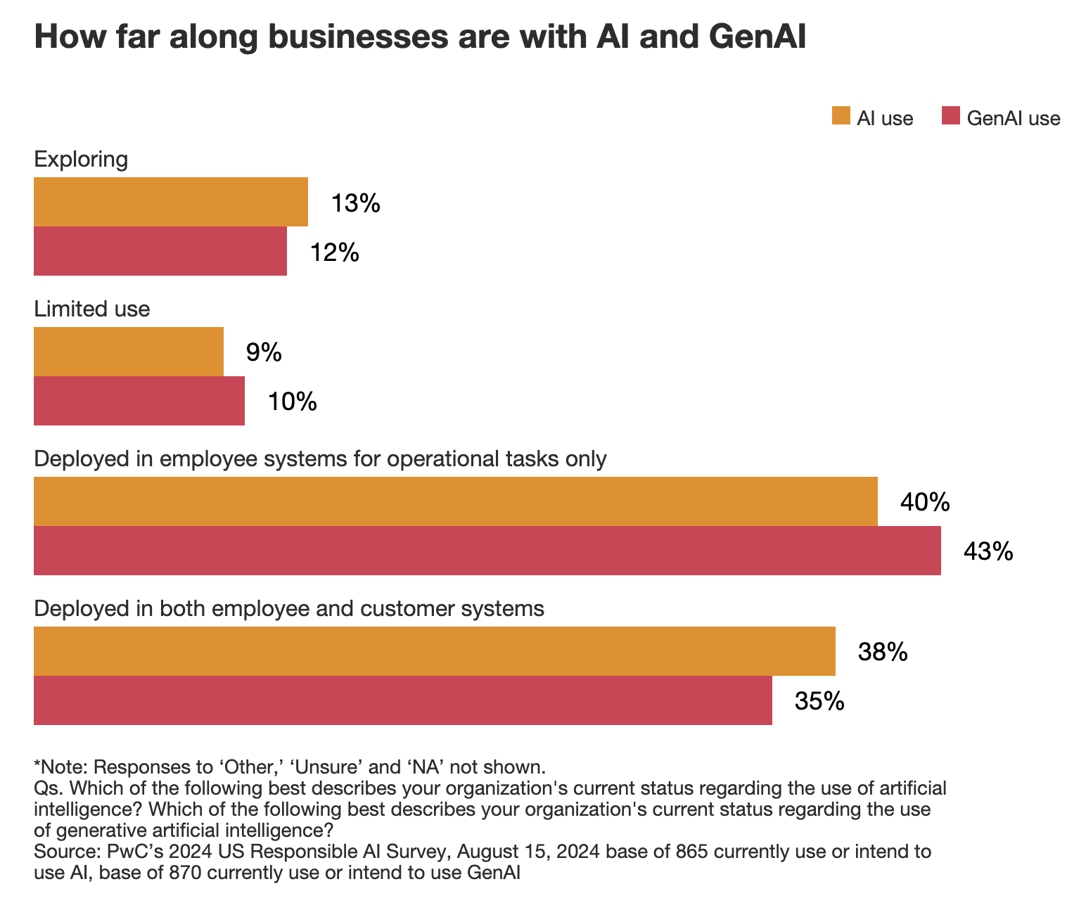
From Responsible AI Survey, published August 2024 by PwC.
AI IN THE ENTERPRISE. A SPECIAL DATA DECK FROM INNOLEAD. INNOLEAD.COM / INFO@INNOLEAD.COM

Slide 9
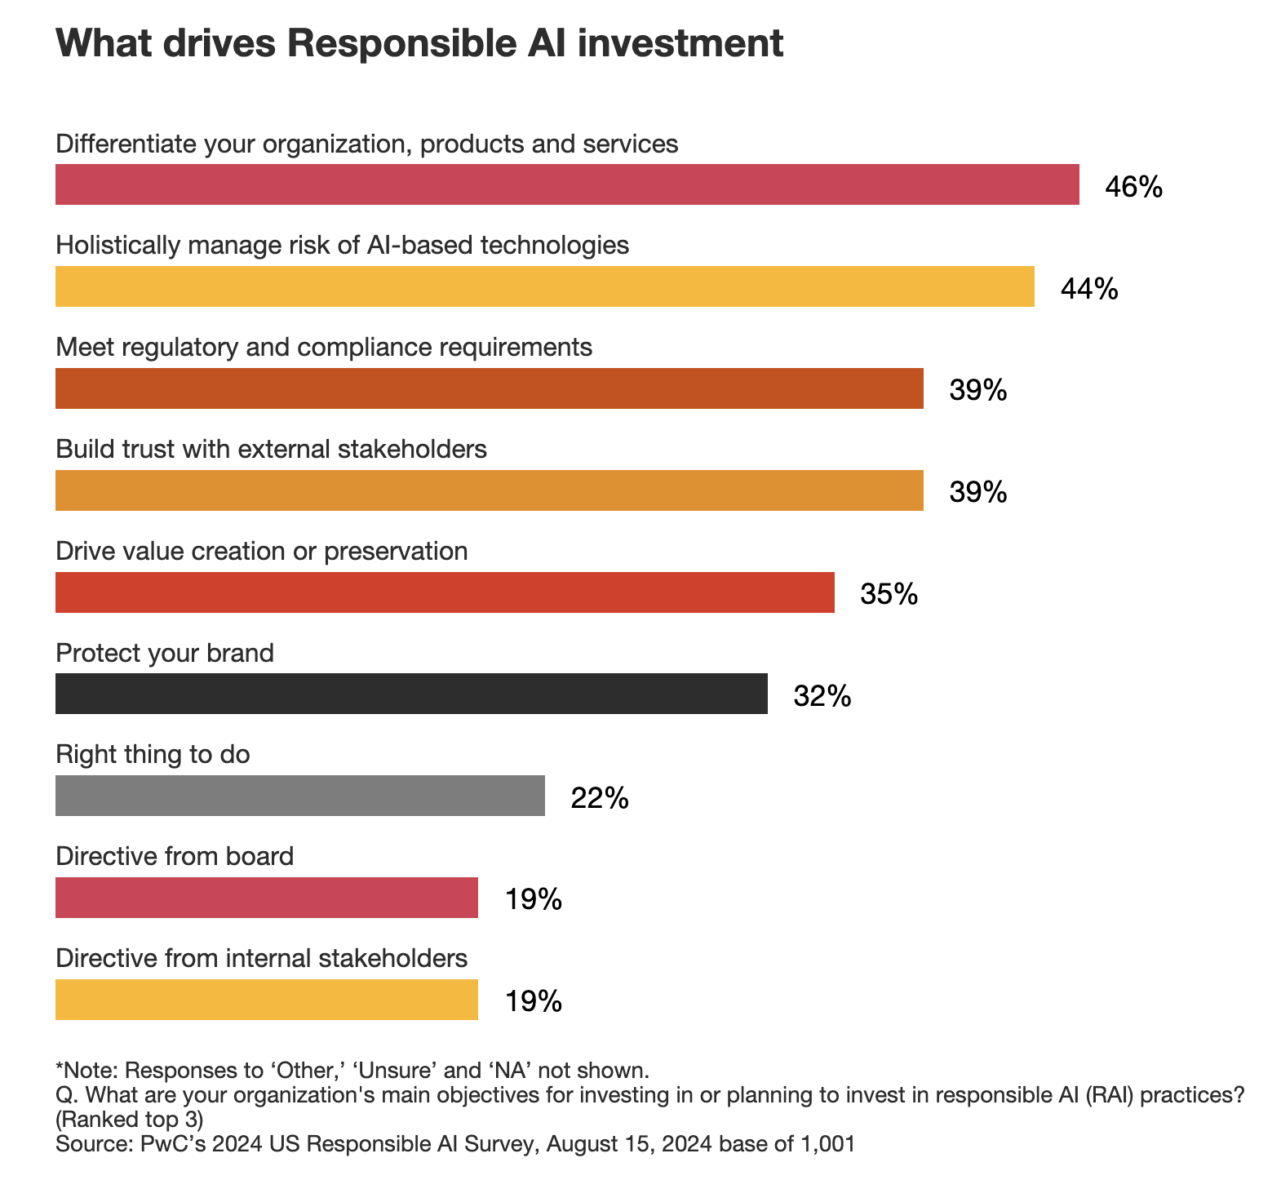
From Responsible AI Survey, published August 2024 by PwC.
AI IN THE ENTERPRISE. A SPECIAL DATA DECK FROM INNOLEAD. INNOLEAD.COM / INFO@INNOLEAD.COM

Slide 10
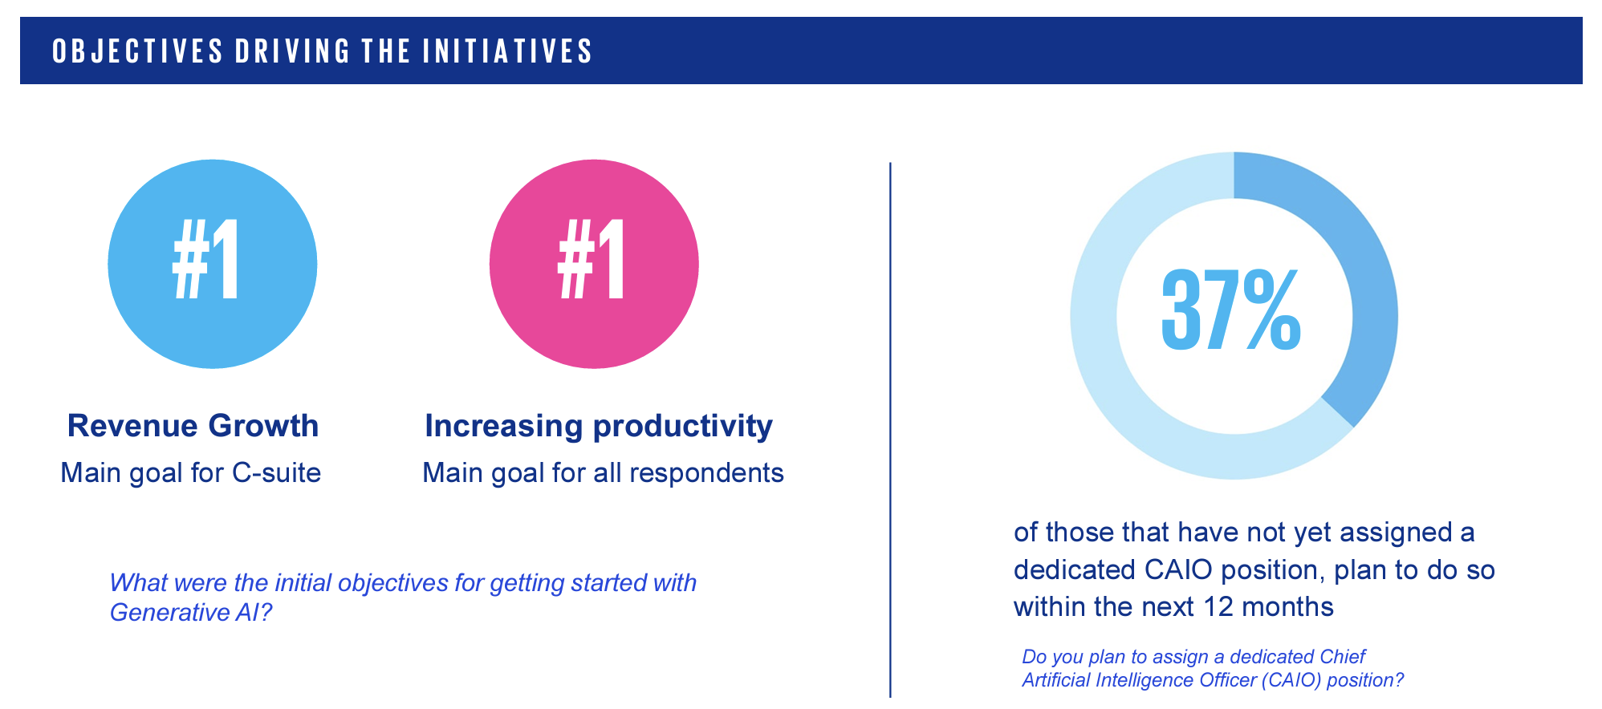
From GenAI Survey 2024, published August 2024 by KPMG.
AI IN THE ENTERPRISE. A SPECIAL DATA DECK FROM INNOLEAD. INNOLEAD.COM / INFO@INNOLEAD.COM

Slide 11
From GenAI Survey 2024, published August 2024 by KPMG.
AI IN THE ENTERPRISE. A SPECIAL DATA DECK FROM INNOLEAD. INNOLEAD.COM / INFO@INNOLEAD.COM

Slide 12
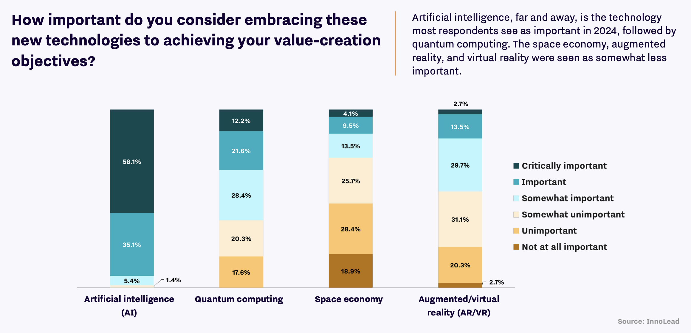
From Creating New Value in Large Organizations, published September 2024 by InnoLead and sponsored by KPMG.
AI IN THE ENTERPRISE. A SPECIAL DATA DECK FROM INNOLEAD. INNOLEAD.COM / INFO@INNOLEAD.COM

Slide 13
2. Use Cases and Value

Slide 14
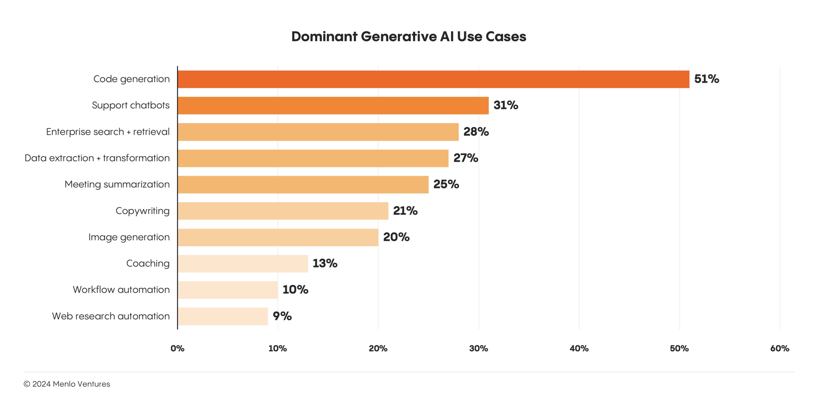
From The State of Generative AI in the Enterprise, published November 2024 by Menlo Ventures. “Our data shows that organizations are primarily investing in practical, ROI-driven use cases. The top five use cases (code generation, chatbots, enterprise search, data transformation, and meeting summarization) focus on enhancing productivity and efficiency.”
AI IN THE ENTERPRISE. A SPECIAL DATA DECK FROM INNOLEAD. INNOLEAD.COM / INFO@INNOLEAD.COM

Slide 15
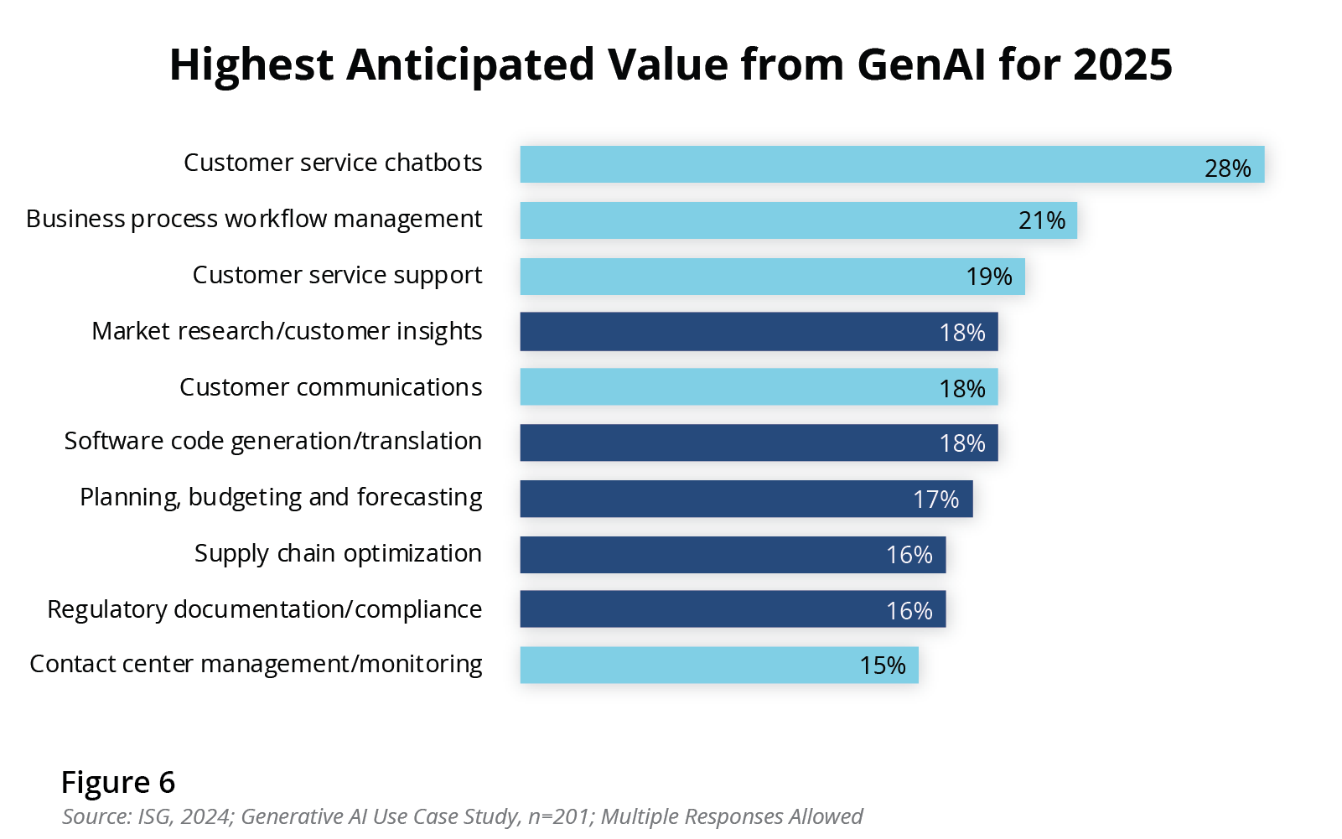
From Enterprise IT Priorities in 2025, published December 2024 by ISG. “Wave one use cases include human-in-the-loop processes like contact center and customer experience, in which GenAI provides input in real-time to drive faster resolutions and more accurate solutions… Wave two use cases will focus on augmenting expertise in areas like compliance, forecasting, market research and supply chain planning.”
AI IN THE ENTERPRISE. A SPECIAL DATA DECK FROM INNOLEAD. INNOLEAD.COM / INFO@INNOLEAD.COM

Slide 16
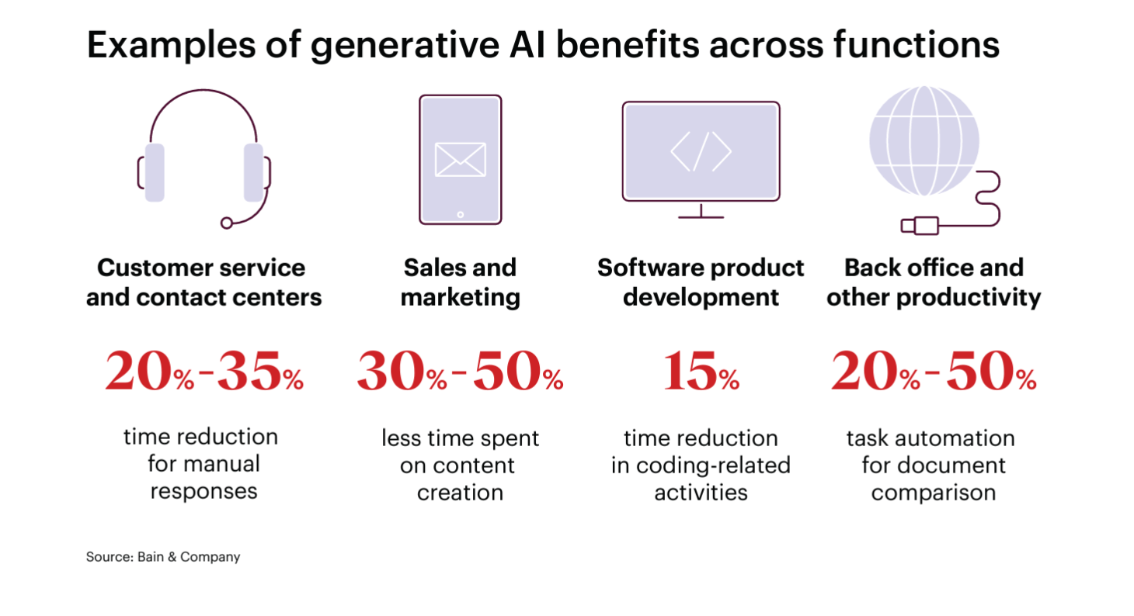
From Technology Report 2024, published September 2024 by Bain & Company.
AI IN THE ENTERPRISE. A SPECIAL DATA DECK FROM INNOLEAD. INNOLEAD.COM / INFO@INNOLEAD.COM

Slide 17
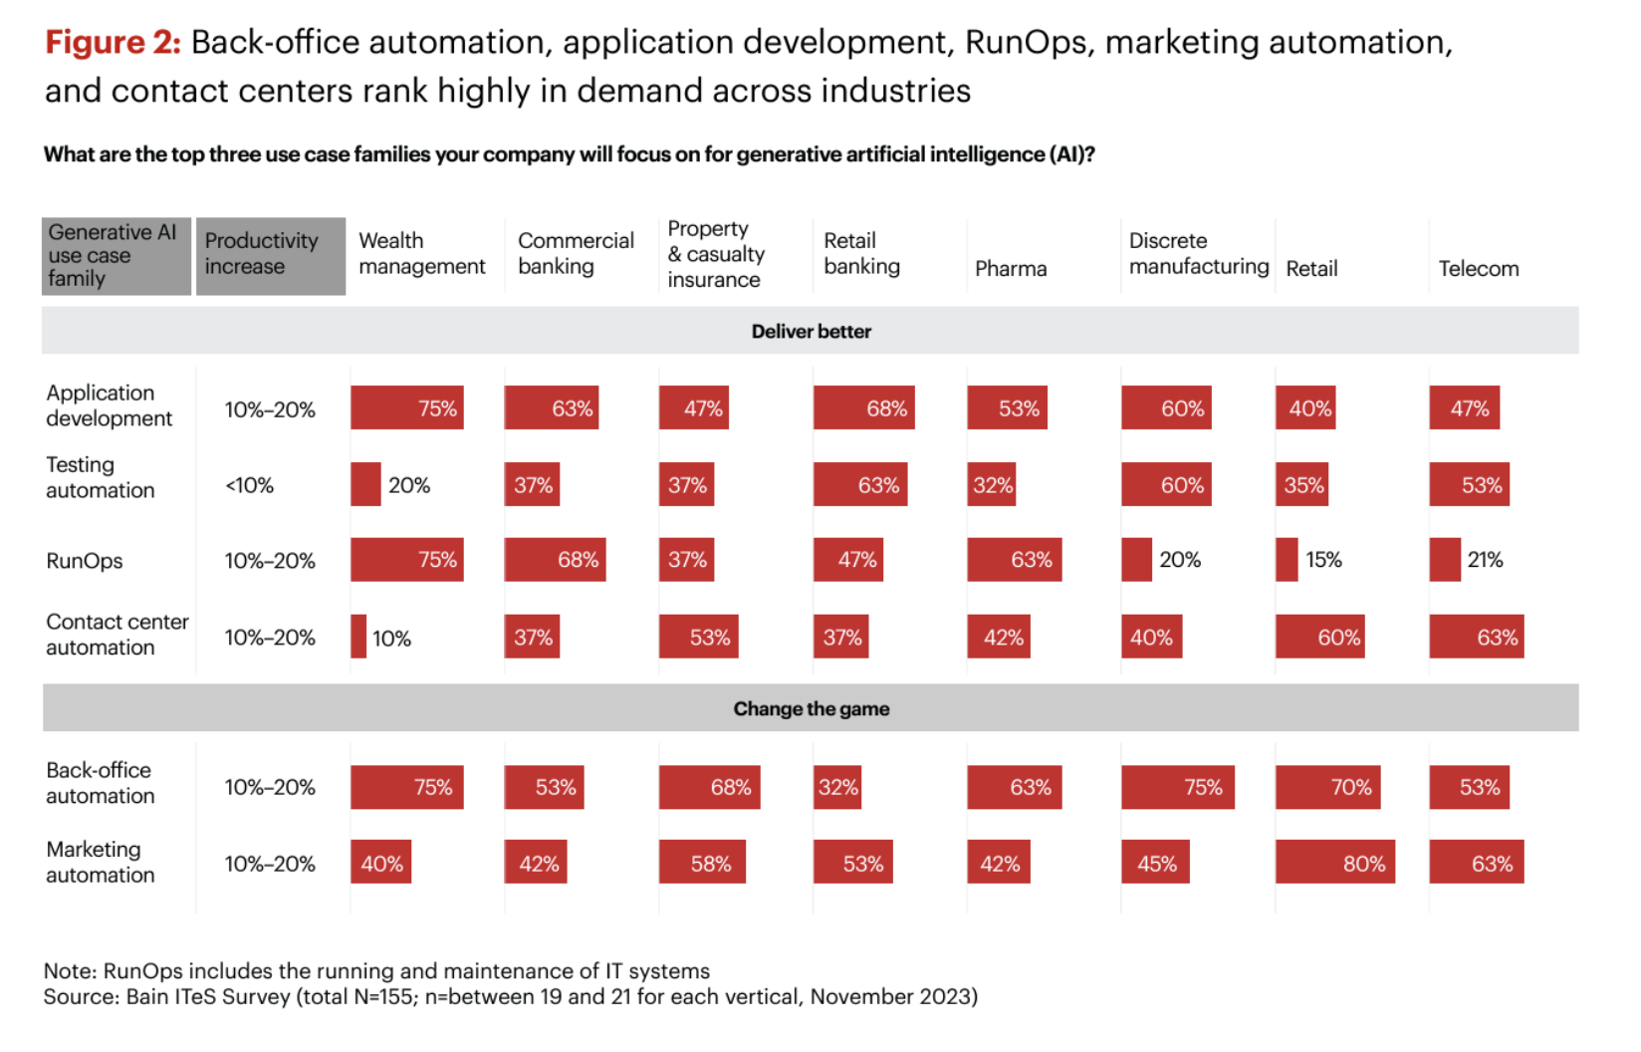
From Technology Report 2024, published September 2024 by Bain & Company.
AI IN THE ENTERPRISE. A SPECIAL DATA DECK FROM INNOLEAD. INNOLEAD.COM / INFO@INNOLEAD.COM

Slide 18
3. People, Training & Upskilling

Slide 19
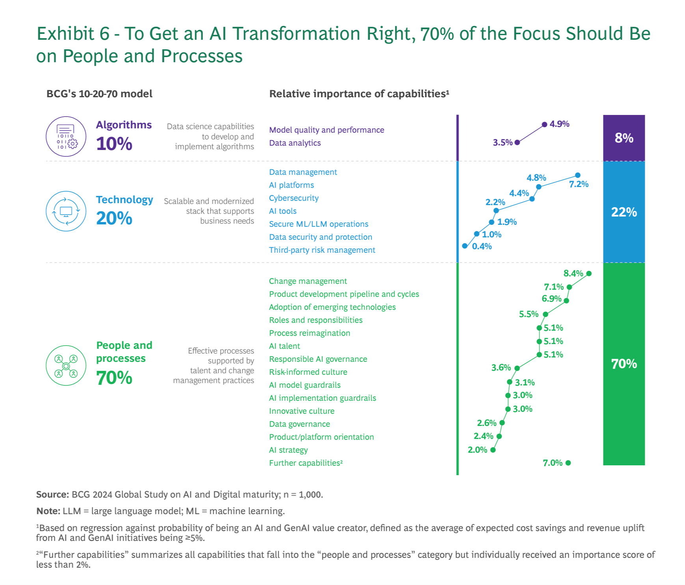
From Where’s the Value in AI?, published October 2024 by BCG. “Our experience, corroborated by our new research, indicates that about 70% of the challenges relate to people and process, about 20% are technology issues, and only 10% involve AI algorithms (which often occupy a lot more organizational time and resources).”
AI IN THE ENTERPRISE. A SPECIAL DATA DECK FROM INNOLEAD. INNOLEAD.COM / INFO@INNOLEAD.COM

Slide 20
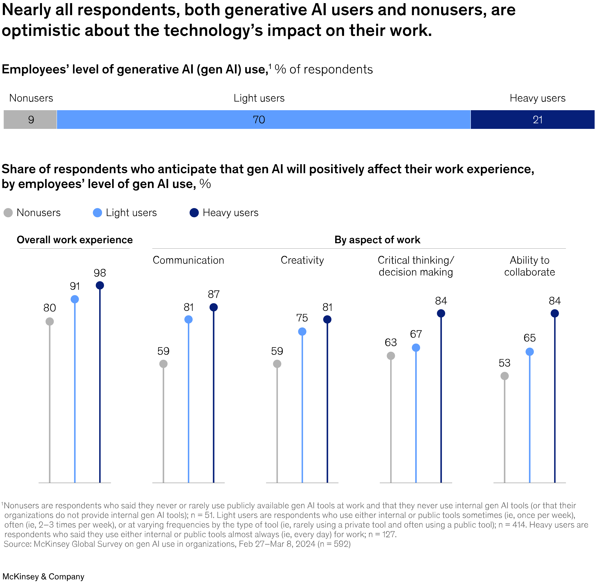
From GenAI’s Next Inflection Point, published August 2024 by McKinsey & Company. “…Most companies are lagging behind their employees. As high as employee usage is, organizational maturity with gen AI is strikingly low. In our survey, only 13 percent of respondents’ companies have implemented multiple use cases, a group we call ‘early adopters.’”
AI IN THE ENTERPRISE. A SPECIAL DATA DECK FROM INNOLEAD. INNOLEAD.COM / INFO@INNOLEAD.COM

Slide 21
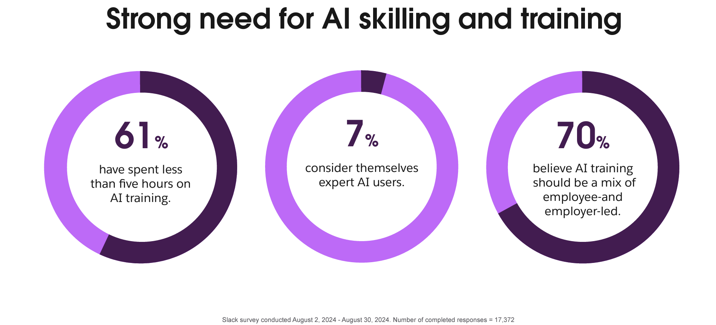
From The Fall 2024 Workforce Index, published November 2024 by Slack.
AI IN THE ENTERPRISE. A SPECIAL DATA DECK FROM INNOLEAD. INNOLEAD.COM / INFO@INNOLEAD.COM

Slide 22
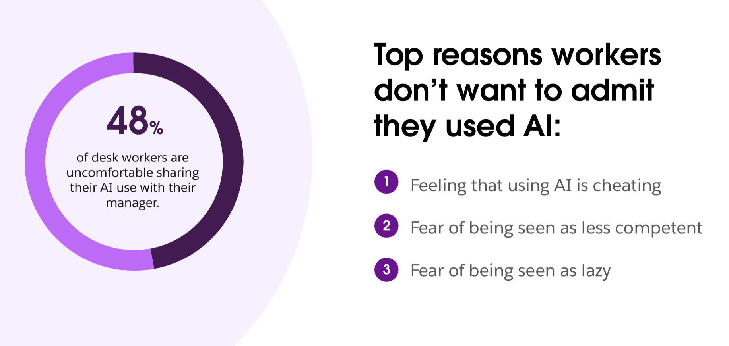
From The Fall 2024 Workforce Index, published November 2024 by Slack.
AI IN THE ENTERPRISE. A SPECIAL DATA DECK FROM INNOLEAD. INNOLEAD.COM / INFO@INNOLEAD.COM

Slide 23
4. Leader Perspectives

Slide 24
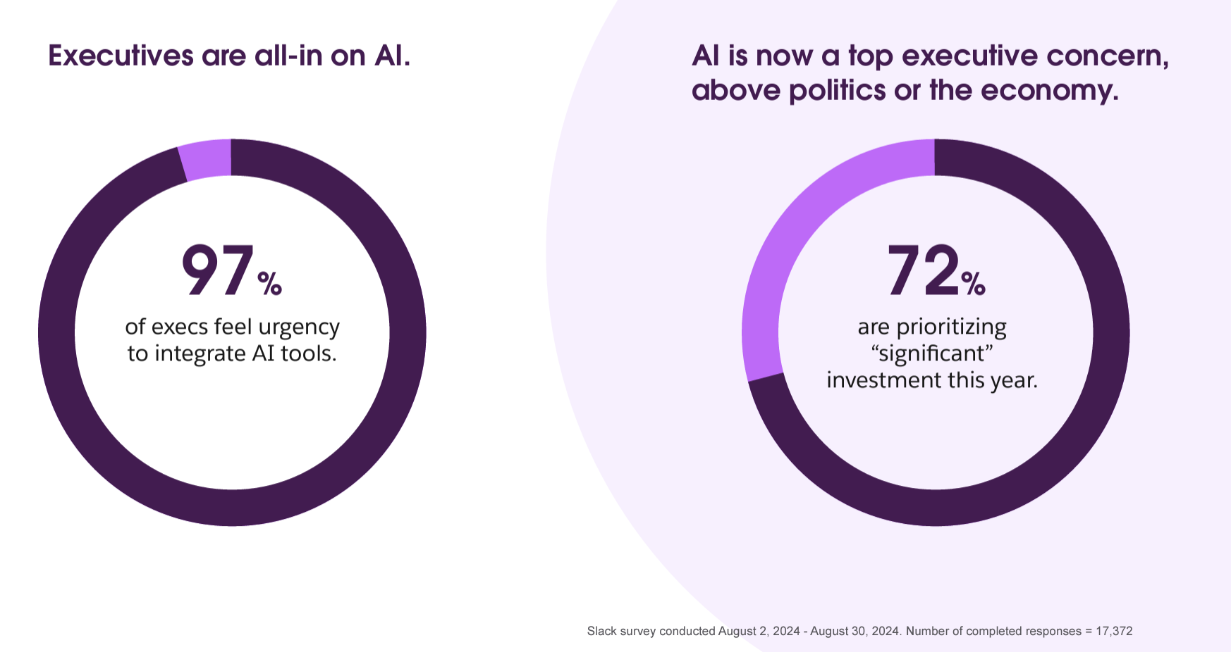
From The Fall 2024 Workforce Index, published November 2024 by Slack.
AI IN THE ENTERPRISE. A SPECIAL DATA DECK FROM INNOLEAD. INNOLEAD.COM / INFO@INNOLEAD.COM

Slide 25
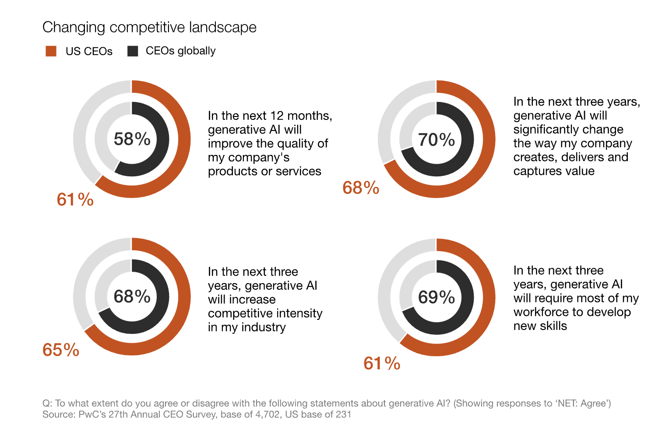
From Global CEO Survey, published January 2024 by PwC.
AI IN THE ENTERPRISE. A SPECIAL DATA DECK FROM INNOLEAD. INNOLEAD.COM / INFO@INNOLEAD.COM

Slide 26
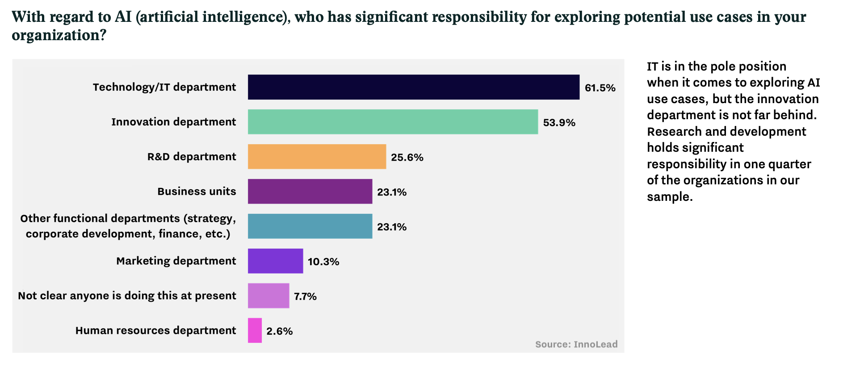
From How AI is Influencing Corporate Innovation Priorities in 2024, published February 2024 by InnoLead and sponsored by HYPE Innovation.
AI IN THE ENTERPRISE. A SPECIAL DATA DECK FROM INNOLEAD. INNOLEAD.COM / INFO@INNOLEAD.COM

Slide 27
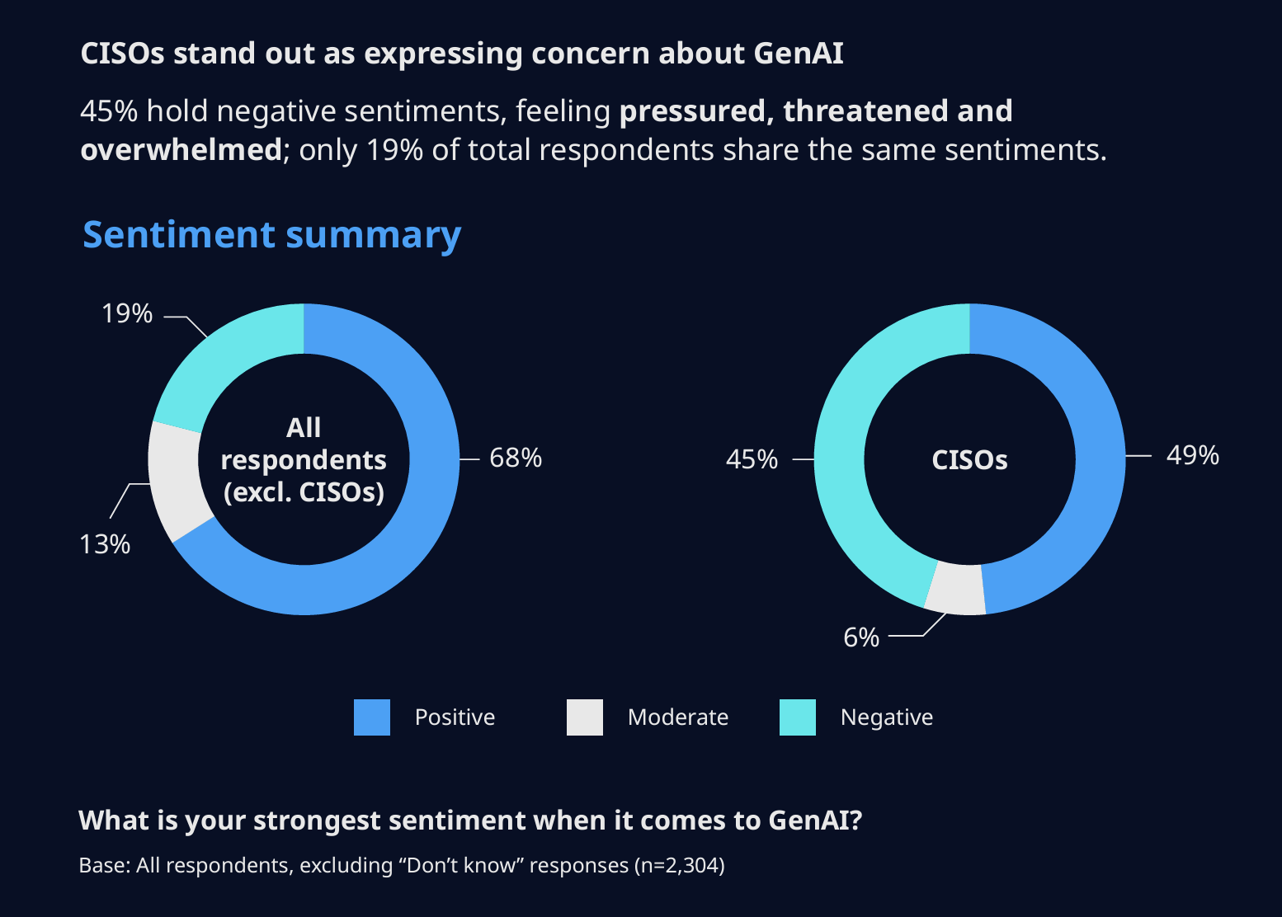
From The Global Gen AI Report, published November 2024 by NTT DATA.

Slide 28
5. Risk Mitigation & Metrics

Slide 29
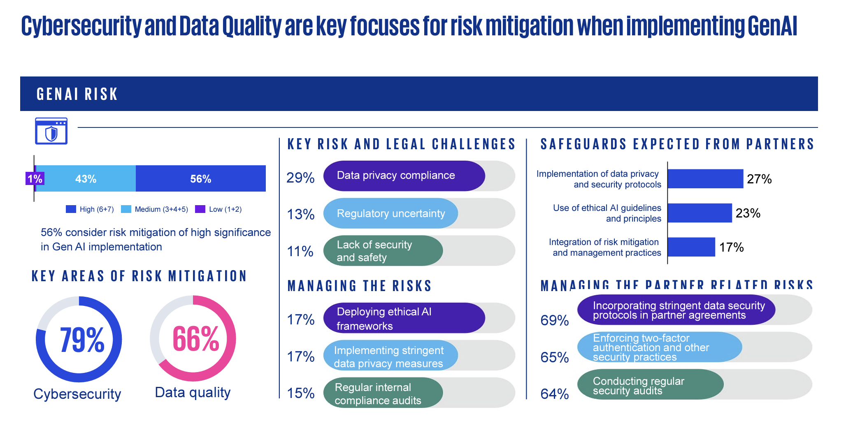
From GenAI Survey 2024, published August 2024 by KPMG.
AI IN THE ENTERPRISE. A SPECIAL DATA DECK FROM INNOLEAD. INNOLEAD.COM / INFO@INNOLEAD.COM

Slide 30
From The Global Gen AI Report, published November 2024 by NTT DATA.
AI IN THE ENTERPRISE. A SPECIAL DATA DECK FROM INNOLEAD. INNOLEAD.COM / INFO@INNOLEAD.COM

Slide 31
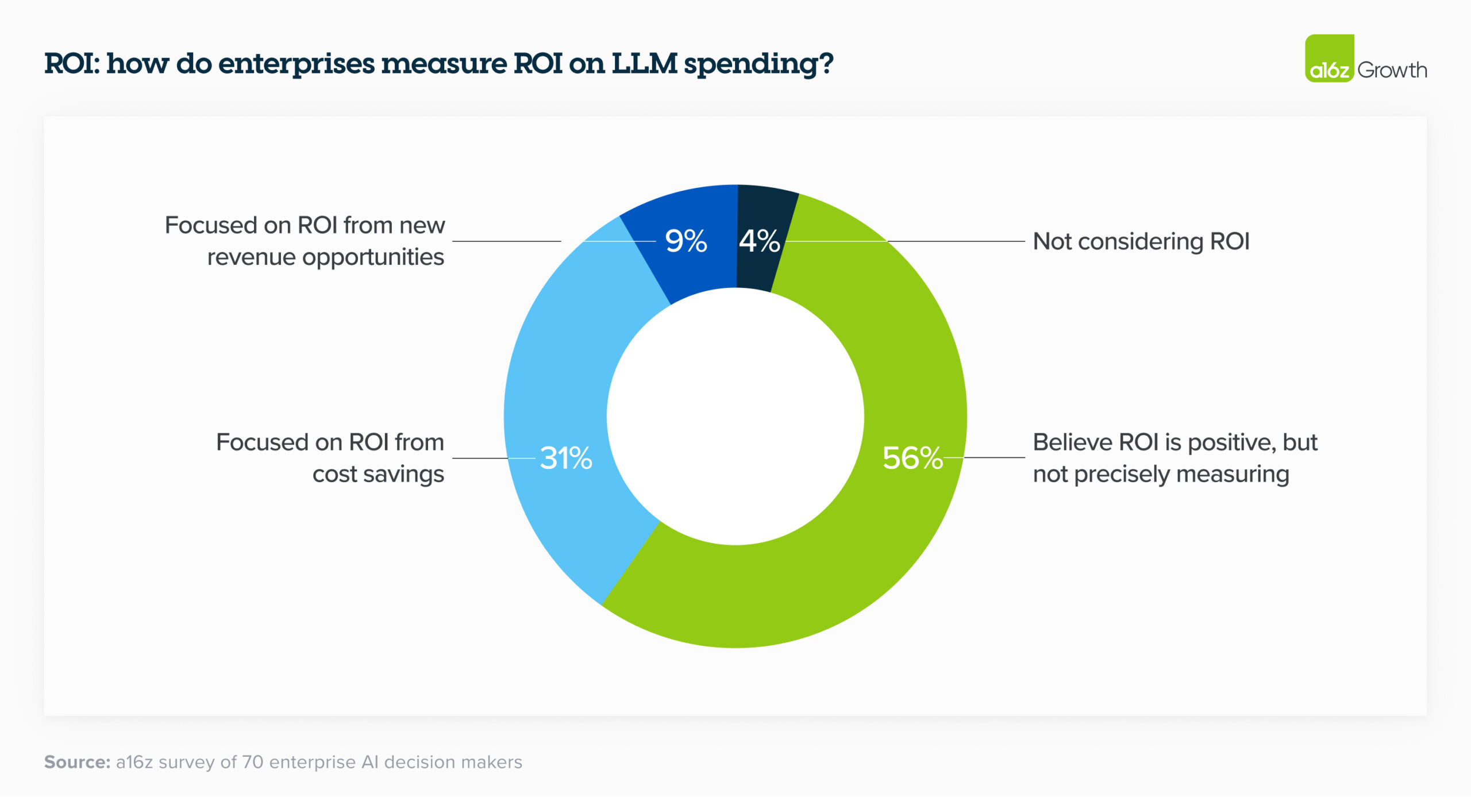
From 16 Changes to the Way Enterprises are Building and Buying Generative AI, published March 2024 by a16z.
AI IN THE ENTERPRISE. A SPECIAL DATA DECK FROM INNOLEAD. INNOLEAD.COM / INFO@INNOLEAD.COM

Slide 32
6. Root Causes of Failure, Data Capabilities & More

Slide 33
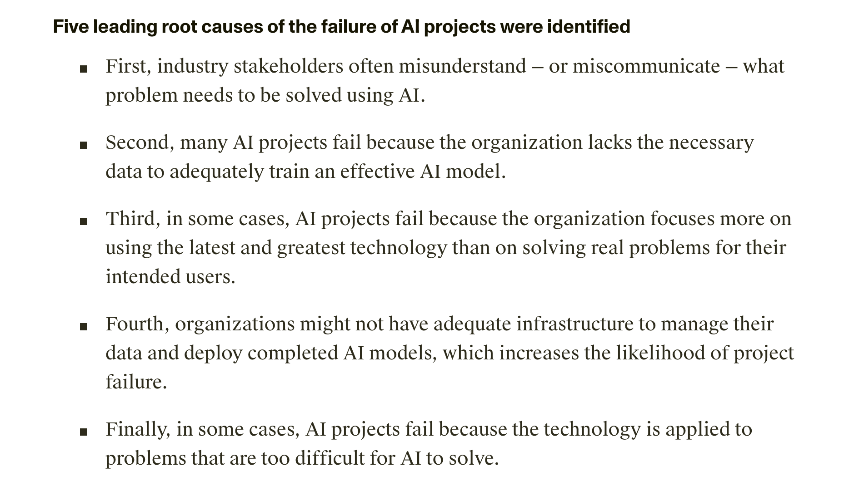
From The Root Causes of Failure for Artificial Intelligence Projects and How They Can Succeed, published August 2024 by RAND.
AI IN THE ENTERPRISE. A SPECIAL DATA DECK FROM INNOLEAD. INNOLEAD.COM / INFO@INNOLEAD.COM

Slide 34
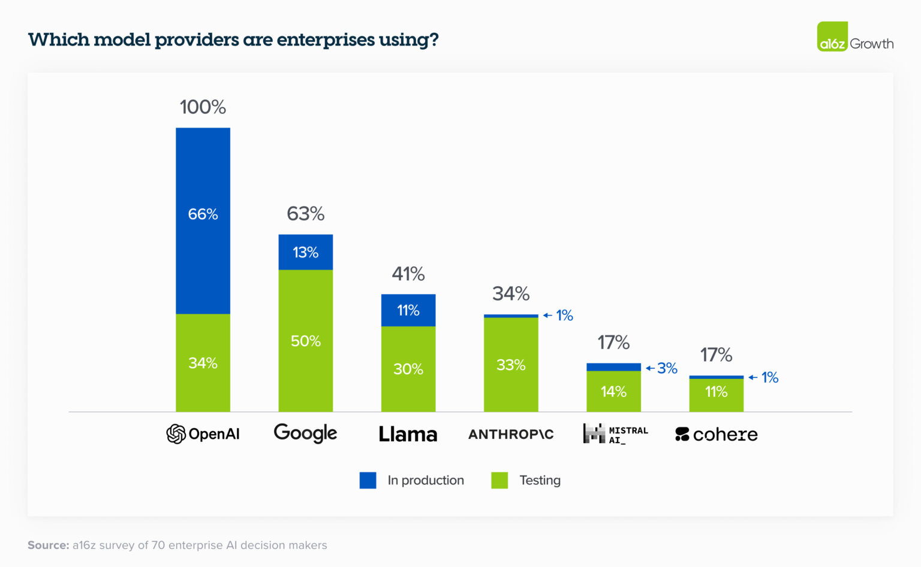
From 16 Changes to the Way Enterprises are Building and Buying Generative AI, published March 2024 by a16z.
AI IN THE ENTERPRISE. A SPECIAL DATA DECK FROM INNOLEAD. INNOLEAD.COM / INFO@INNOLEAD.COM

Slide 35
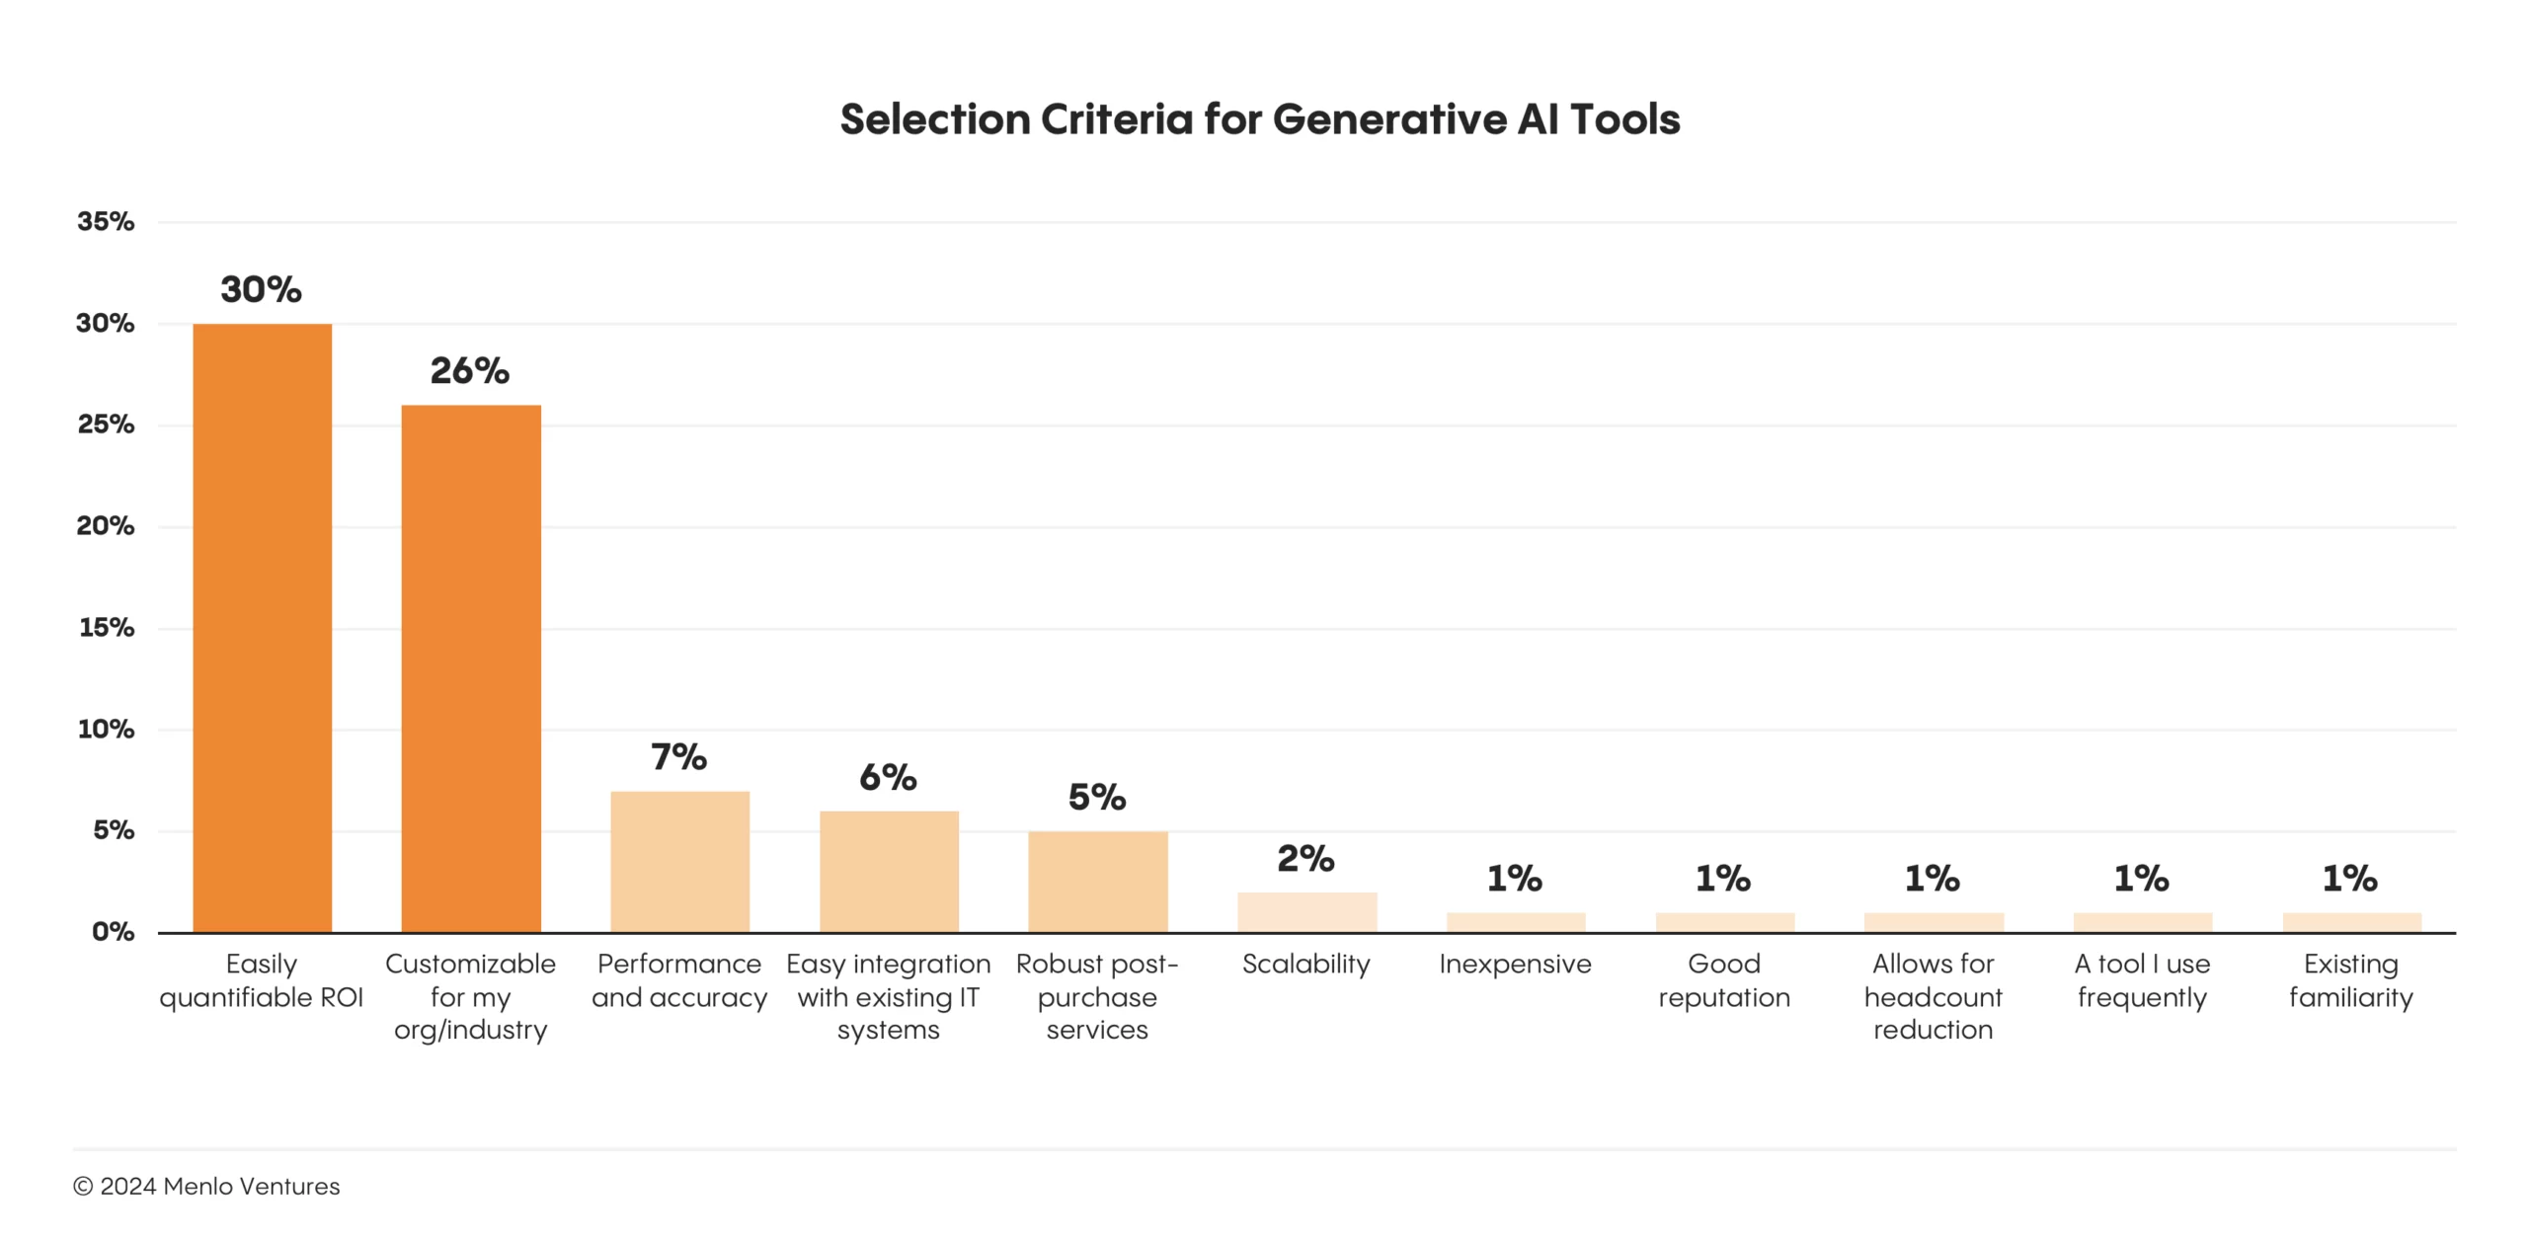
From The State of Generative AI in the Enterprise, published November 2024 by Menlo Ventures. “When selecting generative AI applications, enterprises have clear priorities: Return on investment and industry-specific customization matter most when selecting new tools. Surprisingly, price isn’t a major issue; just 1% of the enterprise leaders we surveyed mentioned price as a selection concern.”
AI IN THE ENTERPRISE. A SPECIAL DATA DECK FROM INNOLEAD. INNOLEAD.COM / INFO@INNOLEAD.COM

Slide 36
From Enterprise IT Priorities in 2025, published December 2024 by ISG. MSP = Managed Service Provider. “Most enterprises lack the internal capability to execute on their AI initiatives. This is leading to a search – often global in nature – to find that expertise… In 2025, enterprises will keep looking for AI expertise from their providers while also trying to build or strengthen their own expertise.”
AI IN THE ENTERPRISE. A SPECIAL DATA DECK FROM INNOLEAD. INNOLEAD.COM / INFO@INNOLEAD.COM

Slide 37
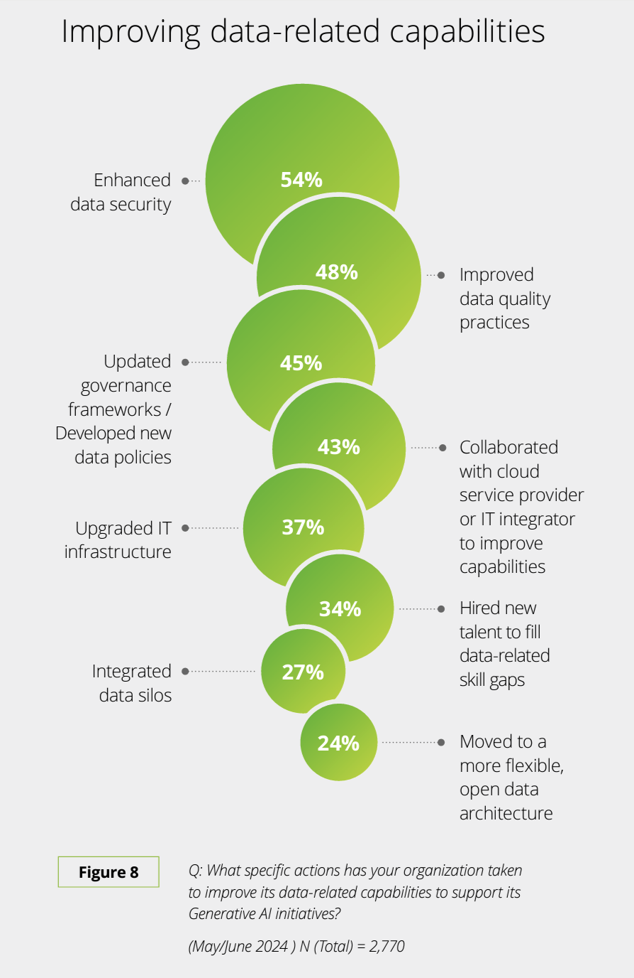
From State of Generative AI in the Enterprise Q3, published August 2024 by Deloitte.
“Data-related issues could be hindering organizations in their quests for getting the levels of value that they are seeking. Data-related issues have caused 55% of the organizations we surveyed to avoid certain Generative AI use cases."
AI IN THE ENTERPRISE. A SPECIAL DATA DECK FROM INNOLEAD. INNOLEAD.COM / INFO@INNOLEAD.COM

Slide 38
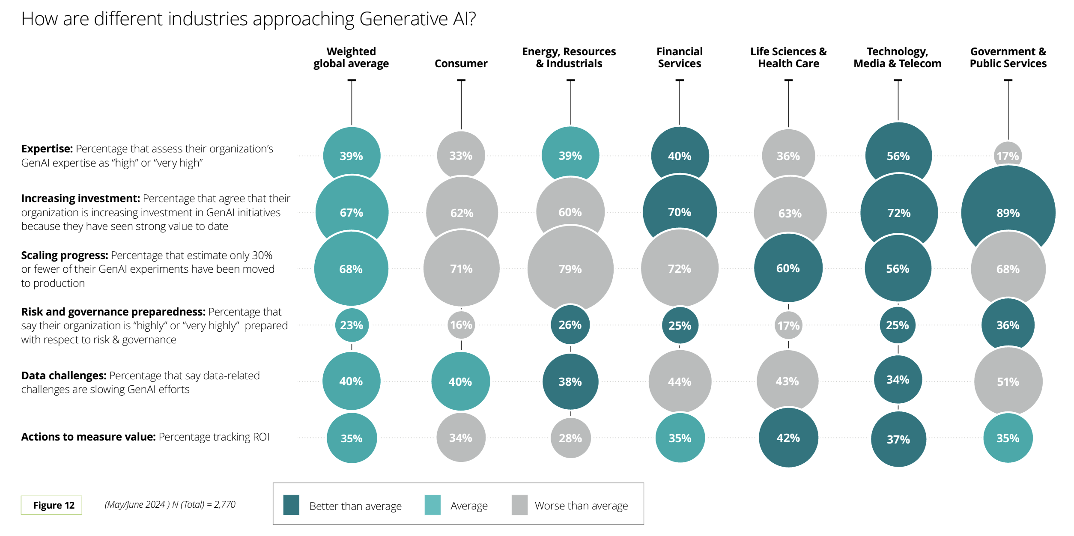
From State of Generative AI in the Enterprise Q3, published August 2024 by Deloitte.
AI IN THE ENTERPRISE. A SPECIAL DATA DECK FROM INNOLEAD. INNOLEAD.COM / INFO@INNOLEAD.COM

Slide 39
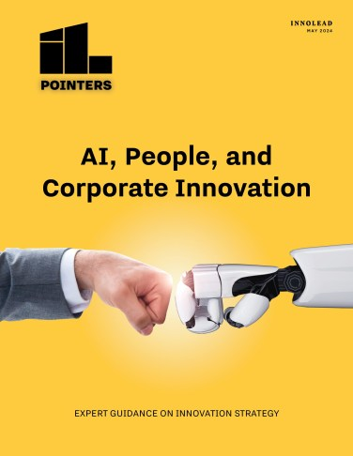
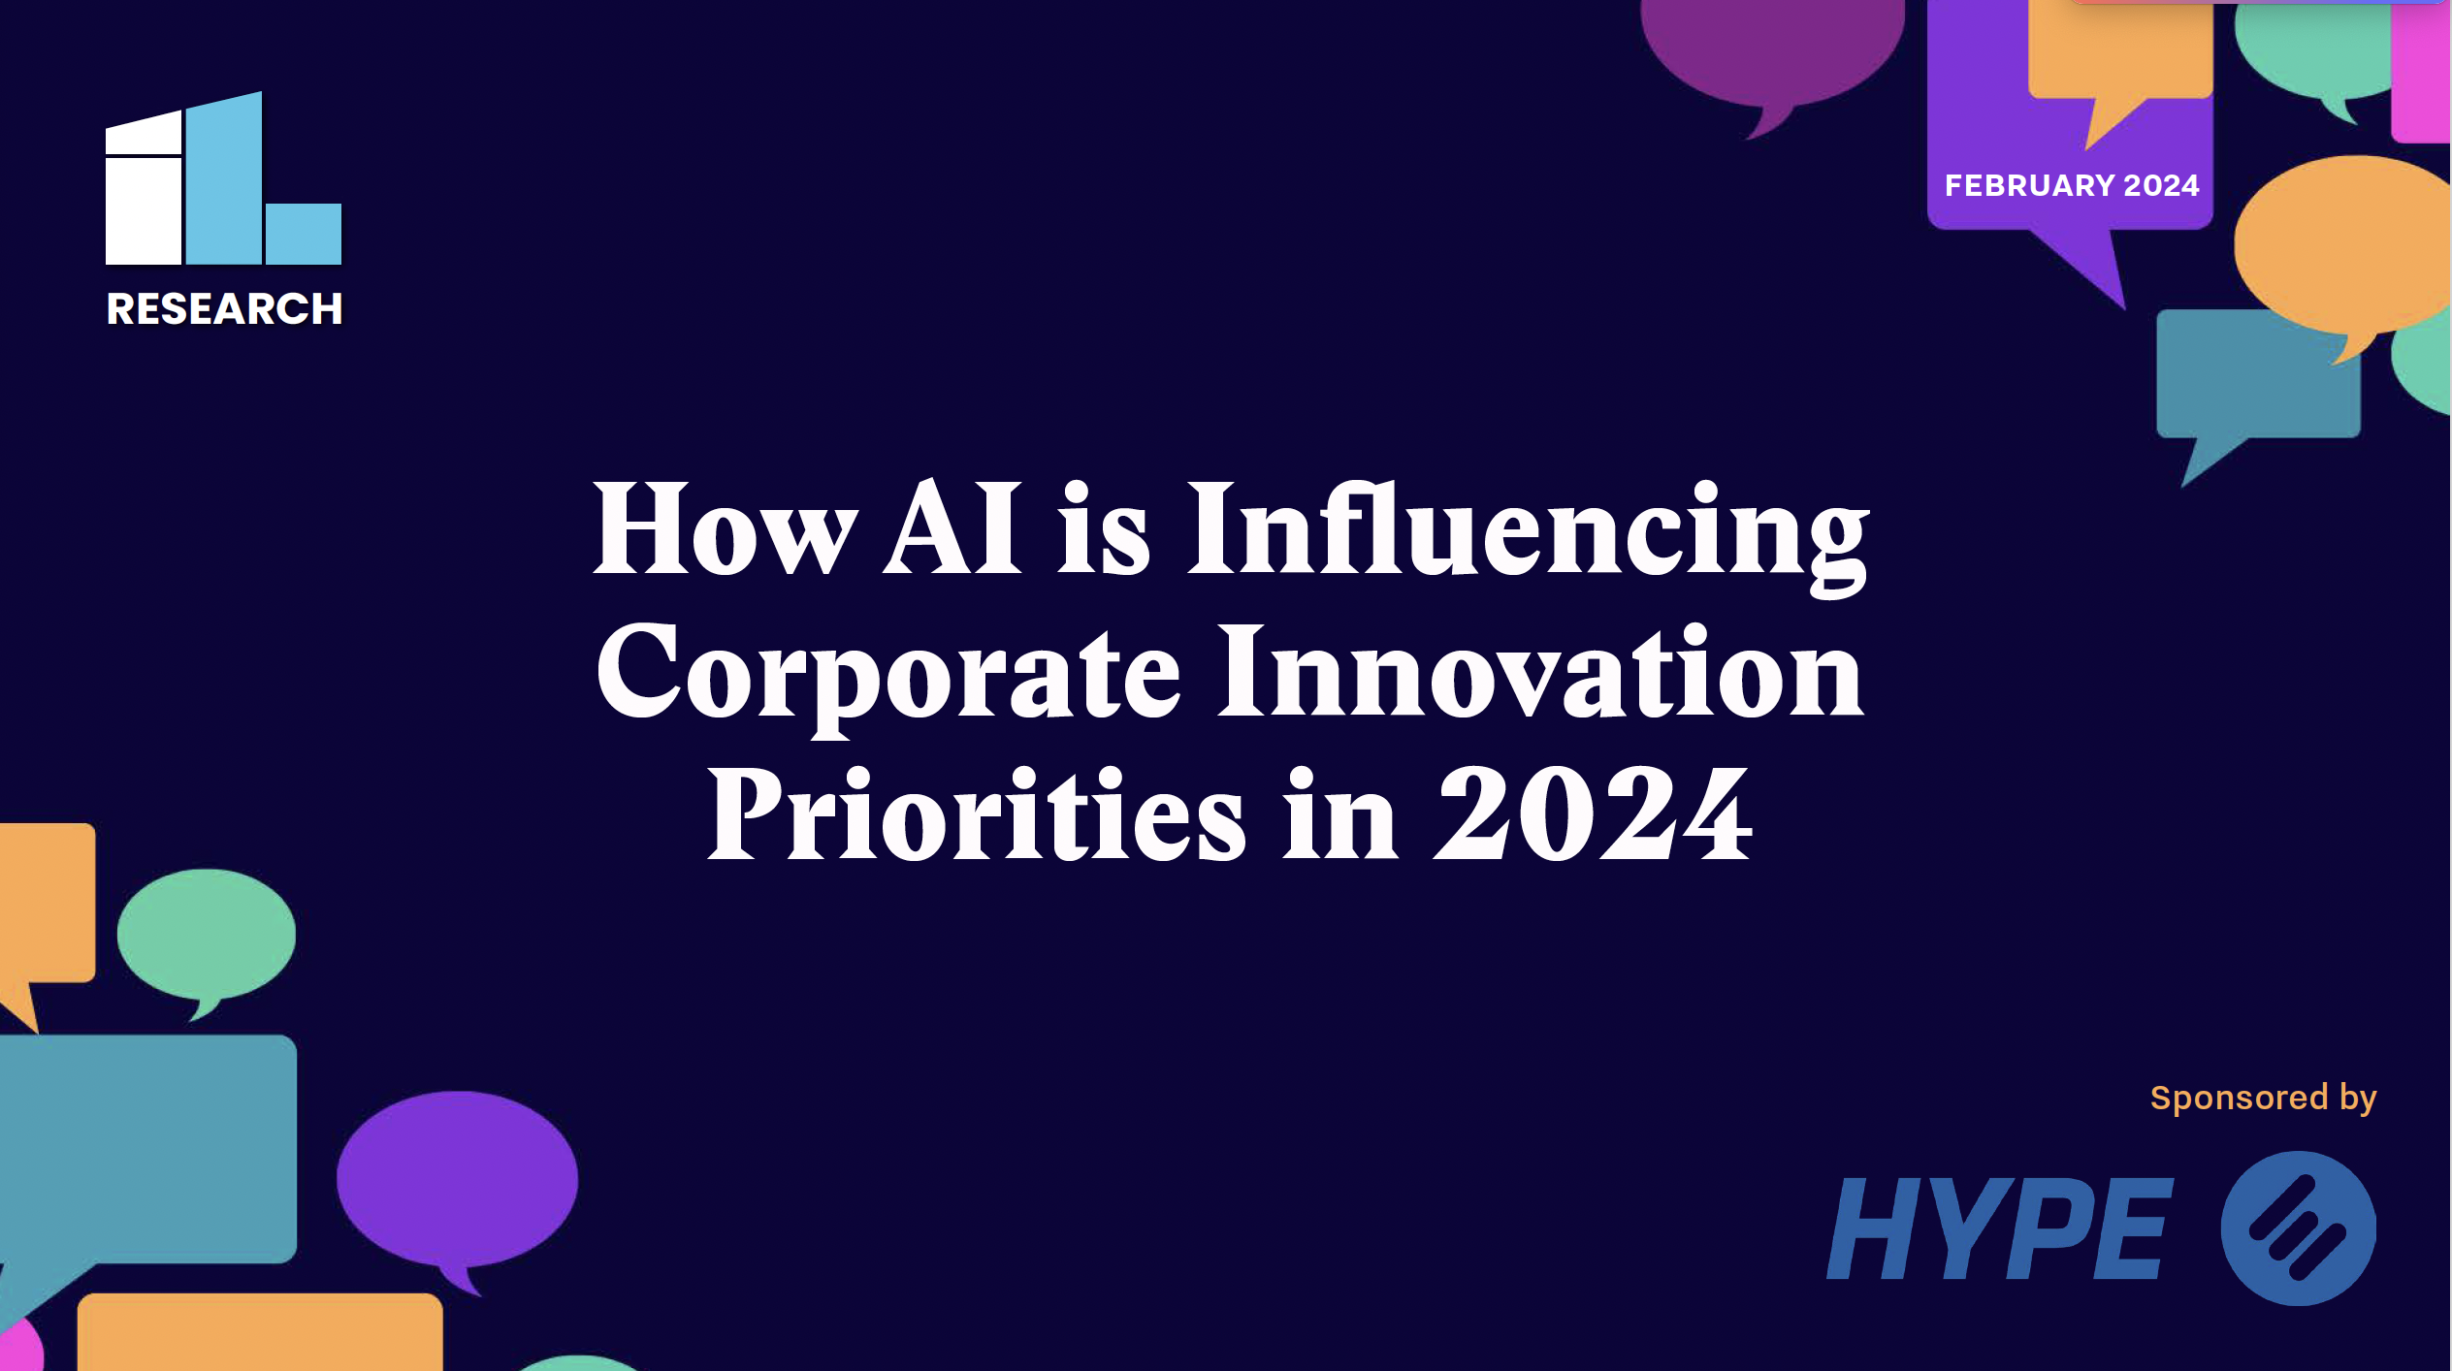
About InnoLead
We’ve built the largest community of corporate innovators, strategy execs, and emerging technology leaders — and we work hard to help them achieve real impact in their organizations. We also distribute and highlight thought leadership from the world’s top advisory firms and software providers.
Website: innolead.com
Membership: info@innolead.com
Email newsletter
Impact conference — Oct 20-22, 2025
@innolead on X, LinkedIn, and Instagram

