Slide 1
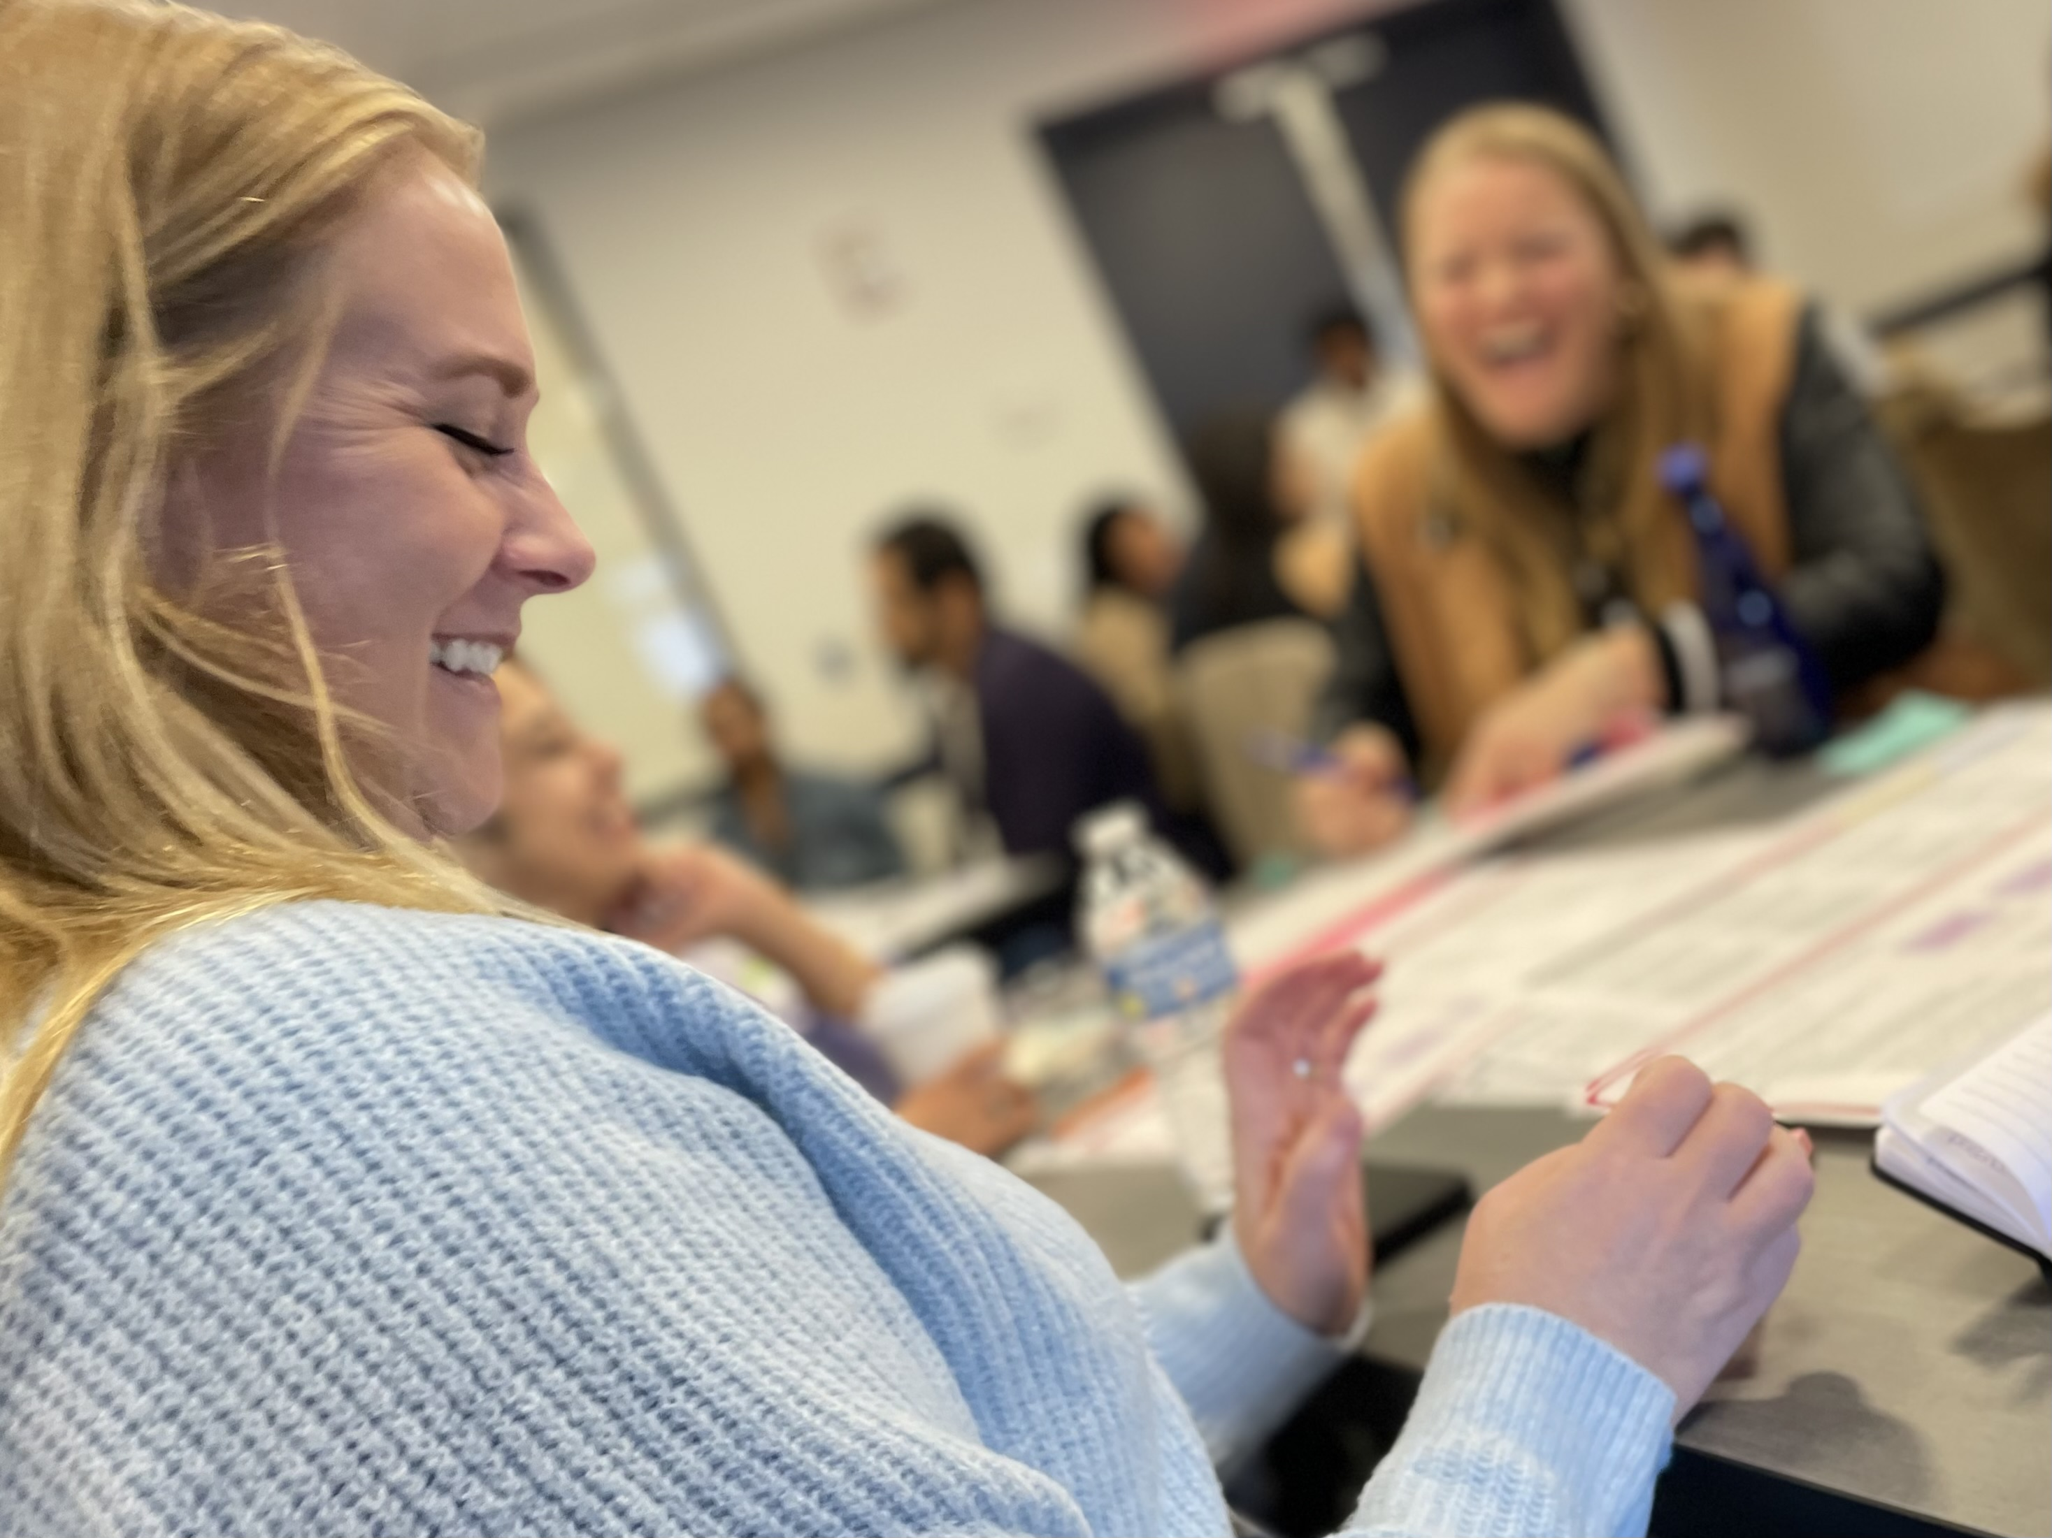
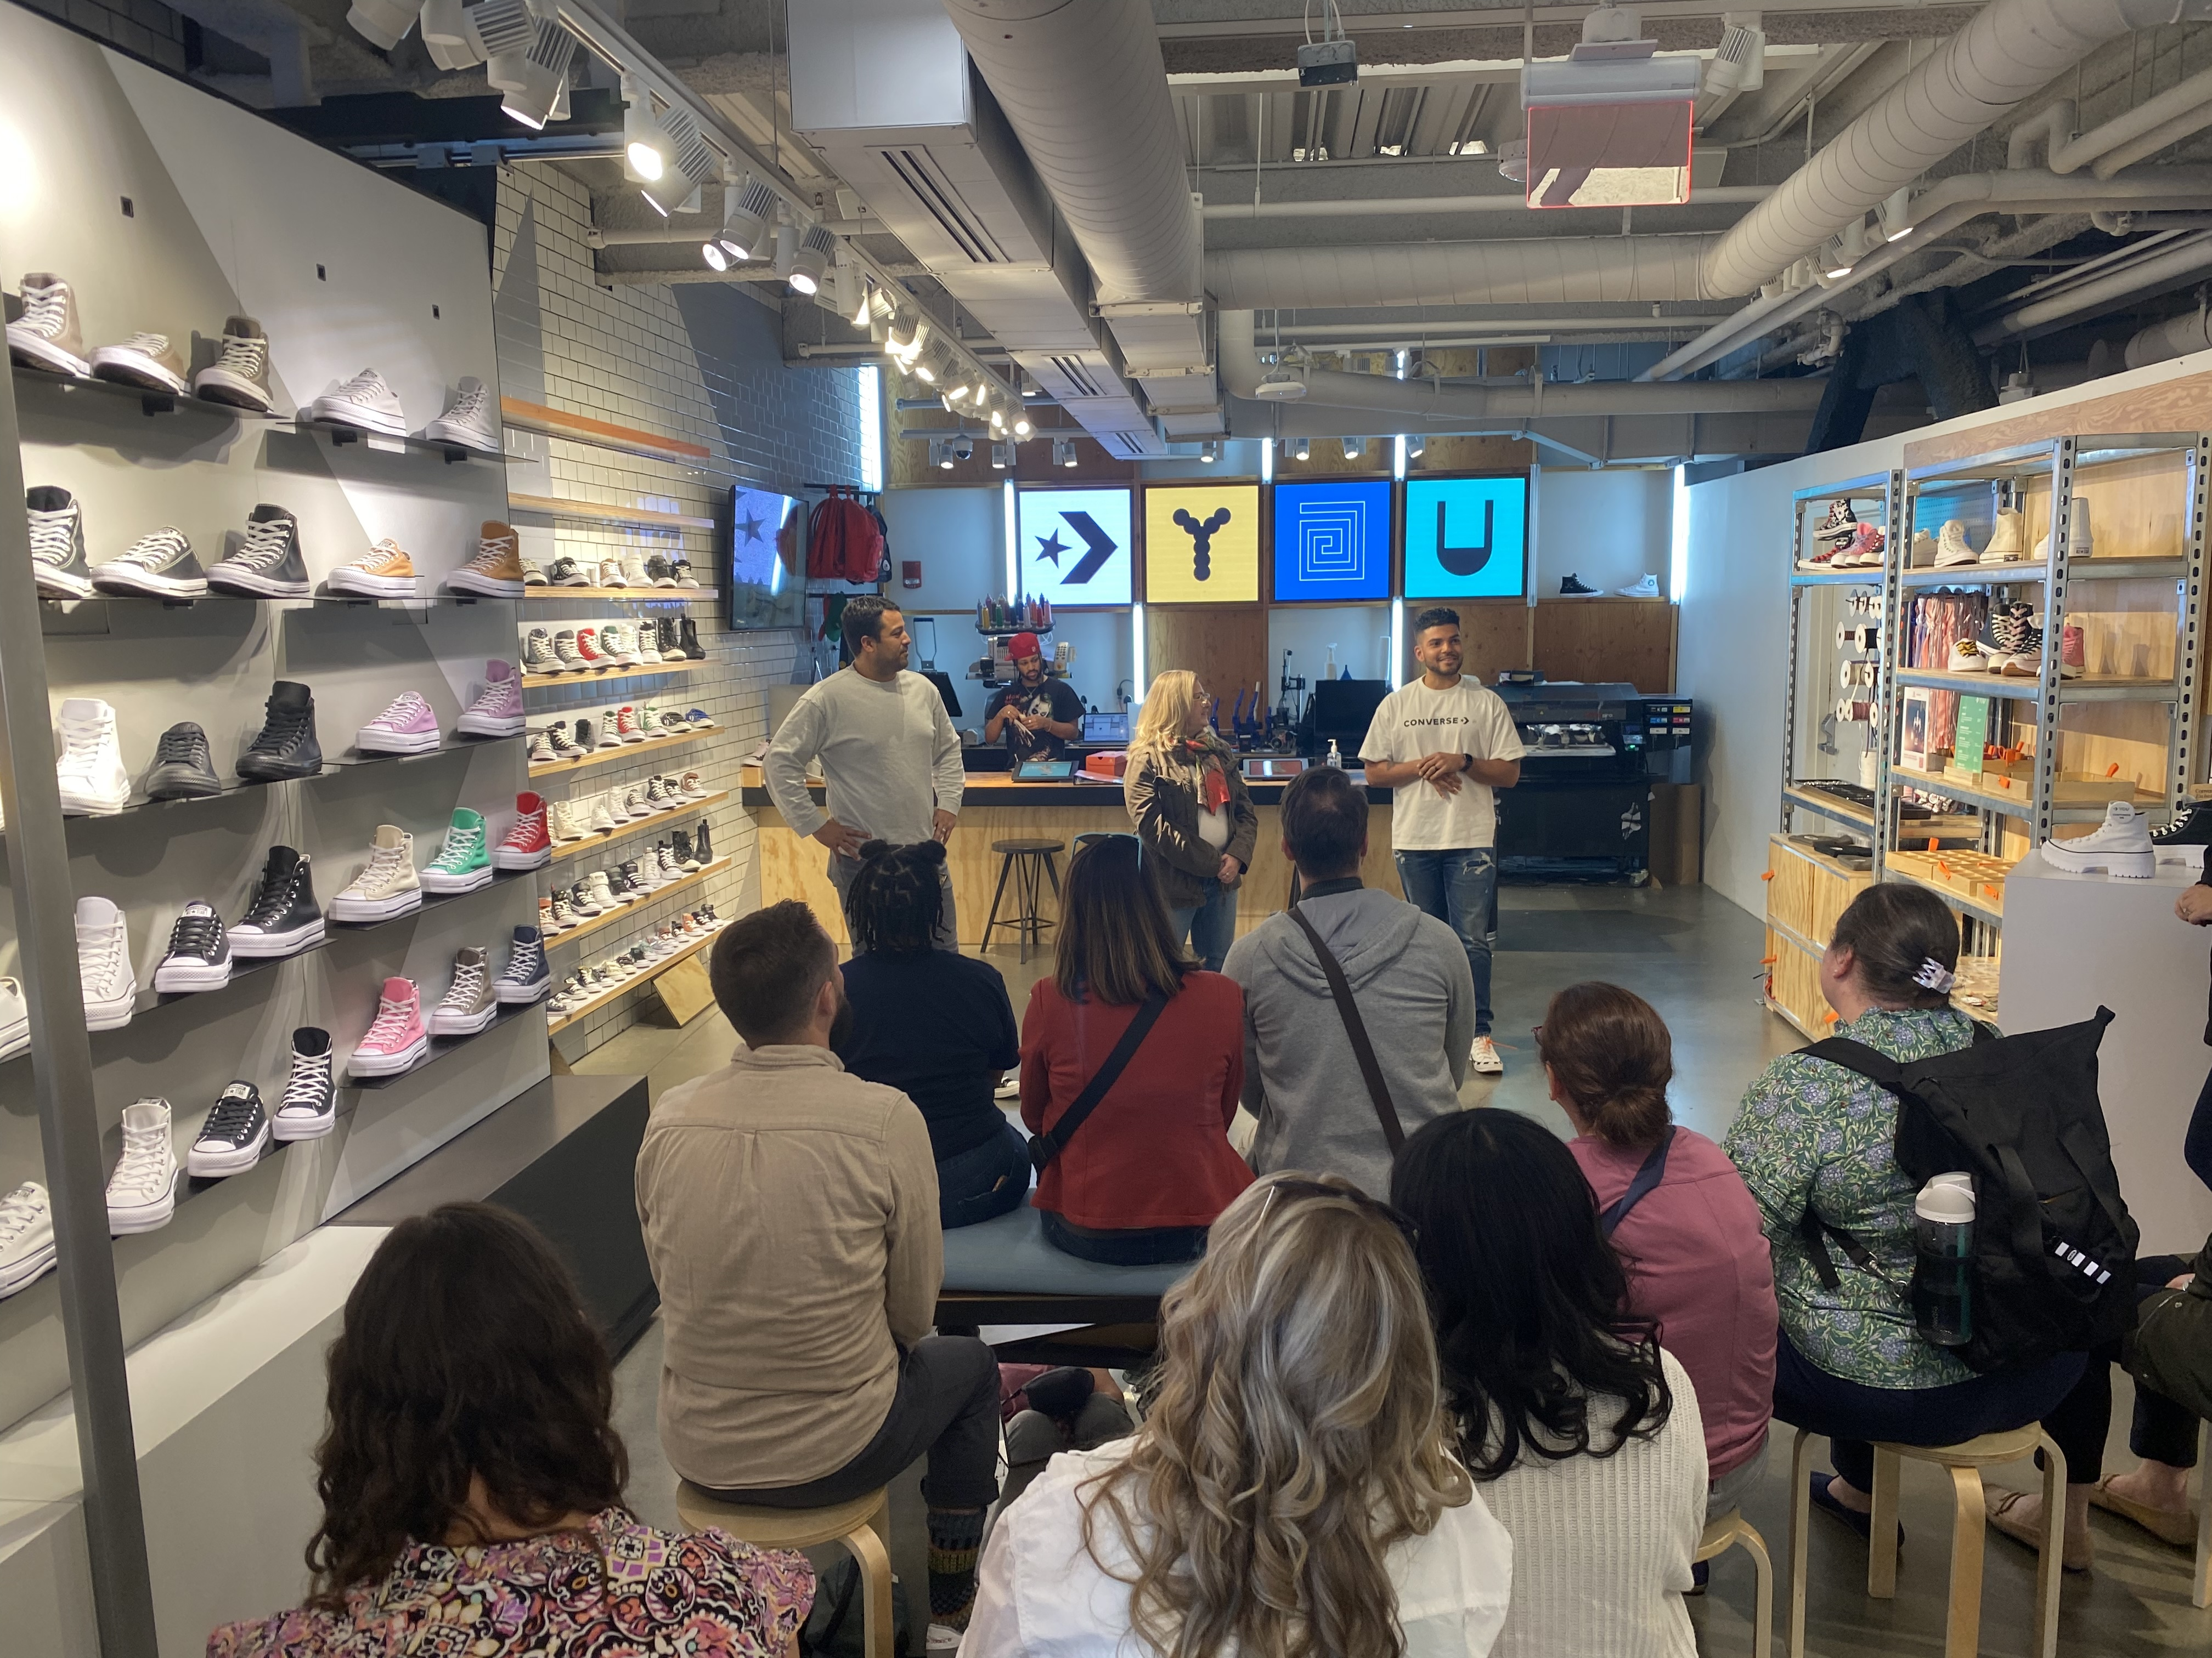
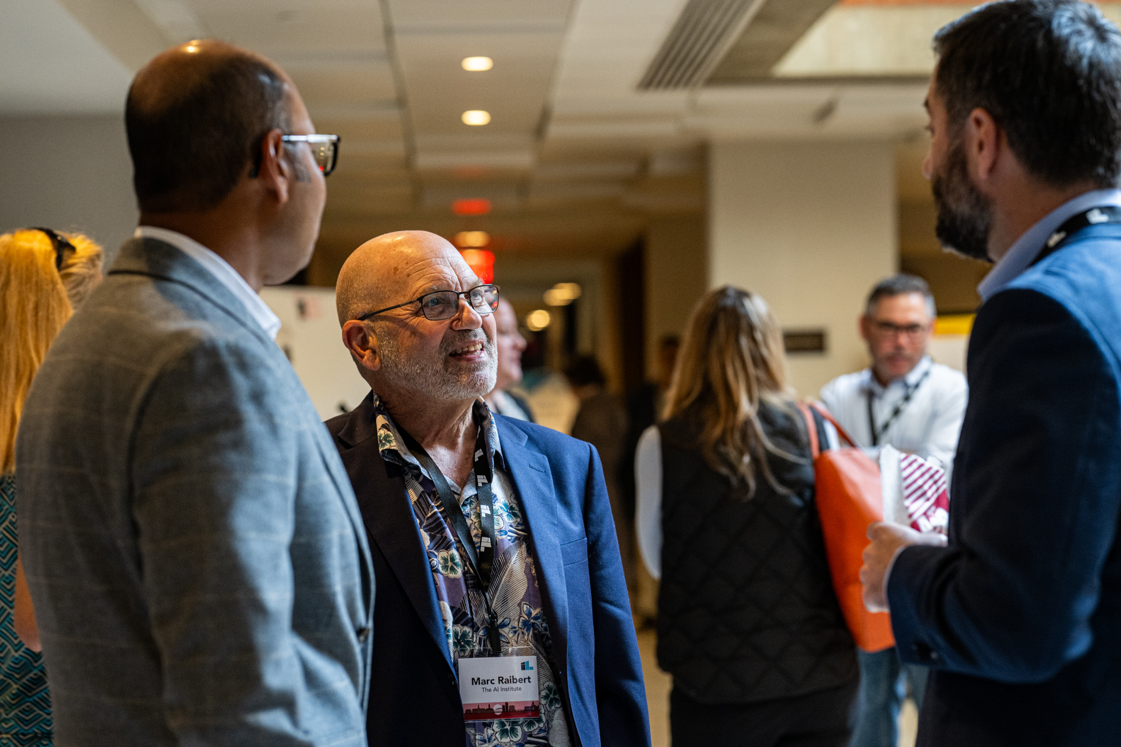
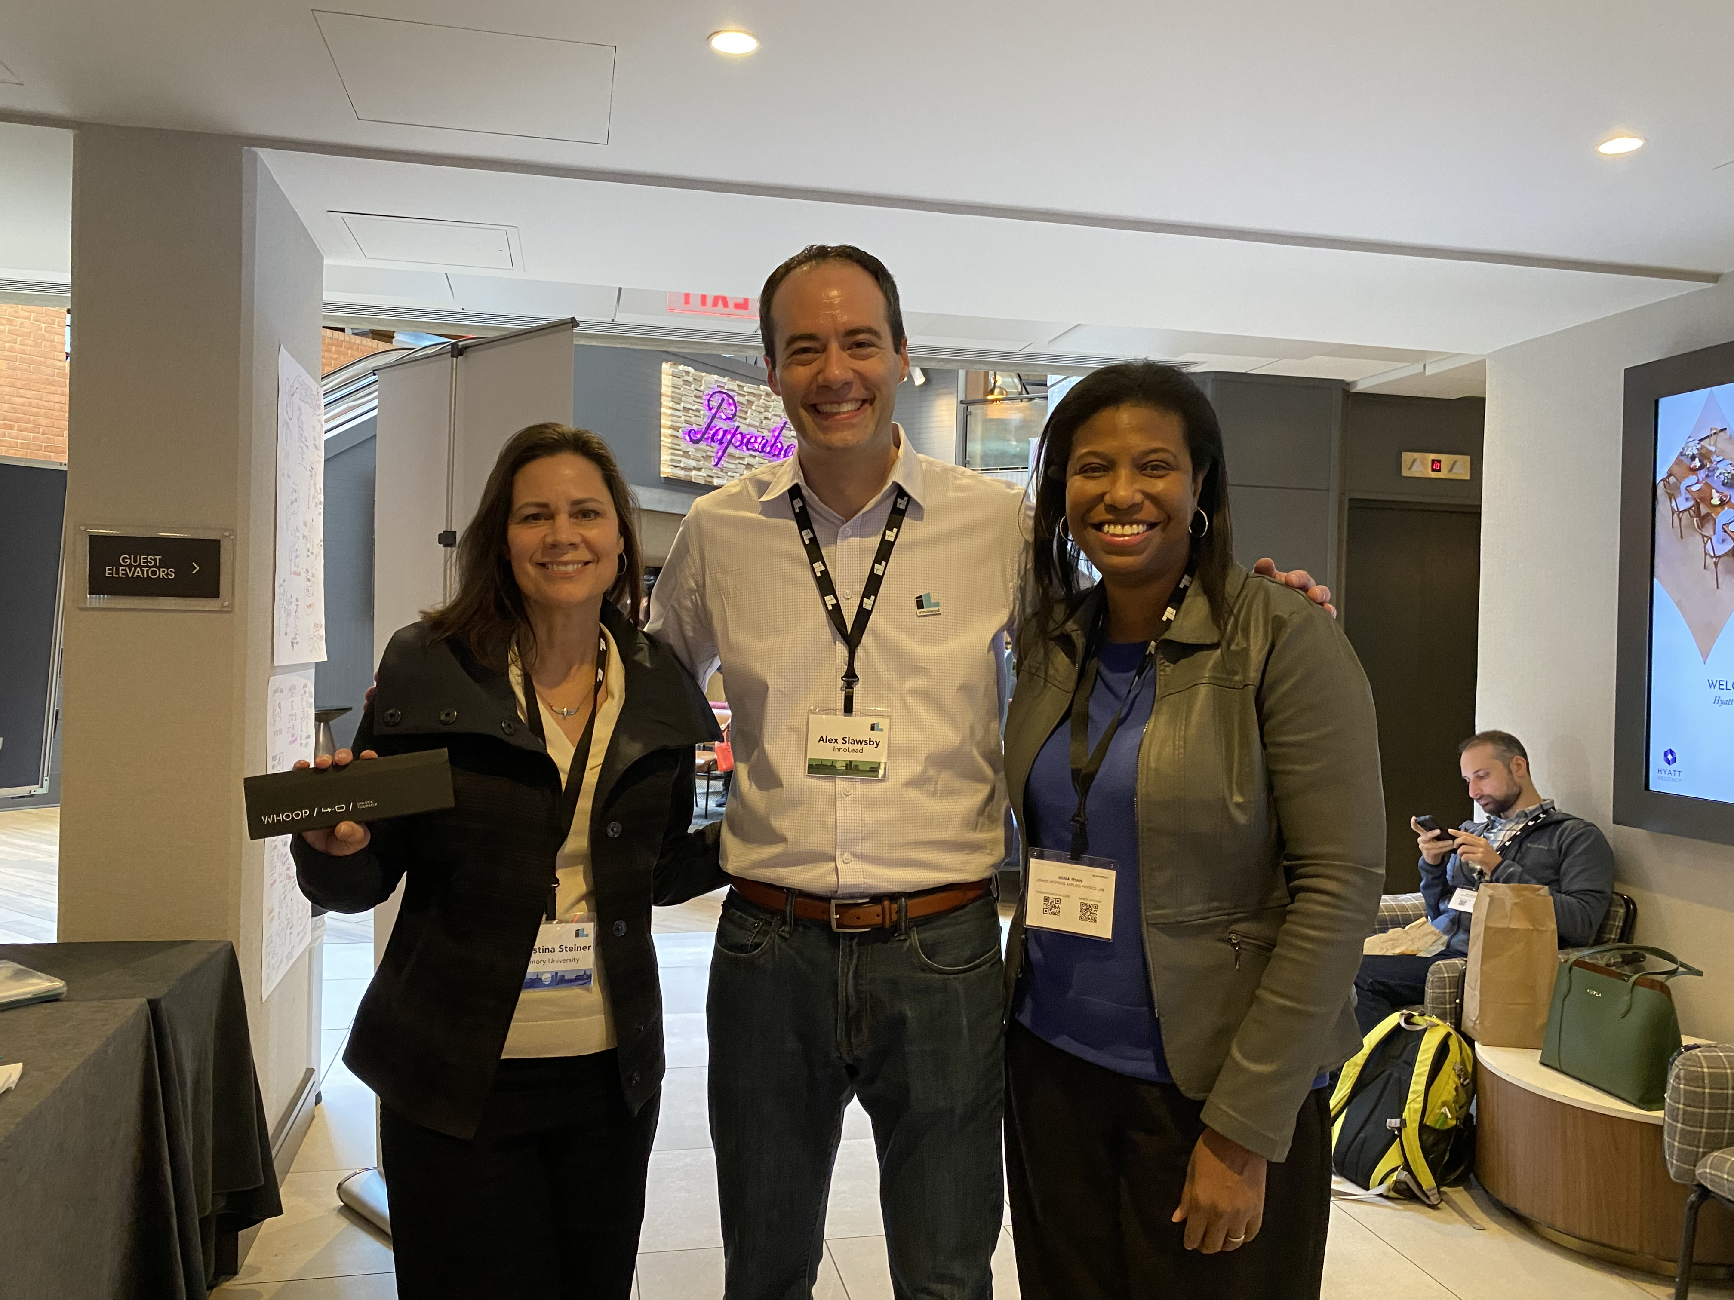
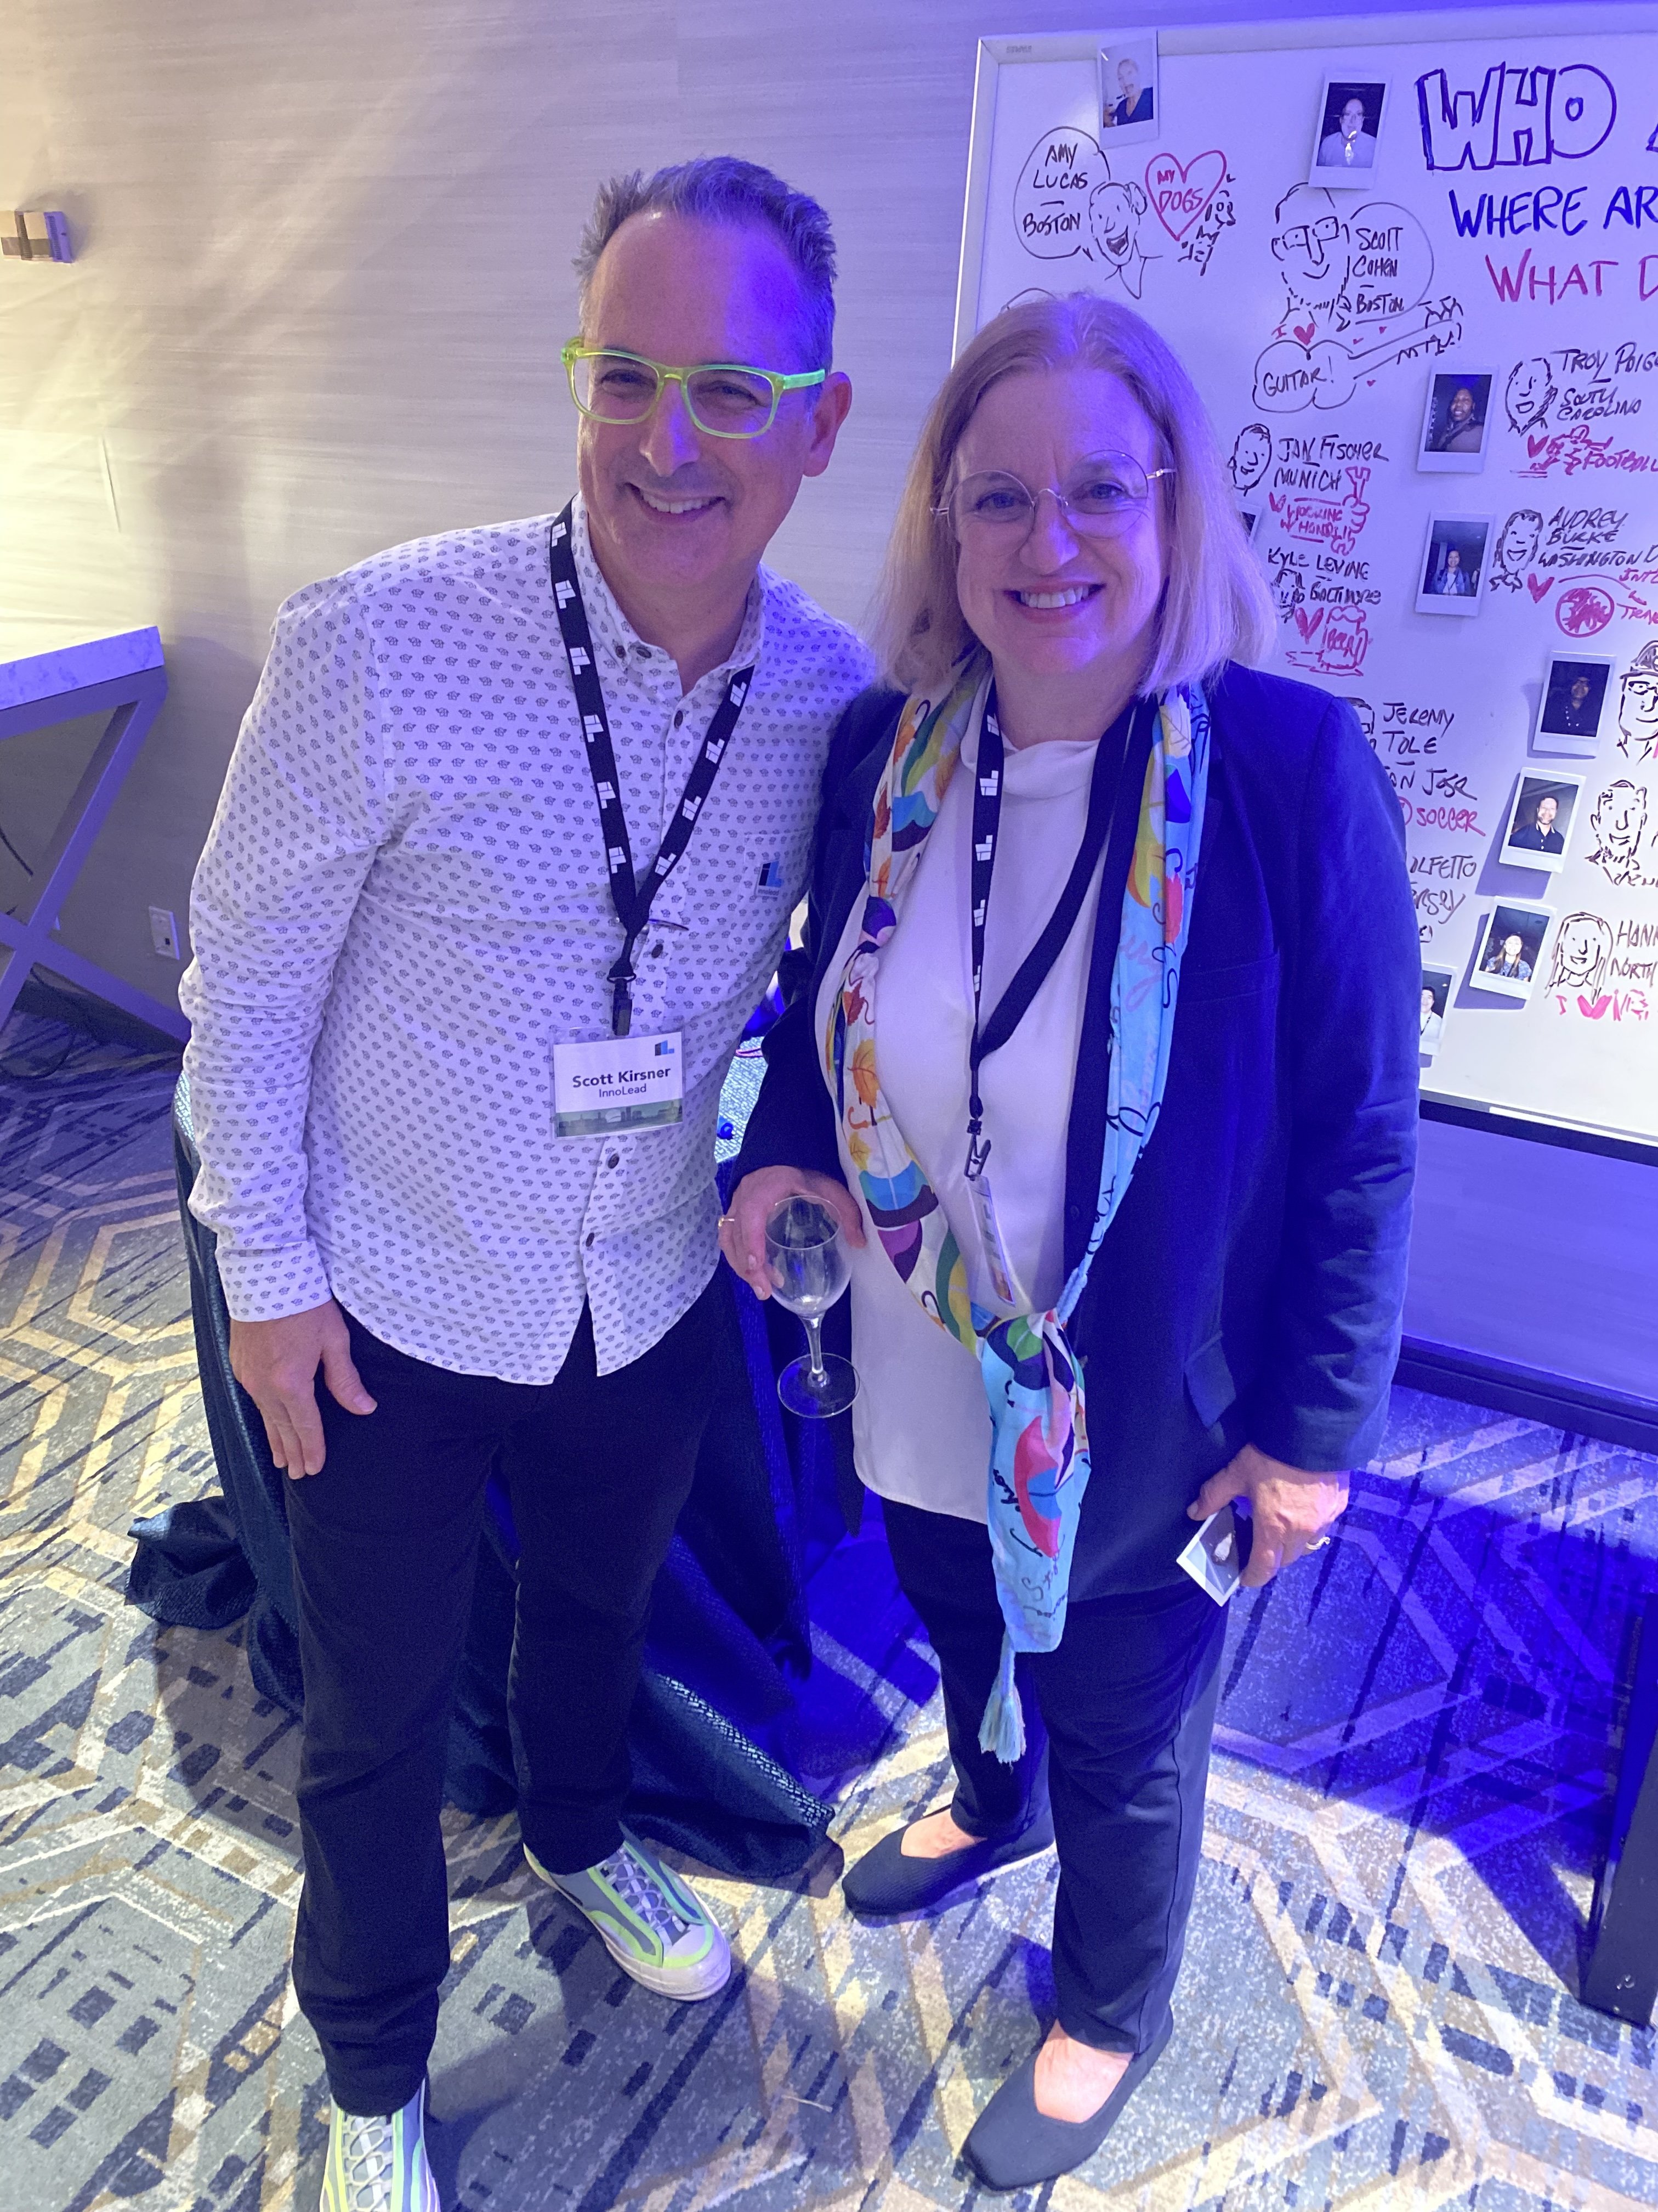
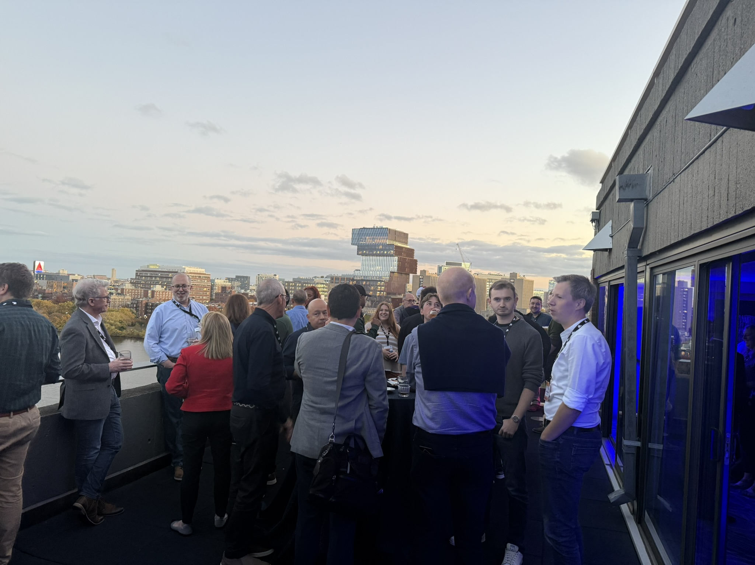
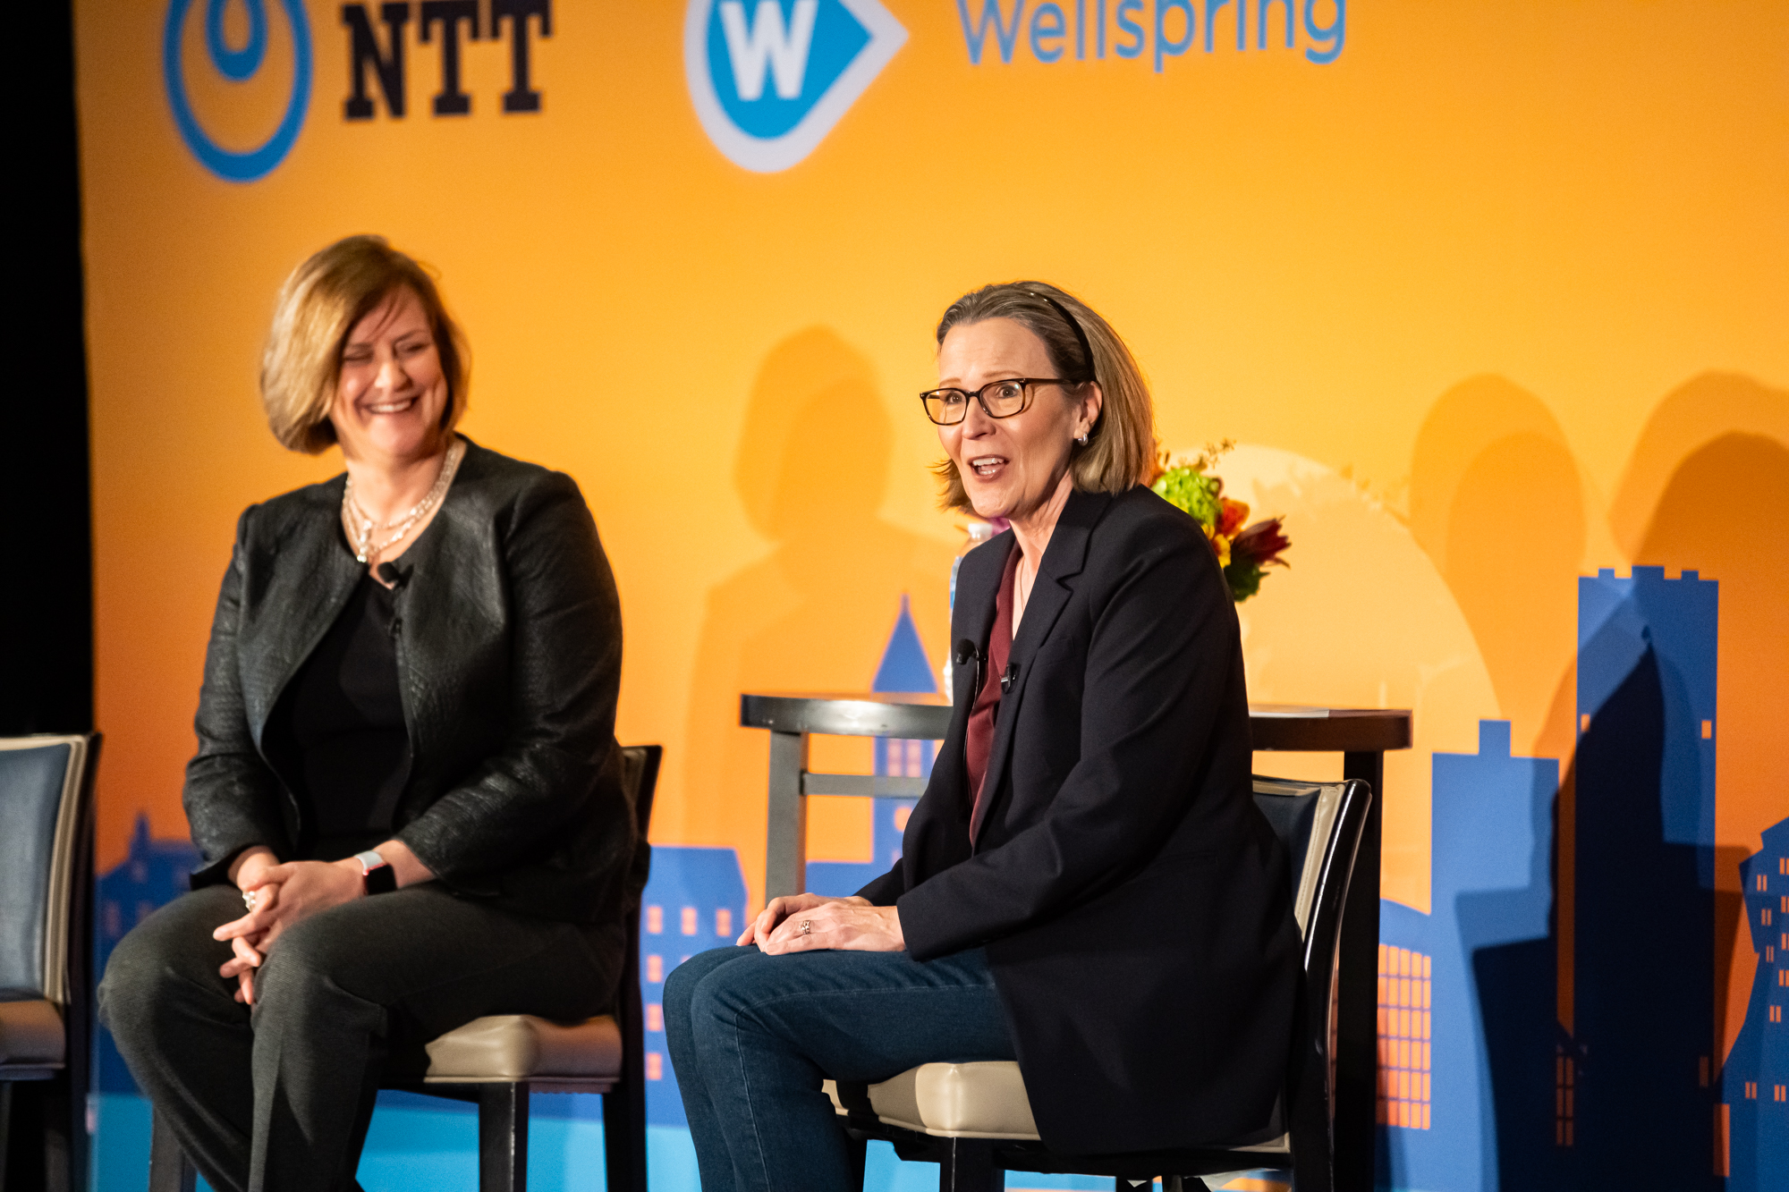
Visual Notes
By Lisa Rothstein

Slide 2
Marc Raibert of The AI Institute, Bob Weis of Walt Disney Imagineering, Chris Townsend of Wellspring

Slide 3
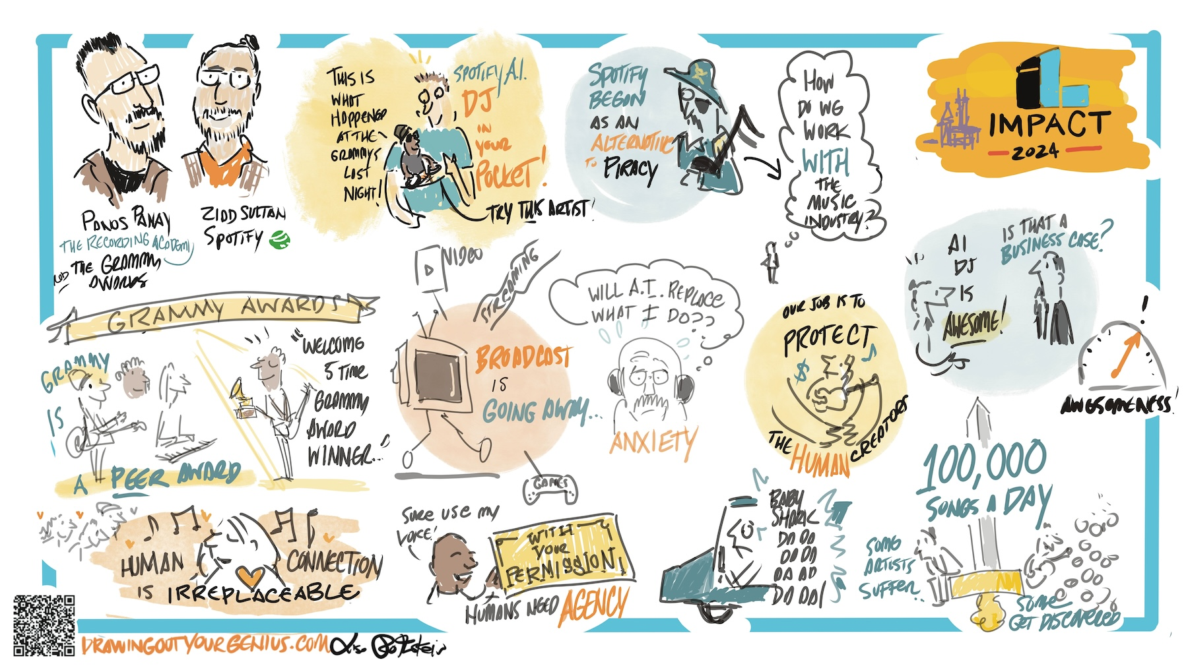
Panos Panay of The Recording Academy, Ziad Sultan of Spotify

Slide 4
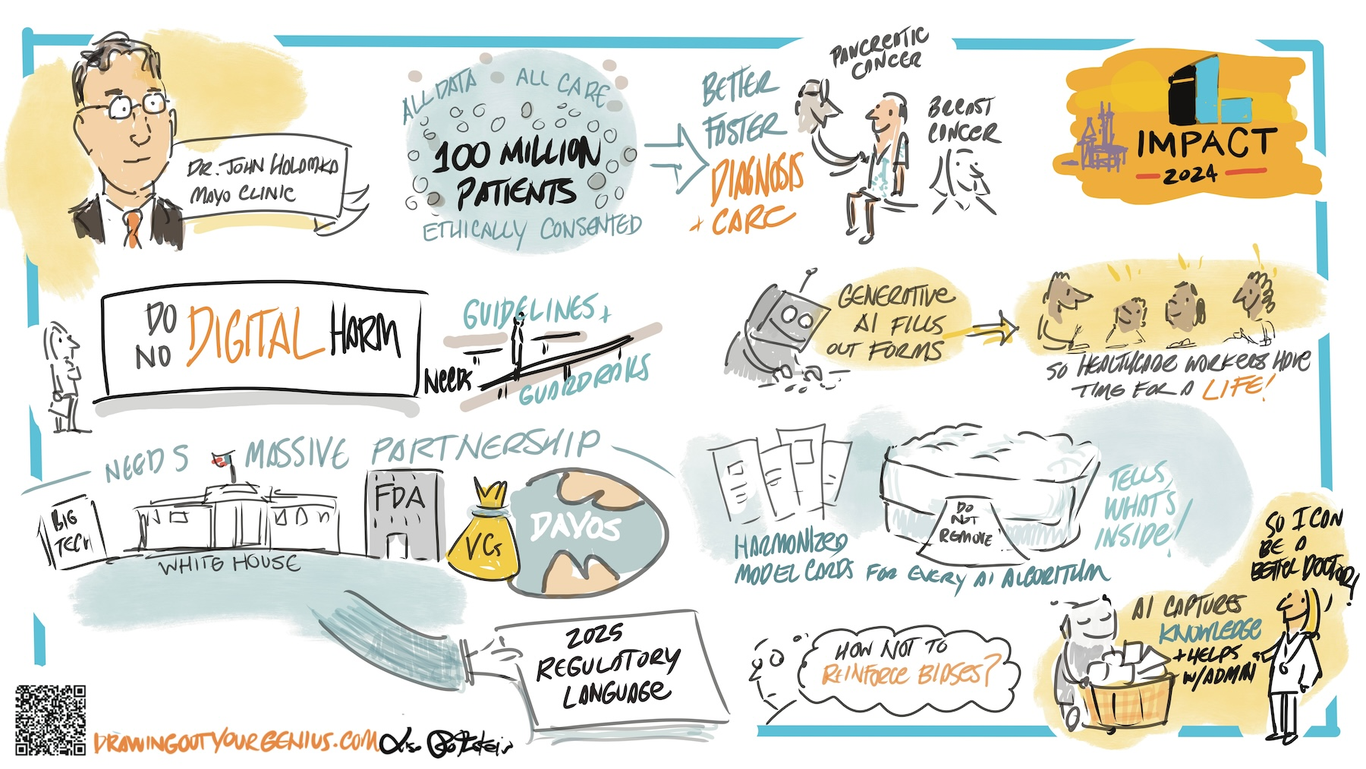
Dr. John Halamka of The Mayo Clinic Platform

Slide 5
Linda Jojo of United Airlines

