Slide 1





Venture Building 2.0
Past Mistakes, New Principles & a Path to Meaningful Growth
Webinar
Innolead Webinar
Thursday – February 29, 2024
2024

Slide 2
Agenda
01
02
03
04
Brief Introduction to Pilot44
The Evolution of Corporate Innovation Models
Venture Building Basics
Five Principles of Venture Building 2.0
10 mins
40 mins

Slide 3



Who we are
Today’s premier brand innovation & venture building studio
What we do
We utilize modern innovation methodologies to help consumer-brands create new products, brands & businesses and grow existing ones
Founded in
2014
Employees
45+
HQ in San Francisco, CA
Offices in
Stockholm & Singapore
Growth YoY for
9 straight years
>25%
Years of
combined brand
building expertise
100+
Notes:
Make headline pop more

Slide 4
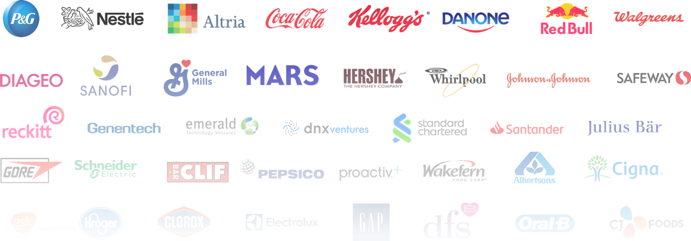
Our Clients
Trusted by today’s top brands to delivery innovation that touches billions of consumers everyday
Notes:
Find a place for touching billions of consumer on another slide??

Slide 5
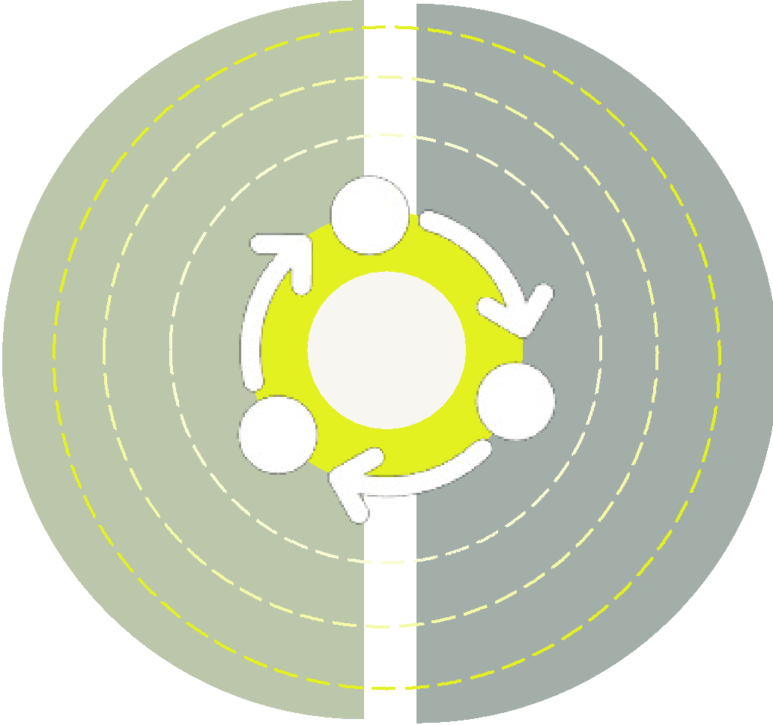
Our practices
Integrated services for growing existing brands and businesses, and for creating new ones
Brand Innovation
Venture Building
Accelerating growth through the adoption of modern digital practices, state-of-the-art technologies, and Innovative brand strategies
Creating new products, brands
and businesses through the utilization of modern venture building, methodologies, expertise & services
OPEN
INNOVATION
VENTURE
BUILDING
The advanced marketing technologies & practices advanced in our Brand Innovation Lab are also utilized to accelerate the growth of new ventures
Our expertise & experience in early-stage venture building informs the growth strategies, practices & technologies exploited in our Lab

Slide 6


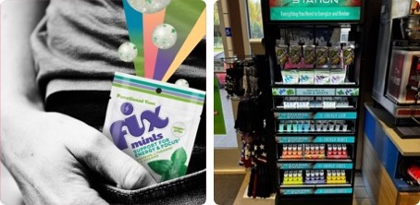
Venture Building
Creating new products, brands, and businesses
New plant-based, compostable zip lock bag that reduces plastic by 60%
Spin-out “newco” for the development of a new hemp-based functional beverage designed to promote relaxation
From discovery to in-market commercialization and growth
Opportunity analysis
Concept development & prototyping
Venture (business) Design
Brand & GTM strategy
Commercialization
In-market incubation
Growth & integration strategy
New functional gums & mints meets multiple needs states including energy, focus and relaxation.

Slide 7

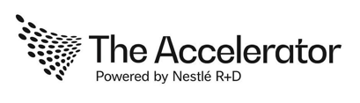



We design and support comprehensive organization-level innovation programs

Slide 8

Our Mission
To help the largest organizations in the world overcome the Innovator’s Dilemma
…allowing our clients to innovate with the horsepower of the enterprise and the entrepreneurial agility of a startup
‘The reason why it is so difficult for firms to capitalize on disruptive innovation is that the processes, and business models that make them great at their existing business actually make them bad at competing for disruption.’
Clayton Christensen
Harvard Professor and Author of The Innovators Dilemma

Slide 9
Incremental Innovation
Disruptive Innovation
Incremental extension at the core
Utilizes tradition “linear” stage gate processes
Operational
Anchored heavily in consumer jobs-to-be-done
Leverages an existing market leadership position
Utilizes processes, skills, and culture in DNA
Adjacent, extension of disruptive
Utilizes non-linear, startup models
Entrepreneurial
Anchored heavily in trends, tech, IP, and paradigm shifts
Penetrate a new of adjacent market
Typically trying to create a new market or enter an existing or emerging one.

Slide 10


Solving the Innovator’s Dilemma
The evolution of Corporate Innovation
2014
2024+
2015
2016
2018
2020
2022
Siloed R&D
Front-end innovation driven primarily by R&D with new solutions “thrown over the wall” to marketing
Corporate Accelerator
Programs 1.0
Big companies join accelerator programs in hopes of getting in early with the next unicorn.
By 2017, nearly all programs had been disbanded
Open (startup)
Innovation Programs
Corporates develop new models and networks for tapping into the startup ecosystem to gather early insights and drive build, buy, partner analysis
The Internal
Venture Building
“Operating System”
External consultancies promote the promise of installing broad “lean” internal innovation programs and training existing employees to be “startup entrepreneurs”
Hybrid Venture
Building Models
A new class of more experienced innovation service providers start to work in collaboration with large brands to connect external startup expertise with corporate expertise and assets
New Spin Out / Spin-in Models
Companies look to move disruptive growth innovation efforts off the balance sheet by utilizing a new ”spin out/spin in” models
Corporate-owned
Spinout Studios
A new class of more experienced innovation service providers start to work in collaboration with large brands to connect external startup expertise with corporate expertise and assets
Tech Tourism
Buses arrive in the
Silicon Valley for inspirational meet-ups
with little tangible outcomes
Corporate Incubator
Programs 1.0
Big companies attempt to create their own startup incubator programs with early investment and hope of integrating learning and solutions back into the mothership

Slide 11
Defining Venture Building
What is a Venture?
A disruptive growth initiative (or “disruptive” startup initiative) that goes beyond product and/or incremental innovation by combining a variety of new models and dynamics.
What is Venture Building?
The application of startup-centric tools and lean processes to the design, development and incubation of new ventures within a large company.
What is a Venture Studio?
A scalable program designed to upskill internal teams, accelerate front-end innovation and develop a portfolio of cross-category growth ventures.
Corporate
Growth
Ventures
New
Marketing
Models
New
Business
Models
Co
r
p
o
r
a
t
e
Gr
o
w
t
h
es
New
New
Ma
r
k
e
t
i
n
g
Bu
s
i
n
e
s
s
Mo
d
e
l
s
Mo
d
e
l
s
New Digital
Experiences
New Service
Offerings
New
Sales
Channels
New D
igit
a
l
New Ser
v
Exp
ic
e
e
r
i
e
n
ce
s
Of
f
er
ing
s
New
Sa
les
Ch
a
n
n
e
l
s

Slide 12





Basic Governance Structures
4 core components
Investment or Governance Committee
Multi-disciplinary executive board responsible for reviewing all venture pitches and making go-forward investment decisions
Venture Portfolio
Set of ventures at various stages in the innovation pipeline
Checkpoints & Funding Events
Established checkpoints where the Investment Committee reviews progress, provides direction and evaluates viability & funding availability
Venture Building Methodology
An integrated end-to-end process made up of distinct phases and specific workstreams with pre-defined deliverables & metrics
  Corporate Investment Committee
  Venture Portfolio
Venture
Venture
Venture
Venture
Venture
  Checkpoints & Funding Events
  Funding rounds – Key phases – Key Deliverables
  Go/No Go Decisions
  Venture Building Methodology
  Discovery & Ideation – Conceptualize & Validation
  Commercialize - MVP Build – Incubate - Grow & Scale

Slide 13
Venture Building
Capability requirements
01
Discovery
02
Design
03
Development
04
Incubation
Integrated Methodology & Tools
INSIGHTS &
OPPORTUNITIES
CONCEPT DESIGN & VALIDATION
BUSINES (VENTURE)
STRATEGY &
MODELING
PRODUCT DEV.& MANUFACTURING
SUPPLY-CHAIN
& OPERATIONS
BRAND & GTM
STRATEGY
DIGITAL
& GROWTH
MARKETING
OMNI-CHANNEL
COMMERCE
E2E Innovation Services

Slide 14
We have dozens of best practices built into our methodologies. Today, we are going to cover just Five Core Principles of Venture Building 2.0
Disruptive Innovation is non-linear
Five Core Tenets
Venture Building 2.0
Other Key Areas of Consideration
01 | Innovation Types
02 | AI + Insights
03 | AI + Concepting
04 | GTM Strategies & Models
05 | 0 to 1 growth
06 | Governance Structures
07 | Portfolio Models
08 | Funding Models
09 | Methodologies & Tools
10 | Integrating to the Core
11 | Commercialization Strategies
12 | Culture & Rewards
13 | Expertise & Resourcing
 | And more…
1
2
It’s not really all about the consumer
3
Concepts are cool, businesses pay the bills
4
Innovation is driven by storytelling
5
Disruptive innovation requires investment

Slide 15

Principle 1
Misconception
Reality
Disruptive Innovation is a linear funnel
Disruptive Innovation
is inherently non-linear

Slide 16
Beware of overly simplified Innovation Models
One of the biggest challenges we see is big companies trying to utilize lean, startup methodologies without implementing all the mechanics and tools that make them work in the Silicon Valley
Discover
Generate
Validate
Incubate
Scale
Opportunity Areas
Funding
Gate
Ideas
Problem
Solution
Business Model
Product /
Market Fit
Growth
#1
#3
#2

Slide 17

What it really takes to build a business
Discover
Generate
Validate
Incubate
Scale
Funding
Gate
Ideas
Problem
Solution
Business Model
Strategic
Narrative
BOM
& COGs
Opportunity Areas
Product / Market Fit
Growth
Completive
Landscape
Financial
Pro Forma
#1
Business
Model
Operations
#3
#2
Brand
Strategy
Use of
Proceeds
GTM
Strategy
Supply-
chain
Venture Plan

Slide 18

Prevent endless cycles of experimentation
Discover
Scale
Generate
The Venture Plan
Validate
Incubate
Funding
Gate
Ideas
Problem
Solution
Business Model
Strategic
Narrative
BOM
& COGs
Opportunity Areas
Product / Market Fit
Growth
#1
Completive
Landscape
Financial
Pro Forma
#3
Business
Model
Operations
#2
Brand
Strategy
Use of
Proceeds
GTM
Strategy
Supply-
chain
Experimentation Loops

Slide 19

Principle 2
Misconception
Reality
It’s all about the
Consumer JTBD
It’s not really all about
the consumer

Slide 20

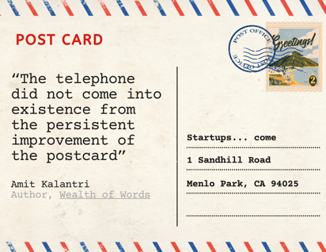
Look beyond consumer pains. Understand new opportunities and paradigm shifts.

Slide 21

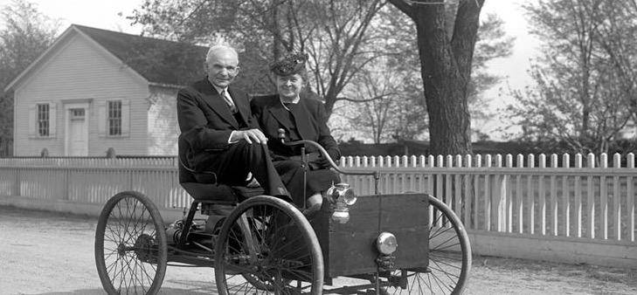
If consumers can tell you they want it, you’re probably too late

Slide 22
Bring the outside-in with open innovation methodologies
The Needs of the Business
Competitive Advantage
Innovation Opportunity
The Art of the Possible
It is rooted in a simple tenet; The fastest most effective way to identify threats, understand emerging trends & technologies and discover new growth opportunities is to go to the source: the VCs, entrepreneurs and technologist that are inventing tomorrow’s solutions.

Slide 23
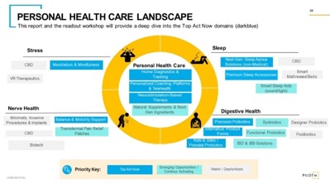
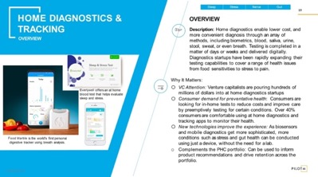
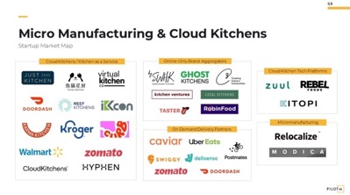
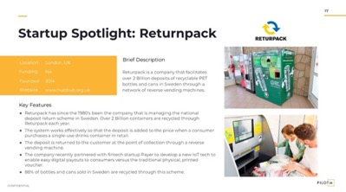
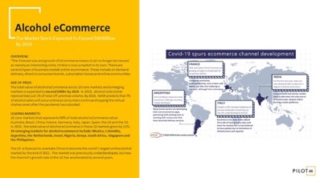
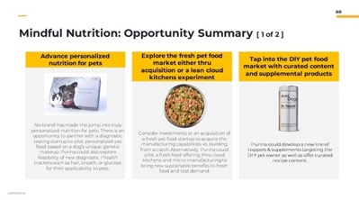
Insights & Opportunities
Research & Insights Leading Disruption Sensing Across 30+ Categories & Business Units
Solution Domain Landscape
Sub-Domain Details
Startup Market Map
Startup Profile
Market Sizing
Where-to-play Strategy

Slide 24

Principle 4
Misconception
Reality
It’s all about the
concept
It’s all about the business (plan)

Slide 25

Get to the business sooner
What you might hear when you get beyond the insights and concepts, and define the business:
“Were not in that business…”
“It cannibalizes current products…”
“There’s no where to land it…”
“We would never invest that much…”
Etc.

Slide 26
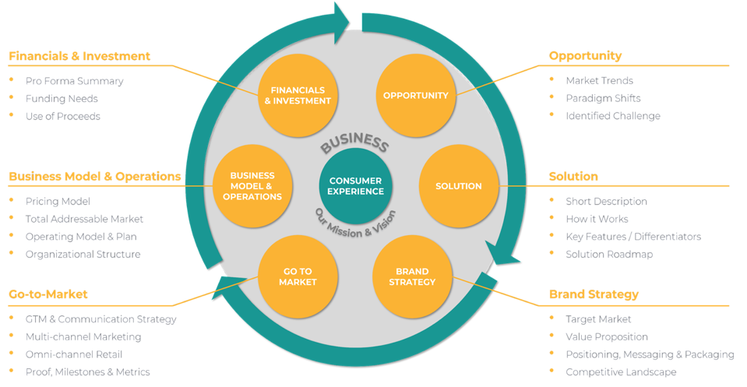
Require a venture plan
Why require a story-based venture pitch?
Lingua franca of the Silicon Valley
Business plan wrapped in a story
Enforces a consistent thread
Provide means of evaluating team
Outlines specific use of proceeds

Slide 27
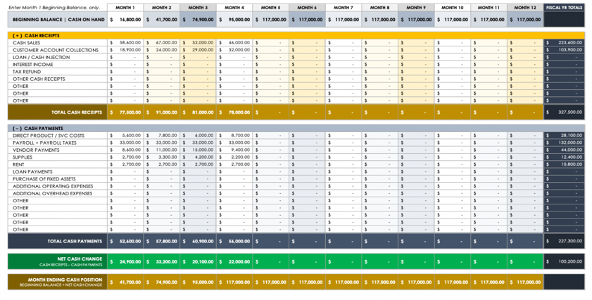
Require 3-5 year cash flow proformas
Developing a cashflow pro forma will force you to:
Defines business model
Captures all assumptions
Documents all hypothesis
Quantifies GTM strategy
Predicts total investment requirements
Developing a basic pro forma financial model with cash and funding requirements is essential

Slide 28
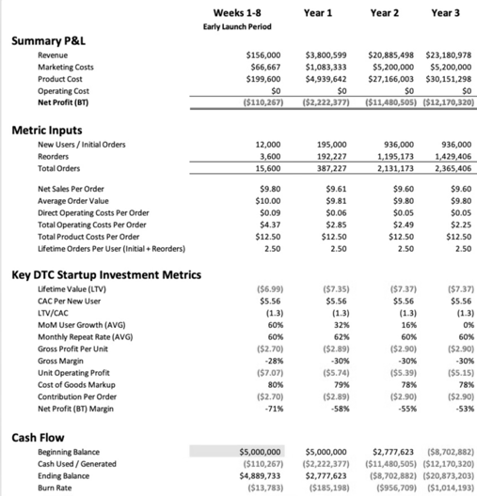
Your vision and strategy in a proforma
Business model
Pricing
Sales Forecasts/Growth Assumptions
BoM/COGs
Hiring plan / Headcount
Overhead/Expenses
Go-to-Market Strategy
Marketing Costs / CAC / ROAS…
Product Roadmap / Release Sched
Burn rate & Cash flow breakeven
Funding Requirements

Slide 29

Principle 3
Misconception
Reality
Innovation is driven by insights & data
Innovation is driven by evangelical storytelling

Slide 30
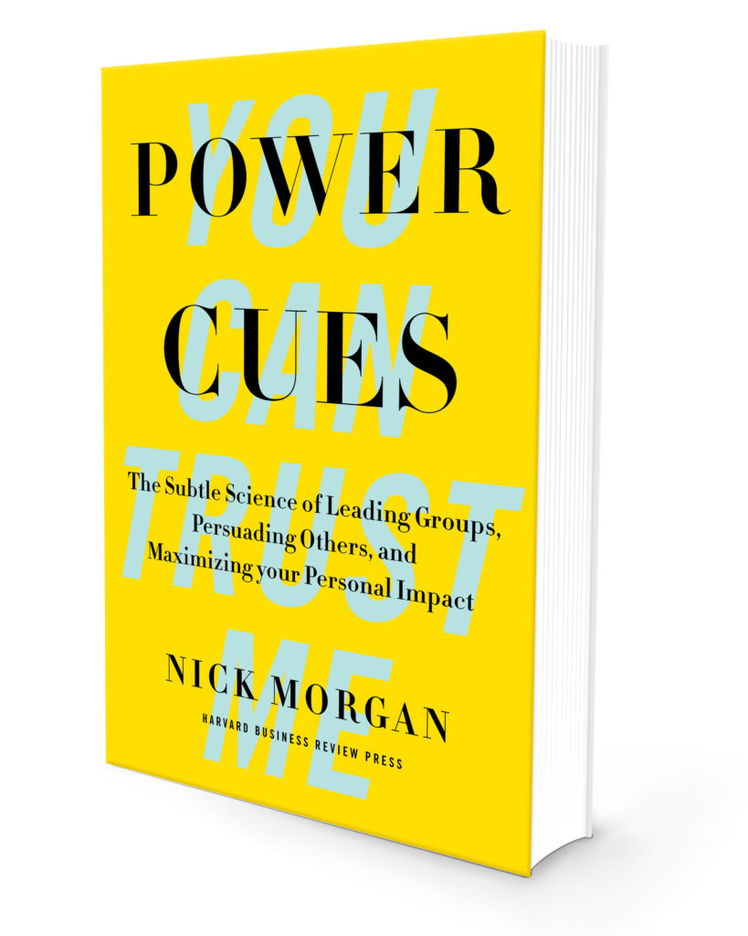
Write stories – not corporate one pagers
“In our information-saturated age, business leaders won’t be heard unless they’re telling stories. Facts and figures and all the rational things that we think are important in the business world actually don’t stick in our minds at all”
Nick Morgan
Author of Power Cues, HBR

Slide 31

“The single most important job of any startup entrepreneur is storytelling”
Sir Richard Branson
Serial Entrepreneur

Slide 32

“Right-brain dominance is the new source of competitive advantage”
Analysis
Creativity
Logic
Intuition
Ideas
Arts
Facts
Creation
Math
Feeling
Training
Imagination
Daniel Pink
Author of Drive

Slide 33
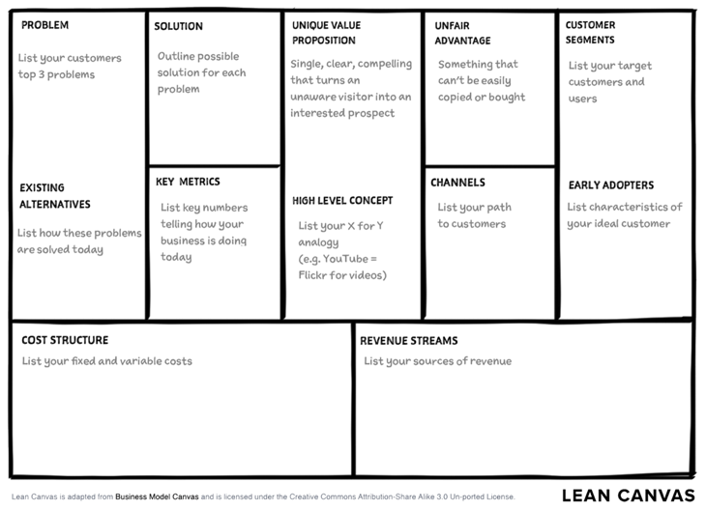
The corporate "one-pager” and an over reliance on ”canvases” is where innovation goes to die!

Slide 34

Principle 6
Misconception
Reality
Innovation can be done safely, $100K at a time
Innovation requires meaningful, speculative Investment

Slide 35
The startup funding model is fundamental to driving successful disruptive innovation
Idea
Early Stage
Growth Stage
Mature
IPO
Or other
exit event
SERIES C
$25M+
SERIES B
SEED
SERIES A
$15M-$50M
BOOTSTRAP
$250K-$2M
$4M-$15M
6-18 months
1-2 years
2-8 years
Why the funding model is so important:
Drives scarcity
Enforce definitive milestones
Separates winners from losers
Provides transparency
Reduces risk
Profitability

Slide 36
Innovation Models Are Being Disrupted
Moving innovation investment off the P&L
Corp. Owned & Led / Pilot44 Support
FEE-FOR-SERVICE
We work alongside active internal teams in a player/coach role providing the outside skills and expertise that compliment your team while also helping to build new internal innovation processes
Corp. Owned /
Pilot44 Led
FEE-FOR-SERVICE
Working under your lean strategic and business guidance, we will fully staff and manage an engagement the projects. Options to assign employees to be part of the founding team. Option to include performance “incentive” bonuses to offset some upfront fees.
Spin-out /
Spin-in Venture
CORP FUNDED OFF BALANCE SHEET
Invest seed funding in an independent NewCo while still retaining future investment preferences and pre-negotiated buy back rights (with caps). Leverage equity to offset Startup cash and venture building service costs. This model best applies to moderate to complex ventures where there is a desire to spin it back in once established (1-3 years). Option to co-locate employees as part of the founding team.
Venture
Studio
CORP + EXTERNAL FUNDING
Invest seed funding in an independent NewCo that can accept joint investment from outside VC sources. Buy-back options are possible but more complicated (high valuation caps). These ventures have longer timelines (3-5+ years) given outside investor incentive. This model is best when there is a desire to try to develop an independent “unicorn” with the goal of high investment returns whether it is spun back in or not.
1
2
3
4

Slide 37



Creator Brands Are On The Rise
Expedited Path to Scale
Mr. Beast’s Feastables is projected to report $200mil in sales in 2023 after launching in 2022.
Mr. Beast is the primary equity holder.
Prime, backed by Logan Paul and Ksi sold over $250mil in year 1 (2022) and is on track to sell over $1bn 2023.
Logan Paul & Ksi have a >20% equity stake each in the company.
Casamigos, the tequila brand founded by George Clooney in 2013 sold to Diageo for ~$1 billion 4 years later.
George Clooney had a ~33% equity stake in the business.

Slide 38
We have 20+ principles...today we are going to cover just Five Core Principles of Venture Building 2.0
Disruptive Innovation is non-linear
Five Core Tenets
Venture Building 2.0
1
2
It’s not really all about the consumer
3
Innovation is driven by storytelling
4
Concepts are cool, businesses pay the bills
5
Disruptive innovation requires investment

Slide 39



Get in touch
Founded in
2014
Employees
45+
Jon Corshen
Managing Partner and Co-founder
HQ in San Francisco, CA
Offices in
Stockholm & Singapore
Growth YoY for
9 straight years
>25%
Years of combined
brand& business
building expertise
100+
jon@pilot44.com
linkedin.com/in/joncorshen/
@pilot44
pilot44.com
© 2024
All rights reserved

