Slide 1
Update picture to reflect de-carbonized future of utilities
Your Random Acts of Innovation aren’t working
A discussion on building an Innovation System
February 15th, 2024

Slide 2
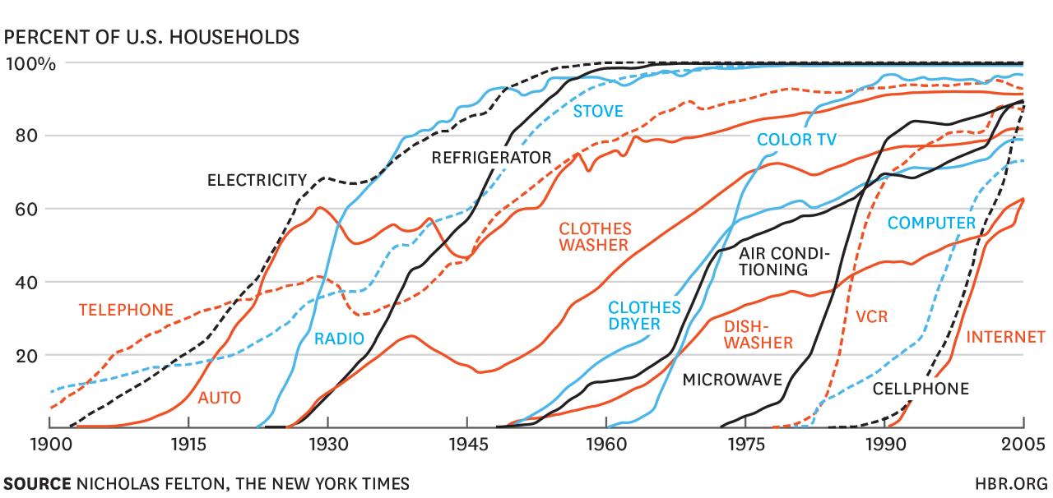
Change is the only constant

Slide 3
Disruption is accelerating. Corporate lifespans are shrinking
Average lifespan on S&P 500
Average lifespan on S&P 500
Rolling 7-year averages
Rolling 7-year averages
Projected
Projected
Years
Years
Source: “Corporate Longevity: Turbulence Ahead for Large Organizations,” Innosight briefing, Spring 2021

Slide 4
Innovation is…
creates value
something
different
that
Faster
More Revenues
Product
Process
Higher Customer Loyalty
Easier
Approach
Less Cost
Service
Cheaper
Higher Performing
Improved Retention
Others

Slide 5
Individual Innovation Initiatives
Predictable Failure Modes
1
Develop an Innovation Strategy
Misalignment between enterprise strategy and innovation strategy leads to a portfolio of ideas that are never prioritized for meaningful investment and scaling.
2
Run a Hackathon
No appropriate governance to oversee decision making and resource allocation means great ideas have nowhere to go or are inconsistent with strategic priorities.
3
Create an Innovation Fund
Leaders put pressure on funds to be reallocated toward core initiatives with clearer short-term return on investment (ROI).
Flawed interaction model between the innovation team and the core business results in the team getting sucked into incrementalism or pursuing opportunities that are ultimately rejected by the business.
4
Build an Innovation Team
5
Implement Lean Startup Sprints
No mechanisms to transition the post-sprint projects into business units.
6
Build a Culture of Innovation
Underlying beliefs about what it takes to be successful create resistance to behavior change, leading to increasing cynicism about the organization’s ability to innovate.
7
Appoint a Chief Innovation Officer
Organizational confusion and frustration are created when the new role isn’t clearly integrated into strategy and resource allocation decisions.

Slide 6
It takes an innovation system to drive innovation performance
Prio
Strategic PRIORITIES
Innovation PATHWAYS
Innovation PERFORMANCE
PEOPLE & CULTURE
PORTFOLIO Governance

Slide 7
Poll: How would you characterize your company’s innovation approach?
Ad-hoc & uncoordinated
Getting started
Have pieces in place but work to do
Starting to hit our stride
Mature innovation system

Slide 8
