Slide 1
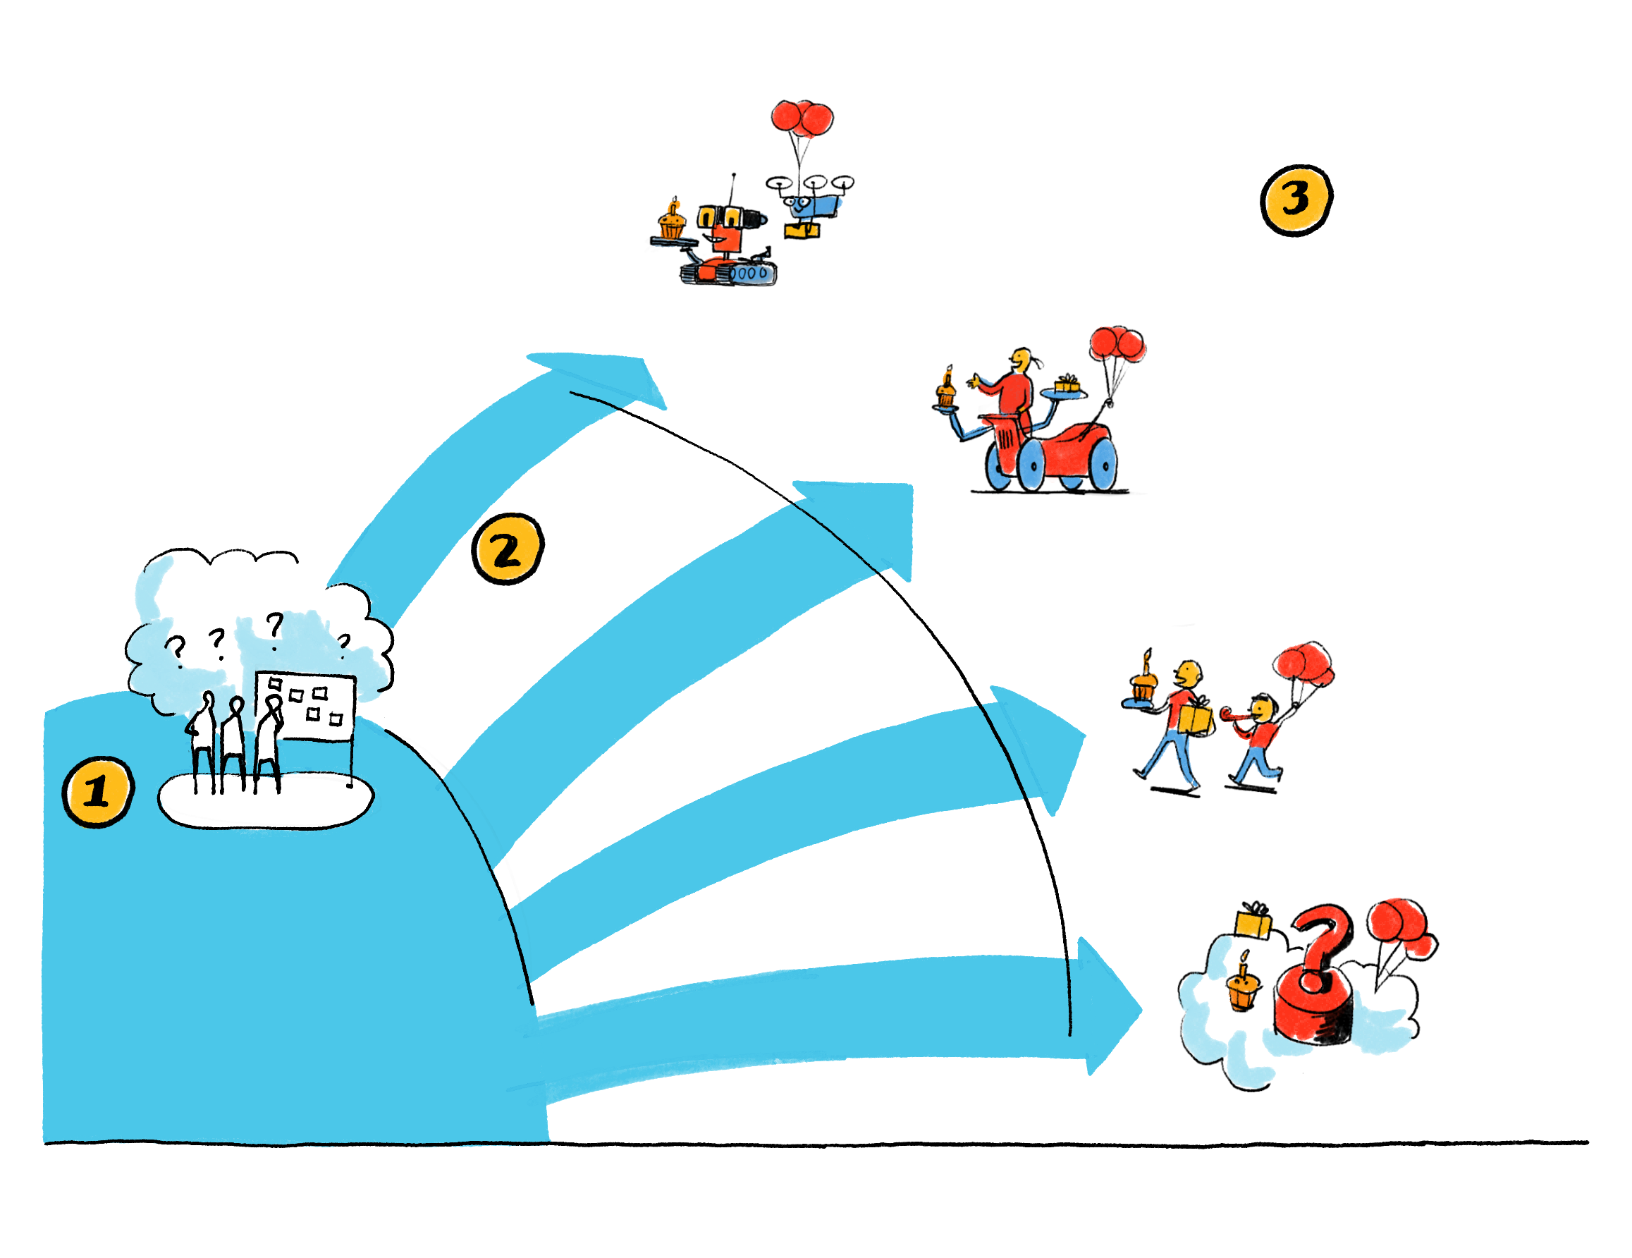
What is your vision for AI?
As organizations rush to learn about, experiment with, and deploy new AI technologies, most leaders do not have a vision for this next evolutionary state. They’re making progress — but toward what?
Full automation
The vision
Automating everything that can be automated — with as few people in the system as possible
Augmented human
The destination. We've laid out three possible visions for an organization's next evolutionary state. If none of these quite capture your organization's vision, [Your vision here] is a blank slate for you to fill.
Enabling our people to be as efficient as possible — and for AI to take on some tasks entirely
The journey
Authentically human
Key questions for the "journey" stage: What is the right pace and number of projects for us? Are we effectively communicating the vision, and dealing with points of conflict — especially around future employment levels, and how jobs will change? How do we get our data in shape, and make sure we have the best tools and infrastructure? Do we have the talent we need? How do we want employees, customers, and partners to participate in this journey?
Preserving the human face of our brand — with limited AI operating behind the scenes
Initiating
Key questions for the "initiating" stage: How long can we stay here? Who should be involved in creating the vision? What forces and issues are keeping us from moving forward — and how can we address them?
[Your vision here]

