Slide 1
INNOLEAD MASTERCLASS
How GenAI is Transforming the Innovation Process
SAN FRANCISCO – TORONTO – PRAGUE – DUBAI
OCTOBER 2023

Slide 2
Reach out: jan@u.plus
Jan Beránek
Learn more: https://ai.u.plus/
Founder, Group CEO
2B
120+
7
In new value created
Products brought to market
Years Of Silicon Valley Mentoring
16+ years of leading digital innovation & transformation products. Helped 120+ ideas become a reality, with total valuation exceeding $2B. Mentor at Google for Startups, European Space Agency BIC, WeWork Labs NYC.

Slide 3
Prompting Basics to Unlock Intelligence

Slide 4
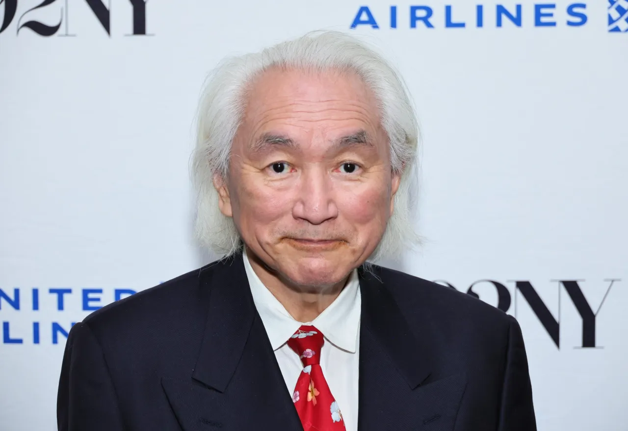
Prompting Developments
Jan 28 2022-Jan 10 2023 – Chain-of-Thought Prompting Elicits Reasoning in Large Language Models
August 30, 2023 – Sensecape: Enabling Multilevel Exploration and Sensemaking with Large Language Models
September 8, 2023 – From Sparse to Dense: GPT-4 Summarization with Chain of Density Prompting
September 18, 2023 – ADAPTING LARGE LANGUAGE MODELS VIA READING COMPREHENSION
September 22, 2023 – Navigating the Jagged Technological Frontier: Field Experimental Evidence of the Effects of AI on Knowledge Worker Productivity and Quality
“glorified tape recorders” – Michio Kaku

Slide 5
An anatomy of a prompt
SAVE THIS:
You are an expert in {Subject}, and you have been doing this for the past 20 years. Your task now is to {Task}. Before doing this task, you MUST ALWAYS ask questions to understand the context, and the details required to perform your task with the highest quality output. Understood?
Give it a role – it changes the weights in the trained model with
Give it a chain of thought – step by step process for it to follow
Give it examples – makes the results more consistent
Give it an output format – so it’s clear how you want to consume the information

Slide 6
How AI is Transforming the Industry

Slide 7
Innovation grows and protects market share.
Unforeseen disruptions¹ along with accelerated pace of innovation left corporate assets underutilized and disrupted traditional business models, making them less effective.
Corporate innovation has a high failure rate and is challenged by increasingly frequent disruptions. It is hard to prove ROI of innovation in a risk averse culture.
JAN BERÁNEK
FOUNDER, GROUP CEO
¹ the COVID-19 Pandemic, the war in Ukraine leading to high energy costs and inflation, SVB’s collapse

Slide 8
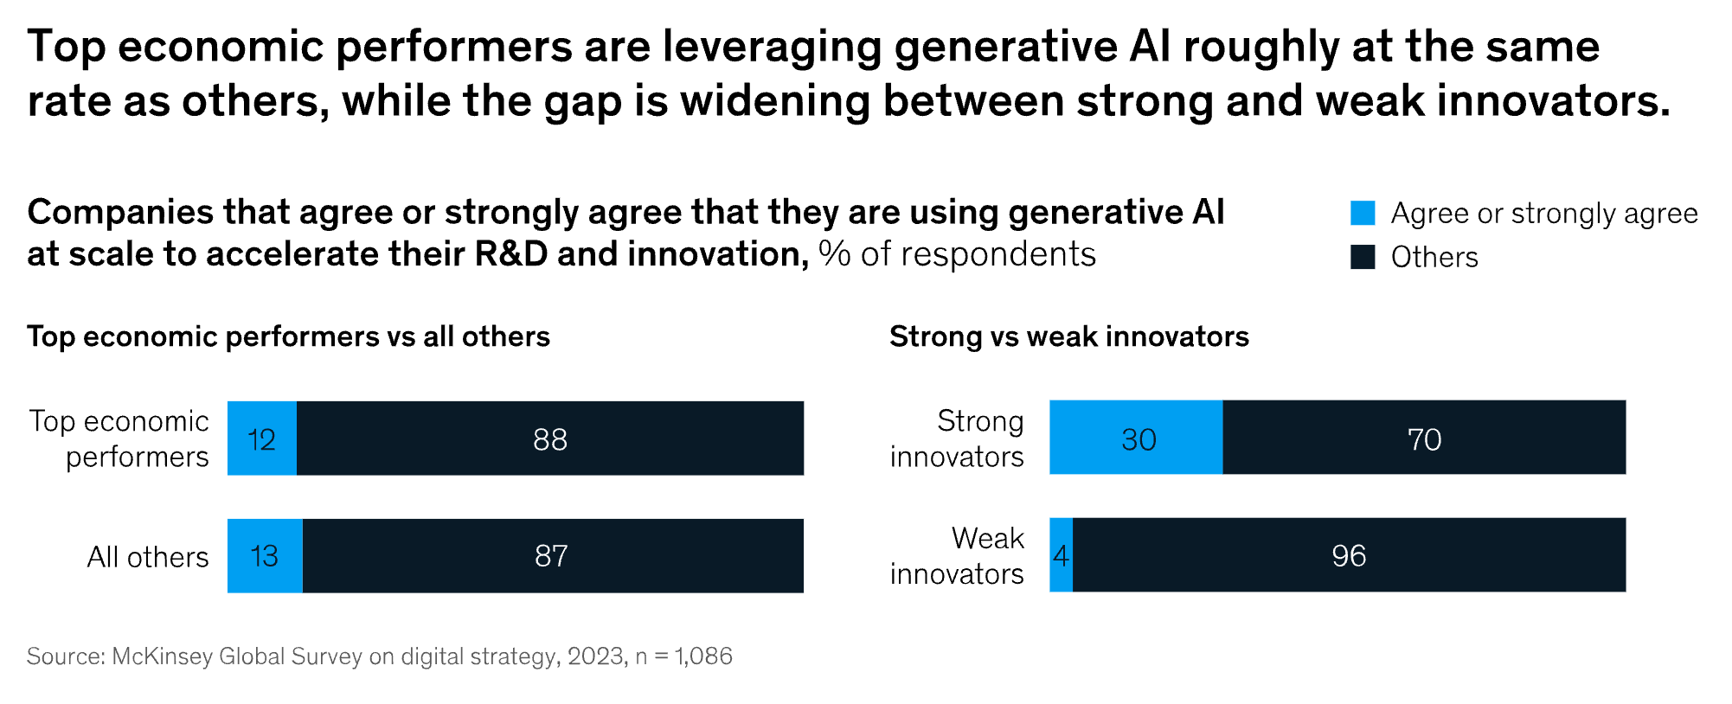
THE RESULTS ARE ALREADY IN
30% of top innovators are already deploying Generative AI at scale in their innovation and R&D functions, more than 6 times the rate of companies that are lagging behind on innovation
McKinsey, Companies with innovative cultures have a big edge with generative AI

Slide 9
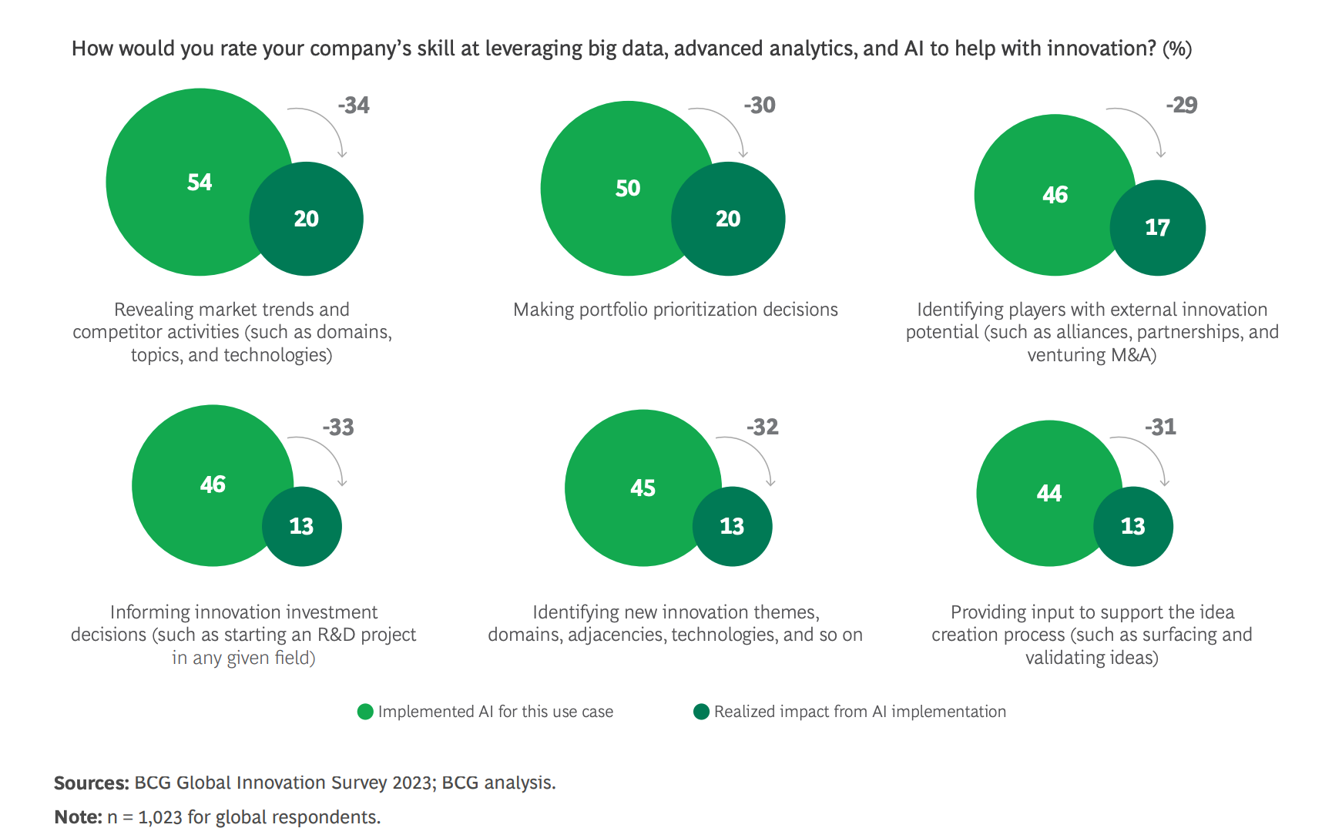
THE RESULTS ARE ALREADY IN
Many companies are using AI to support innovation, but few
are achieving impact
BCG, Reaching New Heights in Uncertain Times, 2023

Slide 10
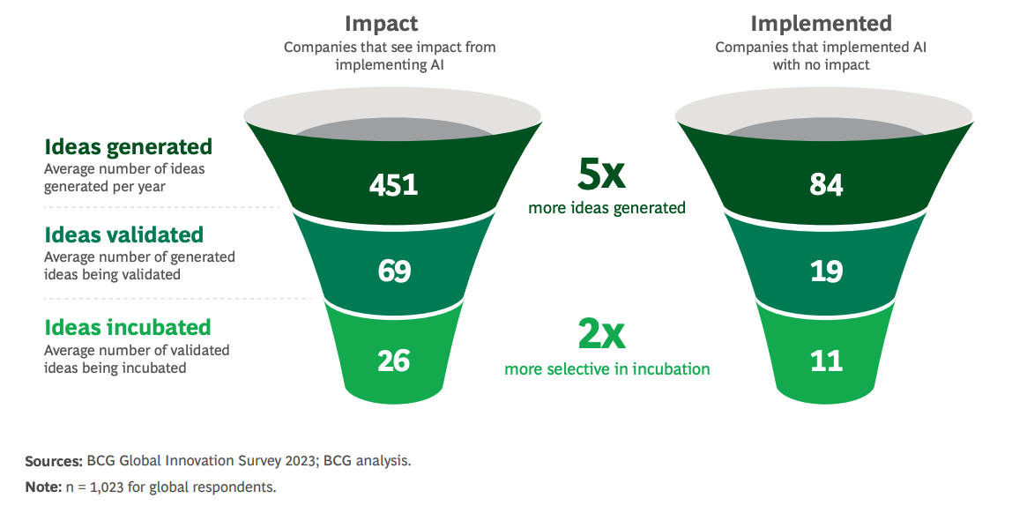
THE RESULTS ARE ALREADY IN
The most innovative companies are implementing AI and seeing 5x larger funnel of venture ideas and are 2x more selective in their choices.
BCG, Reaching New Heights in Uncertain Times, 2023

Slide 11
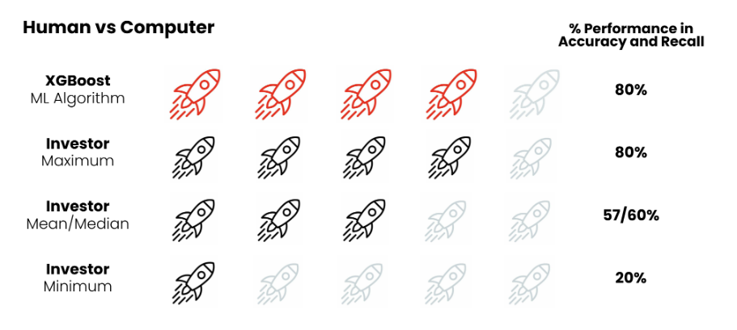
Venture Investing
THE RESULTS ARE ALREADY IN
By 2025, more than 75% of VC and early-stage investor executive reviews will be informed by AI and data analytics.
Gartner, Gartner Says Tech Investors Will Prioritize Data Science and Artificial Intelligence Above “Gut Feel” for Investment Decisions By 2025
The evidence suggests that machine learning models consistently outperform human investors in the screening process
Vauban, From Data to Dollars: How AI is transforming Venture Capital

Slide 12
Estimations and Real-World Results
GenAI could deliver productivity with a value of ~12% of global R&D spending → potential productivity lift of ~$328B
GenAI could add the equivalent of $2.6-$4.4 trillion to the global economy annually across 63 use cases analyzed
McKinsey, The economic potential of generative AI: The next productivity frontier
WSJ has shown ChatGPT beating 200 Wharton MBA students at a venture idea generation test.
The results of their study were not unexpected:
ChatGPT generated ideas more rapidly than humans
ChatGPT had a 47% purchase probability compared to humans' 40%
ChatGPT produced 88% of the top ideas, leaving only 12% to MBA students
The Wall Street Journal, M.B.A. Students vs. ChatGPT: Who Comes Up With More Innovative Ideas?

Slide 13
AI is supercharging innovation across use cases
USE CASES
Fortune 500 companies are already using AI to achieve their strategic innovation goals driving efficiencies:
6-7 figure decrease in market research and innovation consulting spend
Increased Productivity of staff
Larger and more de-risked innovation funnel
M&A research support
Enriching ideation contests with real-world data at scale
Venture Building
100x improvement over the professional services process from problem space to market signal for concrete ventures
Venture Investing
Wider field of view compared with whitespaces for markets within the investment thesis
Venture Studios
Enabling the whole process with faster, AI-enabled go-to-market and more flexible hiring
Internal Matchmaking
Finding the right business unit, the right budget, and the right innovation leader for the identified ventures to become a reality
Hyper-focused Accelerators
Understand the most interesting viable ventures and invite matching startups to a tailor-made accelerator
Ideation Contests
Enrich ideas coming from internal and external sources, rank them and expand them into viable, testable businesses

Slide 14
Impacting the approach

Slide 15
How can Gen AI tools impact your approach to innovation?
Ideation and Concept Development:
Experiment: Utilizing Generative AI to brainstorm new product or service ideas and create diverse concept models.
Metric: Measure the novelty and feasibility of the generated concepts compared to traditional methods.
Gen AI in idea generation, concept prioritization, value proposition design, and business model innovation
Design Generation and Prototyping:
Experiment: Employ AI to autonomously generate design variations and prototypes based on specific criteria or data inputs.
Metric: Evaluate time saved in the design phase and the variety and quality of generated designs.
GPT-4 scored in the top 1% of test-takers for the originality of its ideas, after taking Torrance Tests of Creative Thinking (TTCT), a test that assesses general creative abilities in individuals.
→ Suggesting that AI can excel in generating unexpected and unique ideas, potentially surpassing human creative thinking.
Example Experiments
Automated Content Creation:
Experiment: Implement Generative AI for creating marketing content, ads, and product descriptions.
Metric: Analyze improvement in content production speed, diversity, and engagement metrics. Assess customer engagement.

Slide 16
Amplify your opportunity exploration and validation efforts with AI
AI USAGE EXAMPLES
Hyper-Personalization of Ventures:
Generative AI can craft solutions based on individual consumer behaviors and preferences, working on consumer behavior theories and niche market strategies. Imagine ventures tailored to micro-segments or even individual preferences.
TOOLS EXAMPLES
Generative Design Tools:
Example: Autodesk Generative Design, which explores optimized design alternatives.
AI-enhanced Market Research Tools:
Example: Crayon, which uses AI to track and analyze the online footprint of competitors.
Scenario Planning & Strategy Development:
Drawing from game theory, AI can run multiple scenarios and predict outcomes based on competitor moves, market changes, and internal strategies. This can be used to simulate "games" where different business strategies are played out.
Predictive Analytics Platforms:
Example: RapidMiner, utilizing machine learning to predict future trends and identify opportunities.
Customer Insights and Feedback Tools:
Example: Remesh, which uses AI to analyze customer feedback at scale.
Expanding the Solution Space during Opportunity Exploration:
Generative AI can extrapolate from existing data to visualize potential future states or solutions, grounded in futures thinking and innovation theory. This expands the horizon of opportunities being explored.
Simulation Software:
Example: Simul8, for creating accurate simulation models to test scenarios in a risk-free environment.
AI Content Generation Tools:
Example: Jasper (formerly Jarvis), for generating marketing content, emails, and ad copies.

Slide 17
How to use AI? Centaur and Cyborg Practices Deepdive
Centaur Practices
Use individual’s knowledge of the current strengths of Gen AI relative to theirs to switch between human and AI for each of the modules/sub-task of the tasks accordingly throughout the workflow.
Cyborg Practices
Use AI for each of the sub-tasks throughout the whole workflow. Apply principles based on current knowledge about how to best elicit useful outputs from AI and/or continually question AI and experiment to reach a better output.
Mapping Problem domain: Asking AI for general information related to the problem’s domain for the human to use for their sub-task.
Gathering methods information: Asking AI for specific information on methods that the human is employing to solve their sub-task
Refining human generated content: Users providing their own output and using AI to refine its presentation.
Assigning a persona: Instructing AI to simulate a specific type of personality
Requesting editorial changes to AI output
Teaching with examples: Giving correct answer examples before asking questions
Modularizing tasks: Breaking down tasks into multiple sub-steps for AI to execute
Validating: Asking AI to check its inputs, analysis, and outputs
Demanding logic explanation: Asking AI to explain a confusing output; or why a particular recommendation was made
Exposing Contradictions Pointing out logical or factual inconsistencies
Elaborating: Asking AI to bring more breadth of details and nuance on an interesting or unexpected point
Directing a Deep dive: Directing AI to focus on a particular data point or task
Adding user’s own data: Adding data after an output is generated to re-do the analysis in iterative cycles
Pushing back: Disagreeing with the output and ask AI to reconsider
Dell'Acqua et al., http://dx.doi.org/10.2139/ssrn.4573321
Notes:
Firstly, our resultslend support to the optimism about AI capabilities for important high-end knowledge
work tasks such as fast idea generation, writing, persuasion, strategic analysis, and
creative product innovation. In our study, since AI proved surprisingly capable,
it was difficult to design a task in this experiment outside the AI’s frontier where
humans with high human capital doing their job would consistently outperform AI.

Slide 18
Gathering real market signals and insights to test ventures at scale
Rapid Prototyping with Generative AI:
Approach: Utilize AI to swiftly develop prototype designs and iterate based on initial feedback, reducing the time from idea to market testing.
AI-Driven A/B Testing:
Approach: Implement AI tools to automate and optimize A/B testing of venture ideas on digital platforms, ensuring quicker validation with real-time data.
Semantic Analysis of Customer Feedback:
Approach: Use NLP tools to analyze customer feedback, reviews, and social media mentions to quickly gauge public perception and adjust strategies accordingly.
Predictive Analysis for Market Response:
Approach: Employ predictive analytics to forecast market responses and optimize product features and marketing strategies before full-scale launch.
Scalable Virtual Focus Groups:
Approach: Utilize AI to simulate or manage virtual focus groups, ensuring that insights and validation can be achieved even with remote or dispersed demographics.
Automated Social Media Analytics:
Approach: Leverage AI tools that can scan and analyze social media trends and responses to quickly adapt marketing and product development strategies.

Slide 19
Best Practices & Tangible Results

Slide 20
Use case from an existing U+AI client using this process for Venture Discovery and validation
7
200
“Being enabled by this platform is making me 2-3x more productive”
– Innovation Associate
problem spaces explored within one bigger one
overall venture ideas generated
10
10+
venture ideas selected for bigger enrichment
sign ups within a few days from paid campaigns with 2 venture ideas launch as market test
“Just the market research report portion is saving us 40 hours per week of 1 person”
– Innovation Manager
AI-generated microsites based on AI-generated venture discovery driving real market demand.
5 months of Venture Building work → in 2 weeks

Slide 21
5 steps to leveraging AI for Venture Discovery
Internal collaboration to answer eight key strategic questions
Review and refine AI prompts for the given opportunity or problem space
Run the AI to automate Market Research and Venture Idea Generation
Review and refine results based on strategy and context to get actionable insights
Collaborate to rank and select ideas for Market Validation and Testing
Start building the venture with the best market results
1
2
3
4
5
6
TIMELINE
2 weeks
TIMELINE
~5 months until MVP launch

Slide 22
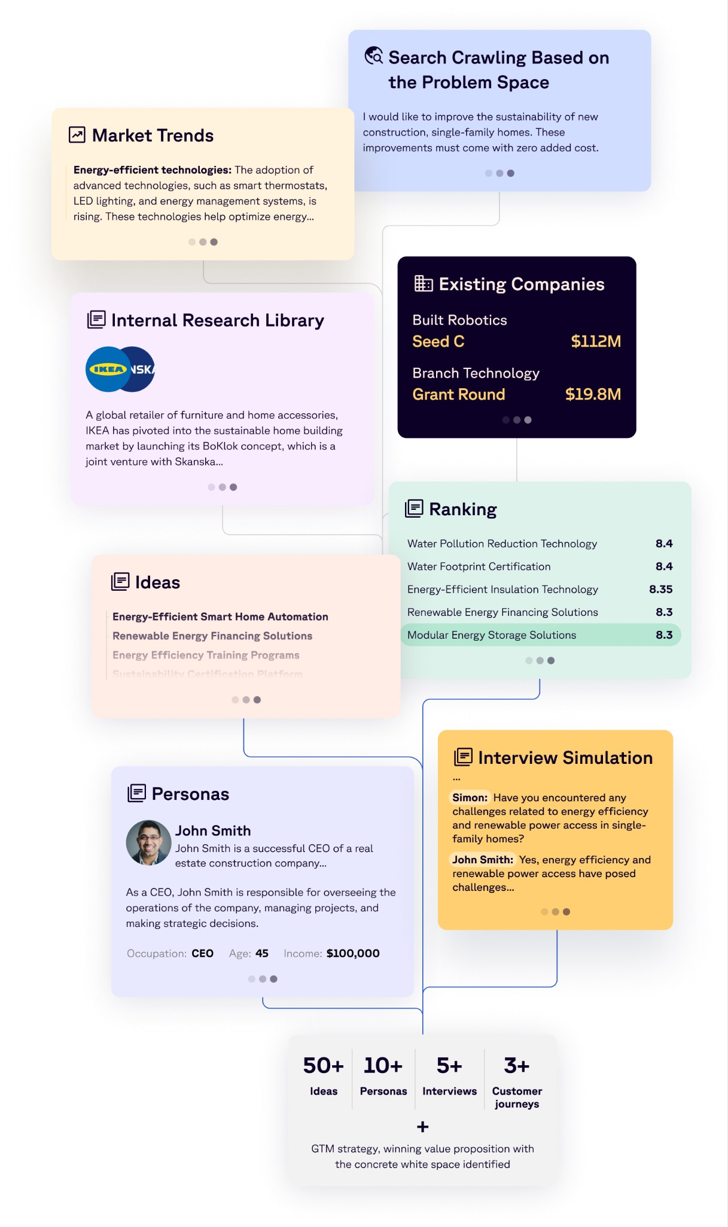
The ROI Engine for Innovation, Strategy, & Investment teams
Research AI
Discovery AI
Market Test AI
Research, Discover, ‍Market Test, Deliver & Grow Ventures 100x faster
Agent-based research
Private Datasets
Market sizing, Trends, Segmentation, Challenges
Startups and VCs
All Sources
Venture Discovery
Venture Ranking
Personas, Interview Simulation, Customer journeys
Venture Recommendations
White-space Analysis
Feature Breakdown
Target Audiences
Campaign Design
Microsite Generation
Multivariate Multigenerational testing

Slide 23
U+ Venture Experience
Esther Eller
Former Techstars Studio Director
Kartikay Chaudhry
Senior Manager for New Ventures, QCells
Garrett Viggers
CEO at Zoë Foundry
U+AI has upped the ante by turning venture studio into an AI-powered process. This will forever change the game.
Having worked in Corporate Innovation, Strategy, & Investments over the years, U+AI platform is a godsend for early investigative work. I have used the platform myself and it's fantastic!
U+AI will drive an efficiency differentiation for our venture studio, and for each of our portfolio companies, working smarter and increasing output.

Slide 24
We have done 100+ PoCs in 3 months
Desert Agriculture
Predictors of CEO performance on IPO Success
Healthcare Financing & Employer-Sponsored Insurance
6G Mobile Communication Standard Solutions
Monetizing End-of-life Tires
End-to-end digital pathology services
Healthcare Financing & Employer-Sponsored Insurance
Insurance Industry: Cross-selling & Bundling Solutions
Parametric Insurance Products
Process Automation of Insurance Claims
Future of Underwriting in Insurance
Home Insurance
Electric Vehicle Insurance
Wildfire Mitigation Techniques
Home Hardening Against Wildfire Damage
Multiple Myeloma
Patient Appointment Scheduling
GenAI Usage in Healthcare
Long-Duration Energy Storage System Solutions
6G Mobile Communication Standard Solutions
Biomass Supply for Energy Production
Carbon Credit Customer Acquisition Capability
AI-Powered Chatbots for Customer Support
Generative AI for Architecture
Solar Panel Hail Damage Mitigation
Addressing Mental Health Challenges Faced by Adolescents
Integration of Modern Art and Design Curriculum into Schools
Luxury Hospitality
Sustainability in Dairy processing and Logistics
Integration of Digital Solutions in the BPM Lifecycle
Aviation Circular Ecosystem

Slide 25
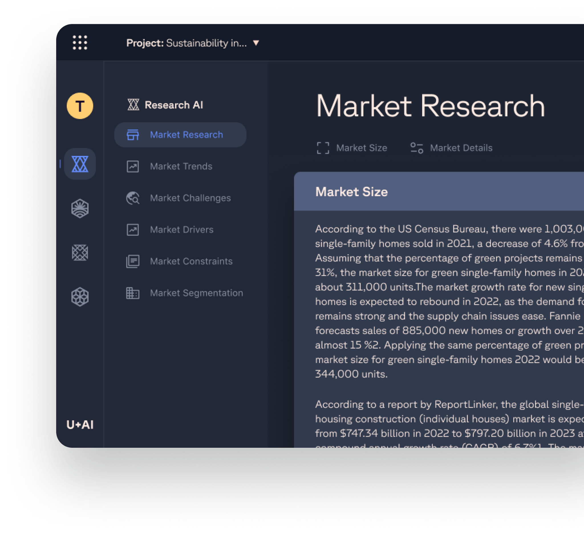
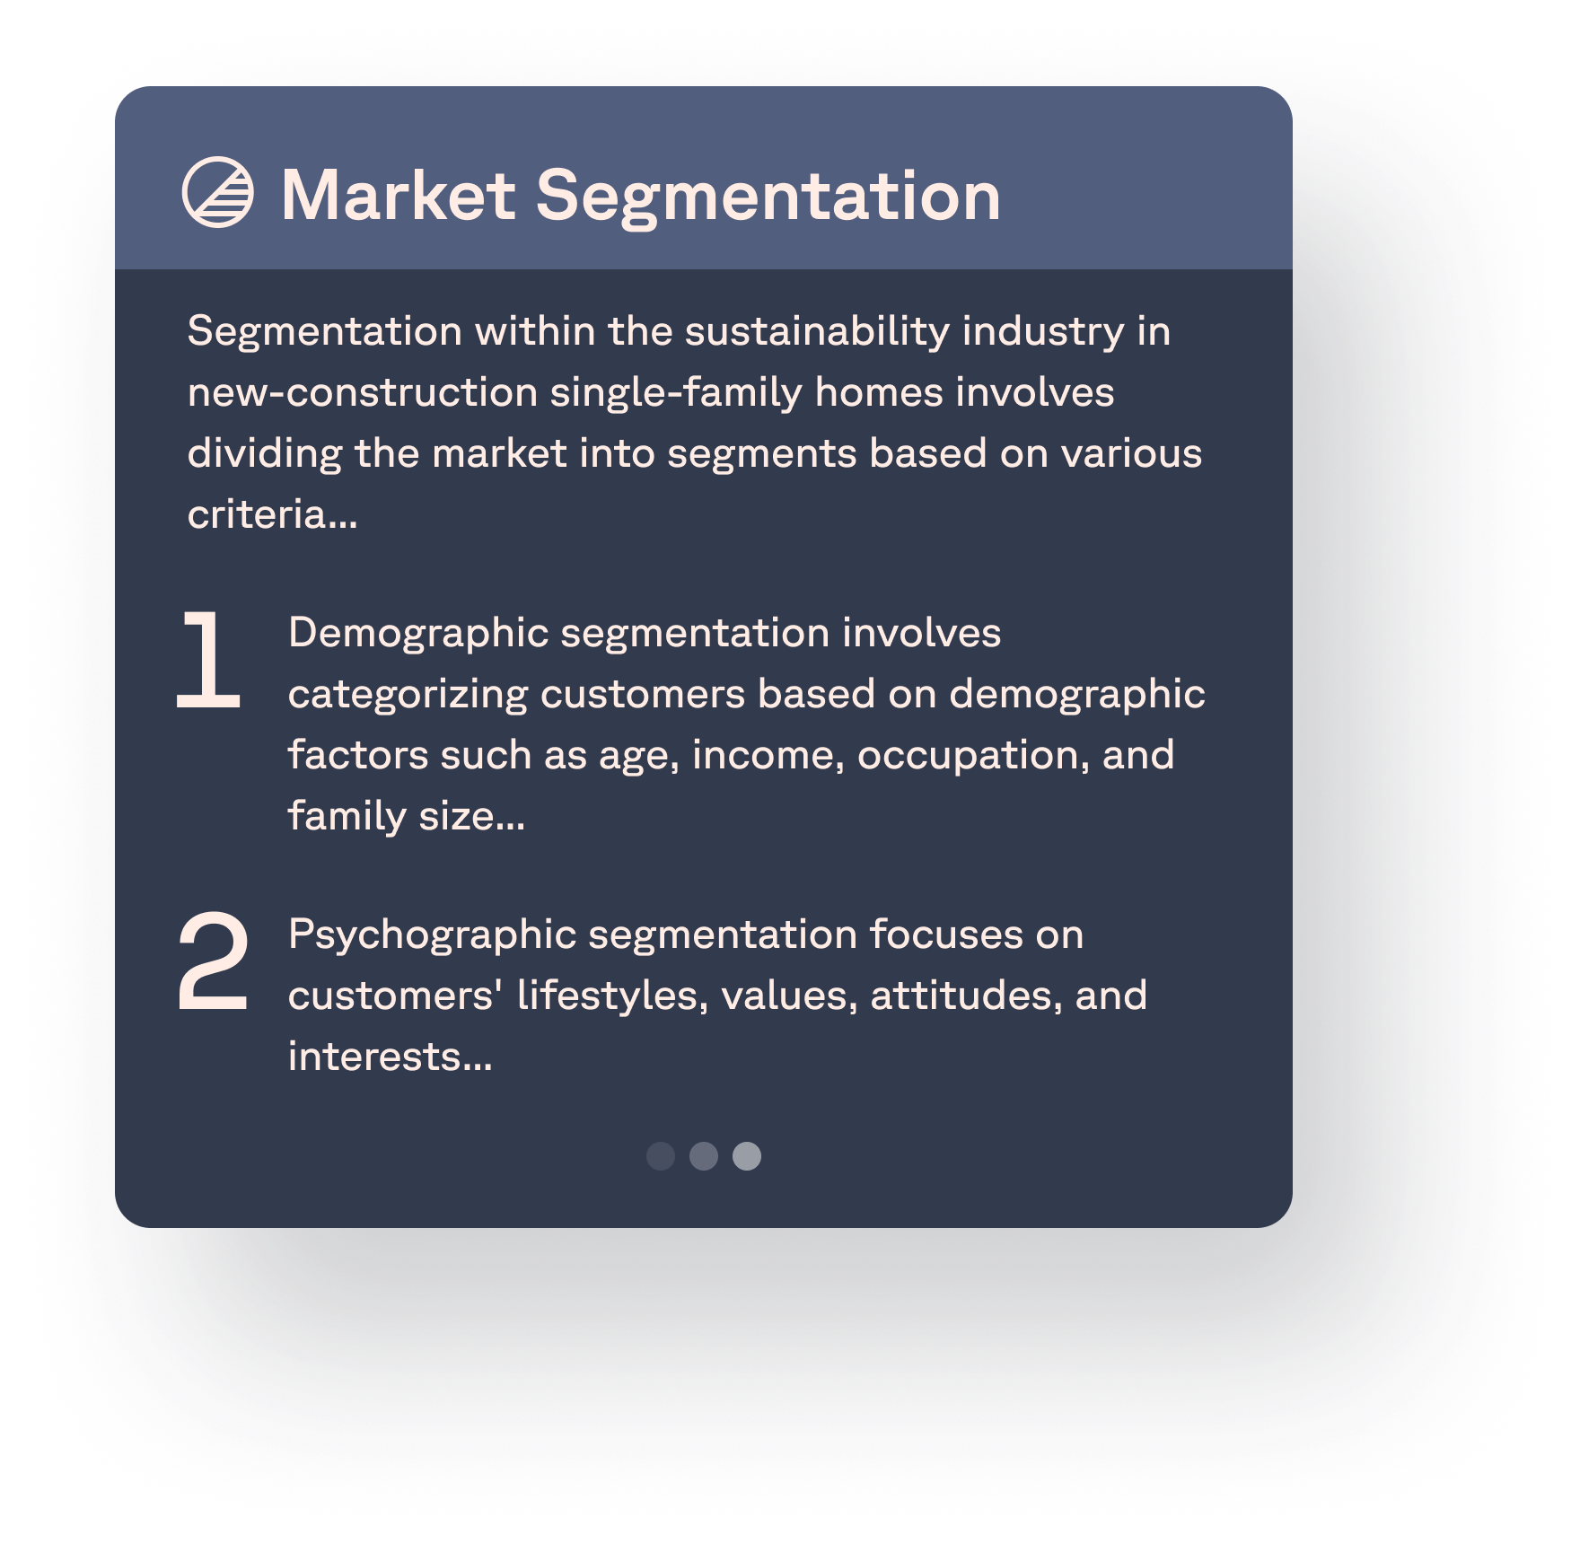
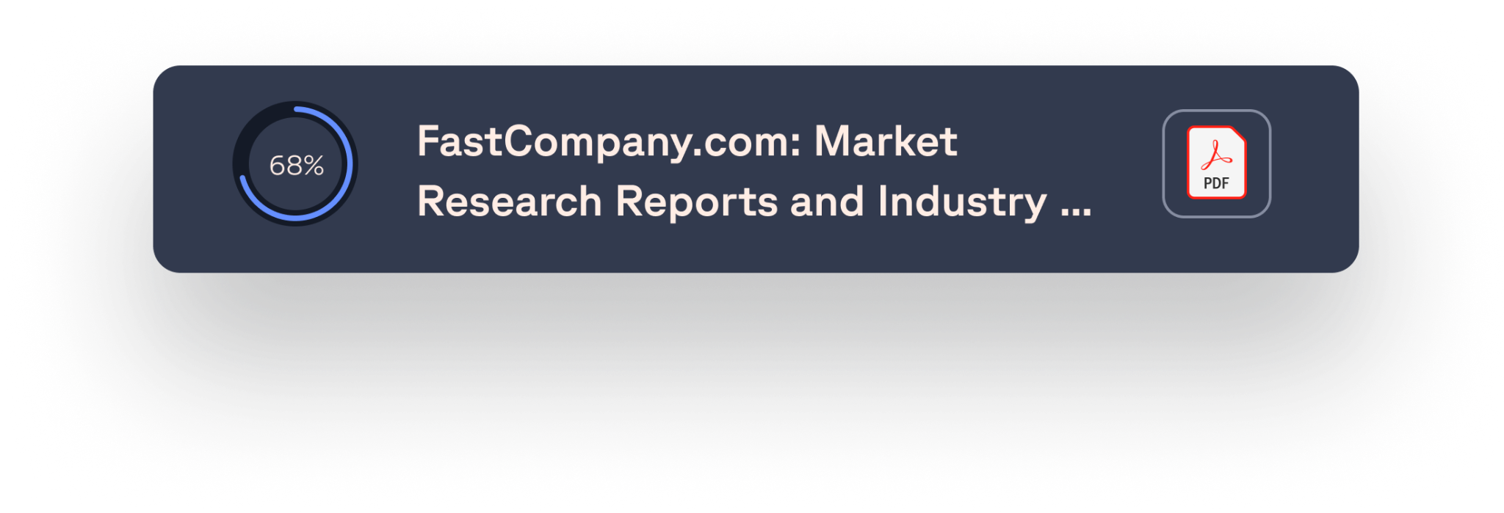
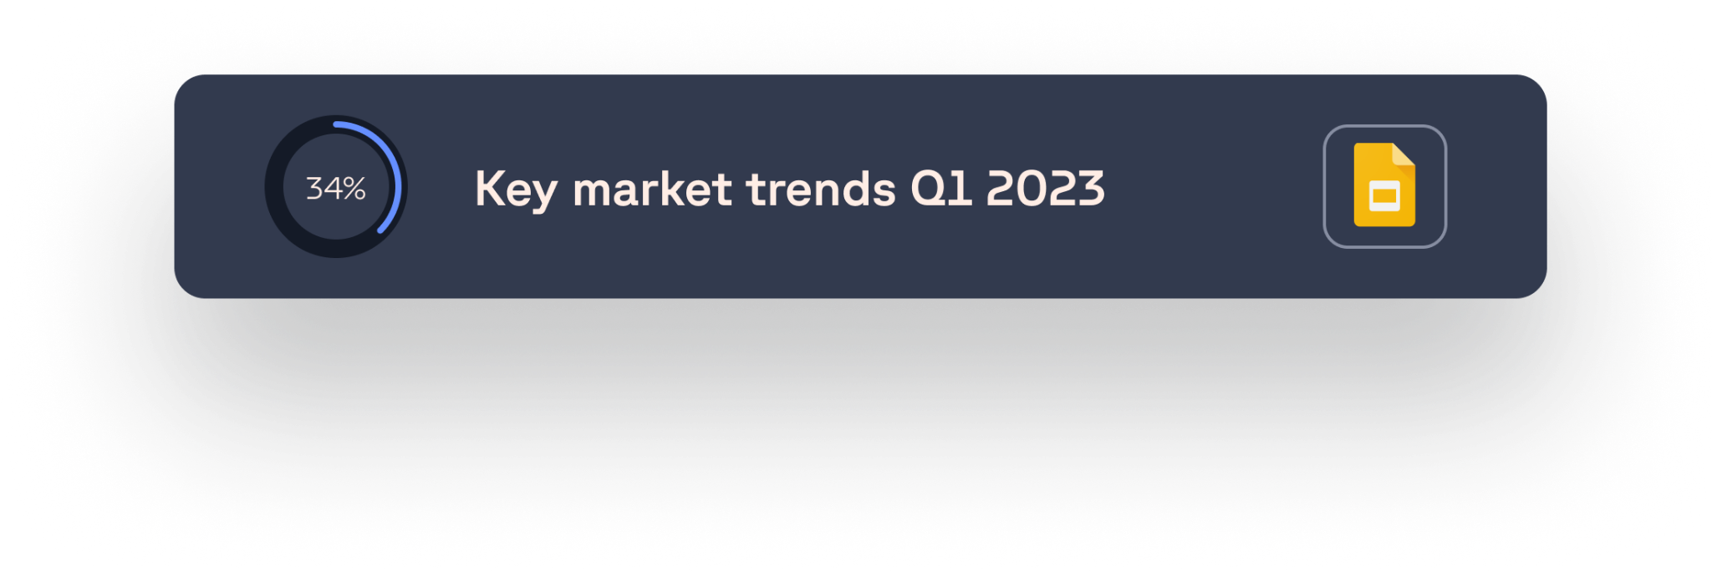
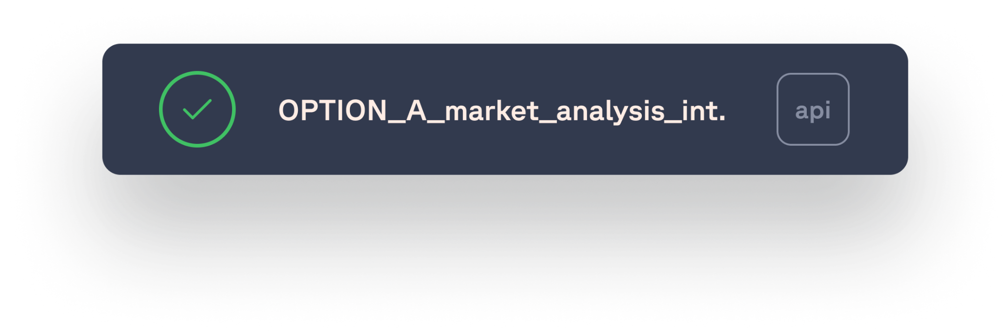
Research AI
Automated Market Research in 30 mins
Explore any opportunity space, discover trends, challenges, existing startups and VCs and get access to hundreds of relevant sources
1. Agent-based Research
Based on the opportunity space focus, the Research AI creates search queries, finds the best matching public market research, and creates a context of information based on it while preserving all the sources.
4. Startup and VC Scouting
Every Opportunity space exploration includes large incumbents as well as a list of startups with funding numbers, funding stage, etc. The space’s most active VCs are included too.
2. Private Datasets
Using internal data enriches the research process and creates a more tailored output. Your PDFs, slides, data lakes, APIs, or report subscriptions can all be added as context
5. Sources
All sources are preserved and fully referenced so that you can dig deeper into aspects of interest.
3. Structured Market Understanding
Market sizing, Trends, Segmentation, Challenges, and Drivers are all summarized based on the public and private context into a digestible report with relevant sources.

Slide 26
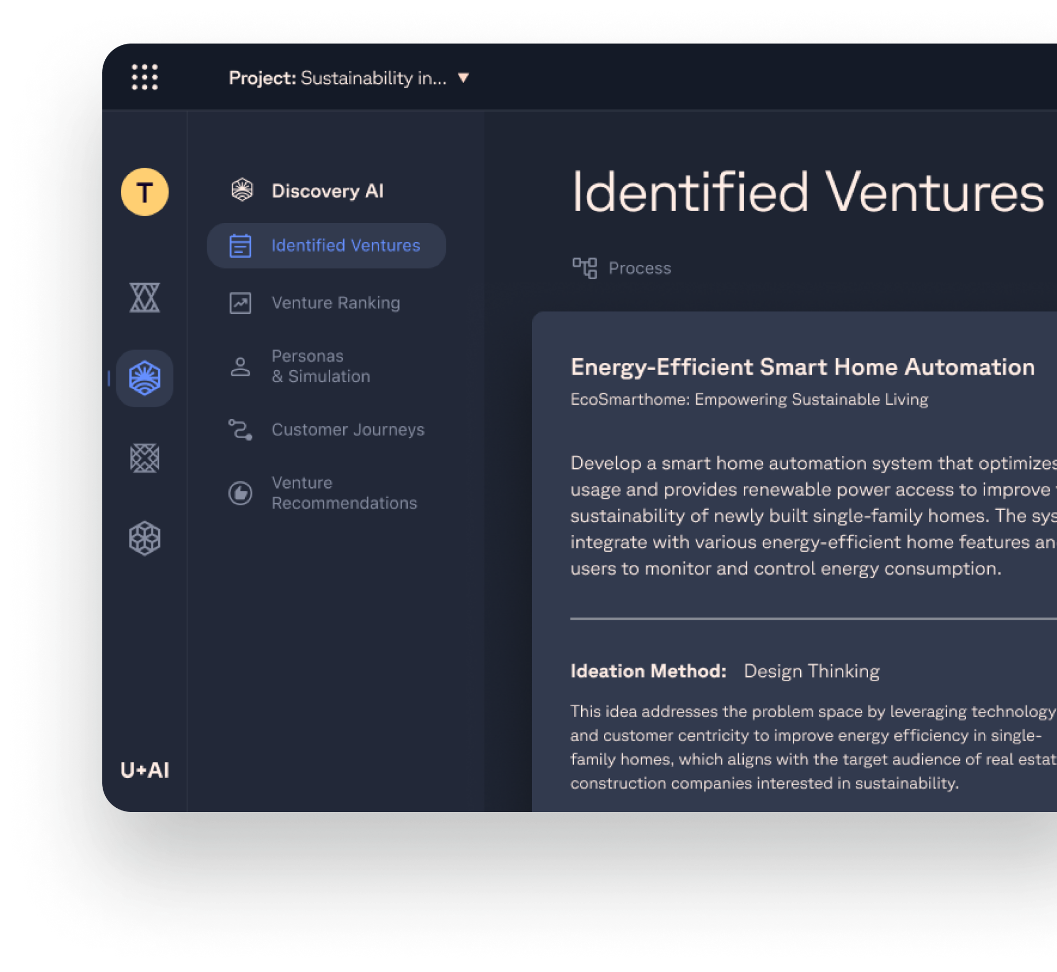
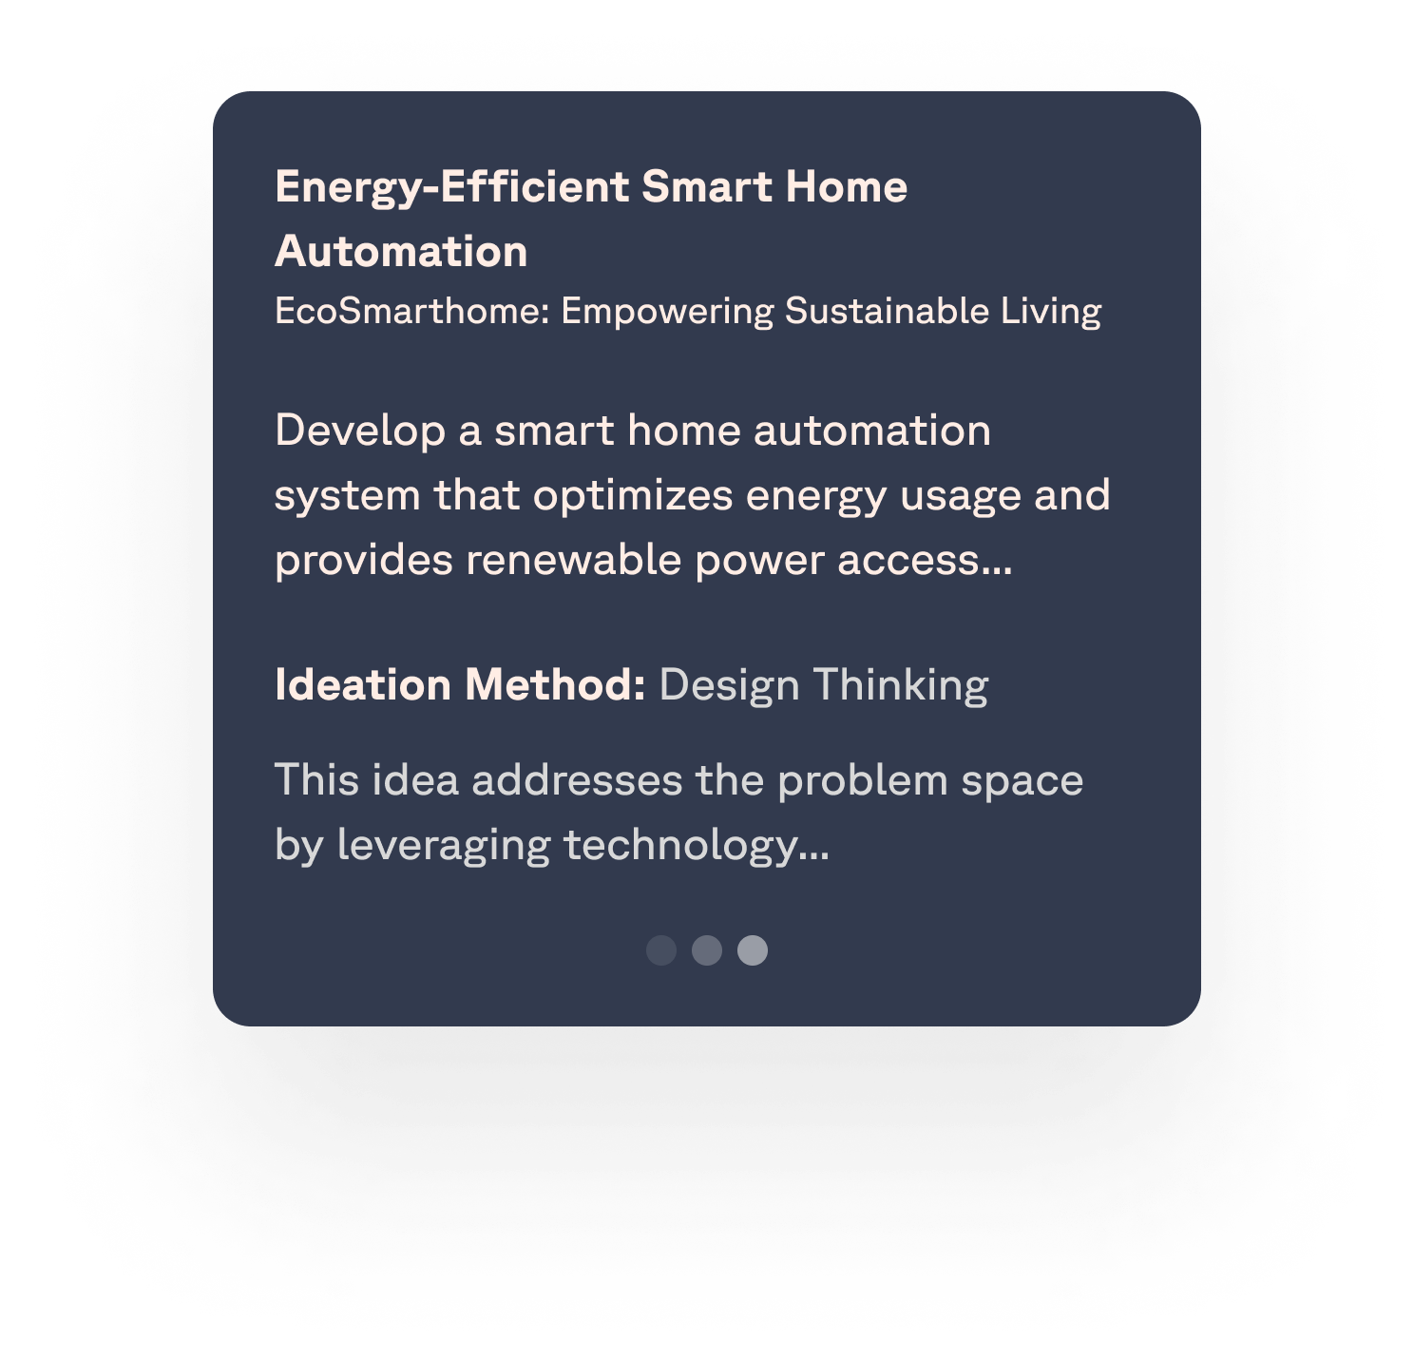
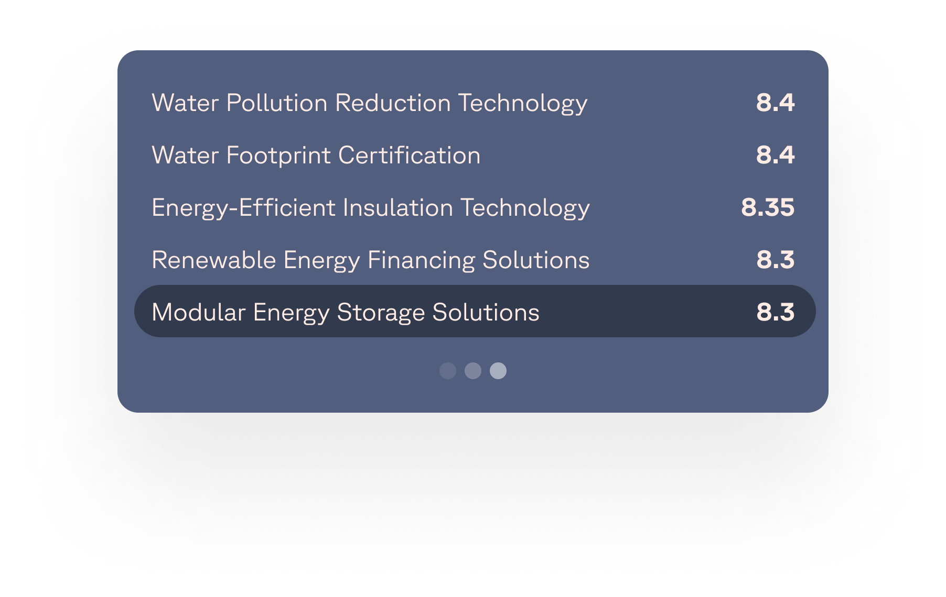
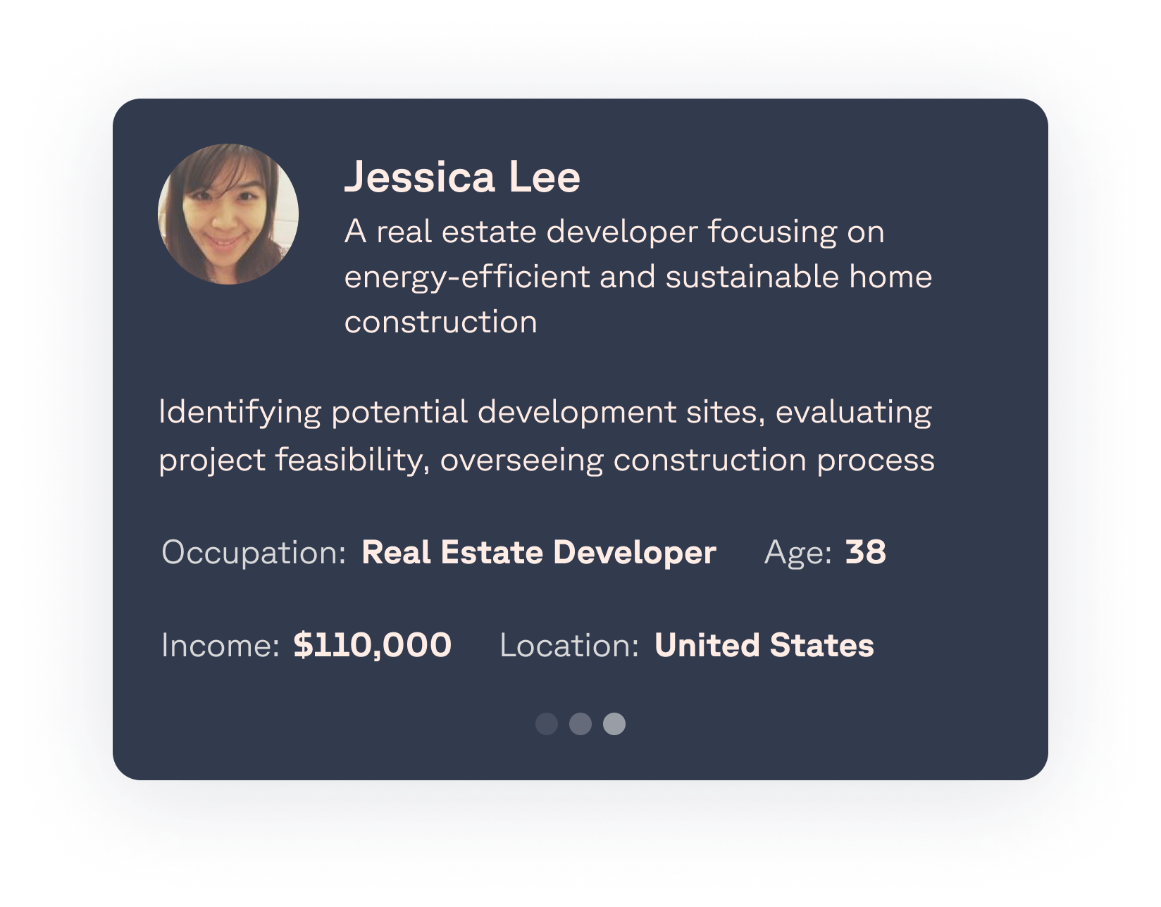
Discovery AI
AI Venture Ideation, Exploration, Ranking, Recommendation
Get viable, testable new business ventures based on public and private data.
1. Venture Identification
Design thinking, Mckinsey 7s, Google Ventures Design Sprint, and other popular ideation methods are used to generate viable ventures based on provided market research context.
4. Venture Recommendations
Once the exploration is done, each venture has a go-to-market strategy, large research-driven justification, value proposition, desired features, positioning, and differentiation are created.
2. Venture Ranking
All generated ventures are automatically ranked based on Market and Company metrics – market sizing, growth rate, concentration, as well as alignment with the company strategy, assets, and the right to win in the space.
5. White-space analysis
Follow-up research is executed to find companies that match the value proposition of the generated venture. The platform assesses their strengths and weaknesses and compares them against the market potential. This identifies a white-space potential for the venture a defines viable positioning.
3. Personas, Interview Simulation, Customer journeys
The platform creates customer personas for each venture as well as discovery interview scripts. The interviews are simulated to get structured outputs based on role-played interviews giving us concentrated insight into the necessary features for the venture + tooling that can be reused for human interviews later.

Slide 27
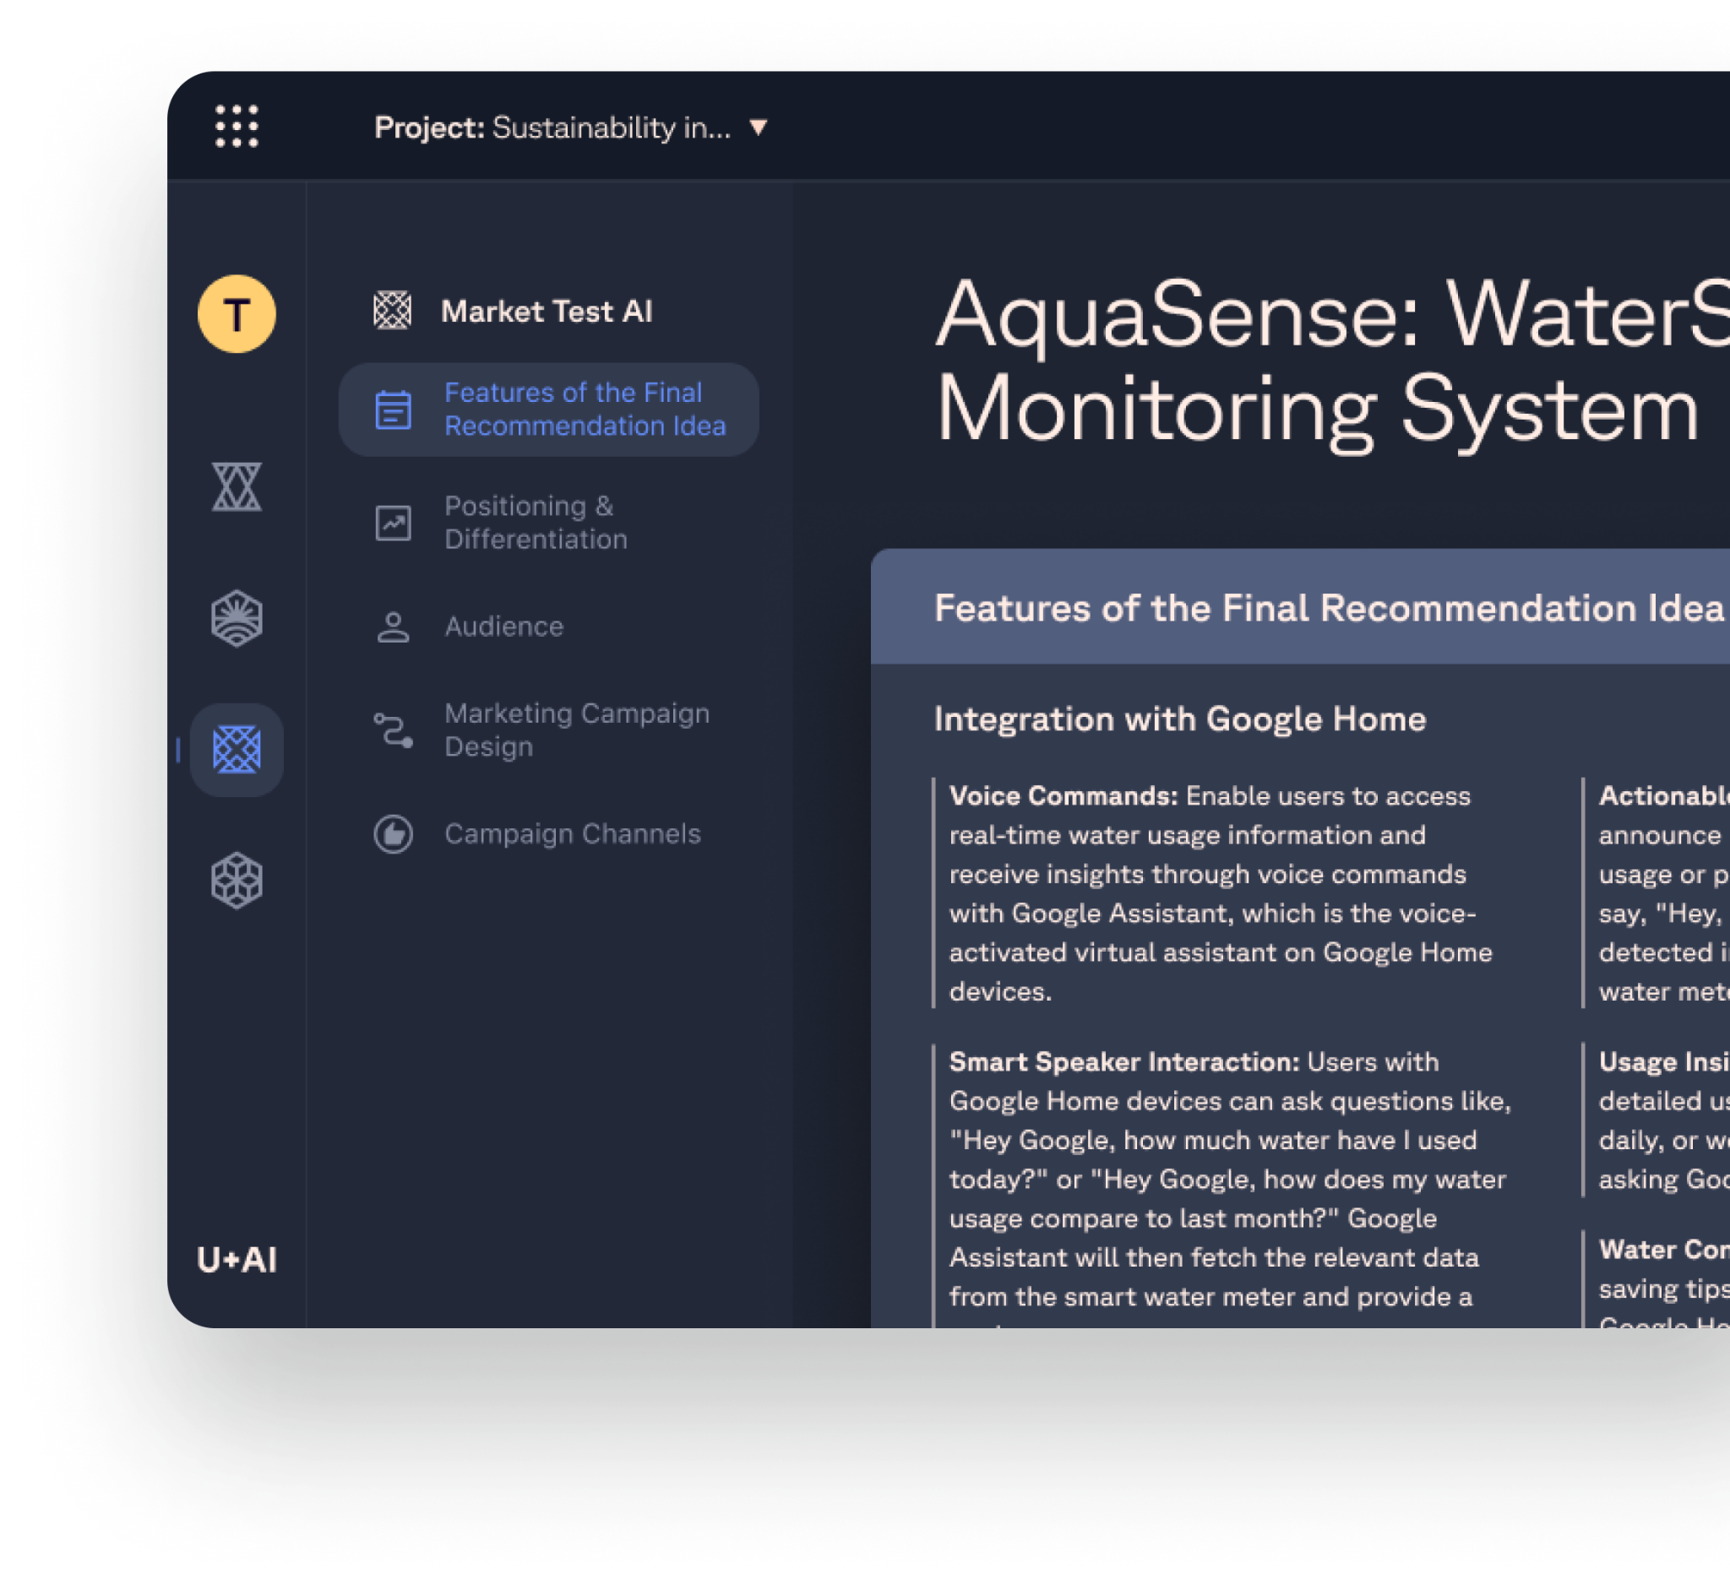
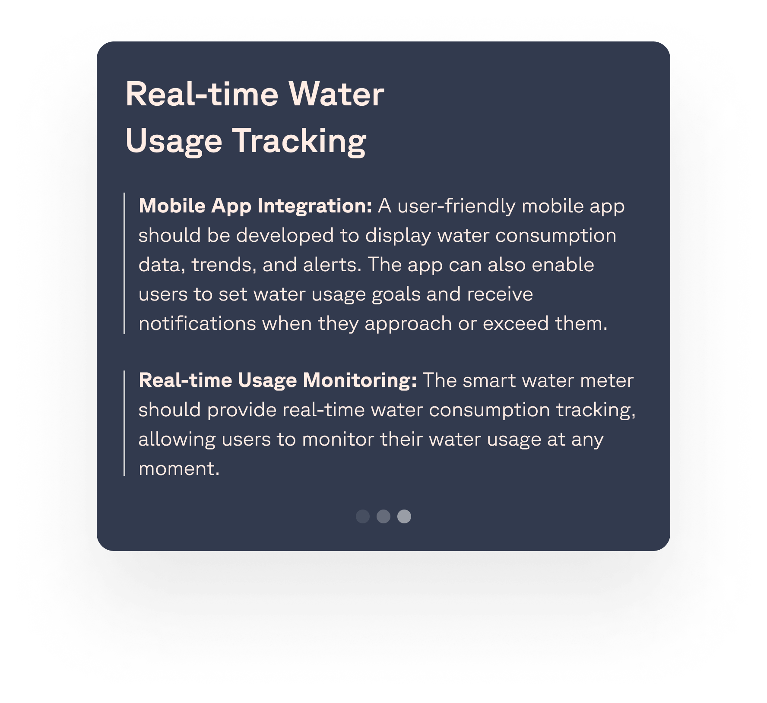
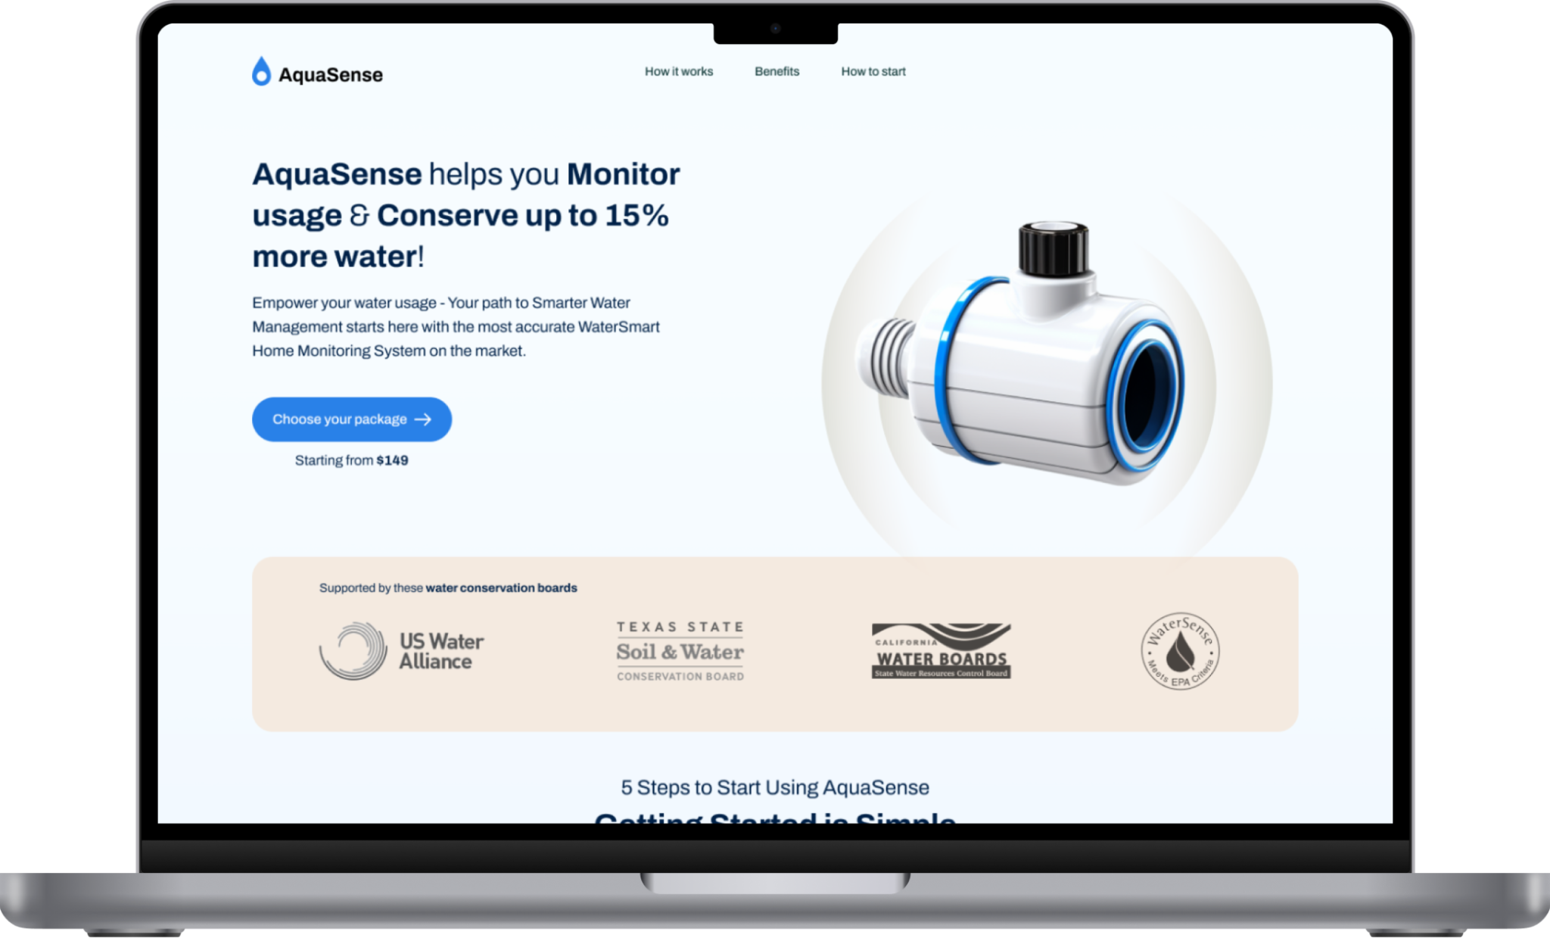
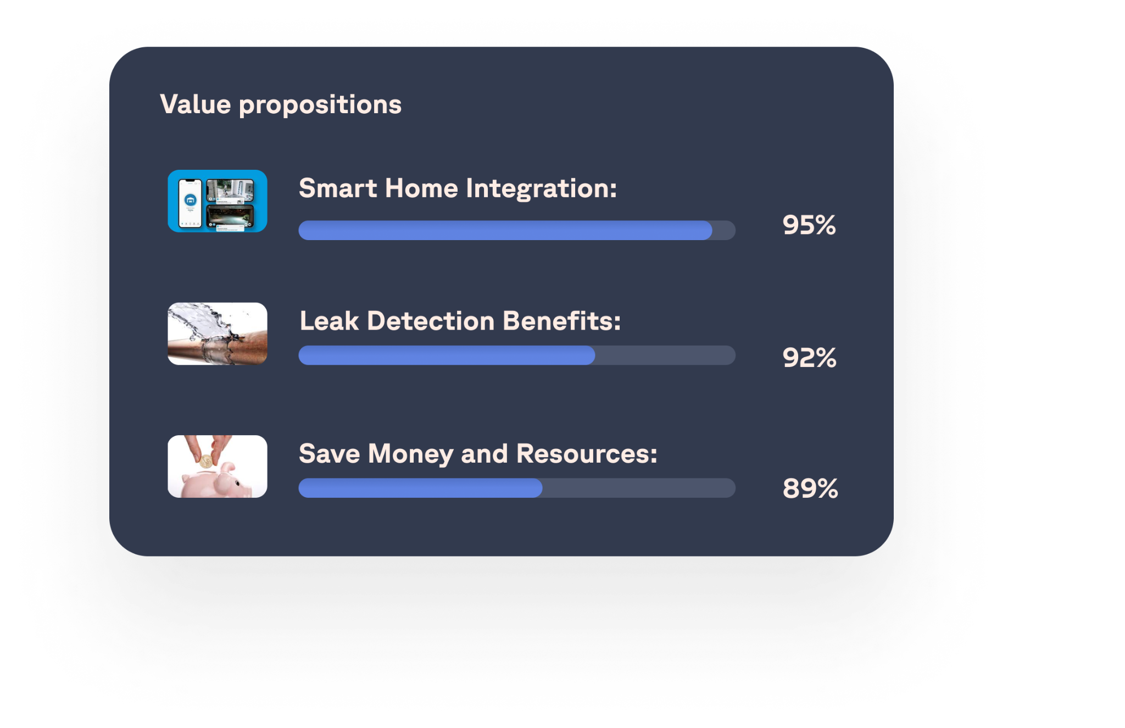
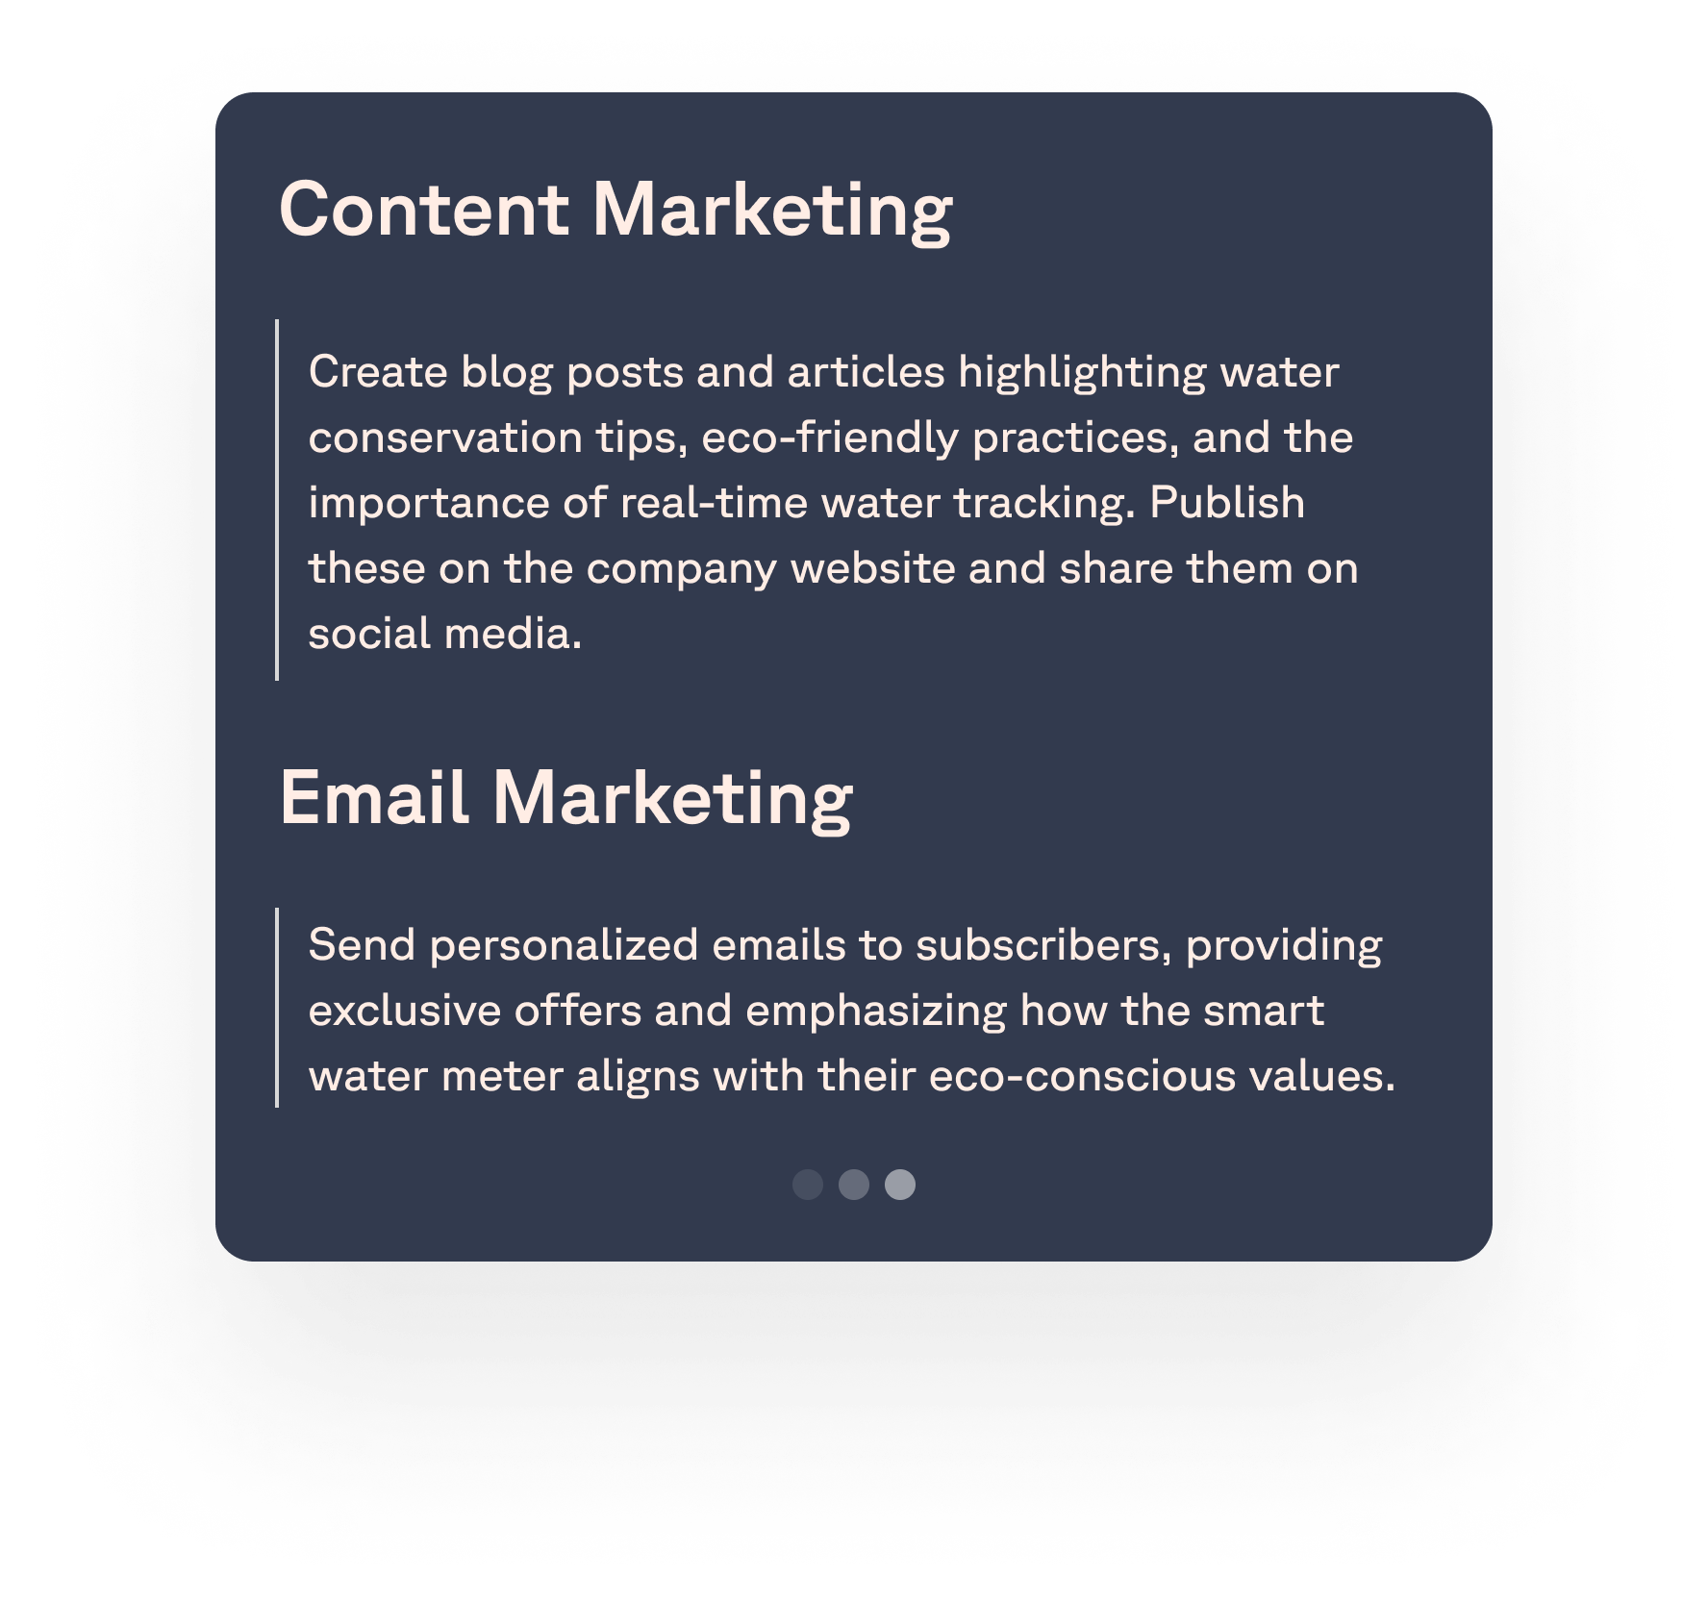
Market Test AI
30 Ventures x 3 Variants = 90 Microsites live in a day
Smoke testing at scale and repeatability never seen before. Real market signals in a matter of days, not half a year.
1. Feature Definition
An automated agent explores possible feature expansion given the conducted research, simulations, and white space potential to create a list of potential features matching with the value proposition. There are then matched into packages to be tested.
3. Testing Microsite Creation
The Discovery AI context is fed into our website builder, which creates multiple versions of possible microsites. The microsites are targeted using campaigns from the previous step to assess market potential.
2. Audience & Campaigns
Multiple sets of audiences with ad copy, campaign channels, and precise targeting are generated so that acquisition marketing can be set up
4. Multivariate Multigenerational testing
Since the microsites are fully generated, multiple variants of a value proposition can be auto-created and adjusted based on the campaign results.

Slide 28
U+AI Output: AI Venture Building

Slide 29
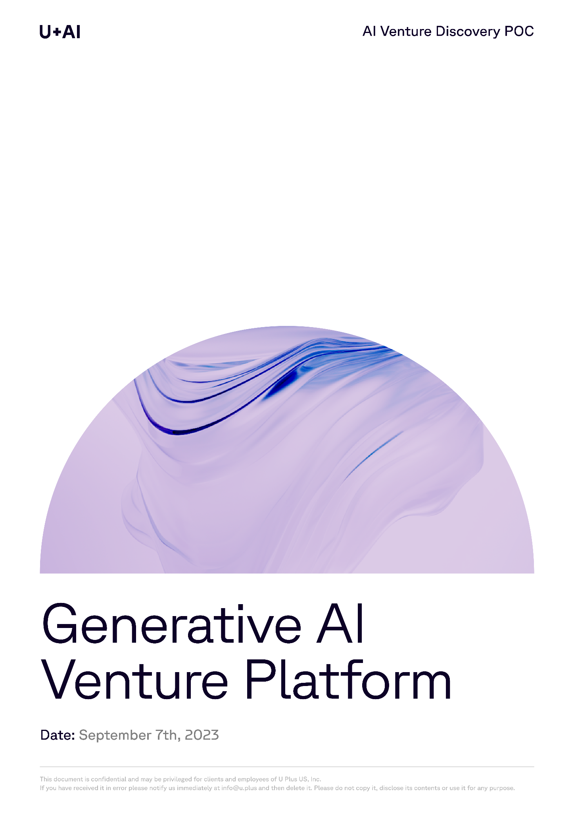
AI SAMPLE
Problem Space
Exclusively for this masterclass, we used our proprietary Venture Discovery AI for the problem space of… using GenAI for Venture Building and Innovation.
The company operates in the problem domain of venture building and innovation. They aim to address the high failure rate of corporate innovation and the challenges posed by frequent disruptions.
Their solution involves leveraging generative AI to automate market research, venture ideation, exploration, ranking, recommendation, and market testing.
The main customer base would be innovation, strategy, and investment teams within corporations, venture studios, and venture investors.
Proprietary U+ AI has generated market research on the initial problem space, segmented the market, identified market trends & constraints, generated 30+ concepts, 10 personas with interviews & journeys in 3 hours.
Full market insights (research, segmentation, trends & challenges), large incumbents and emerging startups can be found in the full report (which I am happy to share after this webinar), while highlights of generated ideas, personas, interviews and final recommendations have been included in this proposal.

Slide 30
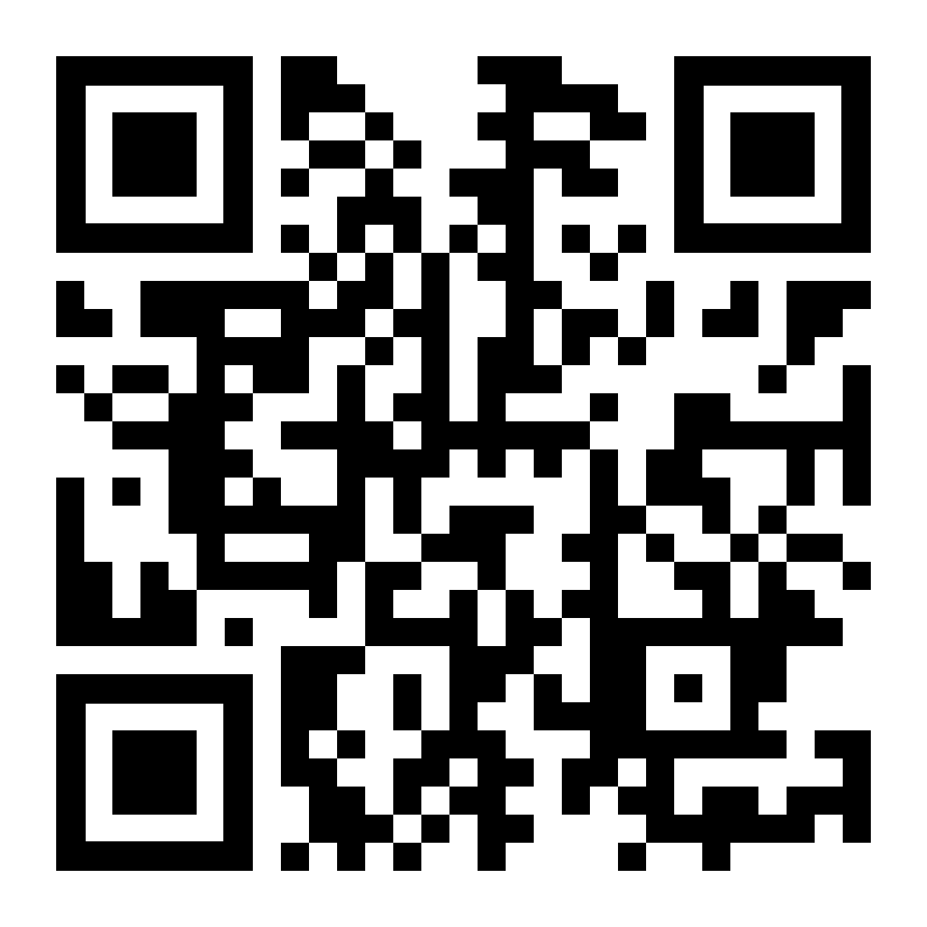
Get in touch
Join forces with us to build your future.
Sean Sheppard
Managing Partner, Americas
Ann Hofvander
Group Chief of Staff
Youssouf Kamal
Managing Partner, MENA
Jan Beranek
Founder, Group CEO
Christine Gulbranson
CEO, U+NOVA
LET’S TALK ABOUT VENTURE BUILDING
LET’S TALK GENERATIVE AI
LET’S TALK ABOUT VENTURE INVESTING

Slide 31
Have you tried AI?
Open Discussion
What challenges did you face during your initial AI integration?
How has AI changed your day-to-day work?
Are you exploring AI use cases for your innovation strategy?
Has AI impacted your decision-making processes in investments?
How do you see AI's role evolving in your firm in the next 5 years?
Are you preparing for the next wave of AI innovations? If so, how?

