Slide 1
Innovation Metrics: What You Measure is What You Get InnoLead / Wazoku Master Class 10.11.23

Slide 2
How mature is your approach to innovation metrics?
Non-Existent
Emerging / Taking Shape
Starting to Become Routinized & Reliable
Optimized & Accessible
Developing Innovation Metrics & Reports That Really Matter, March 2021

Slide 3
Which financial metrics do you consistently use?
Developing Innovation Metrics & Reports That Really Matter, March 2021

Slide 4
Which non-financial metrics do you consistently use?
Developing Innovation Metrics & Reports That Really Matter, March 2021

Slide 5
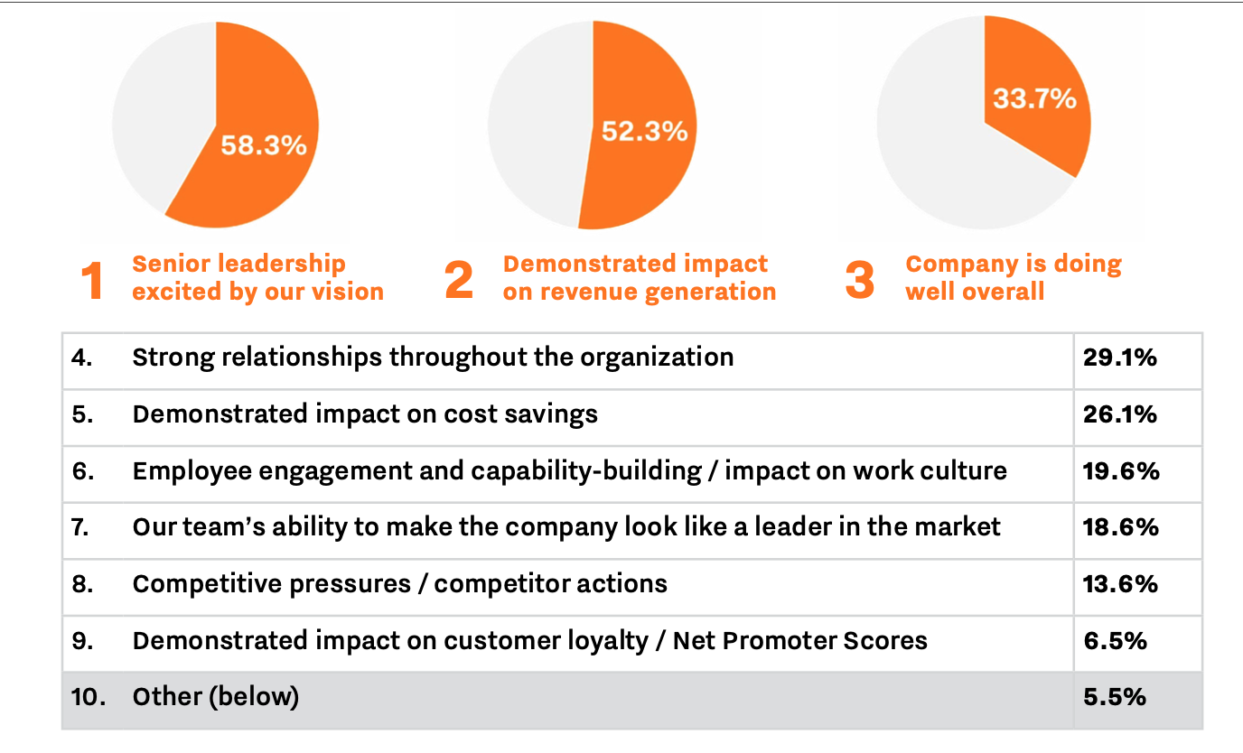
What are the three most important factors that impact your ability to get additional human or financial resources to support innovation?
Benchmarking Innovation Impact 2023

Slide 6
Coming soon…

Slide 7
Webinar Polls

Slide 8
How mature is your approach to innovation metrics? Webinar Poll Results
Non-Existent
Emerging / Taking Shape
Starting to Become Routinized & Reliable
Optimized & Accessible
InnoLead / Wazoku Webinar Poll, October 2023

Slide 9
How mature is your approach to innovation metrics? Combined Results
Non-Existent
Emerging / Taking Shape
Starting to Become Routinized & Reliable
Optimized & Accessible
Developing Innovation Metrics & Reports That Really Matter, March 2021; InnoLead / Wazoku Webinar, October 2021

Slide 10
How long has your most senior innovation leader been in his or her role? Webinar Poll Results
InnoLead / Wazoku Webinar Poll, October 2023

Slide 11
How frequently does your innovation team report innovation metrics to corporate or business unit leadership? Webinar Poll Results
InnoLead / Wazoku Webinar Poll, October 2023

