Slide 1
Building a Healthy
Innovation Program
with ISO 56002

Slide 2
The Speakers
Paul Pirie
Sara Husk
Senior Manager for Integration and Innovation in the Digital Health Program at the Ministry of Health (Ontario)
Planbox's
Chief Customer Officer
Erin Regala
Mark Neff
Program Consultant in Integration and Innovation in the Digital Health Program at the Ministry of Health (Ontario)
Lead Innovation Consultant at Planbox

Slide 3
Today's Agenda
01.
Introduction
02.
The Role of ISO 56002 in Innovation Management
03.
Creating a Steady and Full Pipeline of Innovative Ideas
04.
The Implementation of an Innovation Management Platform
05.
Unintended Benefits of Idea Campaigns
06.
Future Vision
07.
Preparing for ISO 56001
08.
Q&A

Slide 5
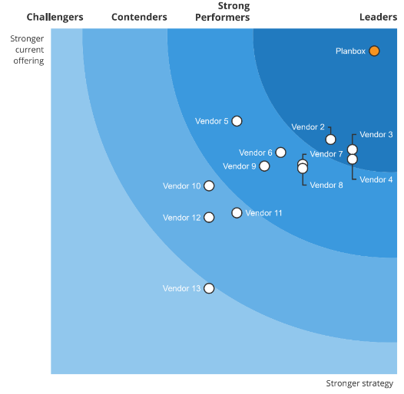
Transforming the Culture of Innovation
Planbox #1 Rated
Innovation Management Platform
According to Forrester:
"Planbox provides some of the more advanced AI capabilities we observed."
20+
5M+
400+
20k+
Years of Domain Expertise
Engaged Participants
Enterprise Deployments
Expert Solver Community

Slide 6
Introduction
Pioneering ISO 56002 in the public sector
Aligning to the ISO 56002 innovation management standard as a consistent, enterprise-wide approach to innovation.
Seeking capacity to assess the impact of digital health solutions across the innovation lifecycle and create a continuous process of intake, assessment and scale.
Goal is for innovation to become the norm, not an occasional serendipity.
Disclaimer:
The Ministry of Health (Ontario) conducted a competitive procurement for an innovation management platform through which Planbox was awarded the contract. The Ministry’s use of Planbox to advance its innovation management maturity is strictly based on the results of the procurement; this joint presentation does not constitute and should not be construed as an endorsement of Planbox.

Slide 7
ISO 56002 Steps
1
2
3
4
Context of the organization
Leadership
Planning
Support
5
6
7
Operation
Performance Evaluation
Improvement

Slide 8
Traditionally...
ISO...
As with many traditional or heavily regulated sectors, public sector can be risk averse.
provides a structured approach to innovation, reducing the sense of risk not being managed.

Slide 9
Benefits of Innovation Management
Increased efficiency and productivity
Enablement of
Key Priorities
Increased satisfaction of citizens
Increased sustainability and resilience
Improve quality of care
Increase productivity of scarce healthcare human resources
Ensure equitable access to publicly funded health services
Improve provider and patient experience
Increased ability to attract partners and funding
Engaged and empowered staff
Increased ability to respond to change

Slide 10
Innovation Management Framework
Leadership
Support
Leadership commitment is key to driving innovation through the strategic pillars of the innovation management program:
Top management is a key driver to foster a culture that supports innovation and creates awareness of its importance;
They ensure structures, support, and resources are in place for the effective implementation of the innovation management system.
The innovation management program is enabled and implemented through necessary supports and resources including:
Leveraging and developing the experience and expertise of the organization and its partners; and
Dedicated innovation funding (e.g., supporting adoption of digital health solutions) and infrastructure (e.g., innovation management software).
Notes:
As per ISO Principle 7.0, the innovation management program is enabled and implemented through necessary supports and resources including:
Leveraging and developing the experience and expertise of the organization and its partners; and
Dedicated innovation funding (e.g., OHT and digital medicine investments) and infrastructure (e.g., innovation management software*).

Slide 11
Leveraging an Innovation Management Platform
Given the complex nature of innovation management and the interplay between multiple partners, adopting a software solution provides support for various innovation activities.
Further, as guided by ISO 56002, the use of an innovation management platform was identified as a tool that would enable MOH to mature and better manage its innovation management program.
KEY PLATFORM FUNCTIONALITIES
Ideation and Content
Collaboration & Gamification
Workflow & Automation
Tasks, Projects and Portfolios
Views, Reports & Dashboards
Use-Case Support
AI & Advanced Analytics

Slide 12
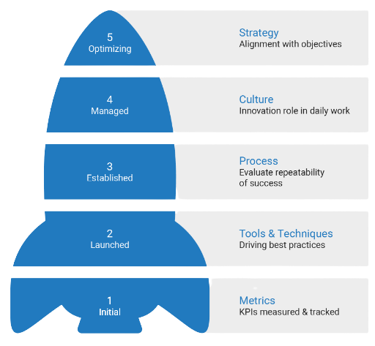
Core Areas to Develop
Innovation Health Checkup
By performing an internal assessment of our alignment with ISO 56002 principles and processes, we'll be able to better understand the current state of the Ministry’s innovation management system and identify areas to focus on. The Ministry uses Planbox’s Innovation Management Test as a supplementary, more rapid self-assessment tool.
Capability Maturity Levels
www.planbox.com/imtest

Slide 13
Results from Idea Campaigns
Idea campaigns: A means of gathering ideas to address a particular challenge. It is an opportunity for unconstrained, creative thinking and leverages the expertise and experience of staff.
ACTIVITIES
2021 branch pilot Ideas Campaign
2022-23, Ministry Ideas Campaign, using an Innovation Management platform.
IMPLEMENTED PROJECTS
ADDITIONAL OUTCOMES
Project #1
Boosts employee engagement and provides additional learning and development and networking opportunities for staff.
New initiatives that can be implemented to address a relevant challenge topic.
Library of ideas that can be considered and used to address future innovation challenges and/or other similar funding opportunities.
Receiving funding, after pivoting from the 2021 Ideas Campaign.
Project implementation in progress
Aimed at supporting patient experience with digital health tools
Project #2
The winning idea following the 2021 Ideas Campaign.
Aims to support health care providers
Project implementation in progress

Slide 14
Challenge Outcomes
Top Contributor
Most Active Ideas
Engagement Levels
Activity Breakdown

Slide 15
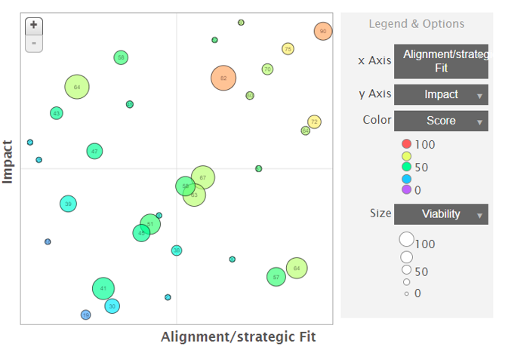
Head-to-Head
Evaluate sets of two ideas against a common set of factors
Get a visual representation of how all evaluated ideas compare

Slide 16
Supports 'Talent Management'
Supports not only staff engagement but also helps to identify talent in unexpected places. Engagement supports retention and internal recruitment.
Unintended Benefits of Idea Campaigns
Drives Executive Buy-in for the Innovation Management program
Ideas Campaigns are a tangible, high-profile demonstration of value of structured innovation.
Supports Strategic Planning
Can be an adjunct to a strategic planning exercise. Pair-wise tool can also be used for prioritization within strategy exercise.

Slide 17
PROJECTS HAVE ENABLED...
Innovation Management
Initiatives
& Results
Earlier interventions
Timelier
access to care
Cost and time savings
The innovation management framework guides digital health investments for health service providers, promoting an innovation culture with rigorous evaluation and gates guiding adoption and spread and scale of innovations.
Inclusive access to screening
ED diversions / ensuring appropriate care
Improved access to specialty expertise

Slide 18
Future Vision
Cascading ISO innovation management principles and processes down to delivery partners and broader health sector.
Virtuous cycle of increasing innovation management maturity and greater quantified benefits supports case for expanded scope and scale of innovation programs.
Continue to embed ISO principles for evaluation of projects / programs and in the development of KPIs
Continuous learning: Leverage lessons learned to guide decision making for program.
Regularly assess and evaluate the innovation management program through audits and compliance checks, identifying areas for improvement to mature the program

Slide 19
ISO 56001 Certification Benefits
Increase long term revenue
Realize consistent and sustainable business results
Scale and professionalize innovation management
Develop a lasting competitive advantage
Measure innovation ROI to prioritize investments
Improve compliance with regulations

Slide 20
ISO 56001 Certification Process
1
2
Innovation Management Assessment
Innovation Management System Implementation
Review Current System
Setup Procedures, Reporting & Training
3
4
Internal Audit
External Certification
Verify Compliance and Effectiveness
Review System with External Auditor
ISO 56001 Certification expected by May 2024*

Slide 21
Want to Learn More About ISO 56001?
Watch the webinar at planbox.com/iso56001
Featured Speakers:
ISO 56000 Experts
MAGNUS KARLSSON
JOANNE HYLAND
webinar

Slide 22
Workshop
Educate and align stakeholders
Getting Started with ISO
For ISO
Assess current state against ISO 56002
Starter Package
Analysis
Data collection and analysis of the current state & recommendations for improvement
Schedule Demo at
planbox.com/demo
Action Planning
Analyse current state and recommend improvements

Slide 23
2023
State of Corporate Innovation
Survey
Based on the ISO 56002 Guidance Standard for IMS
Benchmark your innovation management approaches
Participants receive a copy of the survey report in Fall 2023
Open until June 30th, 2023
IN PARTNERSHIP WITH:

Slide 24
Questions?
innovate@planbox.com
www.planbox.com
1-855-752-6269

