Slide 1
October 2022
Best Practices: Slides from Top R&D and
Innovation Leaders
Sponsored by

Slide 2
Table of Contents
Introduction 3
Ravi Godbolé, AGCO Corporation 4
Jeff George, formerly of Hain Celestial Group 8
Cordell Hardy, 3M 14
Michal Preminger, Johnson & Johnson Innovation 18
Jim Euchner, Outside Insight 22
Paul Konasewich, PACCAR Innovation Center 26
Laura Buen Abad, SONOCO 29
Francesca Scire-Scappuzzo, formerly of BAE Systems 34
Ari Kar, SACHEM, Inc. 38
Joyce Sidopoulos, Mass Robotics 40
Jeremy Tole, Azbil Corporation 43
Jill Lawrence, Crown Equipment Corporation 47
Chuck Brunner, Jasperate 50
About PatSnap 56
Contact PatSnap 59
About InnoLead 60

Slide 3
Introduction
At InnoLead, we’ve learned over the years that people really enjoy seeing slides their peers have created. They are a great way to understand how others approach the challenges of innovation, research and development, and new product creation. How do they think about various horizons and timeframes? How do they structure their teams? What criteria do they use to evaluate what moves ahead, and what gets killed?
That’s why we were excited to work with our friends at PatSnap to assemble a collection of “best practices” slides from R&D and innovation veterans. We asked our contributors to share the kind of slide that prompts everyone in an audience to grab their phones for a photo when it pops onto the screen.
What did we get? An array of thought-provoking ways to evaluate the innovation pipeline; drive transformation and scout relevant technologies; and overcome internal resistance. Before each section, we’ve given you a short intro to the contributor, along with some context about the slides they shared with us. (We’ve left the slides mostly as originally created and designed, making only small adjustments for readability.)
We hope that this collection can help you compare, contrast, and level up your organization’s approach to R&D and innovation.
Scott Kirsner
CEO & Co-Founder
InnoLead

Slide 4
Ravi Godbolé, AGCO Corporation
Ravi Godbolé is a Senior Engineering Manager of Global Research and Innovation at AGCO Corporation, a Georgia-based maker of agricultural machinery. Godbolé works to focus the Grain and Protein division’s innovation efforts on consumer-oriented solutions, whether for AGCO-specific products, or for AGCO products that pair with other brands’ existing technology and products. He has worked with AGCO for 15 years.
Godbolé shared slides with us about the ideal way for an innovation process to run. He said the gates of innovation are important when trying to launch a new product, even when making minor, seemingly obvious changes to an existing product. During that process, he said, it’s important for his team to collaborate with other teams, like product management, to make sure there is interest in the project.
“Eighty percent of our projects are aligned with the product management group, and it reduces a lot of friction later,” he said.
Godbolé also shared his team’s multi-faceted approach to partnering external entities, like universities, for research initiatives and recruiting. He said AGCO works with its partners on a variety of different projects, from on-campus hackathons, to sponsored research, and more.

Slide 5
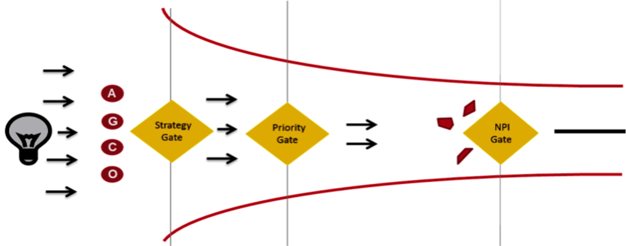
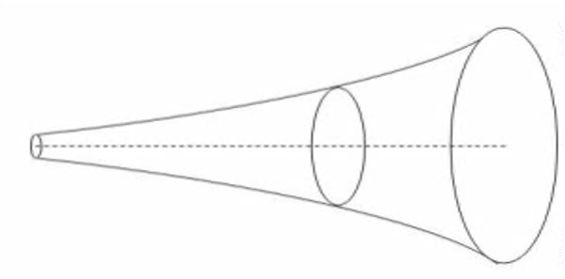
R&D Technology Timeline:
Overarching Innovation Process
Extreme Scenario 1
Present
Trend Scenario
Future
Strategy
Gate
Priority Gate
NPI
Gate
Extreme Scenario 2
Start of Production
Scenario Management
Advanced Engineering
New Product Introduction (NPI) Project Kickoff
Long Term Research
15
Years
10
Years
6
Years
3
Years
© 2022 AGCO Corporation. All rights reserved.

Slide 6
R&D: Front End Innovation
Vibrant Research & Advance Engineering Team spread across 8 major engineering sites
Regular R&AE meetings to share, learn and prioritize research areas
Greater alignment with future product development needs
Gather and disseminate information about technology, processes, projects
Emphasis on relationships with key External Partners
Develop relations with leading Universities Globally
Support Sr. Design projects at campuses
Sponsor Graduate Research Student where appropriate
Scholarships, Internships to attract future talent
Engage with Govt. Agencies (e.g. USDA-ARS, DOE, TEKES, EU Agencies)
Partner with advanced suppliers to develop or use patented technology
Participation in Producer Groups and Research Consortia
Form closer relationships with seed, chemicals and water companies
Influence policy when we can on standards and regulation matters
© 2022 AGCO Corporation. All rights reserved.

Slide 7
University Collaboration Phases
Strategic Partner
Executive Sponsorship
Joint Research Partnerships
State Education Lobbying
Spin-Off Labs/Companies
Endowment Gifts
Sponsorship
Corporate Research Activity
Undergraduate Program Support
Fellowship Program Support
Outreach Programs
Support/Activity
Curriculum Development
Workshops
Guest Lectures
Student Org. Sponsorships
Sponsored Research
University ‘Partners’
While most companies have always operated at ‘Traditional Engagement’ levels with universities to support recruiting efforts or leverage capabilities for technology projects, many R&D organizations desire to expand collaborative efforts towards ‘Strategic Engagement’
Involvement
Advisory Programs
Research Grants
Internships
Awareness
Technology/
Science Fairs
Campus Recruitment
Collaboration Activities
Phase 1
Phase 2
Phase 3
Phase 4
Phase 5
Traditional Engagement
Strategic Engagement
Source: Guiding Principles for University Endeavours, HP Partnership Consortium, (2006); Council Research.
Best Practices that have worked for AGCO since 2009
Our relationships fall in different ‘phases’, depending on university capabilities and AGCO’s focus; e.g. hiring, research
Universities within 2-3 hrs. of AGCO location, Scholarships to create brand awareness, support of Student Clubs & Sr. Design Projects and Employee ambassador (usually an Alum) to foster a relationship

Slide 8
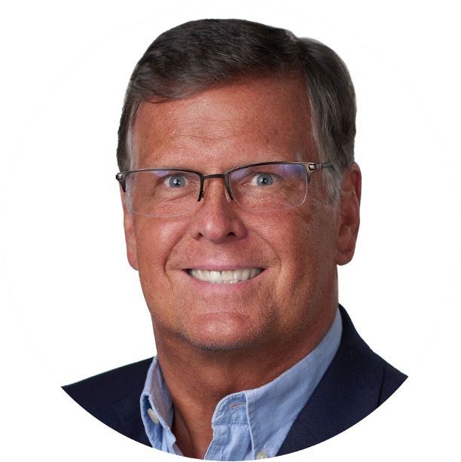
Jeff George, formerly of Hain Celestial Group
Jeff George is the former Senior Vice President of R&D at Hain Celestial Group, a natural food and personal care company based on Long Island. During his time there, he oversaw transformation within the organization to accelerate innovation and product development, using a Design to Consumer Value approach. He previously worked at Campbell’s, PepsiCo, and Hillshire Brands, among other places.
In his slides, George focused on the Design to Consumer Value approach, which he has carried with him throughout his career, after coining the term with his team at Campbell’s. He said product design problems often require multi-faceted solutions to please consumers and the company itself. In order to solve those problems, George said he has used Design to Consumer Value, a combination of design thinking and value engineering. He said Hain has used it both for product development and packaging development. The approach marries competing priorities to look for what George called, “the sweet spot,” where a company can deliver multiple attributes while keeping the product low cost.
The approach focuses in on a deep understanding of the consumer; George said, “We’re getting beyond what consumers say at the surface. We get very deep with them and have conversations about their needs, problems that need to be solved. … We listen to not just what they say, but also their behaviors.”

Slide 9
Challenge of Profitable Growth
Competing Priorities
Delicious Taste, Functionality
Quality, Nutrition, Sustainability
Cost & Margin
9

Slide 10
Design to Consumer Value
Approach for Profitable Growth
Consumer-centric Design Thinking
Value Engineering
+
Design Thinking
10

Slide 11
Design to Consumer Value
Deep Consumer Understanding
More of the benefits they value most
(at the lowest cost)
Less of what they do not value
11

Slide 12
Design to Consumer Value - Outcome
Delicious Taste, Functionality
Competing Priorities
Synergy
Quality, Nutrition, Sustainability
Cost & Margin
12

Slide 13
Design to Consumer Value Approach
Innovation
Cost Savings
Quality Improve
Product
Packaging
13

Slide 14
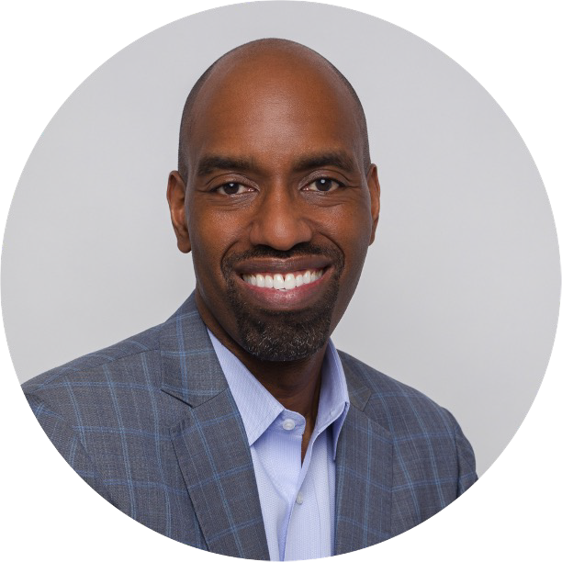
Cordell Hardy, 3M
Cordell Hardy serves as Senior Vice President of Global R&D Operations, Corporate Research & Development at 3M Company. His responsibilities include hiring/HR processes, crisis management (COVID-19 workplace risk mitigation, for example), analytical laboratories, digital media technical support, and product stewardship.
In the slides that follow, Hardy laid out some of his thinking related to advancing digitization at 3M.
“In the last 20 years, digitization has been a huge trend,” Hardy said. “So, we’ve had to think about what research and development looks like as you incorporate increasing digital content and digital technologies and capabilities and partnerships outside the enterprise and how you measure that. Digital business models look different and they scale differently. The ROI and the P&L itself looks different. For the businesses that we run that are heavily focused on software, they have a much different structure to their profit-and-loss than a business related to abrasives, for example.”

Slide 18
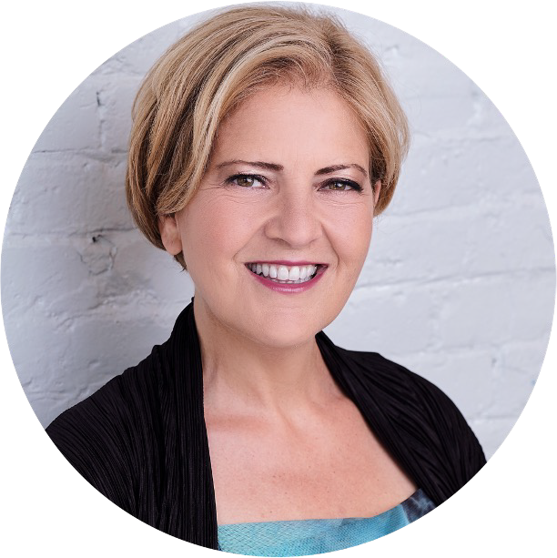
Michal Preminger, Johnson & Johnson Innovation
Michal Preminger serves as Regional Head of Johnson & Johnson Innovation for East North America. She helps the Johnson & Johnson Innovation team to curate and cultivate the most promising, early-stage healthcare innovations in the region. She previously was Executive Director of Harvard University’s Office of Technology Development, Harvard Medical School site. Preminger is currently a member of the Board of Directors at MassBio and the Kendall Square Association, and a member of the Scientific Advisory Board at FutuRx Accelerator.
In her slides, Preminger focused on working collaboratively with other companies and partners, based on the needs of the patient. She said the process described in her second slide occurs once Johnson & Johnson has already decided upon a partner to work with.
“[The slide] really represents the process of going from initial blind date to marriage,” she said. “Bringing both parties’ inputs, we can actually narrow down and zero in on a place in which the innovation would be relevant, and also develop an understanding of what it would take.”
Preminger’s team has a variety of ways to collaborate, she said. Her team tailors its approach to the specific partner it’s working with, and evaluates that particular partner’s needs, whether it’s financial resources, access to mentoring, or otherwise. “There’s no cookie cutter approach,” she said.

Slide 19
Innovation has changed
the trajectory of healthcare…
…but tremendous challenges remain
60% increase in life expectancy¹
Near normal life expectancy with HIV, treat with one pill, once-a- day
Targeted therapies and personalized solutions
Robotics and digital surgery
Long-acting treatments
Major healthcare challenges with significant global burden:
Cancer HIV
Alzheimer’s Disease Heart Disease
Tuberculosis
Ebola & other pandemics Safe surgery
Covid-19
19
¹https://www.seniorliving.org/history/1900-2000-changes-life-expectancy-united-states/

Slide 20
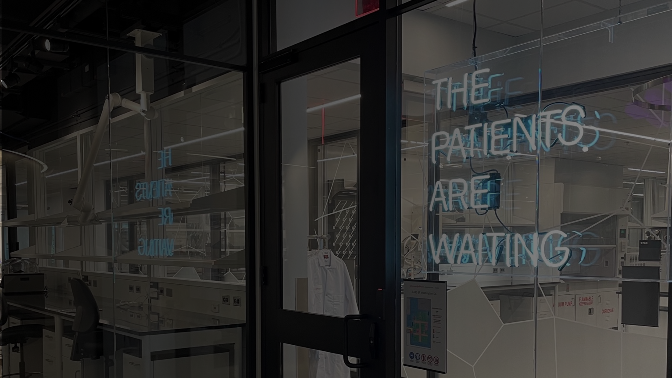
Our collaborative approach
Identify
areas of mutual focus on unmet healthcare need
Fuel the idea
at early stages of innovation leveraging our scientific and cross-functional expertise & resources
Collaborate & co-create
to build a targeted action plan with clear milestones
Scale the opportunity
to deliver value and hope to consumers & patients around the world
20

Slide 21
How can we partner?
Flexible deal structures
Commercial & access expertise
Funding & investing
R&D collaboration & acceleration
Company incubation, mentoring
& facilities
Key ingredients for a successful collaboration
Across the healthcare spectrum
Consumer Health
MedTech
Pharmaceuticals
Integrated Healthcare Solutions
21

Slide 22
Jim Euchner, Outside Insight
Jim Euchner is Editor of the journal Research-Technology Management and author of the recent book, Lean Startup in Large Organizations. He is founder of the consultancy Outside Insight Consulting, and the former VP of Global Innovation at Goodyear Tire & Rubber.
In his slides, Euchner discussed the various types of experiments that can be run to test a new concept, as well as some of the common sources of resistance that innovators face.
“Resistances are very natural,” Euchner said. “They happen for a reason. As an innovator, you shouldn’t bemoan that you live in an organization with people who can’t see the future, but instead ask, ‘How do I work with people in order to make what I need to have happen, happen?’”
His third slide illustrates what he calls the “business model pyramid.” “What you will encounter as you climb up this pyramid are many of the resistances [listed on the previous slide.] You’ll confront the first set when you’re trying to do the experiments. But the last three kinds of resistance you’ll confront at the executive level when people finally say, ‘Here’s the business, here’s the market size, here’s why we can win.’ Then, people start asking if
they’re willing to take the risks of trying something this new.”

Slide 23
Types of business experiments
Value creation
Technology & human behavior
Willingness to pay
Technology in use
Business experiments
Supply chain
Partner support levels
Operational costs
Channel effectiveness
/ efficiency

Slide 24
6 Sources of Resistance to Innovation
Fear of Chaos: Lean Learning Loops, a key, knowledge-gathering element in Lean Startup, can lead to fears of an unmanaged innovation process
Fear of Disruption: Creation of Minimum Viable Products (MVPs), another Lean Startup tool, can disrupt the operations of core internal functions (especially engineering and IT)
Fear of a Loss of Identity: Creating a Value Hypothesis for the new venture can lead to opportunities that the company cannot exploit (orphans)
Fear of Cannibalization: New ventures may succeed by damaging the core; The Business Model Pyramid can help to find solutions
Fear of Misallocation of Resources: Investing in a new venture can drain needed resources from the core
Fear of Making a Blunder: Investing in new spaces introduces new kinds of risks

Slide 25
The Business Model Pyramid
Reduced risk
6. Learn in market (profitability, scalability)
5. Select business model & organize for incubation
4. De-risk through business experiments
3. Prioritize risks via stochastic modeling
2. Identify assumptions for each option generated
1. Generate business model options
High uncertainty
DEMONSTRATE CUSTOMER VALUE CREATION
Source: Euchner and Ganguly: Business Model Innovation in Practice – RTM 2014

Slide 26
Paul Konasewich, PACCAR Innovation Center
Paul Konasewich is the General Manager of the PACCAR Innovation Center in Silicon Valley. PACCAR is the maker of Peterbilt, Kenworth, and DAF trucks. Konasewich is a founding member of the Innovation Center; his office works on finding emerging tech opportunities for PACCAR. He previously worked in R&D at Microsoft and in startup partnerships at Honda, among other opportunities.
In his slides, Konasewich focused on the importance of finding quality startups to work with — and the attributes of a startup that corporate leaders should be considering before agreeing to work with one. Those attributes include a tangible demo, investor backing, and fit for the team.
But working with startups isn’t a one-way street — corporate leaders need to share information with a startup they anticipate they might be working with. That information could come in the form of advice, information about the corporation’s goals, or the corporation’s track record for working with startups. Even though the goal for many startups is to have corporate customers, they still have to be selective about the proper fit, just as a corporation does.
“Incentives are quite different between established companies and startups. Frank discussions on goals and expectations are an important tool to manage those differences,” Konasewich said.

Slide 27
Factors to look for in good startups.
The Right Team, with Appropriate Skills, Education, and Work History
A Working Demo, That We Can See
A Credible Path to Commercialization, Especially Cost and Quality
Backing From Great Investors
What else do you look for?

Slide 28
Info You Might Share with a Startup.
Interest level your company has in their technology area, and why.
Your realistic timing for go-to-market w/ new tech.
How your company will think about their startup. Be constructive, but be frank.
Competitors they should be watching.
Ways you’ve successfully worked with startups.
What else do you share with startups?

Slide 29
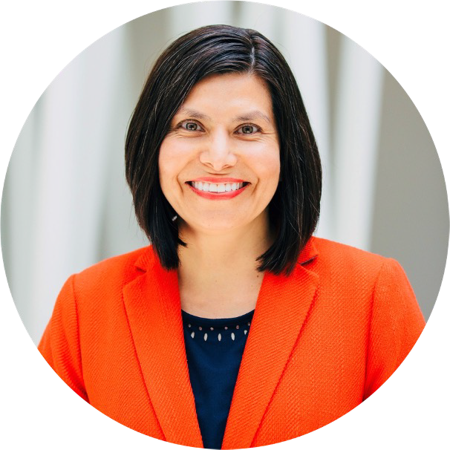
Laura Buen Abad, SONOCO
Laura Buen Abad is the Senior Director of Technology and Marketing for the Flexible Packaging business unit at SONOCO. In her role, she leads R&D, product development, product marketing, business development, and acquisitions. Buen Abad has over 20 years of experience in the industry, having worked in several countries.
In the slides she shared with us, Buen Abad addresses how R&D and innovation leaders can align with the business units in an organization to create successful processes and outcomes. She said having diversity of perspectives in innovation helps an organization to succeed, both in the long term and in the short term.
“A lot of times, what you find is corporate R&D groups... are put in a box,” she said. “It becomes this black box of activity. Money goes there; resources go there, but it’s very difficult for the business to see the benefit, because they may not be aligned on what [R&D] is working on.”
She said sharing goals, assigning cross-functional responsibilities, and showing other teams how the newest innovation or idea can help them throughout the process can mitigate these misunderstandings and share value to the larger organization.

Slide 30
Business and Technology Strategic Alignment
Revenue
Growth
Incremental innovation
Next Generation products
Transformational R&D
Profit
&
Productivity
Material/Supplier
Substitution
Resilience
Business Unit
Technology Department
Supply Assurance
Risk Mitigation
Material/Supplier Substitution
Key success factor: Balance of short- and long-term priorities
30

Slide 31
Technology Delivering Results Through Cross-Functional Collaboration
Operations
Shared objectives among functions
Aligned processes to prioritize (and reprioritize), and clearly define roles and responsibilities
Teamwork, project management, accountability, strategic thinking vs tactical approach to detail
Flexibility – ready to pivot together in crisis
Marketing
Supply Management
Technology – Product Development and R&D
Sustainability
Sales
Quality
31

Slide 32
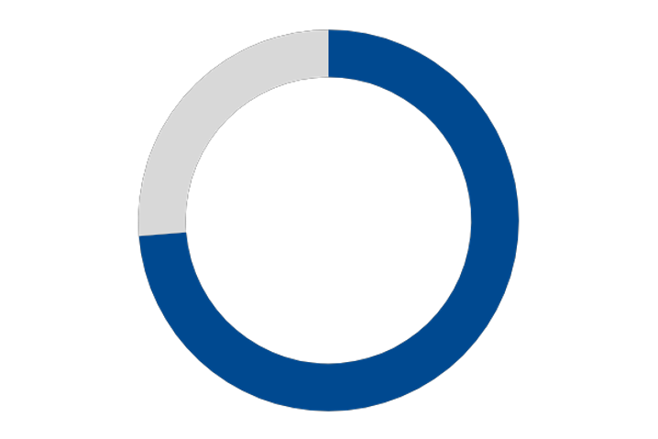
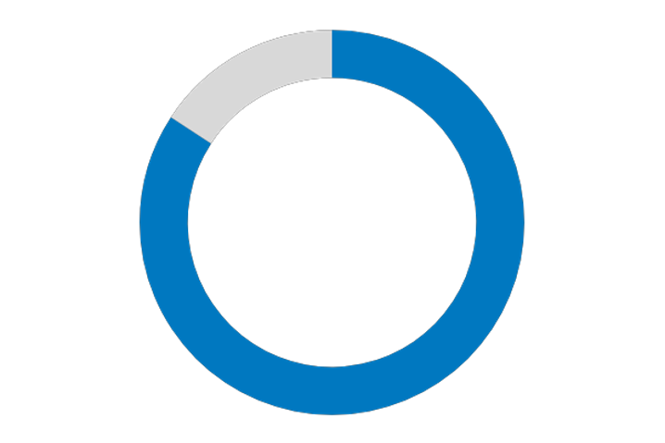
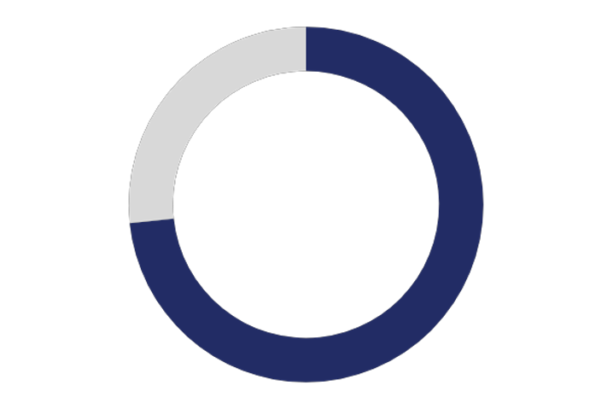
Innovation Process
Innovation by serendipity is not repeatable, innovation needs a process
New foresights and insights
Society problems Regulations
Technology advancements Strengths and capabilities
Grow and Defend
New products New services
INNOVATION
New ideas, solutions
Right problem Right solution Right time and cost
New problems, wants and needs
Technology roadmaps Portfolio project management
Innovate via: Stage-Gate Design Thinking Lean Startup Agile
32
Key success factor: parallel advancement of technical solutions and business experiments

Slide 33
Diversity & Innovation
Diverse teams are more likely to:
Embrace diverse perspectives
Develop more unique solutions
Attract and retain diverse talent
Outperform homogenous teams on innovation
Drive higher financial returns
Diverse Perspectives
Diverse Experiences
Diverse Backgrounds
“Diverse and inclusive cultures are providing companies with a competitive edge over their peers.”
The Wall Street Journal’s first corporate ranking that examined diversity and inclusion among S&P 500 companies.
Better decision making, problem solving, and financial results
33

Slide 34
Francesca Scire-Scappuzzo, formerly of BAE Systems
Dr. Francesca Scire-Scappuzzo has been a professor, an inventor, an entrepreneur, and an executive in small and large high-tech corporations, both in Europe and in the US. She has been Sr. Director of Advanced Technology and Innovation at BAE Systems
Inc., a large aerospace and defense corporation. She also has extensive experience in small business in the commercial sectors, as President and CEO of Ondetech, and as Vice President of R&D and CTO for Metamagnetics Inc. In addition to her industry experience, she was Tenured Professor of Electrical Engineering at University of Catania in Italy.
Scire-Scappuzzo said innovation is a process of transforming an idea that comes from a need that transforms a product into something that creates value to society, a definition she feels is often misunderstood. “In R&D, we sometimes don’t understand that you can come up with the greatest idea, [but] until it brings value to society, it’s not an innovation — it has to make an impact,” she said.
She offered Thomas Edison as an example. While he did not invent the lightbulb, he found a way to make it widely available to consumers. He took a pain point and used an existing idea to solve it.
In her slide, she portrays a structured approach for creating value to consumers once ideation has already begun. She said the development and commercialization phases are extremely important — and where most startups fail, because it’s hard to scale up. She said she recognizes that the journey is not linear, nor simple, which is why she included the curved road graphic on her slide, featured next in our deck.

Slide 35
Technology Innovation
The process of transforming an idea that comes from a need into a product (or service) that brings value to society
Problem
time
Solution
Pain Point
NEED
Theoretical Solution and Demo
IDEA
Development
PRODUCT
Commercializ
-ation
SCALE UP
Availability to Customer
VALUE
Entrepreneurs versus Academics
(problem first vs idea first)
Internal R&D IP Licensing External R&D Prototyping Testing
Business Plan Team
$ Funding Growth
Customer Identification
Production Manufacturing Supply Chain Scale-up
Voice of Customer
Distribution (#) Affordability ($) User friendliness Cyber resilience Sustainability

Slide 36
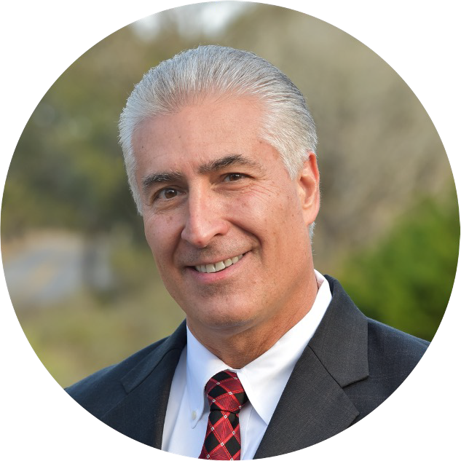
Ari Kar, SACHEM, Inc.
Ari Kar is VP and Chief Technology Officer at SACHEM, a Texas-based provider of chemical services. He was previously a Senior Technology Director at Halliburton, and a Director of R&D at Nalco Champion, a chemical supplier to the oil industry.
In his first two slides, Kar shares his thinking on how sustainability should drive innovation. “You can build sustainability into new product development by considering sustainability aspects through the value chain and across the four dimensions shown on the first slide.This will provide a better understanding of the innovation opportunity decisions you are making, and the impact these decisions will have downstream.”
The third slide illustrates a process for moving ideas from concept to market. Kar explained, “We use an integrated idea-to-launch innovation process based on the Bob Cooper Stage-Gate methodology, and incorporating principles of design theory, Technology Readiness levels, sustainability and portfolio management. We are incorporating sustainability concepts into our NPD process, such that sustainability is considered from Stage 1 including raw materials selection – to stage 5 and manufacturing process – and then finally through to the customer application and the impact on the community.”

Slide 37
Sustainability-Driven Innovation Framework
Good for the Planet Good for the Customer Good for the Company
Sustainable Raw Materials
Sustainable Solutions
1
Sustainable Raw Materials – e.g. RM’s derived from plants and sustainably harvested and processed
2
Sustainable Chemical Processes – green chemistry principles, e.g. less waste, safer, energy efficient
Sustainable Chemical Processes
Sustainable Products
3
Sustainable Products – sustainable downstream processing, cradle-to-cradle considerations
4
Sustainable Solutions – applications that positively impact air, water, safety, circularity, quality of life

Slide 38
Assess our products sustainability risks and opportunities in their operational and business environments
Sustainable Portfolio Management Approach
Product sustainability will be measured against:
The benefits/challenges from a market perspective (downstream value chain analysis of product and application combination - how in their application they bring benefits or faces challenges related to health and safety, climate change, natural resources); AND
 |  |  |  | Sustai | nable
 |  |  |  | Prod | uct
Very Low Risk
Customer Centered
Operation Vulnerability
Low Risk
Medium Risk
Operational risk and impact. Upstream + operational environmental manufacturing footprint and correlated risks and opportunities (Cradle-to-Gate Life Cycle Analysis: RM’s, supply chain, water, energy, waste, emissions)
High Risk
Company Centered
Very High Risk
Challenged Exposed Neutral Aligned Star
Market Alignment

Slide 39
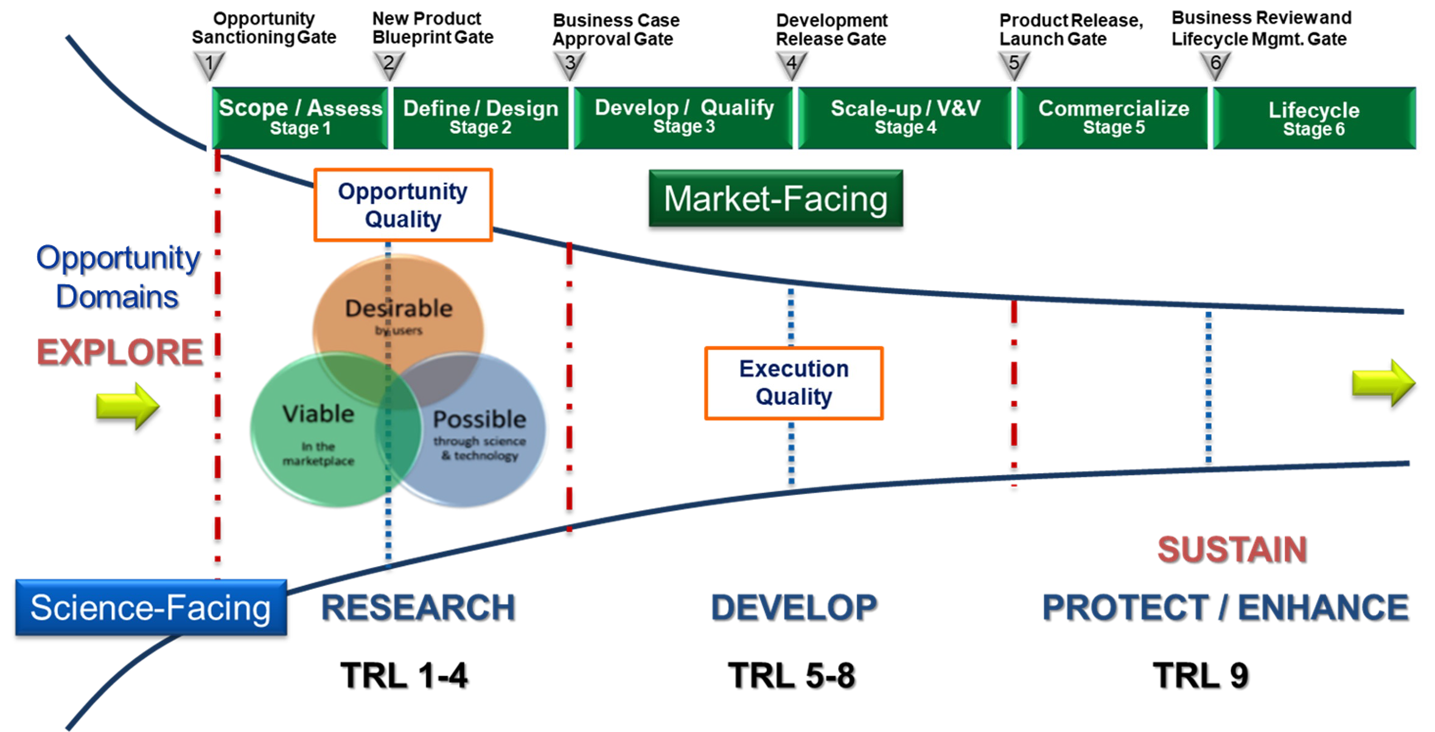
Integrated Idea-to-Launch Innovation Process

Slide 40
Joyce Sidopoulos, Mass Robotics
Joyce Sidopoulos is the Chief of Operations at Mass Robotics, an incubator in Boston for robotics startups. She began her career as an engineer at the Naval Undersea Warfare Center, and later served as a deputy program manager at General Dynamics Information Technology, and a community manager at the Massachusetts Technology Leadership Council.
In her slides, Sidopoulos lays out her thinking on how robotics may impact established industries, and some of the big trends in robotics in 2022.

Slide 41
Markets Disrupted by Robotics: nearly ALL
Manufacturing
Multi-arm collaborative, packaging, inspecting
Logistics
Material moving, intelligent kitting, warehouse optimization
Transportation & Delivery
Autonomous vehicles & busses, mobility aids, last mile delivery
Healthcare
Surgical, rehabilitation, exoskeleton, monitoring
Agriculture
Inspecting, planting, spraying, harvesting
Construction
material handling, surveying, 3D printing, demolition
Defense & First Responders
search & rescue, surveillance, security
Hospitality, education, in-home

Slide 42
Big Trends – Enabling Robotics to Accelerate
5G / Cloud Robotics
New Sensors
Robot Operating System(ROS)
Mobile Manipulation
Modularity
Interoperability
Business Models (RAAS)

Slide 43
Jeremy Tole, Azbil Corporation
Jeremy Tole is the Senior Vice President of Azbil Corporation’s Innovation Center, located in Silicon Valley, California. He oversees integrating new technologies into the Japan-based company, which builds and advances automation processes and services for its customers. Prior to joining Azbil, Tole worked in product line management and marketing on semiconductors. He is the Vice President and Board Director of the Wireless Communication Alliance.
In his slides, Tole focused on the importance of effective technology scouting — both in terms of location and strategy. He said technology scouting allows companies to expand their capabilities and learn about what may be coming around the next bend of the road.
“We’re trying to avoid this ‘technology tourism’ thing, where you're just going in and talking with different startup companies and getting information from them, but we're not really providing information back to the companies. I always feel like we need to have a two-way street,” he said.
Azbil does much of its technology scouting in North America, because of technology centers and the wealth of startups in places like Boston and Silicon Valley. He said a good technology scout has a basic understanding of a wide array of technologies a company has interest in, while also having a curious, outgoing personality.

Slide 44
What is Technology Scouting?
Identifying emerging technologies
Channeling technology related information into our company
Supporting the acquisition of technologies
Matching process between external technologies & internal requirements for strategic purposes
Part of competitive intelligence & strategy
Method of technology forecasting & corporate foresight
Proprietary and
Confidential
Technology scouting is an essential element of a modern technology management system
44
ANA R&D
© 2019 Azbil Corporation and its affiliates. All rights reserved.

Slide 45
What is a Technology Scout?
Company employee or external consultant
Engages in boundary
spanning processes
Taps into novel knowledge
Spans internal boundaries
A lateral thinker
Knowledgeable in science & technology
Cross-disciplinary oriented
Imaginative personality
- Plays a vital role in a formalized technology foresight process
45
https://ezassi.com/external-technology-scouting-works/
ANA R&D
© 2019 Azbil Corporation and its affiliates. All rights reserved.

Slide 46
Why Scout Technology in North America?
Abundant access to technology (Azbil’s location) Large concentration of innovation
Strong, diverse network of research universities and startup companies
Conferences
Consortia/coalitions Partnerships/networking
Promote Azbil brand name recognition
Proprietary and
Confidential
46
ANA R&D
© 2019 Azbil Corporation and its affiliates. All rights reserved.

Slide 47
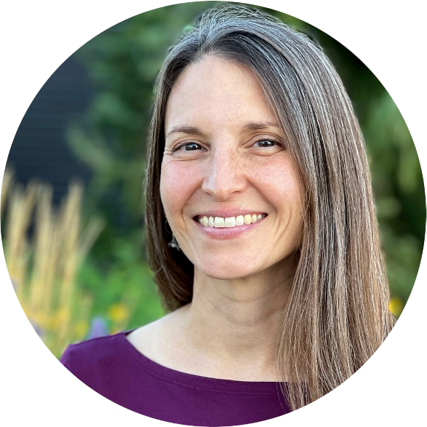
Jill Lawrence, Crown Equipment Corporation
Jill Lawrence heads the global design team for Crown Equipment Corporation, the world’s fifth largest manufacturer of lift trucks and related products and services.
Before Crown, Jill consulted to the World Bank on innovation practices and was the Director of Accelerated Innovation at Pitney Bowes. She has a background in anthropology and over 20 years of experience working with multi-disciplinary teams in design, innovation, and strategy.
Lawrence’s best practice comes from an article she co-authored with Brendon Clark and focuses on an idea known as Tangible Future Scenario planning. The strategy allows storytelling to take a place at the forefront of business discussions. It asks participants to create a short, three-minute puppet play or video about a potential product or service that could come out of the business, and how it could be valuable for users.
Lawrence said this strategy is helpful because it helps R&D leaders and innovators to surpass the Post It note trap, and instead focus on something closer to a prototype — one that stimulates discussion and knowledge sharing across teams. The outline for using this method is highlighted in Lawrence’s slide.
“I think this could easily be reduced to like, ‘Oh, cool, video prototypes.’ [But] this is not just about new prototypes. This is about discovery through performance, and how performance can tease up tacit knowledge and tacit beliefs, especially in a cross-functional group,” Lawrence said.

Slide 48
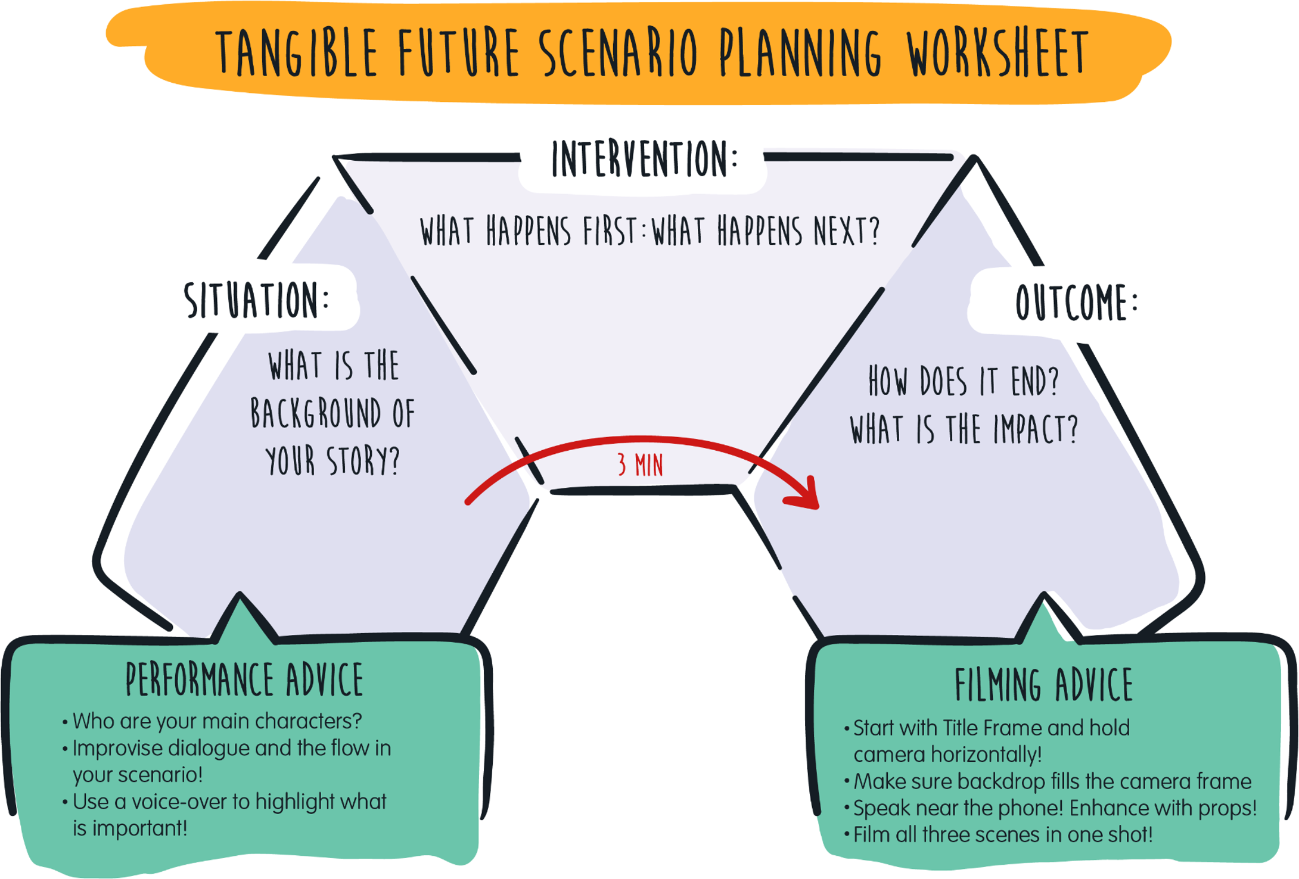
Source: “Building Alignment and Sparking Momentum with Tangible Future Scenarios” DMI Vol.29, Issue 2 2018, authors Jill Lawrence and Brendon Clark.

Slide 49
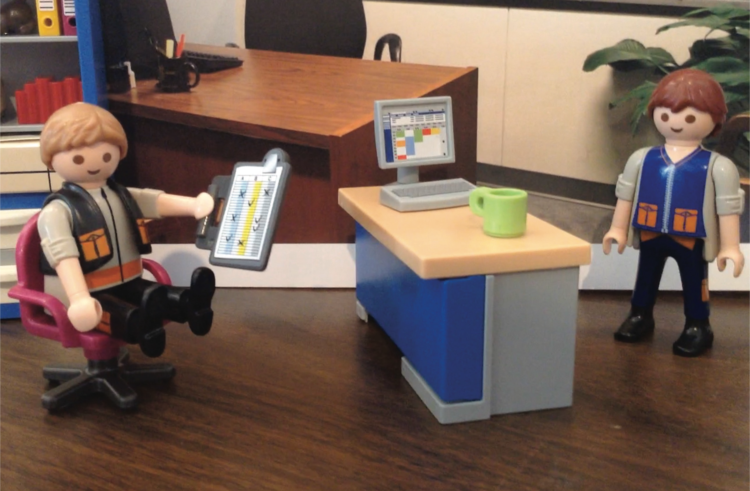
Source: “Building Alignment and Sparking Momentum with Tangible Future Scenarios” DMI Vol.29, Issue 2 2018, authors Jill Lawrence and Brendon Clark

Slide 50
Chuck Brunner, Jasperate
Chuck Brunner is COO of Jasperate, a startup developing a new type of hypodermic needle, and head of the consultancy C.S. Brunner. He was previously Director of R&D at SharkNinja, the maker of household appliances.
In his slides, Brunner defined what an optimal approach to new product development might look like, and some of the challenges and opportunities that R&D teams in consumer product companies face.

Slide 51
What does perfect look like?
R&D/APD
NPD Begins with limited risk | Pre-tool Prototypes | EBs | Pilot MP
Have verified technology and architecture that delivers the right solution at NPD kickoff.
APD = Advanced Product Development
NPD = New Product Development
EB = Engineering Build
MP = Minimum Viable Product

Slide 52
Perhaps like this?
Insights
Opportunity identification Commercial viability Requirements refinement
Detail Design Manufacturability
Tooling Fit and finish
Needs
Trends
Concepts Possibilities
PD
MP
Launch
Roadmap
Tech
Filter
SD/ APD
Competition
Reviews Capabilities
R&D
Rapid insight development System architecture development Translation of consumer and stakeholder insights to MVPs
SD = System Development
AVP = Advanced Product Development
PD = Product Development
MP = Minimum Viable Prototype
POC = Proof of Concept
POT = Proof of Technology
Identify and drive tech development and commercial viability
Technology qualification through calculation, modeling and prototyping – POC/POT

Slide 53
Challenges/Opportunities
Grow or die
Fixed cadence of new products
New product development is the priority (always).
Fire drill; not always technology based
Value add
Global development
Optics
Visibility, sustainability, and accessibility

Slide 54
R&D Goals
Expertise in fundamentals to support new product development and sustaining
Develop understanding/solutions for unknowns
Track and apply emerging technologies
Develop and qualify new “technology”
See your contribution on the shelf

Slide 55
Starting point
Typical
NPD Begins with R&D elements | Pre-tool Prototypes | EBs | Scramble to solve issues | MP
Additional NPD, R&D, Partner Resources
Ideally
Verified technology and architecture that delivers the right solution at NPD kickoff
Long term, by improving R&D / APD efforts we will be able to reduce time to market and minimize post tooling issues / rework
R&D/APD | NPD Begins with limited risk | Pre-tool Prototypes | EBs | MP

Slide 56
About PatSnap
PatSnap is the global leader in connected innovation intelligence for IP and R&D teams. We use AI-powered and machine learning technology to comb through billions of datasets on patents, venture capital, partnerships, mergers and acquisitions, technology news and more so that our customers can connect the dots, increase productivity, and innovate more effectively. We are revolutionising the innovation process and making it faster and more efficient, and easier than ever before.”
56

Slide 57
Turning Billions of Innovation Datapoints into Actionable Intelligence
57

Slide 58
The Data Paradox
Businesses crave more data than they can handle
70%
are gathering data faster than they can use it
64%
have too much data to meet security and compliance requirements
61%
are consequently dealing with overwhelmed data teams
Study conducted by Forrester Consulting, based on 4,036 Director+ decision-makers responsible for data and data strategies, 2021.
58

Slide 59
Contact PatSnap
Interested in learning more about PatSnap?
Reach out:
Sam Wiley Head of Thought Leadership
swiley@patsnap.com
http://www.patsnap.com
59

Slide 60
About InnoLead
InnoLead is the world’s largest network of executives responsible for strategy, R&D, new product development, design, and innovation in established organizations. We connect those executives through online and in-person events, and we supply information and guidance on our website — all focused on helping them to build competitive advantage.
InnoLead’s research reports are written and compiled by InnoLead staff; whenever there’s input from outside entities, we make that clear. We ask that you not republish or post this report in its entirety; if you quote from it or reference it, kindly credit InnoLead. To access prior InnoLead research reports and slide decks, visit innolead.com.
© 2022 INNOVATION LEADER LLC. ALL RIGHTS RESERVED.
60

