Slide 1
Survey data: Ties between innovation and the business units

Slide 2
We surveyed 164 executives at large ($1B+) companies in January 2017, to better understand the linkage between business units and innovation/R&D teams.

Slide 3
Here’s who responded:
The largest respondent clusters from the survey were technology (18 percent), consumer products (14 percent), finance (12 percent), healthcare (12 percent), and manufacturing (9 percent).

Slide 4
How involved are business units in setting the R&D/innovation agenda at your company?

Slide 5
Do business units provide funding for the R&D/innovation group?

Slide 6
How would you describe the effectiveness of the hand-off from R&D/innovation to the business units for deployment?

Slide 7
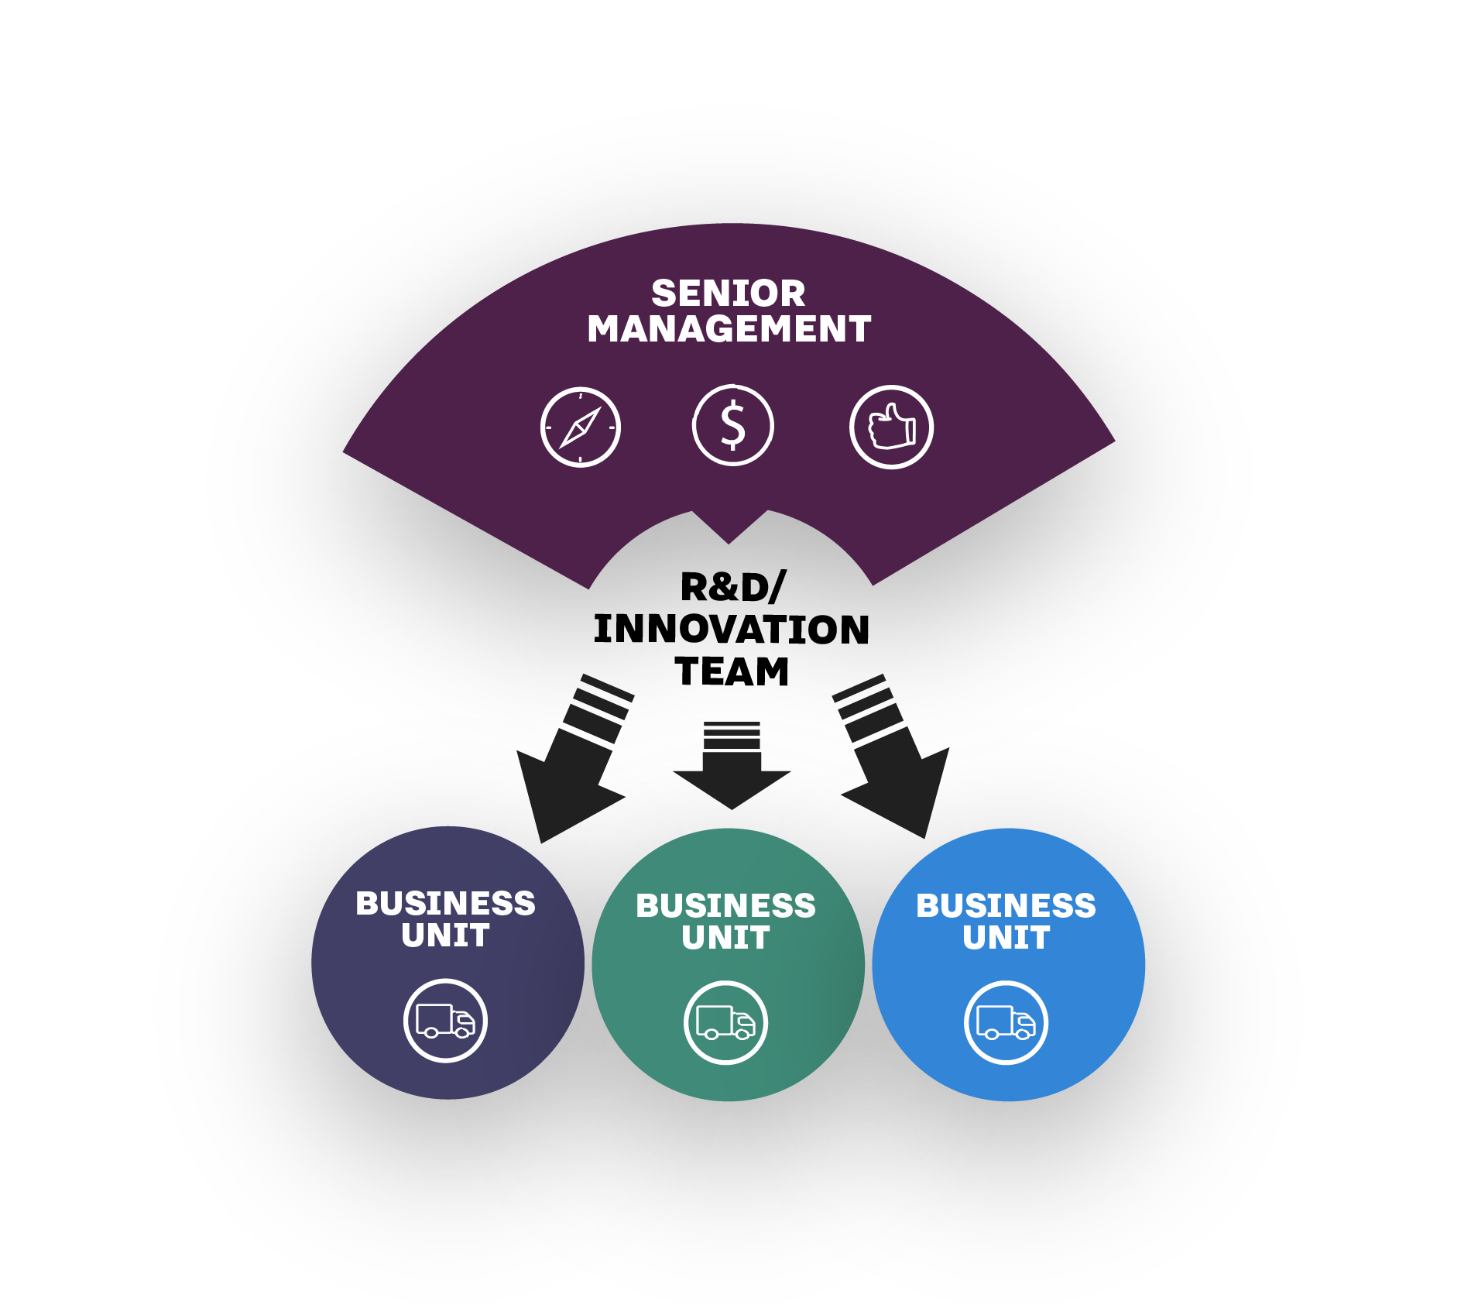
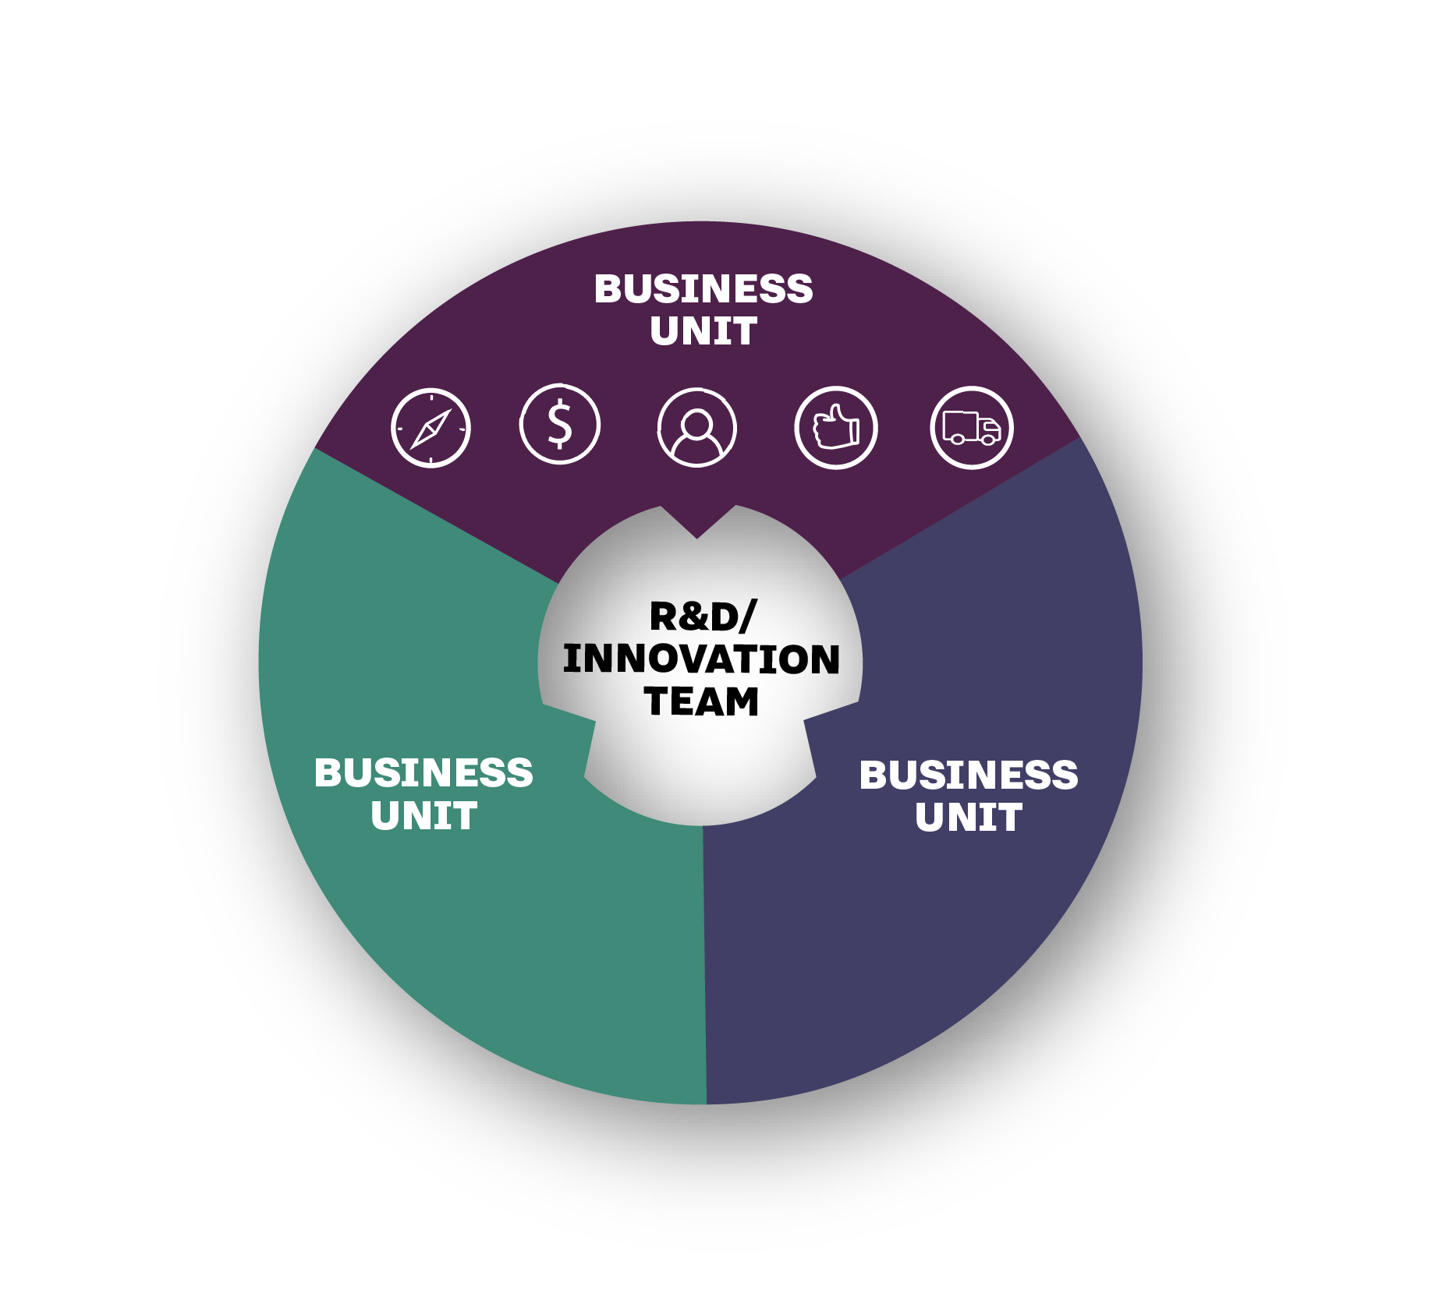
Two models: Insulated versus intertwined
Insulated: Team gets direction, funding, and approvals from senior management, but is insulated from business unit concerns or short-term needs. Even with this model, though, projects are typically handed off to business units for deployment—not always with appropriate levels of support.
Intertwined: Business units and innovation teams work closely together on direction/agenda setting. Some or all of the funding comes from business units, people flow back and forth, and BUs are involved with approvals and deployment.

Slide 8
• “Where possible, run with those projects that have a strong business need and demonstrable benefits.” • “Require a launch plan prior to project approval. Why do the project if you don't know how to launch it?” • “Work with potential customers early on, so that the business case will be a reality. If real revenue is behind [your project], business units will not let the project die.” • “[The] incentive models of the core business need to incorporate introduction and scaling of new solutions.” • “We own these projects together; there is no ‘hand off.’” • “For projects requiring a certain level of capital investment or that have specified certain levels of revenue generation or cost savings, conduct look-backs at regular intervals to gauge the success of the project's implementation, as well as financial return.” • “Keep a liaison involved from the innovation lab until the effort is on firm ground.”
Some advice from respondents

Slide 9
The complete 35-page report is available at InnovationLeader.com/ research. If you use slides or data from this presentation, please credit Innovation Leader/@innolead. Thanks!

