Slide 1
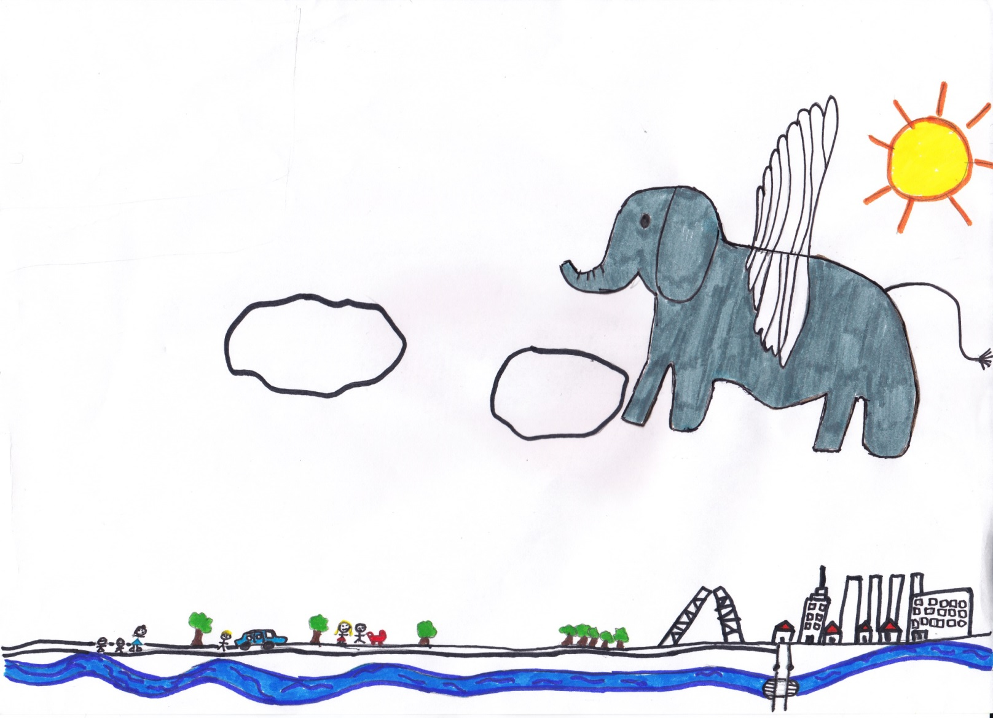

Lean Elephants: Lean Product Development in a Very Big Organization_
@sjapru

Slide 2

Start small aim high
Iterate fast
Market validation
Fail fast, fail cheap
Multidisciplinary teams
Open Innovation
The art of killing

Slide 3

Training
Internal mentors
External mentors

Slide 4
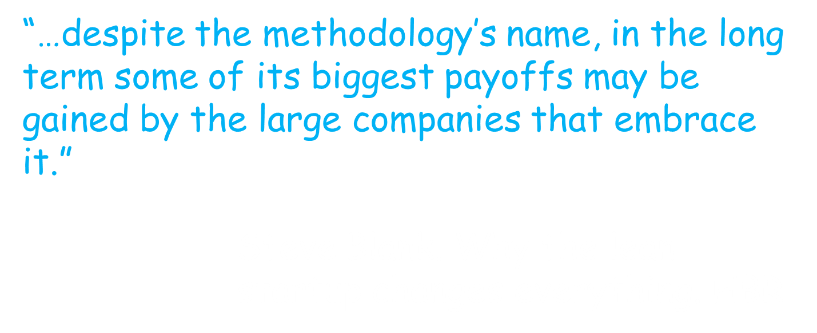
http://hbr.org/2013/05/why-the-lean-start-up-changes-everything/ar/1

Slide 5

Dealing with corporate politics and processes. Get upstairs in the building

Slide 6
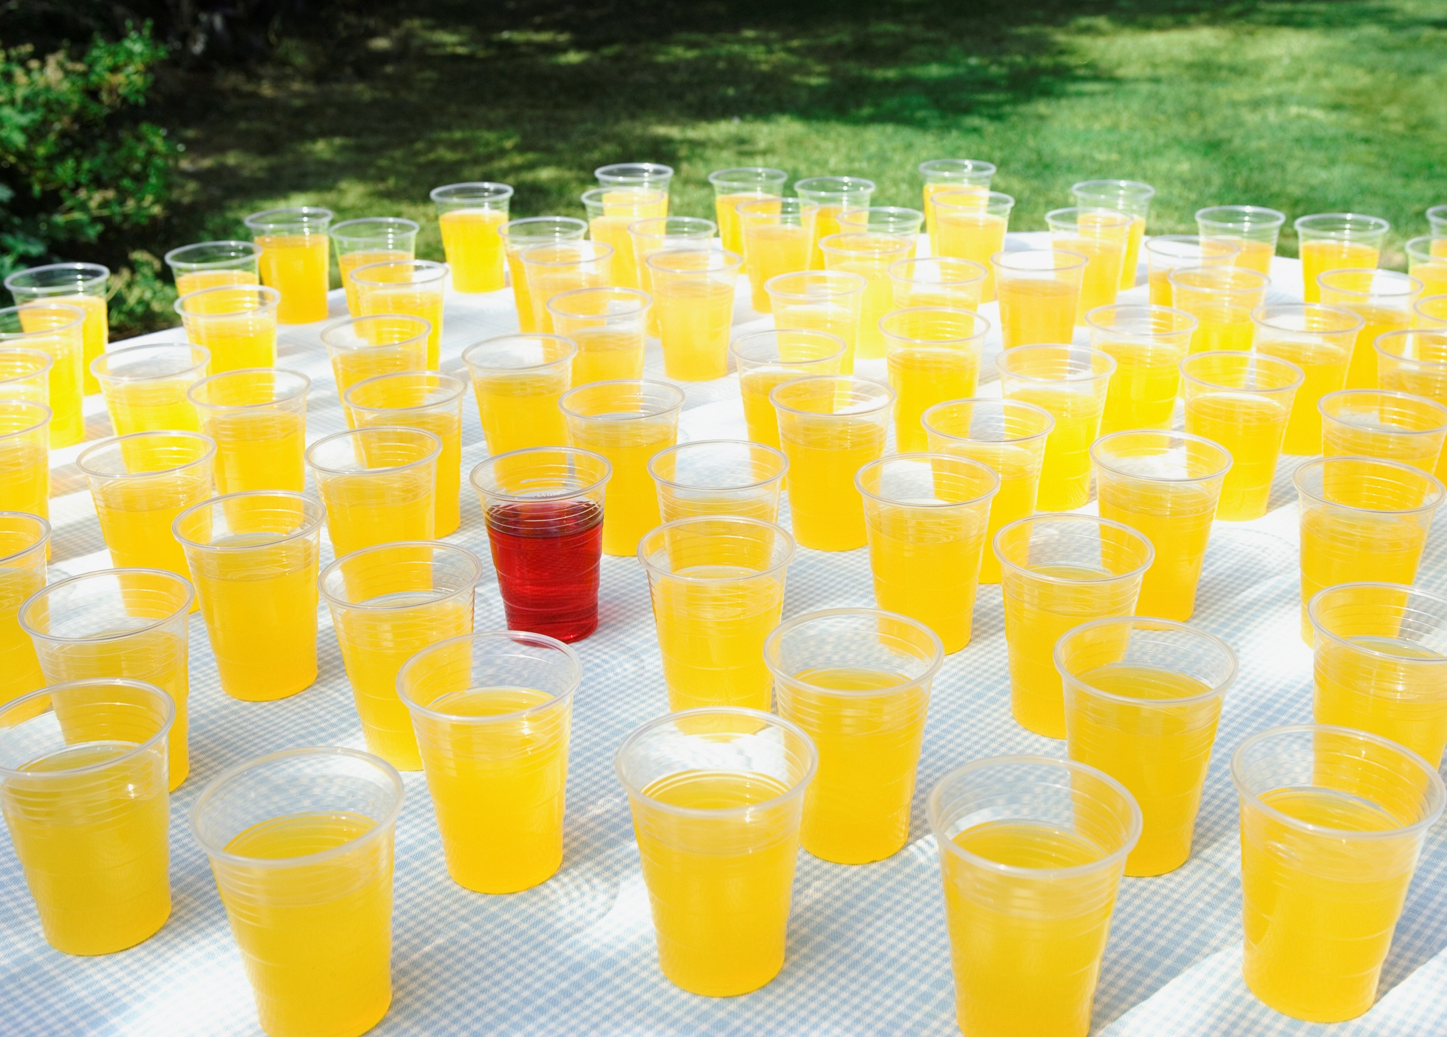
Finding intrapreneurs.
Entrepreneurs and intrapreneurs are not the same kind of people

Slide 7

What branding to use for experiments and tests?

Slide 8
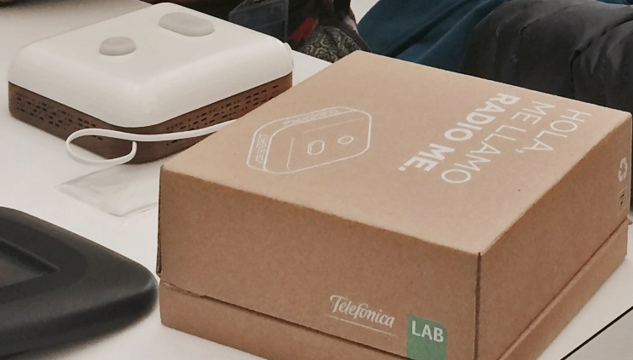

Slide 9

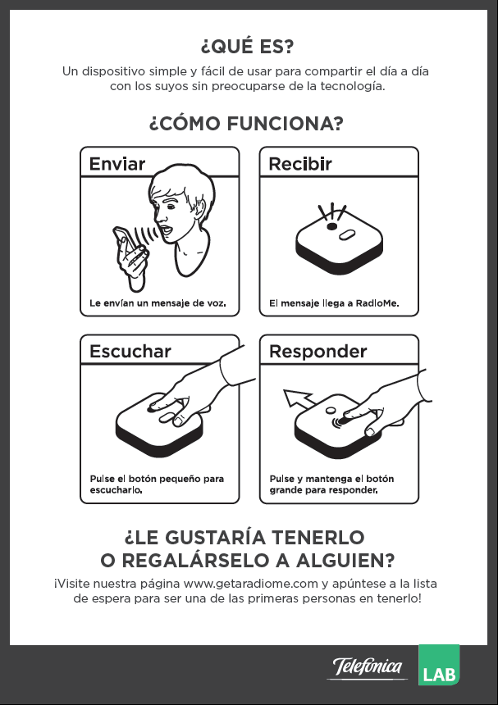

Slide 10
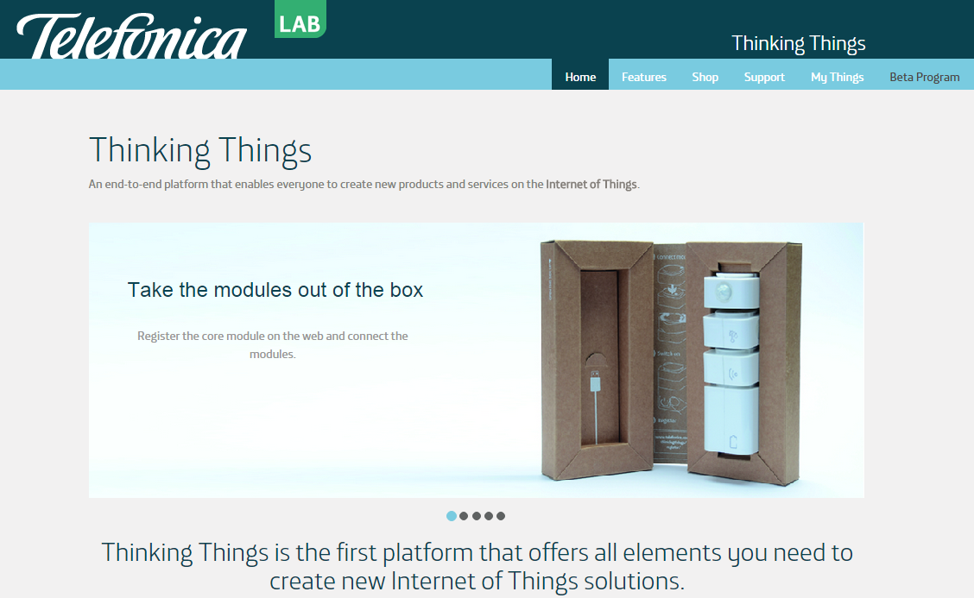

Slide 11
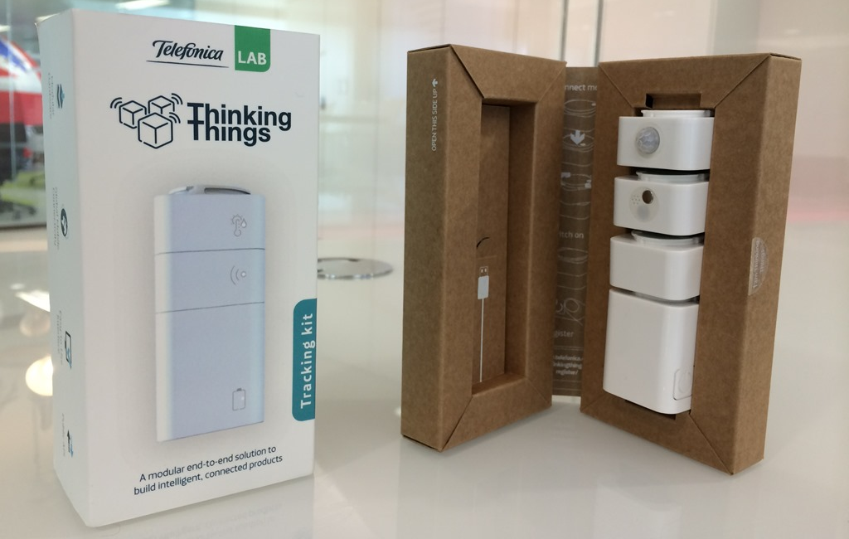

Slide 12


http://driviesapp.com/

Slide 13
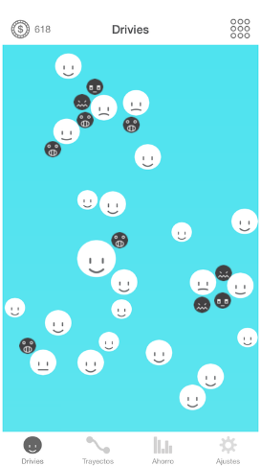
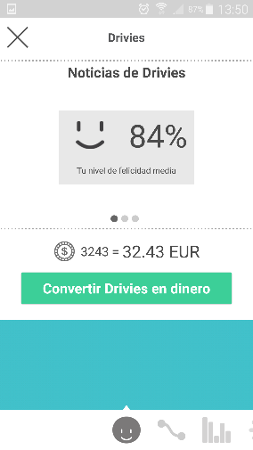
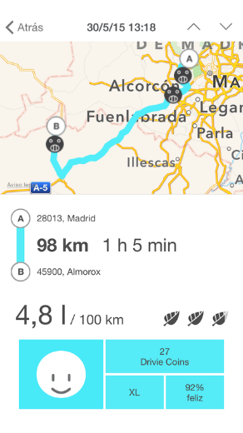
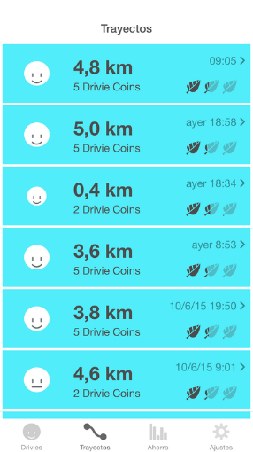
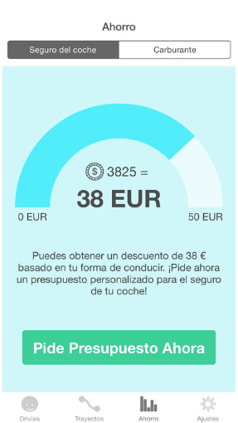
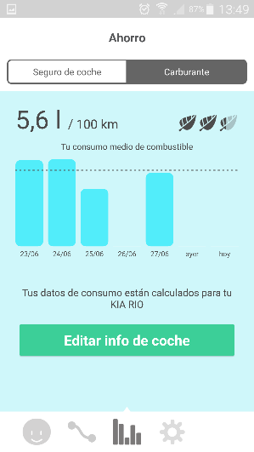

Slide 14

Experimenting in B2B environments, when you are addressing account managers’ business customers

Slide 15

Measuring innovation success: common analytical methods can destroy innovation

Slide 16
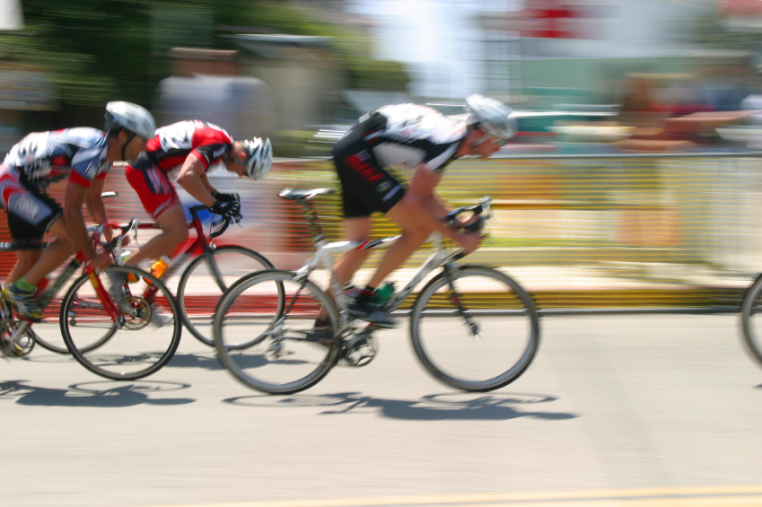
Competing with core business products in the go to market race

Slide 17



Slide 18

The unexpected: the problem’s problem, finding the pain

Slide 19
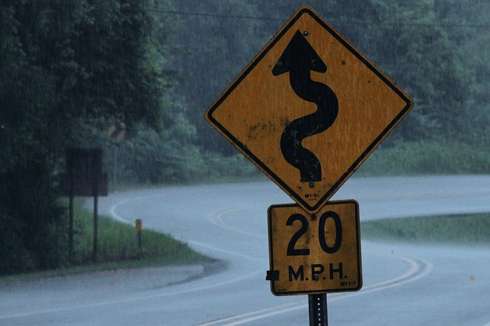
Lean Startup does not necessarily apply to any type of project

Slide 20
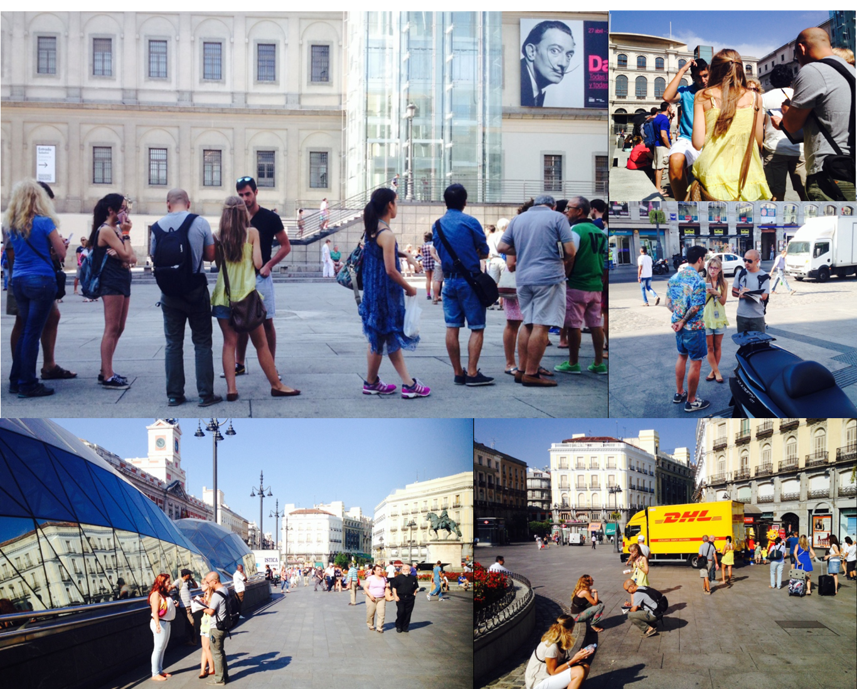
Getting out of building to have face to face conversations

Slide 21
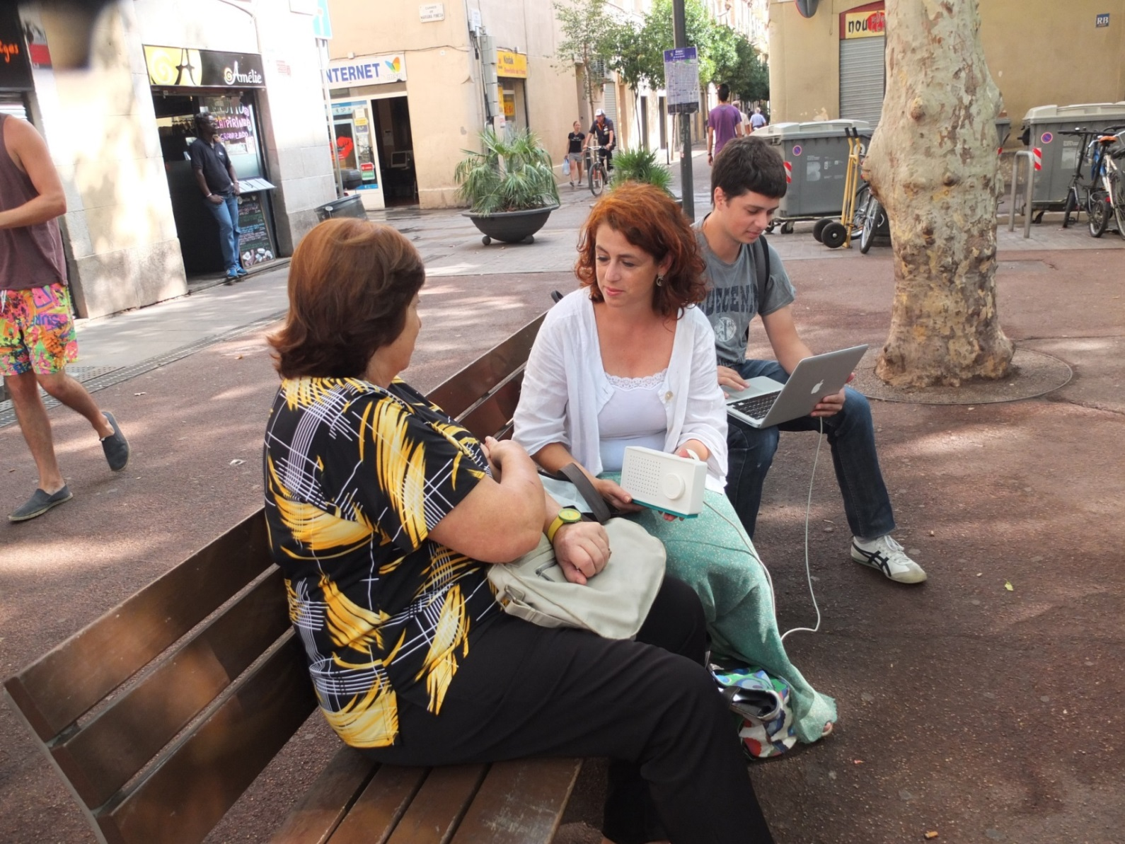

Slide 22
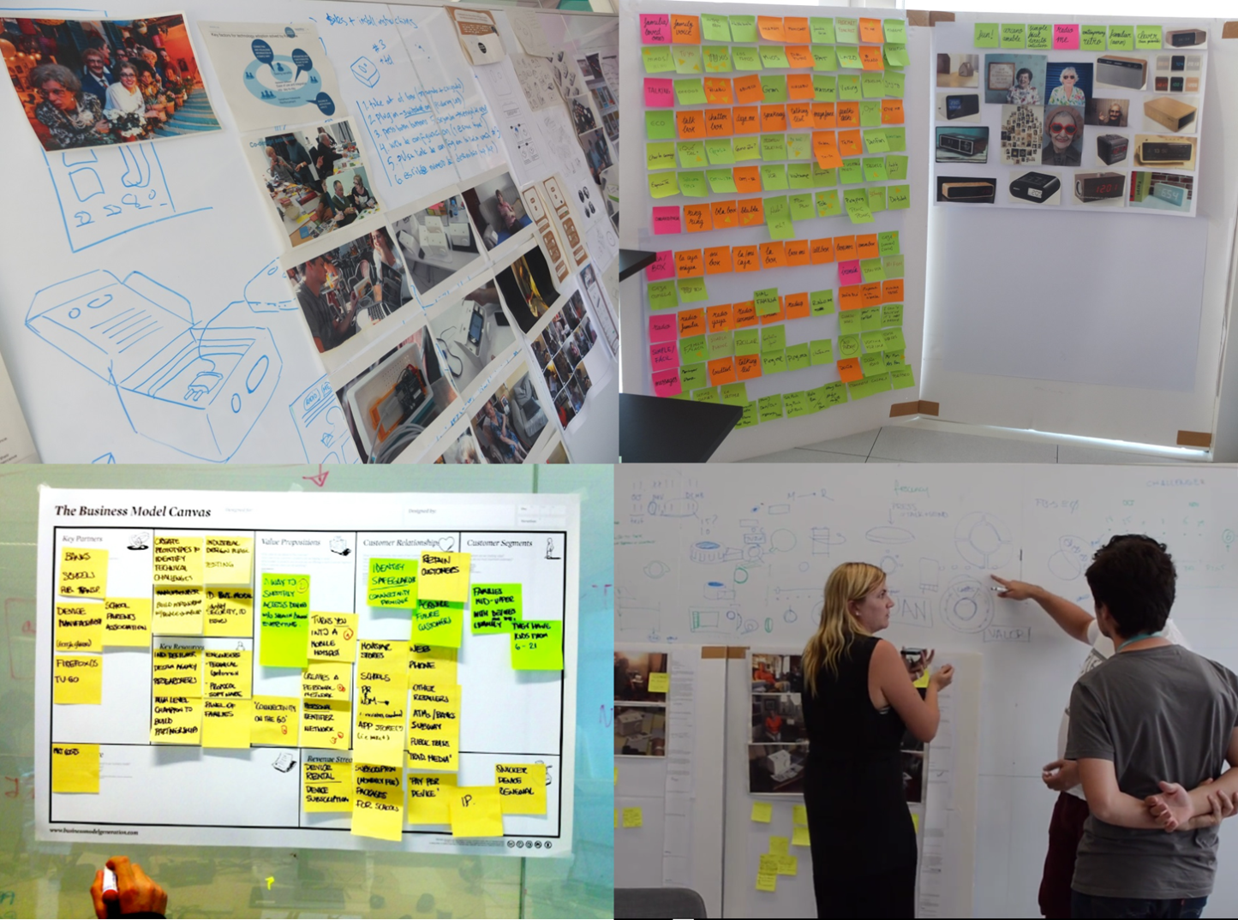
Early market tests, validating every step with customers and pivoting

Slide 23
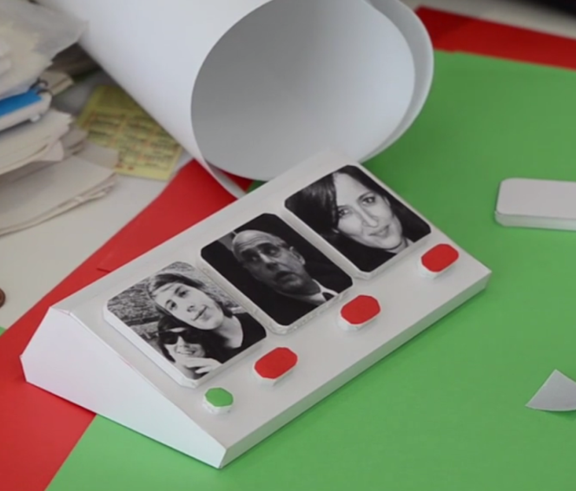

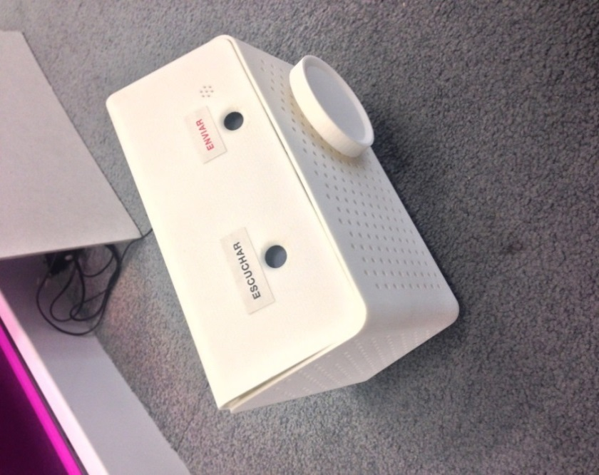
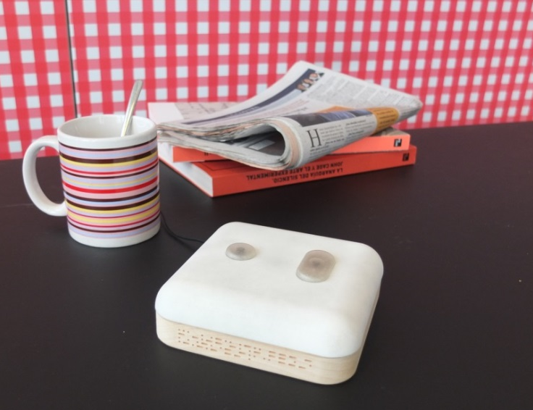
Working with limited resources, bootstrapping and fast iterations

Slide 24
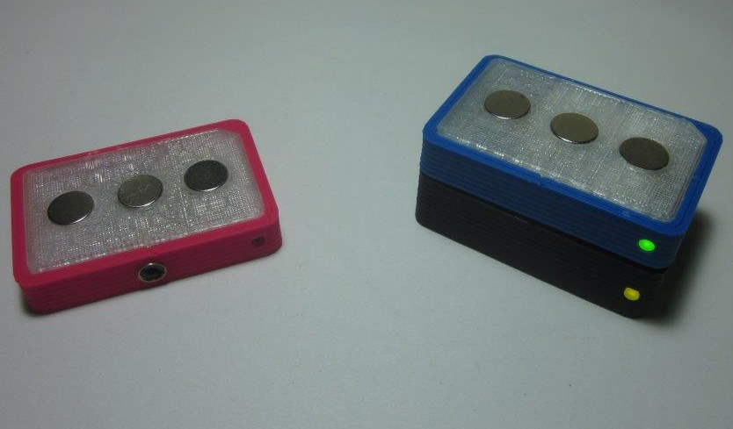
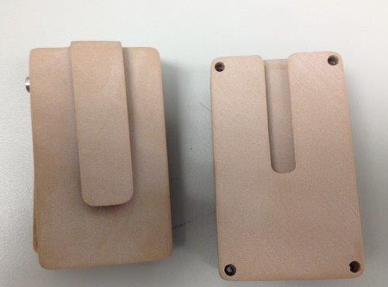
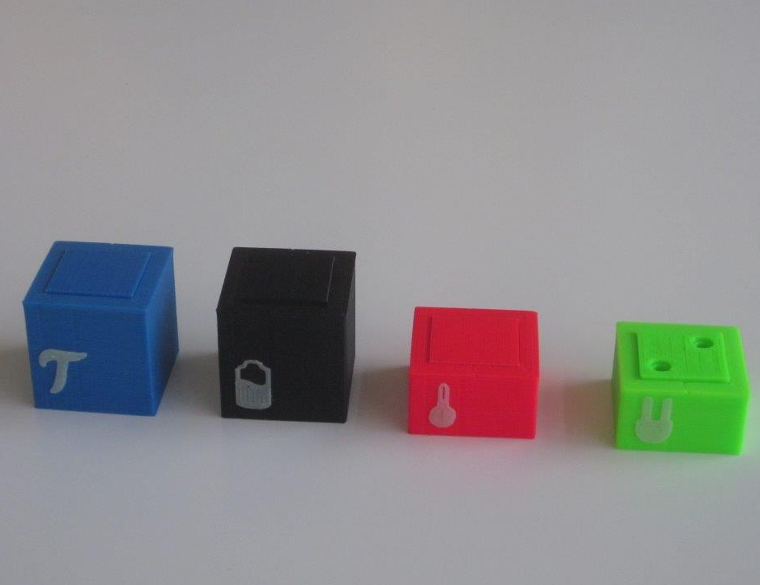
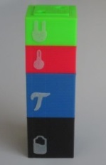
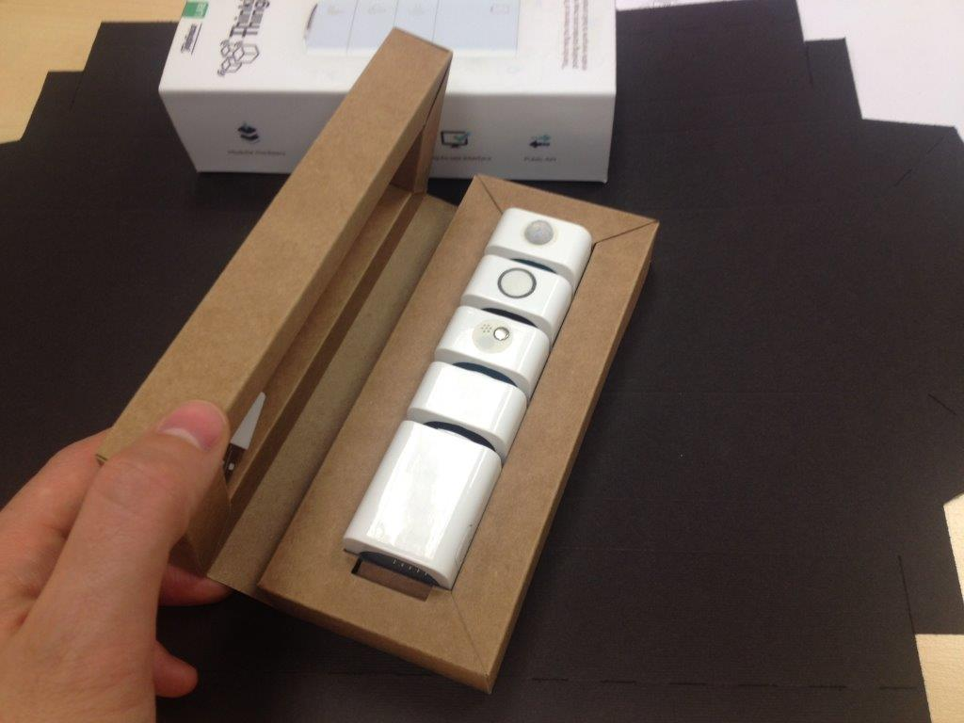


Slide 25



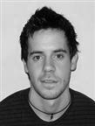


Fostering intrapreneurship

Slide 26


Accelerating innovation cycles

Slide 27

Do more with less: 45% more projects while in average reducing a 48% the medium budget

Slide 28
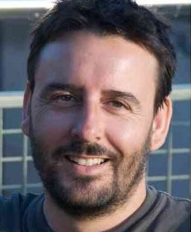

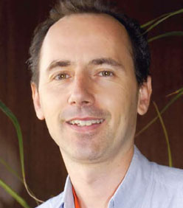

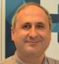
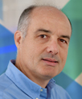
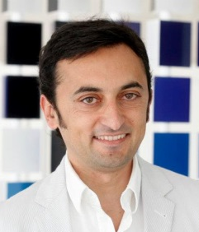

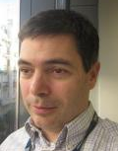



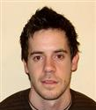
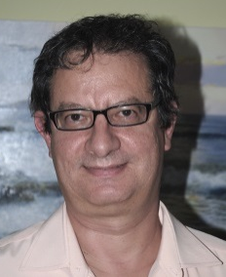
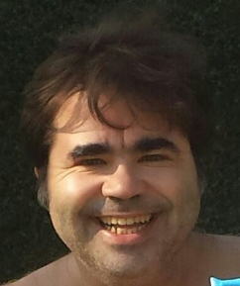

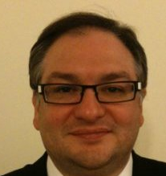
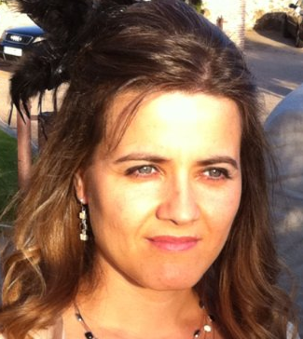
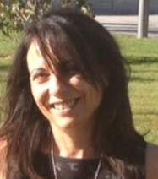

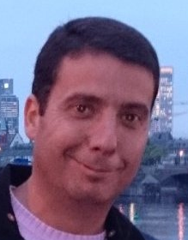
This would not have been possible without people
Luis I. Vicente
Oriol Lloret
Mario López
Ricard Huguet
Diego Díaz
Pere Obrador
Pablo Rodríguez
Luis Dejo
Javier Zorzano
Alberto de Vega
Anna Hiltunen
Bert Bräutigam
Carlos Moliner
David Muñoz
Javier López
Rafael de las Heras
Jaime González
Maria J. Tomé
Jesús Bernat
Laura García
Lucia Lavara
Oscar Mancebo

Slide 29
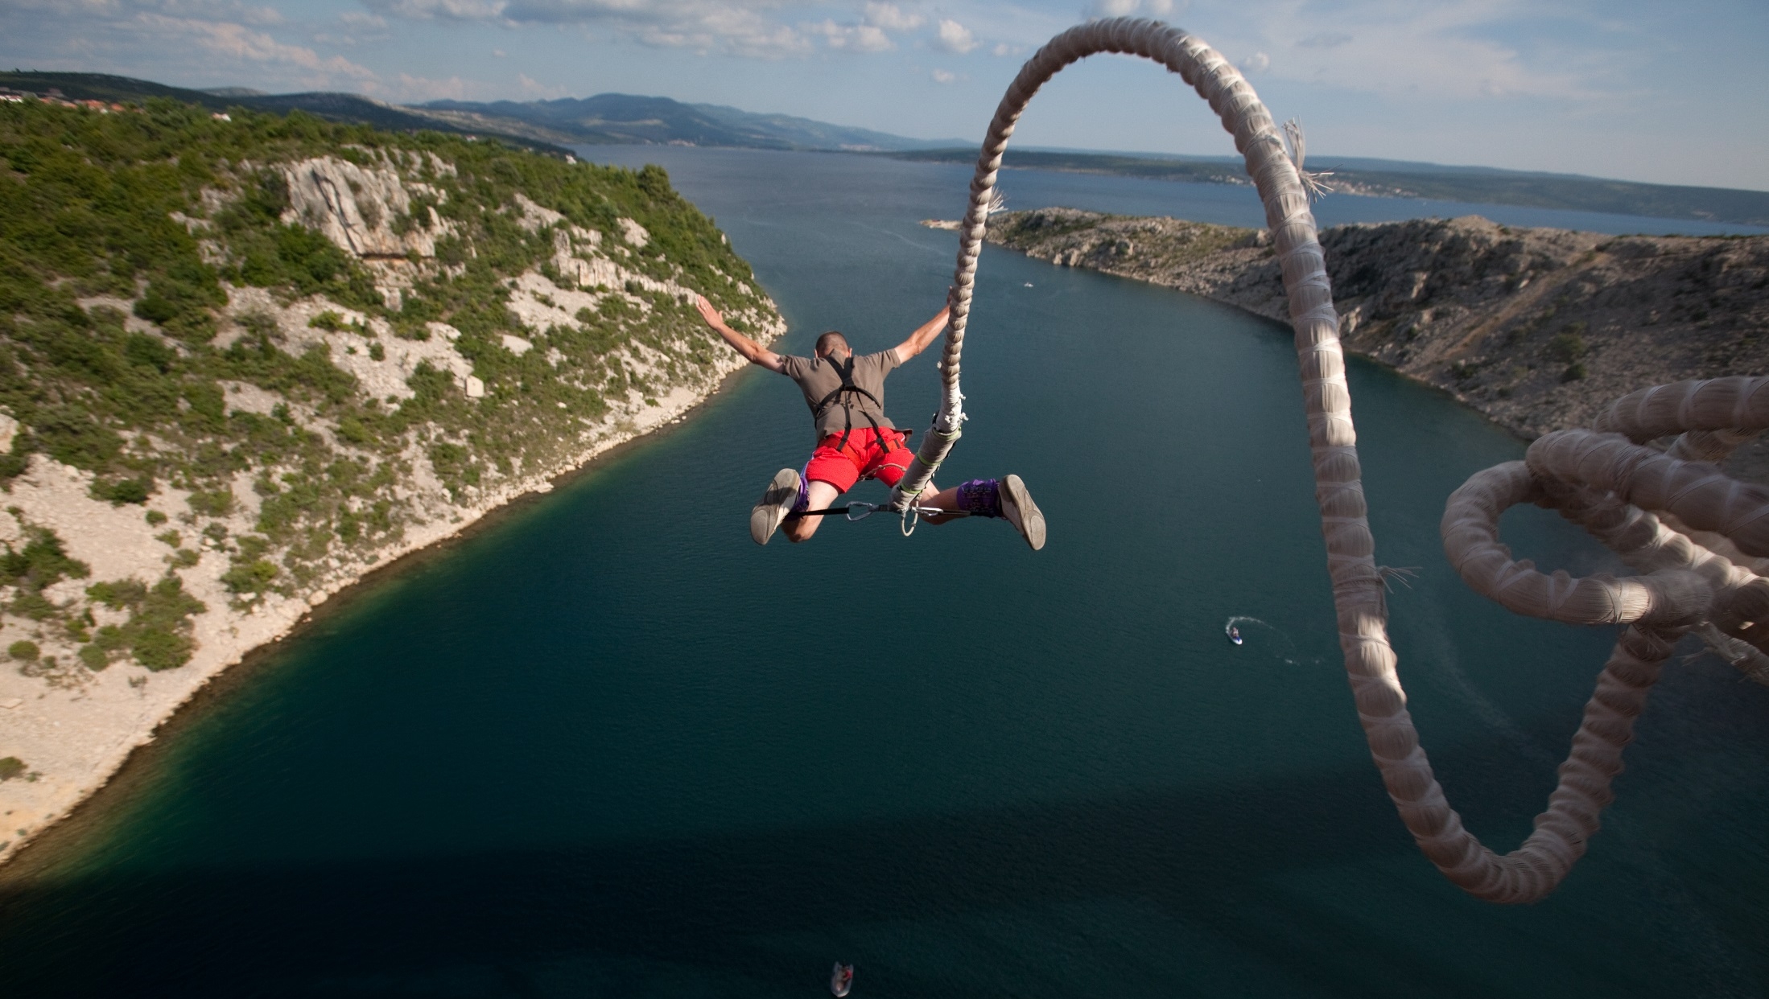
Provide training and mentorship
Adapt Lean Startup
Start small

Slide 30

Thank you!!!
Questions? Comments?
@sjapru susana.juradoapruzzese@telefonica.com
@mdomata maria.deolanomata@telefonica.com
More info in our “Lean elephants” paper at www.tid.es

