Slide 1
Innovation Showcase Summary 2014-2015
Notes:
The innovator showcase is a key event for one of our global employee engagement initiatives and for the past 3 years it has been the platform for creating a culture of grassroots innovation across NTT Data.

Slide 2
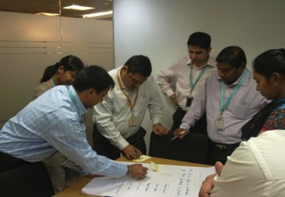
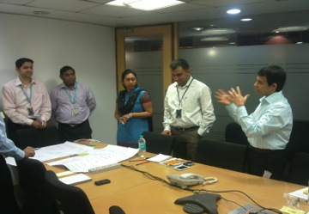
Innovation Workshops
Workshops conducted for teams within the organization to foster collaboration and critical thinking among employees in an effort to devise innovative solutions
Gamified engagement outreach
Based on the Open Ideo methodology
Each workshop can have up to 50-60 participants and is run in only 2.5 hours
The objective is to create solutions to solve challenges faced by client teams within their organization
Key part of the global initiative to foster grassroots innovation across NTT DATA
Notes:
Every year, we go to various accounts across the globe to conduct workshops for employees and present them with a design challenge.
These innovation workshops are based on IDEOs open-sourced innovation process, which focuses on Human-Centric design. Basically what that means is that it enables an opportunity for employees to come together and create novel and inventive solutions for a given design challenge that is physically, perceptually, cognitively and emotionally intuitive. So we present them with a challenge that a client could be facing and the employees collaborate to solve the problem using certain criteria.
It is also gamified to better engage the employees with the use of some healthy competition and incentives. One winner is chosen from each city and then subsequently a handful of finalists from that list are chosen to compete in the annual innovator showcase. All in all, these global workshops have become a critical part of the global initiative to foster grassroots innovation within our organization.
During the past 2 years, the Design Challenge has been “How do we help our clients get products to market faster” and one of the actual exercises is a 45 min group brainstorming and prioritization session where the entire group come up with “categories” of solutions for the design challenge: E.g Quality, Project Management, New Technologies etc and then the group votes on the top 5 or 6 categories that they want to create actual solutions for. This excsercice serves several purposes:
1. Starts them brainstorming in a “coached” session with both Naureen and I so they understand how it works.
2. Lets them “own” the design challenge by voting on the categories they want to create solutions for. This is important because the stronger the sense of ownership, the more engaged the group is in the rest of the session.
3. As part of this exercise we randomize participants who work on each of the voted categories so people can’t just work with their friends. They are forced to work together with people across disciplines, orgs etc.

Slide 3
Converting Opportunity Areas to Solutions
Applying game design principles to various aspects of the workshop incentivizes participants to create and present innovative solution ideas for the design challenge
Final Step: Role Playing and the 5-Minute Pitch
Why is this final step important?
Information alone rarely makes people change their minds or gain new perspective about different ideas, but personal experience often does
‘Role-playing’ exercises emphasizing the importance of people and their viewpoints
The role-playing approach transforms the content of education from information to experience.
It makes the situation more REAL as opposed to theoretical
Makes it ACTIONABLE
With specifications/limitations around time consciousness
Stimulates self-awareness, problem-solving, communication, initiative, teamwork (Adam Blatner, 2002)
Notes:
Another exercise is the final presentation where they have 5 minutes to present their actual solution. The other groups get to ask questions and “stump” the presenters, making this another competitive yet thought provoking exercise.

Slide 4
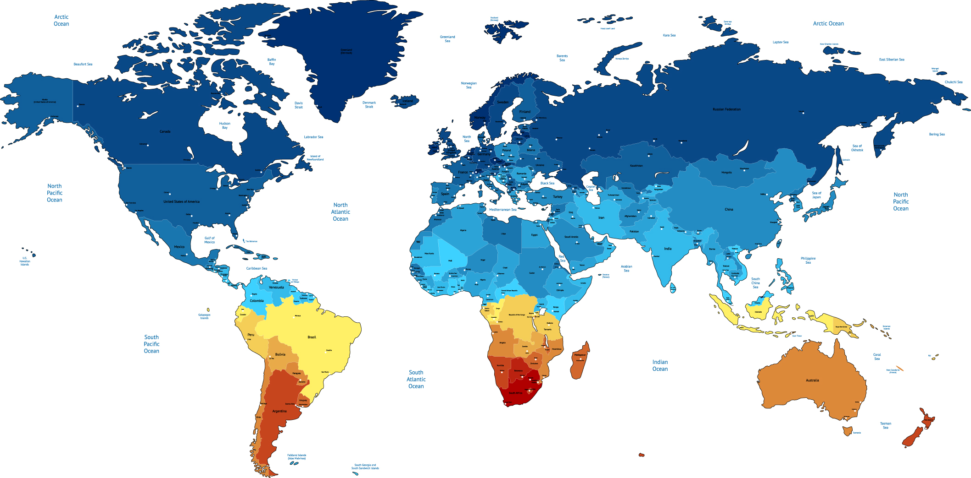
2013-2014 Innovation Workshops
London
Bloomington
Halifax
Rome
Boston
Istanbul
New York
Delhi
San Francisco
Washington DC
Tokyo
Pune
Hyderabad
Bangalore
Chennai
Singapore
Melbourne
Notes:
In 2013-14, we conducted 17 workshops across the world spanning over 4 continents. As you can see we visited cities from North America to Asia, Europe to Australia. The global winner for the 2014 showcase was the team from PUNE, INDIA.

Slide 5
2014 Global Winner
EXPRESSO
Packaged Open Source
Tools
Toolkit to get real time analytics on software development projects
Key enabler of a DevOps strategy
Can reduce project variance and improve time to market
Already being piloted in Japan and in active discussion with U.S. clients
Pluggable
Adaptors
Measurement & Gamification
Engine
CIO View
BU View
PM View
PM View
BU View
PM View
Role based
Multi level
Consolidated Dashboard
Notes:
A little bit about their solution - - it’s called “EXPRESSO”.
it’s a toolkit to get real time information on software development projects. And what it does is that it obtains key metrics on a project’s health by leveraging industry leading open source tools. A tool like this can actually make the difference on whether a project succeeds or fails.
As it stands, the 1st phase of development has been completed and it is now in the pilot stage, in which the development team is currently having active discussions with a number of US clients to identify projects that can use Expresso.
They have already piloted this on 2 projects in Japan.

Slide 6
2014-2015 Innovation Workshops
Seattle
Milan
Chicago
Toronto
Madrid
Rome
Beijing
Phoenix
Barcelona
Jacksonville
Bangkok
Notes:
This year we conducted workshops in 11 more cities across 6 countries.

Slide 7
Benefits of Innovation Workshops
Development of practical yet distinctive solutions
some which have been funded
Discovery of great talent to deploy on high profile projects
creating innovative leaders
Laid groundwork that generates foundational excitement within the company
plans to tap for various innovation initiatives going forward
Employee engagement
exposure that leads to EMPOWERMENT
Value-add that fosters higher levels of innovation and productivity
Notes:
Identified some important benefits from doing these workshops
1. Employees who are on the field every day, with a variety of skillsets and experience have come together in these workshops and created a number of unique and useful solutions, many of which have been funded and are in use today
Through this process we have been able to recognize very talented people within the organization and give them opportunities to lead high profile projects
This initiative has laid the groundwork that has generated much excitement within the company – compelling our employees to really think outside of the box (be disruptive, if you will) about potential solutions and it has paid off through the accolades that NTT DATA has received because of it.
And last but not least, an area that I feel is really the key to all of the above - - Employee Engagement
This is an investment in our employees that becomes a real value add in promoting proactive critical thinking and increased productivity – all precursors to a fruitful bottom line
we traveled to many different countries/cities
And I wanted to add that while there were DIFFERENCES in the perspectives and approach to the design challenges based cultural relevance, there were more commonalities which I think really indicate where the overall success of this initiative lies
Commonalities: for example --
No matter where in world we held the workshops, employees were excited to step out of day to day work and do something different. This gave them exposure to different ppl and a chance to present in front of senior leaders, be recognized - - this type of excitement leads to more job satisfaction --more efficient
Employees got to experience innovation first hand – group brainstorming, friendly competition, thrill of winning, the interactivity – employees loved that
Employees felt a part of the NTT DATA global family

